Slide 1
Fig. 1. The predictions for the C.elegans ver-1 gene from different gene-finders form one ‘exon cluster’. The gene ...
Notes:
Fig. 1. The predictions for the C.elegans ver-1 gene from different gene-finders form one ‘exon cluster’. The gene model shown at the top has been experimentally confirmed. Genomix aims to select the subset of predicted exons that are most likely to be correct, and join them into a frame-consistent gene structure. For ver-1, although none of the input gene-finders predict the correct gene structure, Genomix predicts the correct structure by selecting all the correct predicted exons (grey) and no incorrect predicted exons (black).
Unless provided in the caption above, the following copyright applies to the content of this slide: © 2007 The Author(s)This is an Open Access article distributed under the terms of the Creative Commons Attribution Non-Commercial License (http://creativecommons.org/licenses/by-nc/2.0/uk/) which permits unrestricted non-commercial use, distribution, and reproduction in any medium, provided the original work is properly cited.

Slide 2
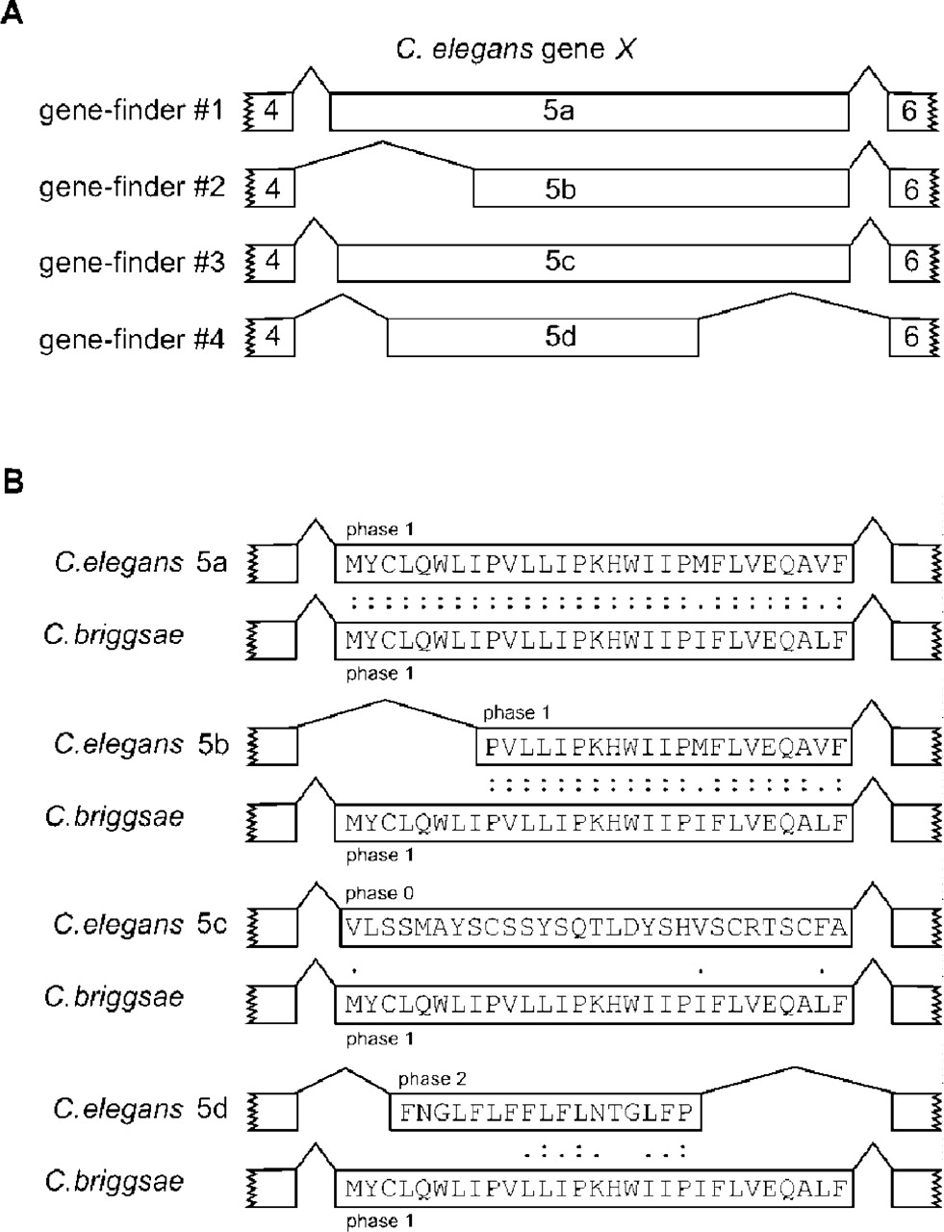
Fig. 2. Measuring exon conservation. (A) Four different gene-finders predict different coordinates for the fifth exon ...
Notes:
Fig. 2. Measuring exon conservation. (A) Four different gene-finders predict different coordinates for the fifth exon of C.elegans gene X. (B) Genomix calculates a score for each of the four predicted C.elegans exons, which reflects how conserved is its sequence, intron–exon boundaries, phases and length relative to the C.briggsae exons in a matching exon cluster. Caenorhabditis elegans predicted exon 5a has the highest conservation score, followed by 5b, then 5c and 5d.
Unless provided in the caption above, the following copyright applies to the content of this slide: © 2007 The Author(s)This is an Open Access article distributed under the terms of the Creative Commons Attribution Non-Commercial License (http://creativecommons.org/licenses/by-nc/2.0/uk/) which permits unrestricted non-commercial use, distribution, and reproduction in any medium, provided the original work is properly cited.

Slide 3
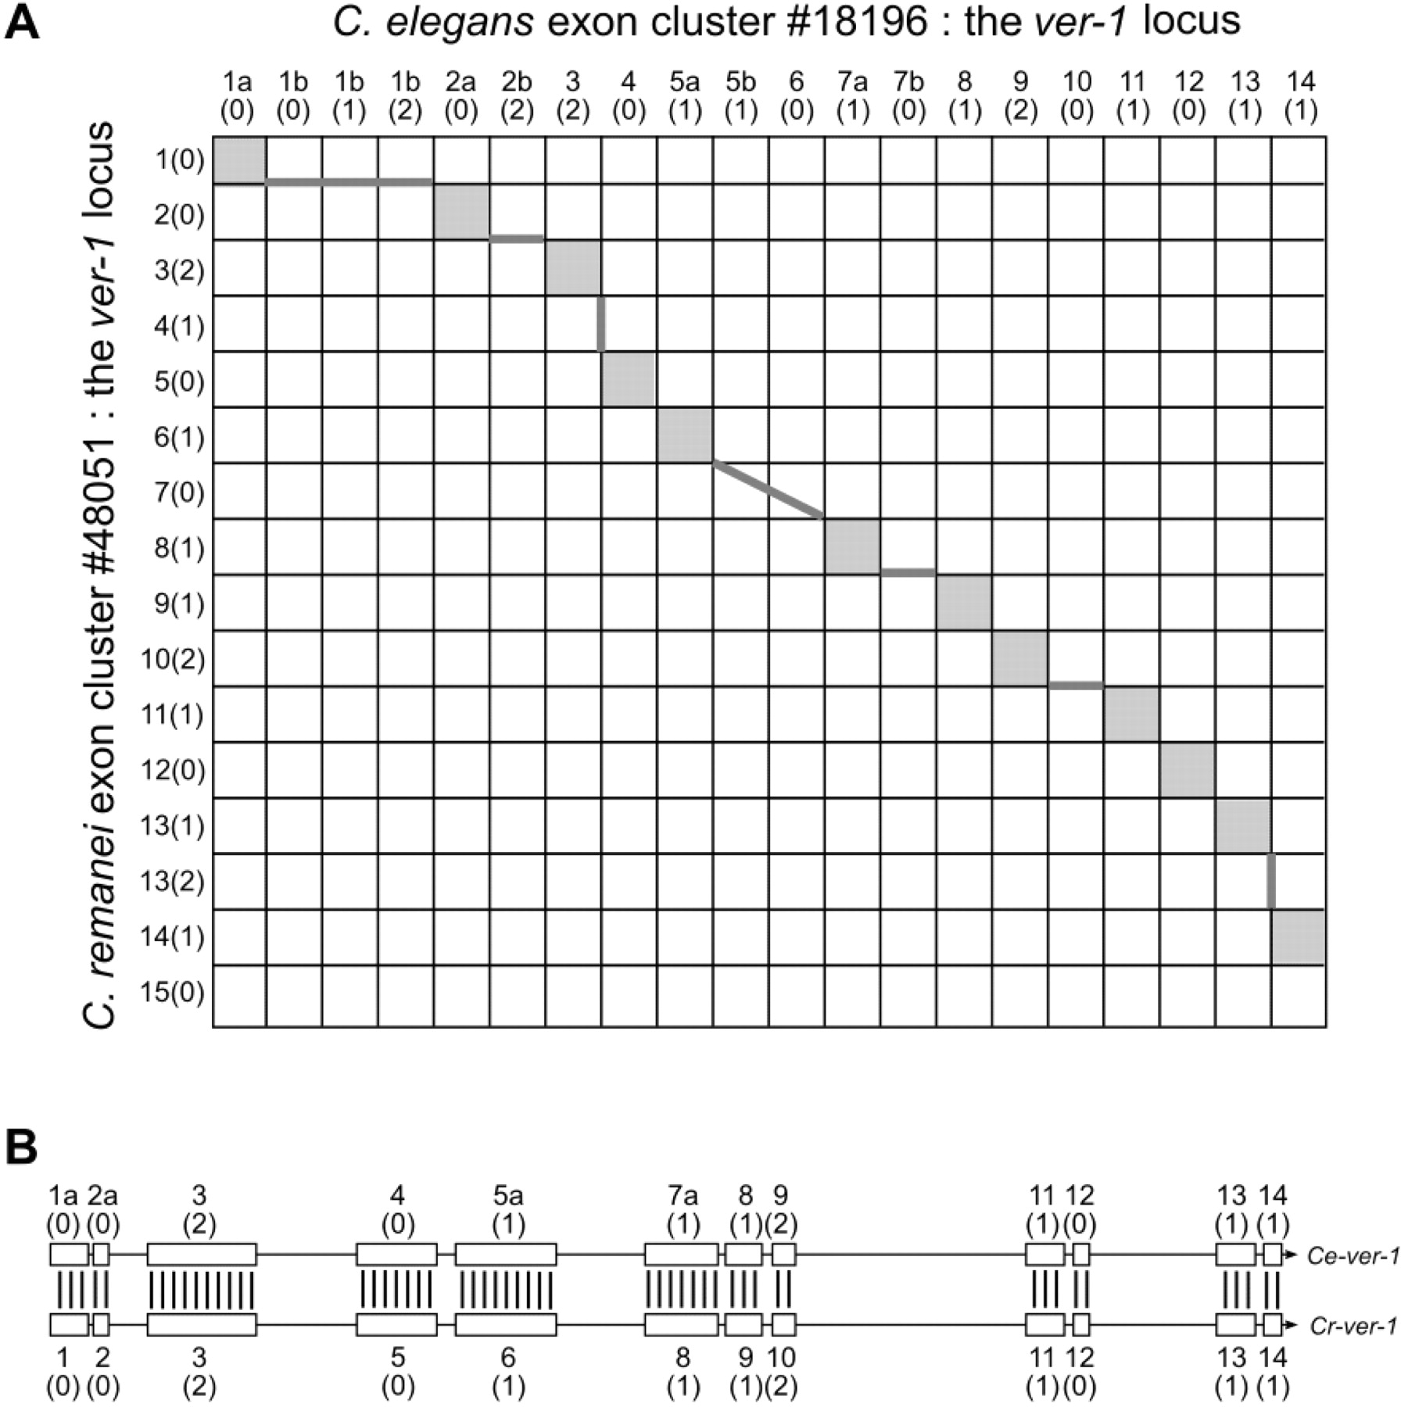
Fig. 3. Using dynamic programming to select predicted exons. (A) To select the best subset of exons predicted in the ...
Notes:
Fig. 3. Using dynamic programming to select predicted exons. (A) To select the best subset of exons predicted in the C.elegans query exon cluster (here exon cluster 18196, which corresponds to the C.elegans ver-1 locus), dynamic programming is used to find the optimal alignment between the C.elegans exons and the exons in the top matching exon cluster (here C.remanei exon cluster 48 051, which corresponds to the C.remanei ver-1 locus). (B) The solution of the dynamic programming algorithm is the optimal alignment between the predicted exons from the query C.elegans exon cluster and the predicted exons from the matching C.remanei exon cluster.
Unless provided in the caption above, the following copyright applies to the content of this slide: © 2007 The Author(s)This is an Open Access article distributed under the terms of the Creative Commons Attribution Non-Commercial License (http://creativecommons.org/licenses/by-nc/2.0/uk/) which permits unrestricted non-commercial use, distribution, and reproduction in any medium, provided the original work is properly cited.

Slide 4
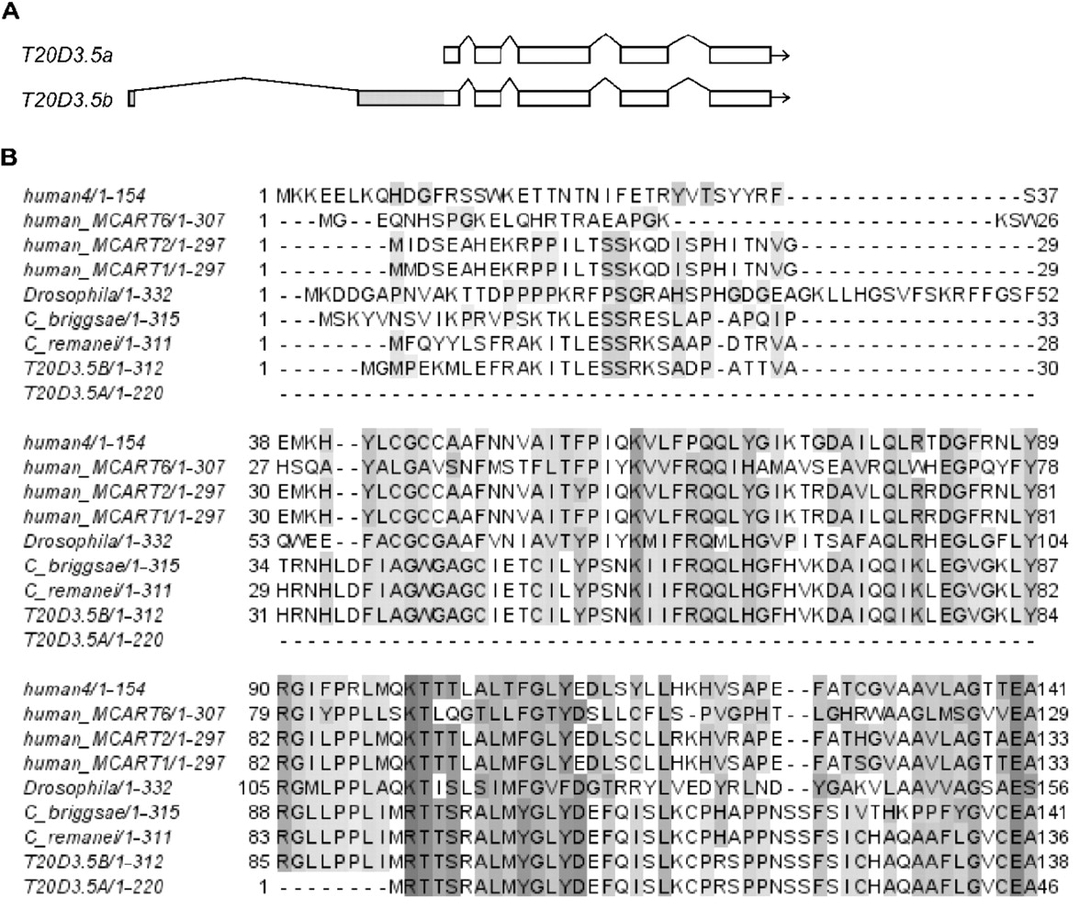
Fig. 4. An alternative isoform of a WormBase curated gene that was suggested by Genomix. (A) WormBase release WS147 ...
Notes:
Fig. 4. An alternative isoform of a WormBase curated gene that was suggested by Genomix. (A) WormBase release WS147 contained one confirmed transcript for gene T20D3.5, now known as T20D3.5a. Genomix suggested an alternative isoform T20D3.5b. The grey box indicates the extra upstream coding region of T20D3.5b that is missing from T20D3.5a. (B) A multiple alignment of T20D3.5a, T20D3.5b and their C.briggsae, C.remanei, Drosophila melanogaster and human orthologs. The alignment is truncated after the start of T20D3.5a, since T20D3.5a and T20D3.5b are identical after this point. The human and D.melanogaster orthologs were identified from TreeFam (Li et al., 2006). Here ‘human4’ is Ensembl gene ENSG00000189332. Gene predictions for the C.briggsae and C.remanei orthologs were made using Genomix.
Unless provided in the caption above, the following copyright applies to the content of this slide: © 2007 The Author(s)This is an Open Access article distributed under the terms of the Creative Commons Attribution Non-Commercial License (http://creativecommons.org/licenses/by-nc/2.0/uk/) which permits unrestricted non-commercial use, distribution, and reproduction in any medium, provided the original work is properly cited.

