Slide 1
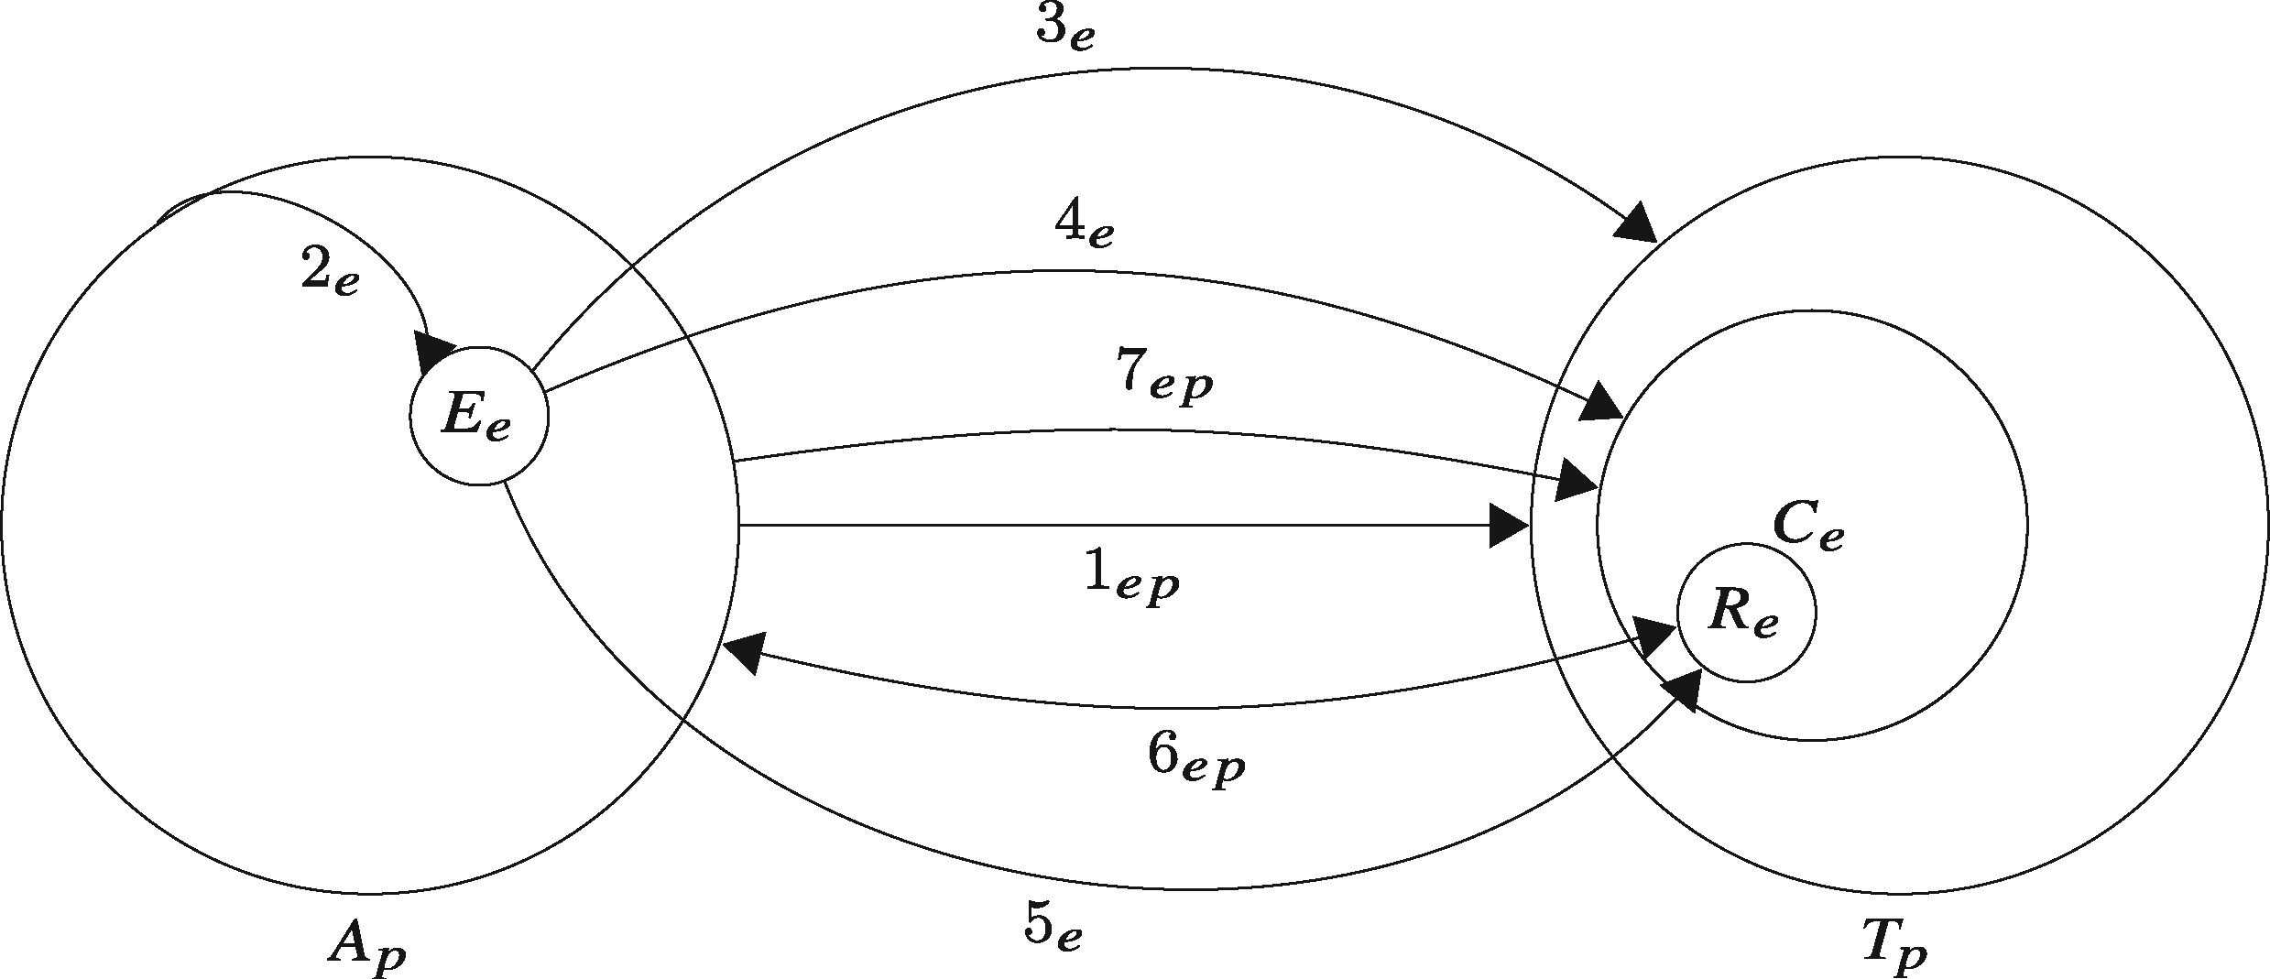
Figure 1. Rough mechanistic diagram relating the entities and activities involved in an intrusion, following the kill ...
Notes:
Figure 1. Rough mechanistic diagram relating the entities and activities involved in an intrusion, following the kill chain model of intrusions. The large entities are adversary A and target T; the medium-sized entity is target computer C; the small entities are weaponized exploit E and remote access trojan (RAT) or some malicious code R. The seven activities are labeled for the seven steps in the kill chain Hutchins et al. (6): reconnaissance (1), weaponization (2), delivery (3), exploitation (4), installation (5), command and control (6), actions on objectives (7).
Unless provided in the caption above, the following copyright applies to the content of this slide: © The Author 2017. Published by Oxford University Press.This is an Open Access article distributed under the terms of the Creative Commons Attribution License (http://creativecommons.org/licenses/by/4.0/), which permits unrestricted reuse, distribution, and reproduction in any medium, provided the original work is properly cited.

Slide 2
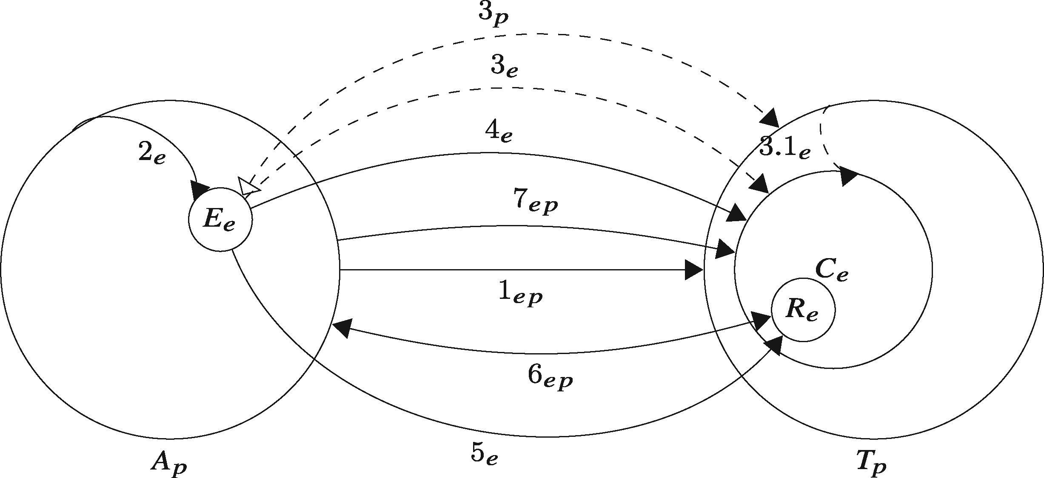
Figure 2. Improved kill chain mechanistic diagram, where delivery (3) in Fig. 1 is replaced by two options, an ...
Notes:
Figure 2. Improved kill chain mechanistic diagram, where delivery (3) in Fig. 1 is replaced by two options, an engineered activity directly to the target (3e) and a physical activity through the human (3p) with an optional secondary engineered delivery step (3.1e).
Unless provided in the caption above, the following copyright applies to the content of this slide: © The Author 2017. Published by Oxford University Press.This is an Open Access article distributed under the terms of the Creative Commons Attribution License (http://creativecommons.org/licenses/by/4.0/), which permits unrestricted reuse, distribution, and reproduction in any medium, provided the original work is properly cited.

Slide 3
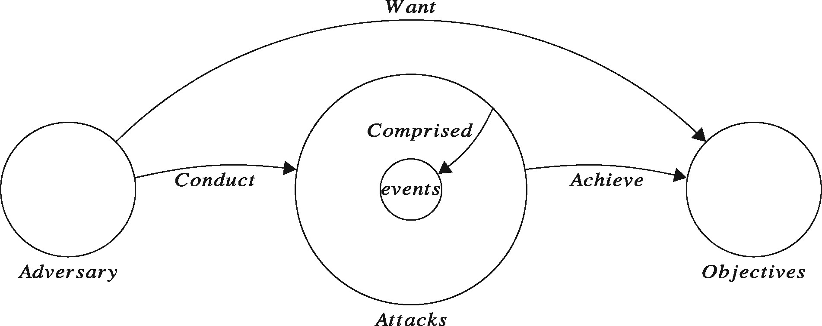
Figure 3. Visualization of the common language for computer security incidents Howard and Longstaff (18) as a ...
Notes:
Figure 3. Visualization of the common language for computer security incidents Howard and Longstaff (18) as a mechanism, where "attack" is simplified to one entity that can be explored in many ways, with sub-mechanisms, at a finer granularity. One such sub-mechanism is described in Fig. 1.
Unless provided in the caption above, the following copyright applies to the content of this slide: © The Author 2017. Published by Oxford University Press.This is an Open Access article distributed under the terms of the Creative Commons Attribution License (http://creativecommons.org/licenses/by/4.0/), which permits unrestricted reuse, distribution, and reproduction in any medium, provided the original work is properly cited.

Slide 4
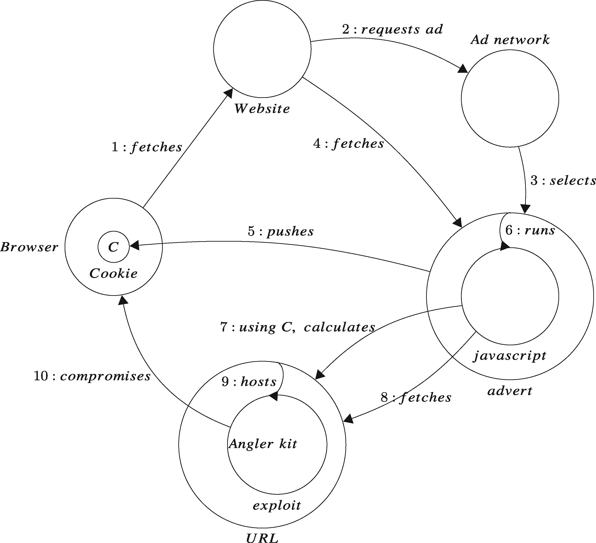
Figure 4. Diagram of an obfuscated drive-by-download delivered via a malicious web advertisement.
Notes:
Figure 4. Diagram of an obfuscated drive-by-download delivered via a malicious web advertisement.
Unless provided in the caption above, the following copyright applies to the content of this slide: © The Author 2017. Published by Oxford University Press.This is an Open Access article distributed under the terms of the Creative Commons Attribution License (http://creativecommons.org/licenses/by/4.0/), which permits unrestricted reuse, distribution, and reproduction in any medium, provided the original work is properly cited.

Slide 5
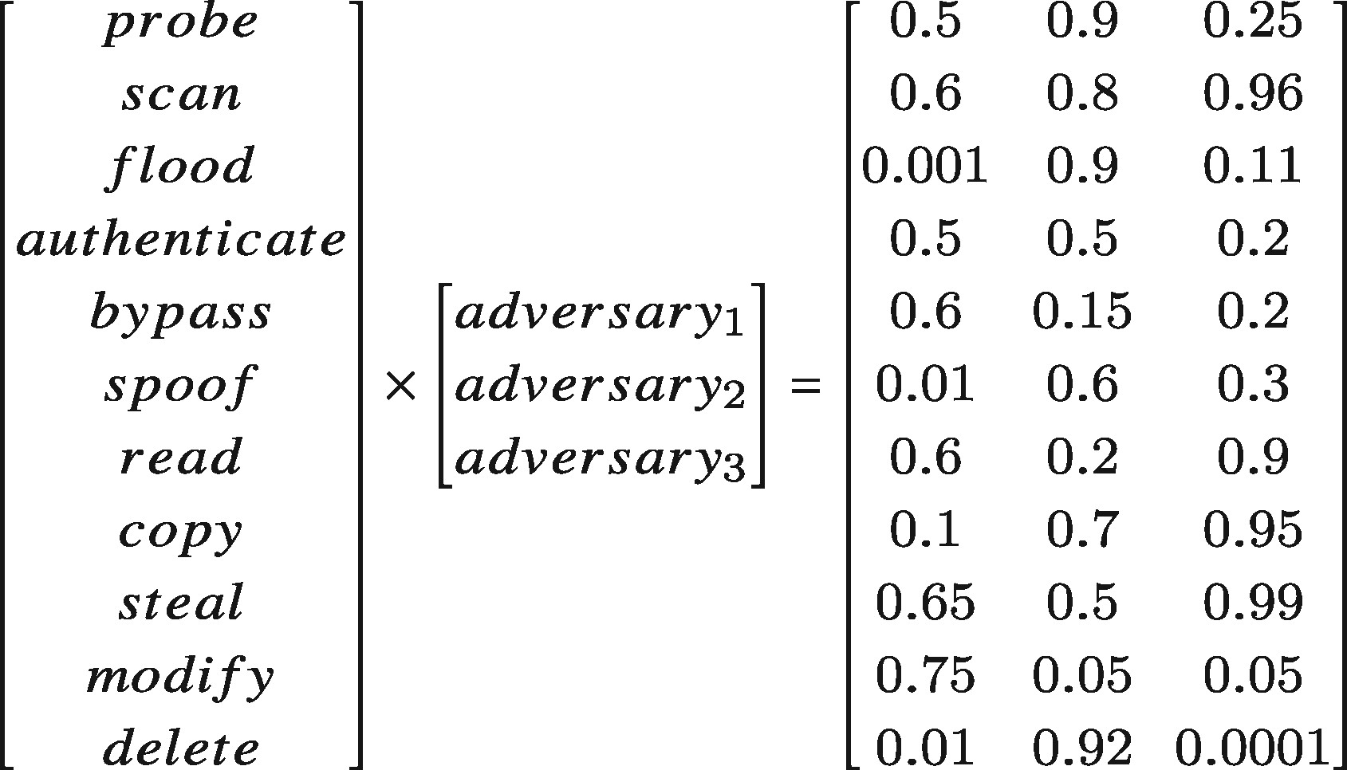
Figure 5. Notional adversary action prior probability distributions based on the Howard and Longstaff (18) ...
Notes:
Figure 5. Notional adversary action prior probability distributions based on the Howard and Longstaff (18) classification of adversary actions. These priors are relative: the matrix does not sum to 1 in each column. If needed, they could easily be normalized to sum to 1.
Unless provided in the caption above, the following copyright applies to the content of this slide: © The Author 2017. Published by Oxford University Press.This is an Open Access article distributed under the terms of the Creative Commons Attribution License (http://creativecommons.org/licenses/by/4.0/), which permits unrestricted reuse, distribution, and reproduction in any medium, provided the original work is properly cited.

