Slide 1
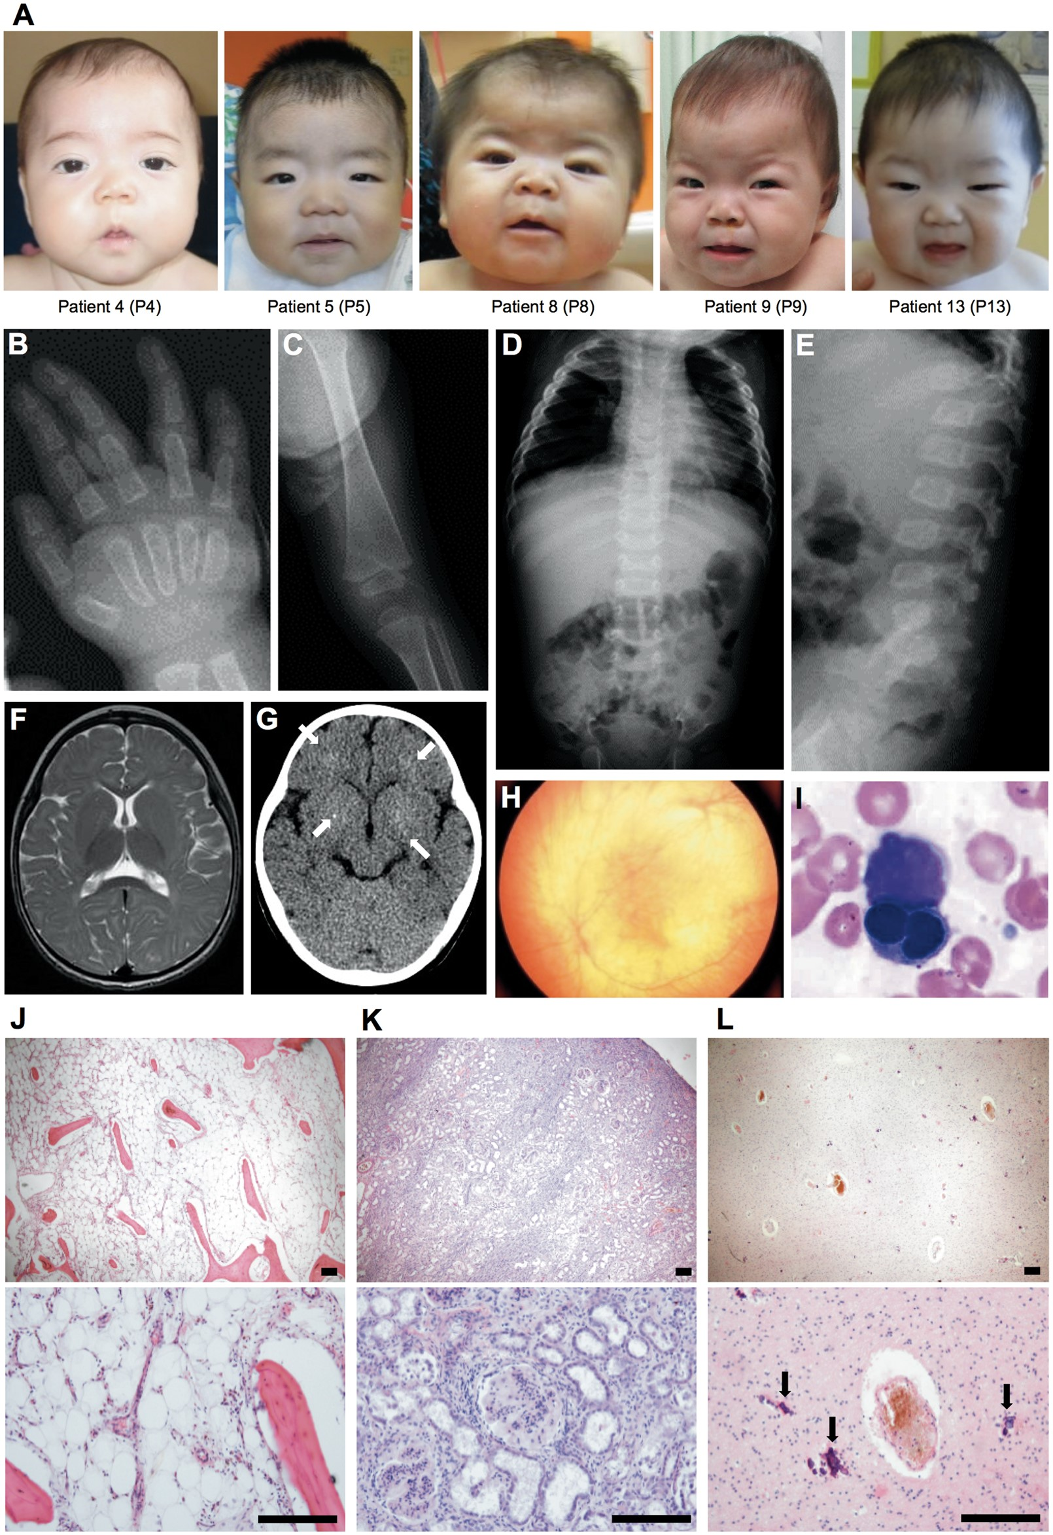
Figure 1 Clinical features of the patients. (A) Facial phenotypes. Patients have a prominent forehead, epicanthal ...
Notes:
Figure 1 Clinical features of the patients. (A) Facial phenotypes. Patients have a prominent forehead, epicanthal folds, telecanthus, large rounded cheeks, broad nose, full lips, and short neck. The patient numbers correlate with the family pedigrees of Fig. 2A. (B-I) Findings of P9 at 11 months. (B-E) Radiographs showing the characteristic features of dysostosis multiplex. Note the bullet-shaped phalanges and the metacarpal pointing (B), metaphyseal widening of the long bones with cortical thinning (C), oar-shaped ribs (narrow at the vertebrae and widening anteriorly), flared iliac wings, and remarkable hepatomegaly (D), and malalignment of vertebrae and vertebral dysplasia with round vertebral bodies (E). (F) T2-weighted image of brain MRI showing apparent delayed myelination in the peripheral white matter. (G) Brain CT scan showing fine calcification in the basal ganglia and white matter (arrows). (H) Fundus photograph showing hypopigmentation of the retina. (I) Morphologic dysplasia of the erythroid lineage observed in the bone marrow. (J-L) Autopsy findings of P1 at 16 months. (J) Hypoplastic bone marrow in the sternum. (K) A significant grade of glomerular hyalinization and accumulation of lymphocytes in the renal interstitium. (L) Calcification in the cerebral white matter (arrows). Tissues were stained with hematoxylin and eosin. Scale bars, 200 μm. Consent to publish images of the patients was obtained. Clinical characteristics of the patients PatientP1P2P3P4P5P6P7P8P9P10P11P12P13SexMFFFMFMFFFFMMAge of death (months)(age at last observation)3020101719123520Alive (11)19940Alive (14)MPS-like phenotypeCoarse facial features+++++++++++++Joint contraction+++++++++++++Dysostosis multiplex (X-ray)+++++++++++++Hepatosplenomegaly+++++++++++++Respiratory disturbance+++++++++++++Psychomotor retardation+++++++++++++ Able to walk−−−+−−+−−−−+− Able to speak words−−−−−−−−−−−−− Able to smile for family+++++++++++++Uncommon phenotypes for MPSDelayed myelination (MRI)+NANANANANANANA++NA−−Brain atrophy (MRI)+NANANANANANANA−+NA−−Optic atrophy (Funduscopy)+++++−+−−−−−−Heart failure++++++++−+++−Hypertrophic cardiomyopathy+++++++−−++−−Congenital heart defect (CHD)PDAPDAASDASDASDPDA ASDASDPDA−PDAASDASDPDASurgery for CHD−+−+−+−−−+−−−Frequent respiratory infections+++++++++++++Anemia+++++++++++++Thrombocytopenia++++++++−++++Leukocytopenia++++++−+−−−+−Bone marrow hypoplasia+NANANANANANANA−+NANANANephromegaly+−+−+−−−−−−−−Proteinuria+++++++++++++Nephritic syndrome+−+−++−−−−−−−+, present; −, absent; F, female; M, male; m, months; NA, not available; PDA, patent ductus arteriosus; ASD, atrial septal defect.
Unless provided in the caption above, the following copyright applies to the content of this slide: © The Author 2016. Published by Oxford University Press. All rights reserved. For Permissions, please email: journals.permissions@oup.com

Slide 2
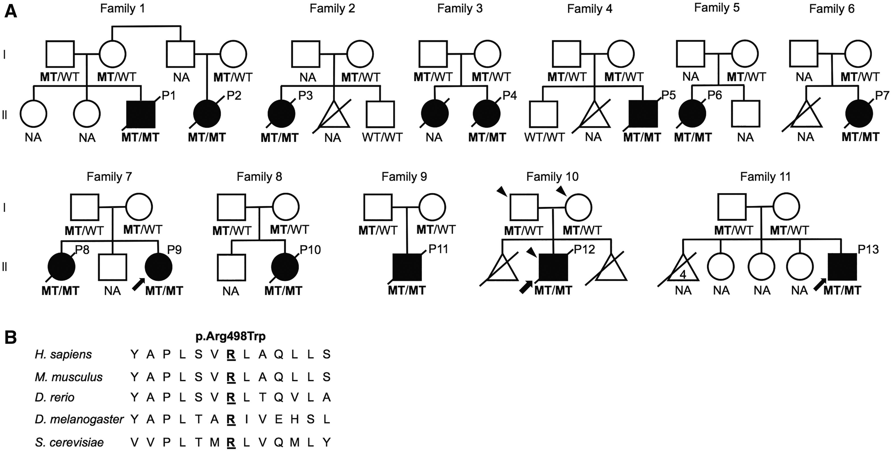
Figure 2 Family pedigrees and mutation analysis. (A) Pedigrees of the 11 families, indicating autosomal recessive ...
Notes:
Figure 2 Family pedigrees and mutation analysis. (A) Pedigrees of the 11 families, indicating autosomal recessive inheritance. Affected individuals are shown in black. An affected sister of P4 had similar symptoms but was not available for gene testing. All affected individuals whose DNA was available were found to be homozygous for the c.1492C > T (p.R498W) mutation in VPS33A and their parents were heterozygous for the mutation. The individuals selected for exome sequencing are marked with an arrowhead. Arrows indicate individuals whose fibroblasts were analysed in this study. NA, not available; WT, wild-type allele; MT, mutant allele, c.1492C > T, p.R498W in VPS33A. (B) Amino acid alignment of VPS33A showing high conservation of the Arg498 residue among species.
Unless provided in the caption above, the following copyright applies to the content of this slide: © The Author 2016. Published by Oxford University Press. All rights reserved. For Permissions, please email: journals.permissions@oup.com

Slide 3
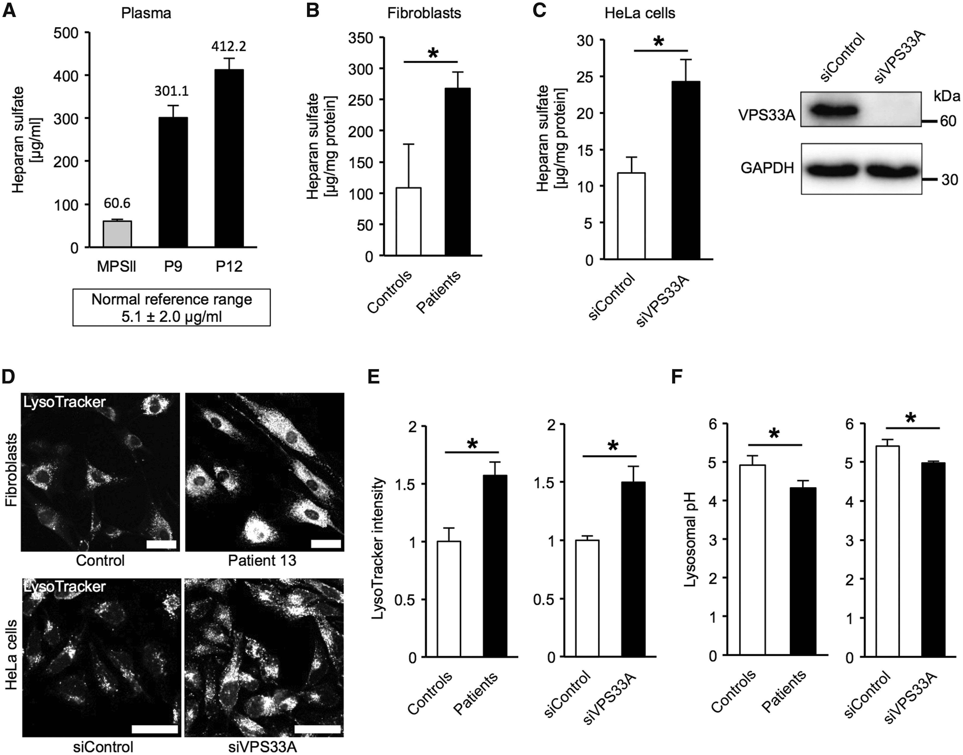
Figure 3 Quantification of heparan sulfate (HS) levels and lysosomal function. (A-C) HS quantification. (A) Plasma HS ...
Notes:
Figure 3 Quantification of heparan sulfate (HS) levels and lysosomal function. (A-C) HS quantification. (A) Plasma HS was accumulated in patients compared with an age-matched MPS patient and the reference range, which is 3.1 ± 2.0 (Mean ± SD) μg/ml (14). (B) HS accumulation in patient-derived fibroblasts and (C) VPS33A-knockdown HeLa cells. A western blot demonstrating the efficiency of knockdown of VPS33A is shown at the right. (D-F) Over-acidification of lysosomes in patient-derived fibroblasts and VPS33A-knockdown HeLa cells. (D) Patient-derived fibroblasts and VPS33A-knockdown HeLa cells showed increased intensities of LysoTracker compared to controls. (E) Quantification of LysoTracker intensity. LysoTracker intensities in LAMP2-positive areas were measured and relative levels to the control are shown. (F) Measurement of lysosomal pH in cells using LysoSensor Yellow/Blue DND-160. siVPS33A, HeLa cells treated with siRNA against VPS33A; siControl, siRNA of a negative-control sequence. Data are indicated as Mean and SEM (A) or SD (B, C, E and F) from 3 independent samples; *P < 0.05; Scale bars, 20 μm.
Unless provided in the caption above, the following copyright applies to the content of this slide: © The Author 2016. Published by Oxford University Press. All rights reserved. For Permissions, please email: journals.permissions@oup.com

Slide 4
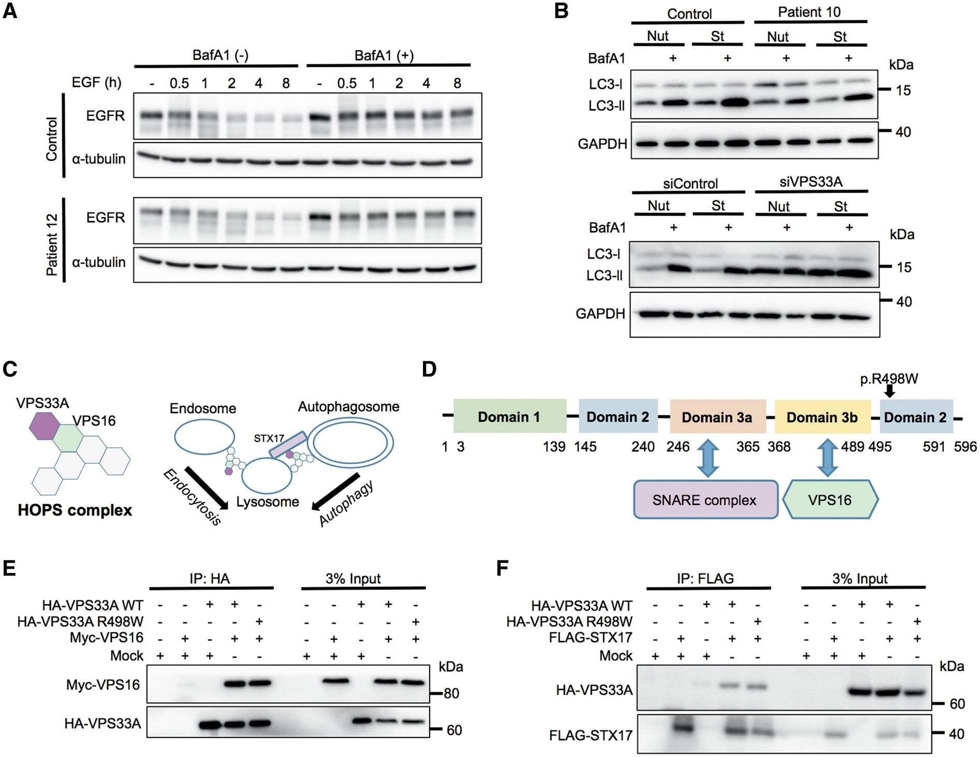
Figure 4 Endocytic and autophagic functions in fibroblasts and interactions of mutant VPS33A with STX17 or VPS16. (A) ...
Notes:
Figure 4 Endocytic and autophagic functions in fibroblasts and interactions of mutant VPS33A with STX17 or VPS16. (A) Immunoblot analysis showing normal EGFR degradation in patient-derived fibroblasts. Cells were treated with bafilomycin A1 (BafA1, 125 nM) as a negative control of degradation, and stimulated with 100 ng/ml EGF at time 0. Samples were analysed by immunoblotting at the indicated time points. (B) Normal autophagic flux in patient-derived fibroblasts (upper), in contrast to VPS33A-knockdown HeLa cells (lower). Cells were treated with regular or starvation medium for 2 h with or without BafA1, and analysed by immunoblotting. Nut, nutrient-rich condition; St, starved condition. Quantifications of A and B are shown in Supplementary Material, Fig. S3A–C. (C) Schematic model of the human HOPS complex (left), and its interaction with STX17 (an autophagosomal SNARE) or organelles (right); both modified from ref.6. (D) A diagram of the predicted VPS33A domains and their interaction partners. The p.R498W mutation detected in this report is located in domain 2, which has not been reported to interact with SNARE complex or VPS16. (E,F) Immunoprecipitation and immunoblot analysis of VPS33A, VPS16, and STX17. (E) HA-VPS33A (wild-type (WT) or mutant) and Myc-VPS16 were cotransfected in HEK293T cells. Cells were lysed, immunoprecipitated with an anti-HA-agarose antibody, and analysed by immunoblotting. (F) HA-VPS33A (WT or mutant) and FLAG-STX17 were cotransfected in HEK293T cells. Cells were lysed, immunoprecipitated with an anti-FLAG M2 affinity gel, and analysed by immunoblotting. The results indicate that the p.R498W mutant of VPS33A can interact with both VPS16 and STX17. siVPS33A, HeLa cells treated with siRNA against VPS33A; siControl, siRNA of a negative-control sequence; IP, immunoprecipitation.
Unless provided in the caption above, the following copyright applies to the content of this slide: © The Author 2016. Published by Oxford University Press. All rights reserved. For Permissions, please email: journals.permissions@oup.com

