Slide 1
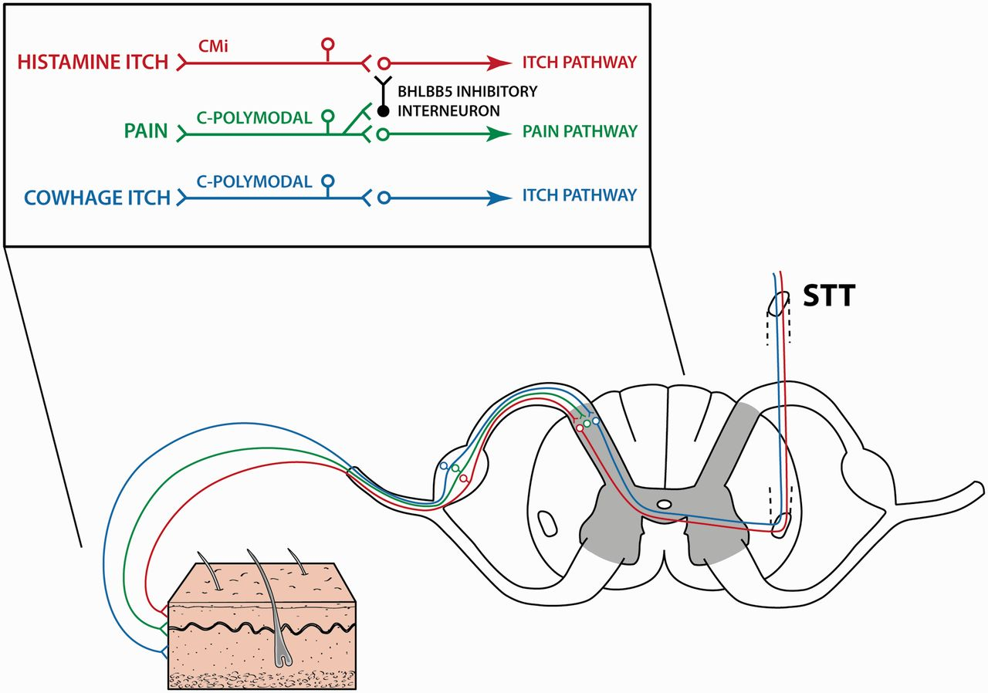
Figure 1 Peripheral anatomy of itch. Two itch pathways (histamine in blue, cowhage in red) and the peripheral limb of ...
Notes:
Figure 1 Peripheral anatomy of itch. Two itch pathways (histamine in blue, cowhage in red) and the peripheral limb of the pain pathway (green) are shown. The itch pathways are stimulated by histamine and cowhage skin receptors in the epidermis and dermis, respectively. Impulses are transmitted primarily via mechanically insensitive C-fibres and polymodal C-fibres, respectively, to secondary neurons in the dorsal horn. One means of modulation by the pain pathway (depicted only partially) is through a Bhlbb5 interneuron. STT = spinothalamic tract; Bhlbb5 = transcription factor protein; CMi = mechano-insensitive C-fibres; C-polymodal = polymodal C-fibres.
Unless provided in the caption above, the following copyright applies to the content of this slide: © The Authors (2013). Published by Oxford University Press on behalf of the Guarantors of Brain. All rights reserved. For Permissions, please email: journals.permissions@oup.com

Slide 2
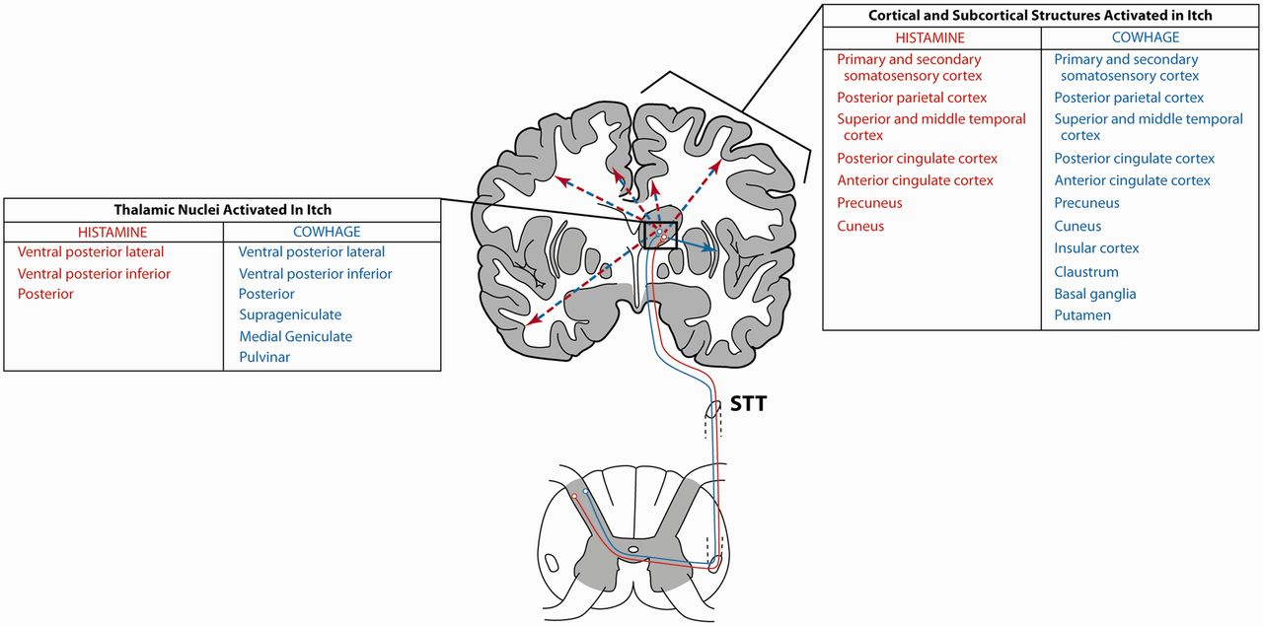
Figure 2 Central anatomy of itch. Histamine (red) and cowhage (blue) itch fibres travel in the spinothalamic tract to ...
Notes:
Figure 2 Central anatomy of itch. Histamine (red) and cowhage (blue) itch fibres travel in the spinothalamic tract to the thalamic nuclei (listed in the left box) usually contralateral to the stimulus. Cowhage neurons project to a broader set of nuclei than histamine neurons [data derived from Davidson et al. (2012) and Papoiu et al. (2012)]. Thalamic neurons transmit to multiple cortical and subcortical structures (listed in the right box) with a more diffuse pattern in cowhage itch. These structures are usually activated in a bilateral and symmetric pattern, except that the insular cortex, claustrum, basal ganglia, and putamen have a minor emphasis contralateral to the stimulus [data derived from Leknes et al. (2007); Papoiu et al. (2012)]. STT = spinothalamic tract.
Unless provided in the caption above, the following copyright applies to the content of this slide: © The Authors (2013). Published by Oxford University Press on behalf of the Guarantors of Brain. All rights reserved. For Permissions, please email: journals.permissions@oup.com

