Slide 1
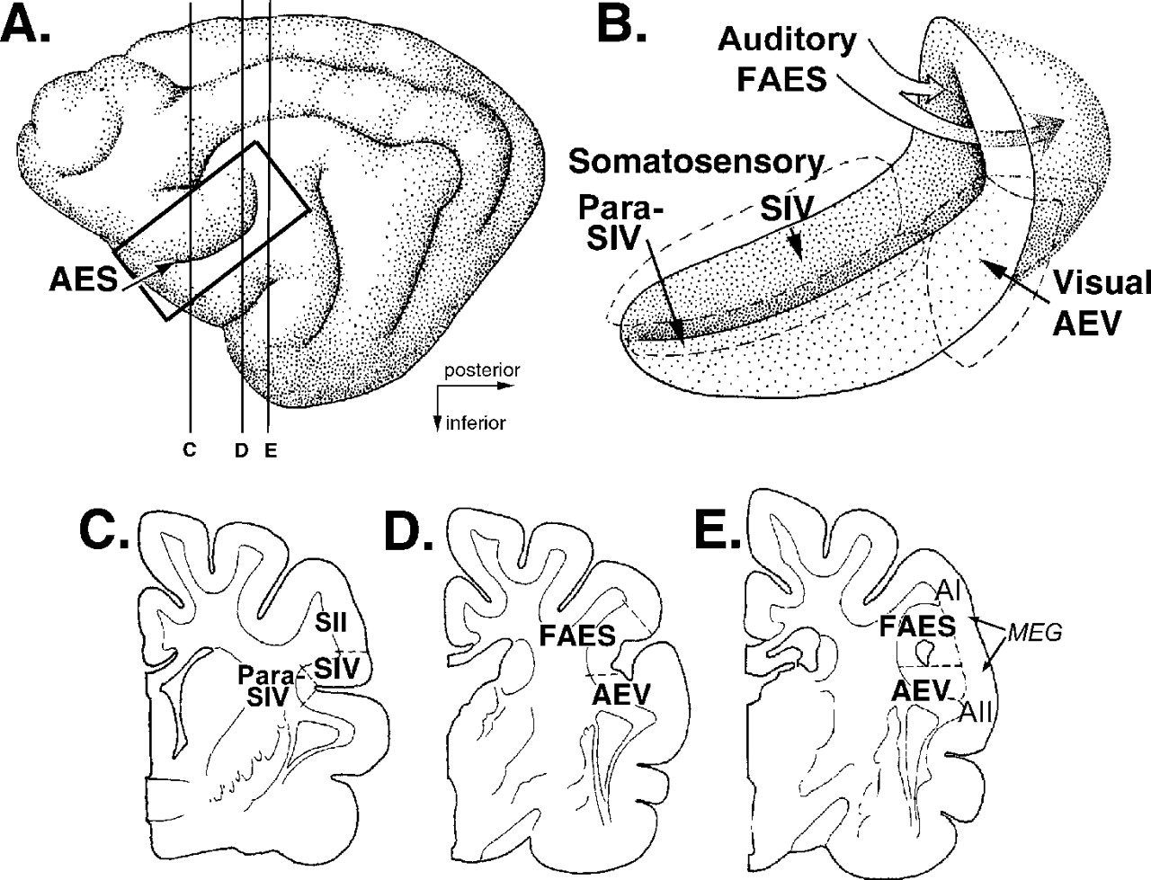
Figure 1. Somatosensory (SIV), auditory (FAES) and visual (AEV) representations in the AES cortex. (A) ...
Notes:
Figure 1. Somatosensory (SIV), auditory (FAES) and visual (AEV) representations in the AES cortex. (A) Lateral view of the left cortical hemisphere of the cat; the box indicates the location of the AES (arrow). The vertical lines labeled ‘C–E’ indicate the location coronal sections through the AES shown in the lower panel. (B) AES magnified and opened to reveal its banks and fundus, as well as the posterior portion (stippled) that is submerged under the middle ectosylvian gyrus (MEG). The dashed lines indicate the borders between sensory representations. (C) Coronal section through the anterior portion of the AES, with SIV in the dorsal bank and para-SIV in the fundus. (D) Coronal section through the posterior portion of the horizontal limb of the AES, with FAES in the dorsal bank and AEV in the ventral bank. (E) Coronal section further posterior than in (D) with the FAES (dorsal) and AEV (ventral) enclosing a circular remnant of the AES and underlying the MEG.
Unless provided in the caption above, the following copyright applies to the content of this slide:

Slide 2
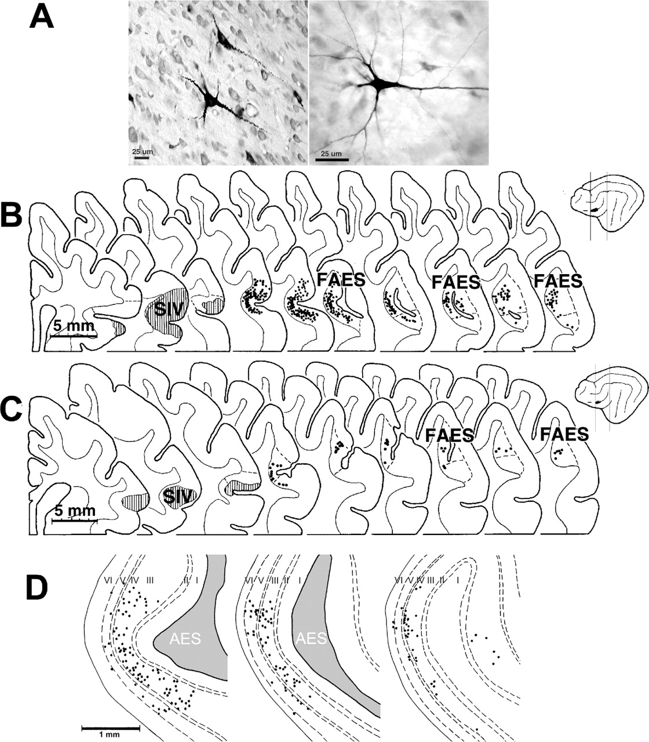
Figure 2. Retrograde documentation of FAES projections to SIV. (A) Injections into SIV retrogradely labeled ...
Notes:
Figure 2. Retrograde documentation of FAES projections to SIV. (A) Injections into SIV retrogradely labeled neurons with pyramidal morphology in FAES (400×) using HRP (left) or BDA (right). (B, C) HRP or BDA injections (respectively) into SIV produced retrogradely labeled neurons in the posterior-medial aspects of the AES cortex, corresponding to FAES. In each panel, the three coronal sections on the left indicate the anterior, middle and posterior extent of the SIV injection site (shaded). Further to the right, serial coronal sections (at 400–500 µm intervals) through the posterior end of the AES are shown with the location of retrogradely labeled neurons (1 black dot = 1 neuron) plotted on each. On the schematic of the brain (far right), the vertical lines bracket the area from which the coronal sections were taken; the blackened area approximates the location of the injection. (D) Magnified views of the FAES with the cortical lamination indicated (dashed lines), illustrating that FAES neurons projecting to SIV originate primarily in cortical lamina III, but with some also found in lamina V.
Unless provided in the caption above, the following copyright applies to the content of this slide:

Slide 3
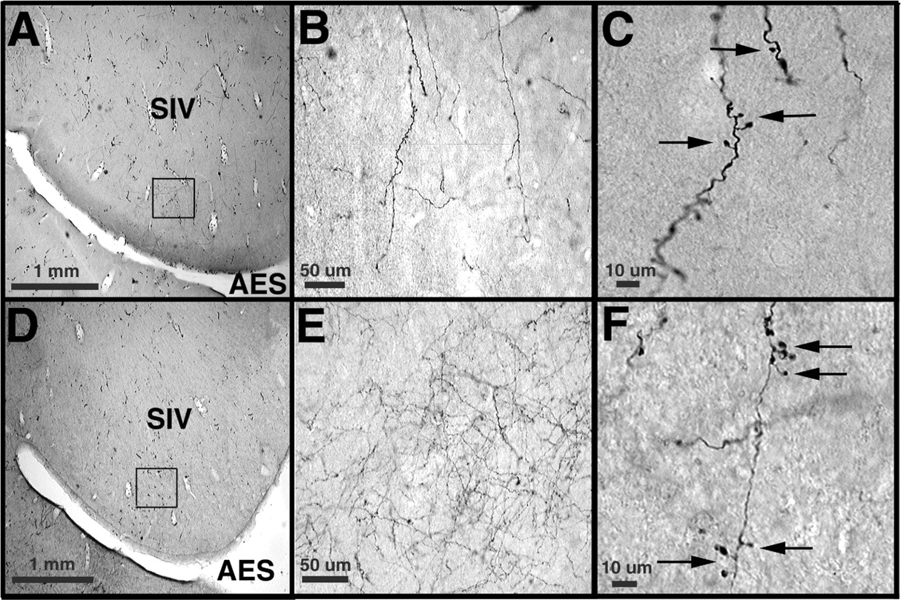
Figure 3. Tracer injections into FAES orthogradely labeled axon terminals within SIV. (A–C, D–F) ...
Notes:
Figure 3. Tracer injections into FAES orthogradely labeled axon terminals within SIV. (A–C, D–F) Photomicrographs from two cases of BDA injections into FAES. Both (A) and (D) are low-power (40×) views of the anterior, dorsal bank of the AES where SIV is located. The square box in each indicates the location of tissue magnified in the subsequent panels. The mid-power (400×) views, shown in (B) and (E) reveal networks of FAES axons within SIV. (C, F) High-power (1000×) views showing BDA-positive FAES axon terminals (arrows indicate boutons) in SIV.
Unless provided in the caption above, the following copyright applies to the content of this slide:

Slide 4
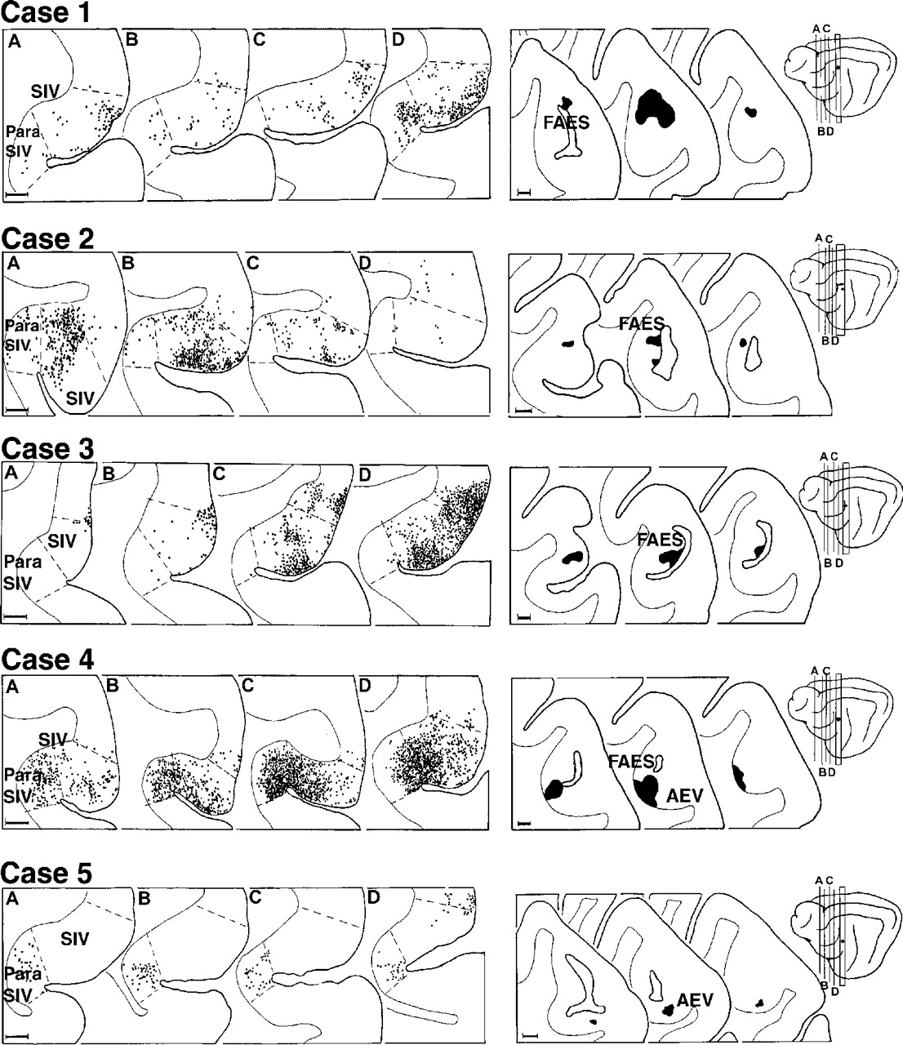
Figure 4. The distribution of orthogradely labeled FAES terminals within SIV. This figure represents the ...
Notes:
Figure 4. The distribution of orthogradely labeled FAES terminals within SIV. This figure represents the results of five cases in which BDA was injected in or near FAES (coronal sections on right show the anterior, middle and posterior extent of the injection site) with the resulting pattern of terminal label within SIV (coronal sections labeled A–D; 1 dot = 1 terminal). Terminal labeling within AEV, when present, is not shown. BDA injections that included the medial bank of FAES consistently produced moderate to heavy patterns of terminal labeling in SIV (Cases 2–4). In contrast, BDA injections superior (Case 1) or inferior (Case 5) to this medial FAES region yielded modest to no terminal labeling in SIV. The brain schematic (far right) indicates the location of the coronal sections through SIV (lines A–D) as well as that of the injection site (blackened).
Unless provided in the caption above, the following copyright applies to the content of this slide:

Slide 5
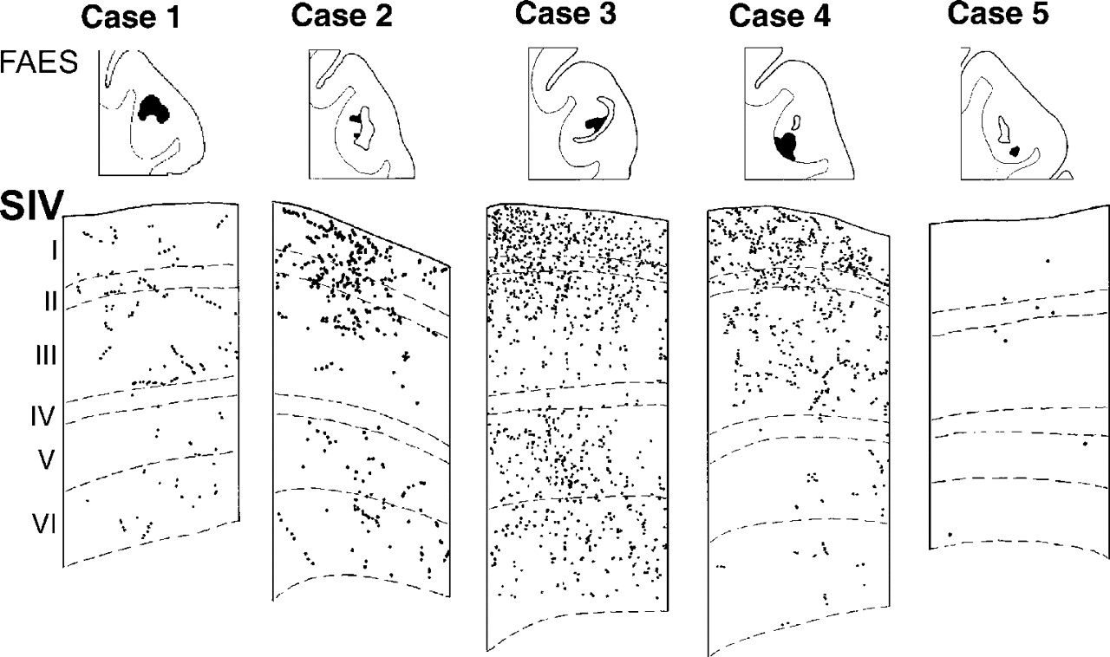
Figure 5. Laminar distribution of FAES axon terminals in SIV. For the each of the cases (1–5) illustrated in ...
Notes:
Figure 5. Laminar distribution of FAES axon terminals in SIV. For the each of the cases (1–5) illustrated in Figure 4, axon terminals were plotted on a magnified view of SIV (pial surface at top). Laminar boundaries (dashed lines) were determined using adjacent Nissl-stained sections. The center of the corresponding injection site in FAES is depicted in the top row. For BDA injections that included the medial bank of FAES (Cases 2–4), terminal label was found primarily within the supragranular and, to a lesser extent, the infragranular layers of SIV. A similar supragranular preference, but much weaker projection, was evident for the less effective injections located high and lateral in FAES (Case 1), or low in AEV (Case 5).
Unless provided in the caption above, the following copyright applies to the content of this slide:

Slide 6
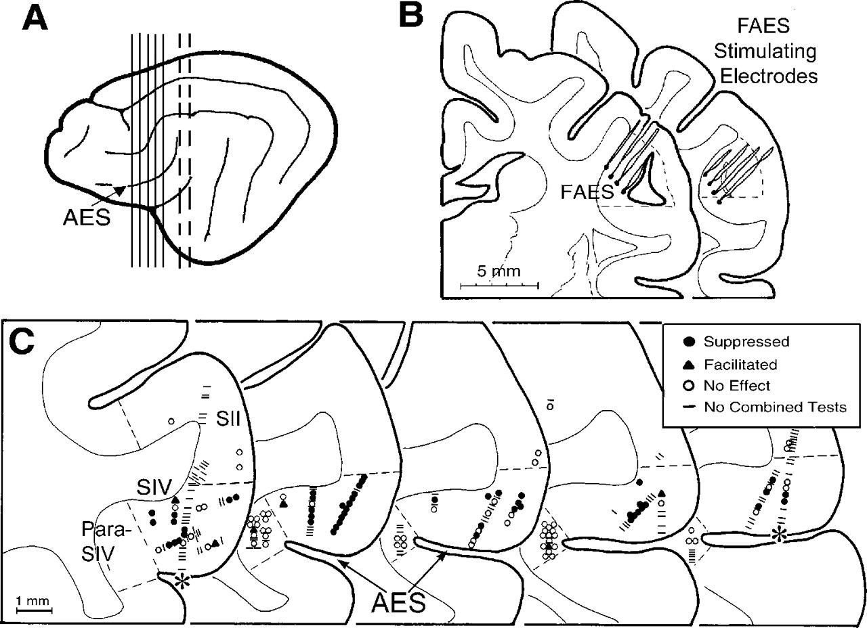
Figure 6. The distribution of somatosensory-responsive neurons examined for responses to auditory FAES ...
Notes:
Figure 6. The distribution of somatosensory-responsive neurons examined for responses to auditory FAES stimulation. (A) Lateral view of the cat cerebral cortex indicating the location of the AES and the levels from which the coronal sections, shown in B (dashed vertical lines) and C (solid vertical lines), are taken. (B) Sections through FAES show the position of the eight, indwelling stimulating electrodes for a single case. Note that the tip of all but one of the electrodes is positioned within the medial part of the FAES. (C) Plot of the histological location of somatosensory-responsive neurons encountered in SII, SIV, or para-SIV that were tested for orthodromic and subthreshold inputs from auditory FAES. All of the neurons depicted were examined for but failed to show orthodromic responses to FAES stimulation. The effect of combined somatosensory + FAES stimulation on each neuron is indicated by the symbol, as defined in the ‘key.’ The asterisks on the first and last sections denote two penetrations at widely different locations in the same animal.
Unless provided in the caption above, the following copyright applies to the content of this slide:

Slide 7
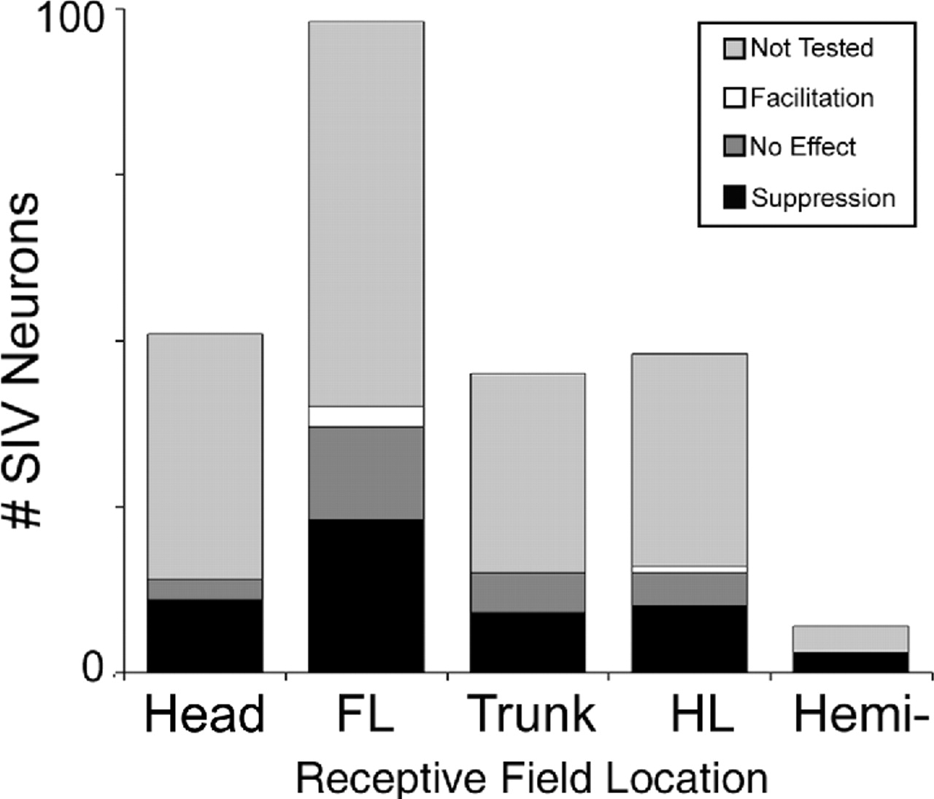
Figure 7. Receptive field locations of SIV neurons examined for inputs from FAES. Each bar indicates the ...
Notes:
Figure 7. Receptive field locations of SIV neurons examined for inputs from FAES. Each bar indicates the number of neurons whose receptive field included the stipulated body region. Of the neurons tested for FAES-induced suppression, a majority was suppressed in each receptive field category. Thus, even though forelimb receptive fields were most frequently encountered, tested, and suppressed, FAES-inputs appear to similarly influence all the represented regions of the body. Note that because some receptive fields encompassed more than one body region, numbers sum to greater than the number of neurons examined. FL = forelimb; HL = hindlimb; Hemi = hemi-body receptive field.
Unless provided in the caption above, the following copyright applies to the content of this slide:

Slide 8
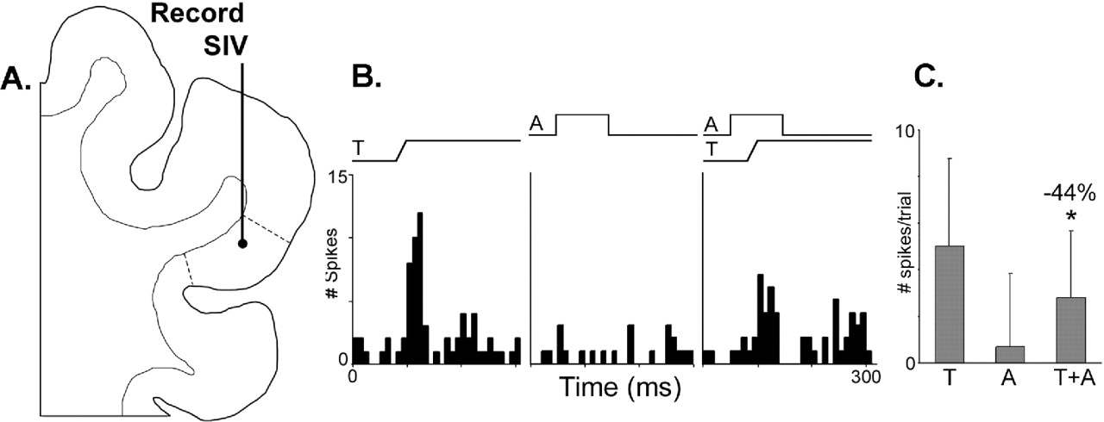
Figure 8. Combined-modality stimulation results in response suppression. A neuron located in SIV (coronal ...
Notes:
Figure 8. Combined-modality stimulation results in response suppression. A neuron located in SIV (coronal section labeled A) produced the responses shown in B and summarized in C. A vigorous response (mean = 5.0 ± 3.8 spikes/trial) was produced by the rapid deflection of hairs (ramp labeled ‘T’) on the trunk, but a response to an auditory stimulus (squarewave labeled A; 0° elevation; 60° azimuth; 69 dB SPL, 100 ms duration) could not be distinguished from baseline (mean = 0.7 ± 3.1 spikes/trial). No auditory cues were effective in producing an excitatory response in this neuron. However, when these same stimuli were combined, the level of activity was reduced (mean = 2.8 ± 2.8 spikes/trial), representing a significant (indicated by asterisk; P < 0.05; paired t-test) 44% reduction from the response to the tactile stimulus alone. Peristimulus time-histogram bin width = 10 ms; these conventions are the same in subsequent figures.
Unless provided in the caption above, the following copyright applies to the content of this slide:

Slide 9
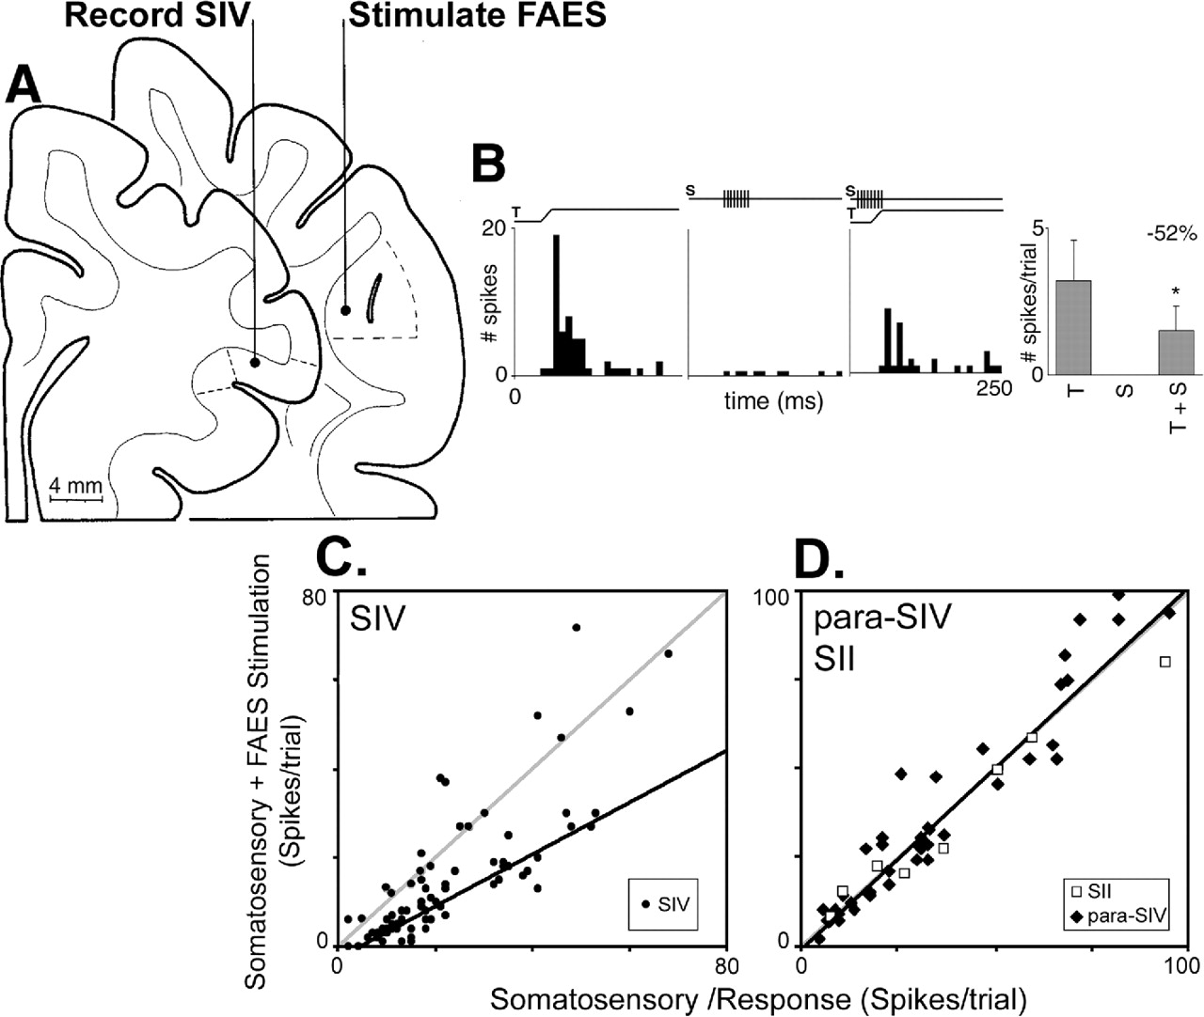
Figure 9. Somatosensory responses of a majority of SIV neurons were suppressed by concurrent stimulation of ...
Notes:
Figure 9. Somatosensory responses of a majority of SIV neurons were suppressed by concurrent stimulation of auditory FAES. (A) The coronal sections illustrate the SIV recording and FAES stimulation sites for the neuron whose activity is depicted in B. (B) tactile stimulation alone (ramp labeled ‘T’) elicited a robust response (mean = 4.4 spikes/trial), but stimulation of FAES (line and pulses labeled ‘S’) did not. However, when these same stimuli were combined, the neuronal response was significantly suppressed (mean = 2.1 spikes/trial), as summarized in the bar histogram at the far right (response suppression =56%; P <0.05, paired t-test). (C) Data for the population of SIV neurons tested in this same manner, where the y-axis represents the responses to the combined somatosensory + FAES stimulation, while the x-axis represents the response to the somatosensory stimulus alone. Note that the majority of responses (66%) fall well below the unity line (grey line); the regression line (black line; slope = 0.58) for these suppressed responses was significantly lower than unity. In contrast, the plot labeled D illustrates the responses to the same stimuli from the population of neurons sampled in SII (open squares) and in para-SIV (black diamonds), where somatosensory responses were not significantly affected by FAES stimulation (grey unity line nearly equaled the black regression line, slope = 1.01).
Unless provided in the caption above, the following copyright applies to the content of this slide:

Slide 10
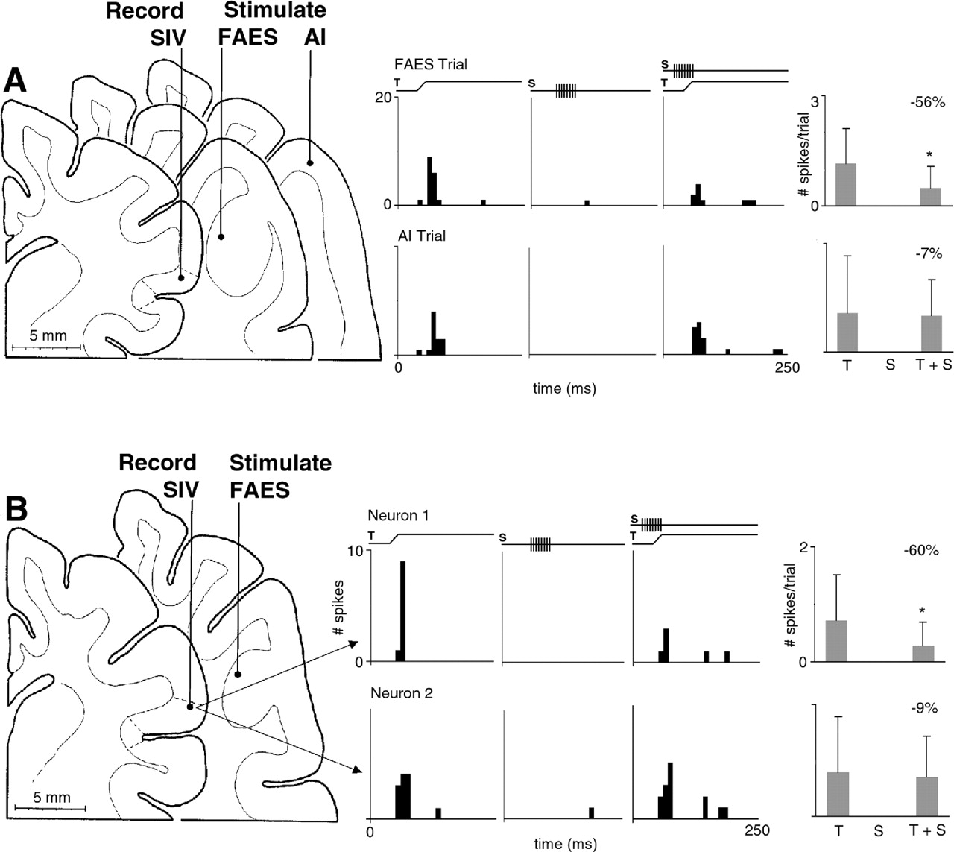
Figure 10. FAES-induced suppression of SIV is specific for FAES stimulation ‘A’ and for particular SIV ...
Notes:
Figure 10. FAES-induced suppression of SIV is specific for FAES stimulation ‘A’ and for particular SIV neurons ‘B’. (A) The coronal sections illustrate the location of the SIV neuron, as well as its FAES and AI stimulation sites, whose activity is depicted in the panels to the right. The top row of panels shows that the response to tactile stimulation (mean = 1.6 spikes/trial) was reduced by 56% (mean = 0.7 spikes/trial) when combined with FAES stimulation. However, the bottom row shows that the response to the same tactile stimulus (left; mean = 1.4 spikes/trial) was essentially unchanged by concurrent stimulation in AI. The bar histograms to the far right summarize these effects, illustrating that FAES stimulation significantly (P <0.05, paired t-test) suppressed SIV responses, but AI stimulation did not. (B) As illustrated by simultaneous recordings from two SIV neurons at the same site, FAES-induced suppression targeted some neurons, but not others. The coronal sections show the FAES stimulation site and the SIV location at which both neurons were recorded. On the right, the top row of panels show that the tactile responses (mean = 1.0 spikes/trail) of this neuron were reduced (–60%) by concurrent FAES stimulation (mean = 0.4 spike/trial). In contrast, the bottom panels show that the same tactile and FAES stimulation parameters failed to influence the activity of a simultaneously recorded neuron. Here, the response to tactile alone (mean = 1.1 spikes/trial) was not significantly different from that evoked by the combined stimulation (mean = 1.0 spikes/trial). These effects are summarized in the bar histograms (far right).
Unless provided in the caption above, the following copyright applies to the content of this slide:

Slide 11
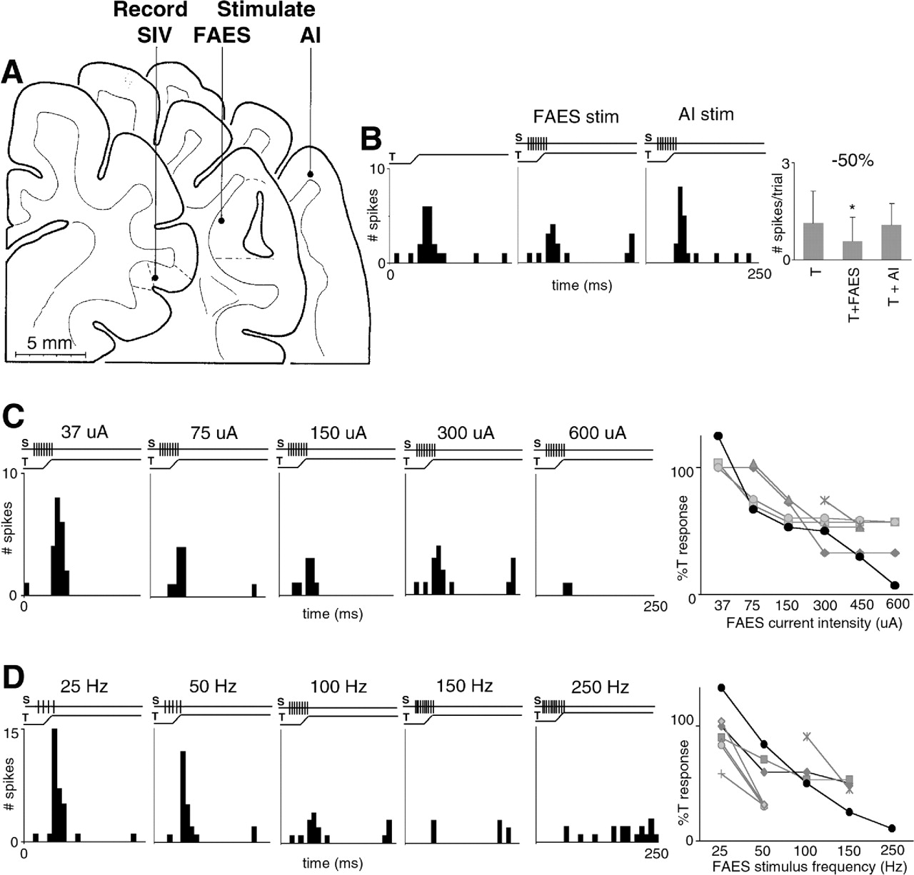
Figure 11. Systematic changes in FAES stimulation parameters yielded parallel changes in suppression of SIV ...
Notes:
Figure 11. Systematic changes in FAES stimulation parameters yielded parallel changes in suppression of SIV activity. In A, the coronal sections show the location of an SIV neuron, as well as the FAES and control (AI) stimulation sites. The panels in B show the responses of the neuron to tactile stimulation alone (left) were suppressed when combined with FAES (middle) but not AI (right) stimulation. The bar histogram (far right) summarizes this activity. In C the tactile responses (mean = 1.6 spikes/trial) of the same SIV neuron were tested with increasing levels of FAES stimulation intensity from 37 to 600 µA (37 µA = 2.0 spikes/trial; 75 µA = 1.0 spikes/trial; 150 µA = 0.9 spikes/trial; 300 µA = 0.8 spikes/trial; 600 µA = 0.2 spikes/trial) and, as FAES stimulation intensity increased, the level of response suppression also increased. This monotonic effect is graphed (far right) for this neuron (black trace) as well as for five other similarly tested neurons (grey traces). Note that each level of suppression was calculated by comparison to results from tactile stimulation alone for a given FAES stimulus intensity (not shown). Part D illustrates the same SIV neuron’s responses to tactile stimulation when combined with increasing FAES stimulus frequency (from 25 to 250 Hz). As the frequency of the FAES stimulation was systematically increased, the level of suppression also gradually increased (25 Hz = 2.8 spikes/trial; 50 Hz = 2.0 spikes/trial; 100 Hz = 0.8 spikes/trial; 150 Hz = 0.3 spikes/trial; 250 Hz = 0.2 spikes/trial). The graph (far right) summarizes this monotonic effect on the SIV neuron’s responses (black trace) and that of seven other SIV neurons (grey traces). Each level of suppression was calculated by comparison with responses to tactile stimulation alone for a given FAES stimulation frequency (not shown).
Unless provided in the caption above, the following copyright applies to the content of this slide:

Slide 12
Figure 12. Excitation in SIV neurons is held in check by GABAergic inhibition. An in vitro slice preparation ...
Notes:
Figure 12. Excitation in SIV neurons is held in check by GABAergic inhibition. An in vitro slice preparation of the AES in a parasagittal plane included both dorsal (i.e. SIV) and ventral banks, as well as its posterior end where FAES is located. Under normal conditions, electrical stimulation (concentric bipolar, 600 µA, 0.1 ms, 50 repetitions) of FAES minimally excited neurons at the recording site in SIV. However, when bicuculline methiodide (BIC; 50 µM, picospritzed) was introduced, GABAergic inhibition was blocked and the SIV was strongly activated by the same FAES stimulus. When BIC was co-applied with the excitatory antagonist, d-APV (40 µM), the duration but not the amplitude of the excitatory effect was truncated. Ultimately, when the excitatory antagonist NBQX (10 µM) was co-applied with BIC, all synaptic activity was blocked.
Unless provided in the caption above, the following copyright applies to the content of this slide:

Slide 13
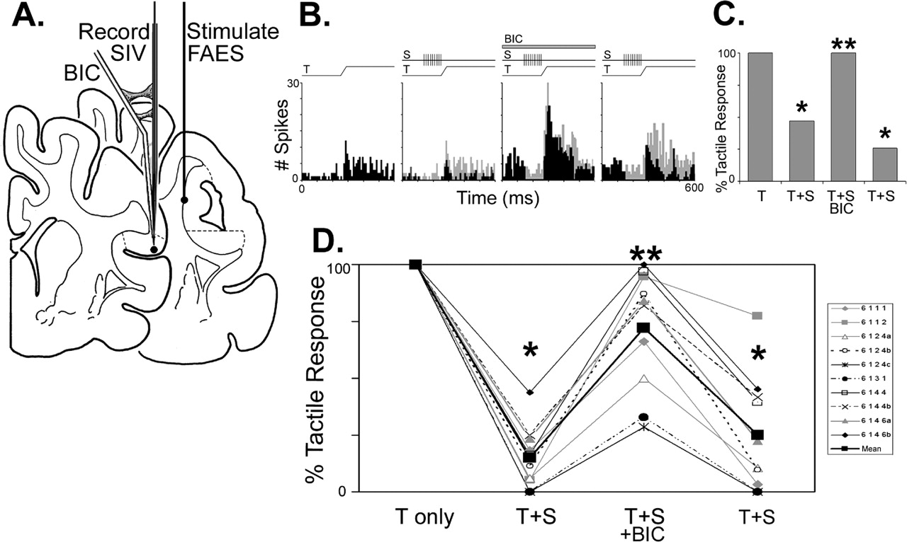
Figure 13. Iontophoretic application of the GABA antagonist bicuculline methiodide (BIC) blocks (or reduces) ...
Notes:
Figure 13. Iontophoretic application of the GABA antagonist bicuculline methiodide (BIC) blocks (or reduces) FAES-induced suppression of SIV tactile responses. (A) Location of an SIV neuron tested for the influence of FAES stimulation before, immediately after ejection of BIC through a microiontophoresis/electrode assembly and then after a period of recovery. The responses of this neuron are depicted in the histograms in B, which first shows the responses evoked by the tactile stimulus alone (mean = 8.0 spikes/trial). Next, its responses to the same tactile cue are shown (mean = 8.0 spikes/trial; same as in first panel, but histogram is now grey) overlaying the responses to tactile + FAES stimulation (mean = 3.5 spikes/trial; black histogram), where the response reduction is easily apparent. When BIC was iontophoresed (bar labeled ‘BIC’; 50nA ejection current; 3 min ), not only was neuronal activity elevated, but also the response to tactile alone (mean = 20.5 spikes/trial; grey histogram), when overlain by the combined tactile + FAES stimulation (mean = 20.5 spike/trial; black histogram), was virtually identical, indicating that FAES-induced suppression was blocked. After a period for recovery, the difference between tactile alone (mean = 13.2 spikes/trial; grey histogram) and combined tactile + FAES stimulation (mean = 5.5 spikes/trial; black histogram) returned, indicating that the suppressive effects of FAES stimulation were again present. The bar histogram to the far right (C) summarizes these results, showing that the tactile responses that were significantly suppressed by FAES stimulation were disinhibited in the presence of BIC. (D) Summary of the responses of 10 SIV neurons tested in the same fashion and showing the same BIC-induced disinhibition of FAES-mediated suppression. The large black squares linked by heavy black lines represent the mean for the sample. *Significant difference between the tactile response alone and the suppression induced by the tactile and FAES costimulation; **indicates that there was a significant disinhibition due to the presence of BIC (Wilcoxon signed rank test, P < 0.05).
Unless provided in the caption above, the following copyright applies to the content of this slide:

Slide 14
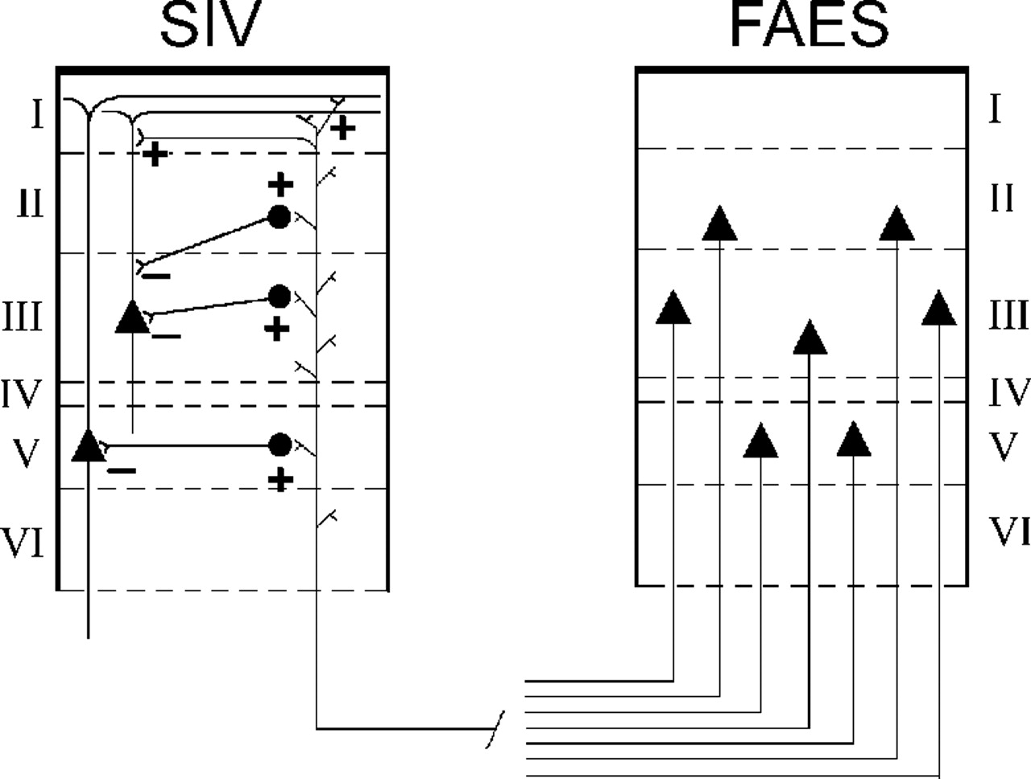
Figure 14. Possible architecture of the cross-modal circuit linking auditory FAES to somatosensory neurons in ...
Notes:
Figure 14. Possible architecture of the cross-modal circuit linking auditory FAES to somatosensory neurons in SIV. Anatomical evidence shows that pyramidal FAES neurons in lamina III and, to a lesser extent, lamina V project to the supragranular (predominantly) and infragranular layers of SIV. Electrophysiological data demonstrated that FAES activity does not elicit suprathreshold excitement of SIV neurons, but suppresses their somatosensory responses and this suppression was sensitive to GABA antagonism. Such cross-modal suppression could be generated by excitatory FAES projections terminating on SIV inhibitory interneurons, which in turn inhibit or reduce the activity of other SIV neurons. In addition, data from in vitro slice experiments show that excitatory inputs to SIV neurons are powerfully held in check by GABAergic mechanisms, indicating that excitatory inputs from FAES may reach distal dendrites of SIV neurons.
Unless provided in the caption above, the following copyright applies to the content of this slide:

