Slide 1
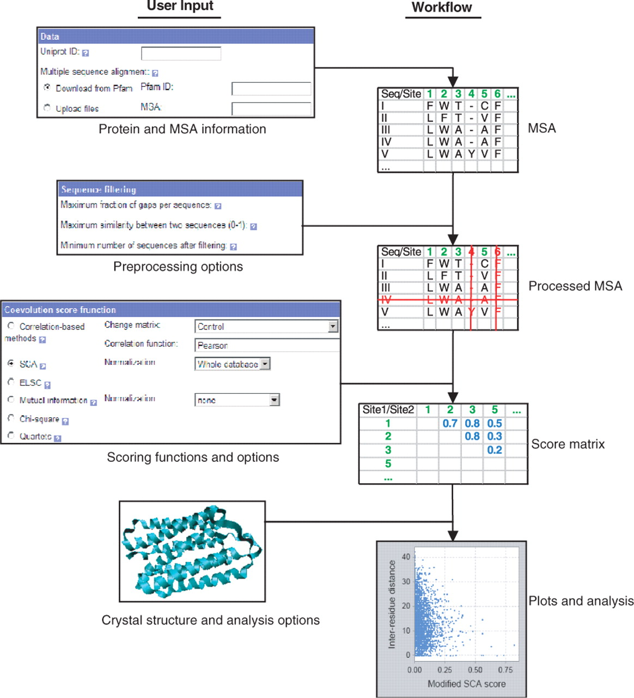
Fig. 1. The workflow of the system (a larger version can be found at the supplementary web site).
Notes:
Fig. 1. The workflow of the system (a larger version can be found at the supplementary web site).
Unless provided in the caption above, the following copyright applies to the content of this slide: © 2007 The Author(s)This is an Open Access article distributed under the terms of the Creative Commons Attribution Non-Commercial License (http://creativecommons.org/licenses/by-nc/2.0/uk/) which permits unrestricted non-commercial use, distribution, and reproduction in any medium, provided the original work is properly cited.

