Slide 1
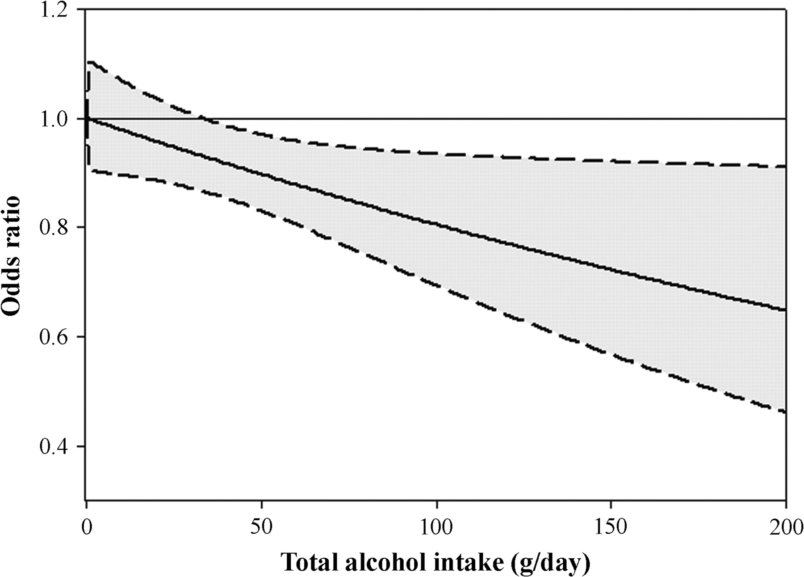
Figure 1. Estimates of odds ratios (solid line) and 95% confidence intervals (dashed lines) of renal cell cancers using ...
Notes:
Figure 1. Estimates of odds ratios (solid line) and 95% confidence intervals (dashed lines) of renal cell cancers using regression spline by total alcohol intake. Regression equations include terms for age, sex, study, study centre, education, smoking habits, body mass index and family history of renal cancer. Curves are shown for best-fitting splines according to Akaike information criterion.
Unless provided in the caption above, the following copyright applies to the content of this slide: © The Author 2008. Published by Oxford University Press on behalf of the European Society for Medical Oncology. All rights reserved. For permissions, please email: journals.permissions@oxfordjournals.org

