Slide 1
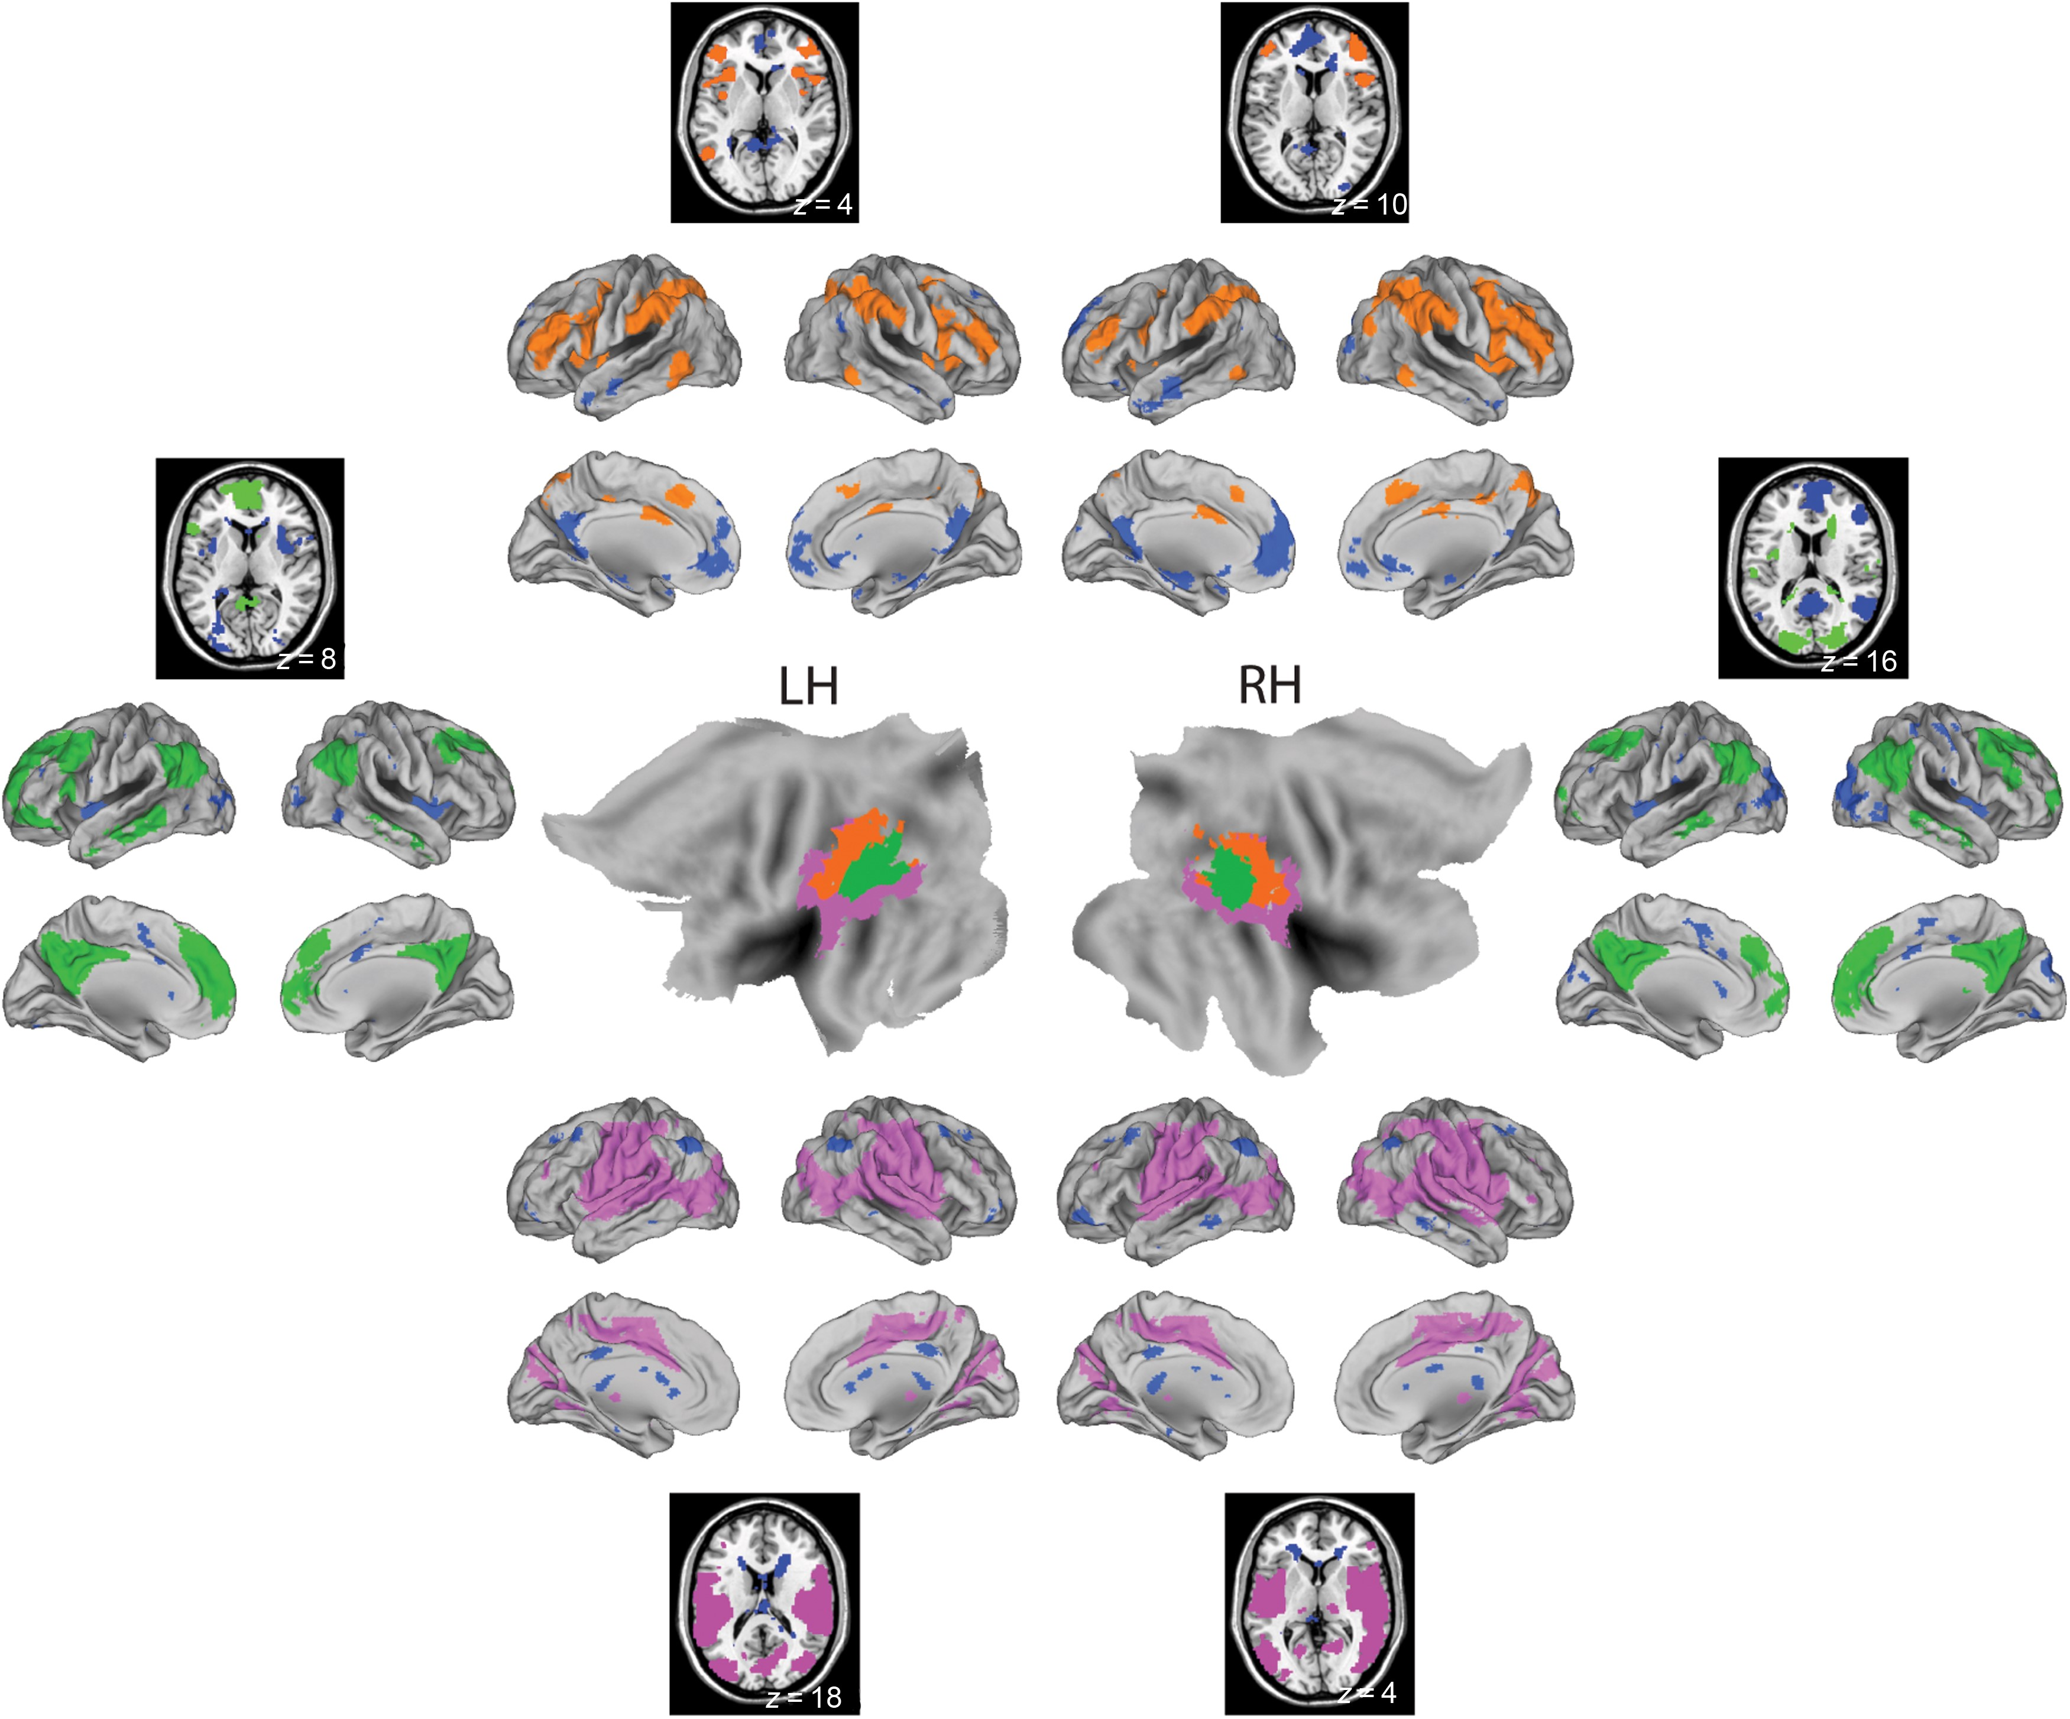
Figure 1. TPJ clusters and associated networks for 3-cluster solution. Central panels show TPJ clusters for the left ...
Notes:
Figure 1. TPJ clusters and associated networks for 3-cluster solution. Central panels show TPJ clusters for the left and right hemispheres overlaid on inflated and flattened brains (posterior pointed toward the center). Detailed information about seed clusters is presented in Table 2. Each cluster was used as a seed to identify an associated network across the group. These are shown around the periphery, on cortical surfaces, color-coded to match central clusters. Significant negative associations are shown in dark blue across all panels. The green (angular gyrus) cluster was associated with posterior cingulate, medial prefrontal, and inferior parietal DMN regions. The violet (superior temporal) cluster showed connectivity with cingulate and insular regions of the salience network. The orange (anterior/IPL) cluster was associated with intraparietal sulcus and dorsal prefrontal regions typically linked with the DAN or fronto-parietal network. These are similar to networks identified in Mars et al. (2012). Network overlays are thresholded at P < 0.05 FWE-corrected. LH, left hemisphere; RH, right hemisphere; DMN, default-mode network; DAN, dorsal attention network; IPL, inferior parietal lobule; TPJ, temporo-parietal junction.
Unless provided in the caption above, the following copyright applies to the content of this slide: © The Author 2015. Published by Oxford University Press. All rights reserved. For Permissions, please e-mail: journals.permissions@oup.com

Slide 2
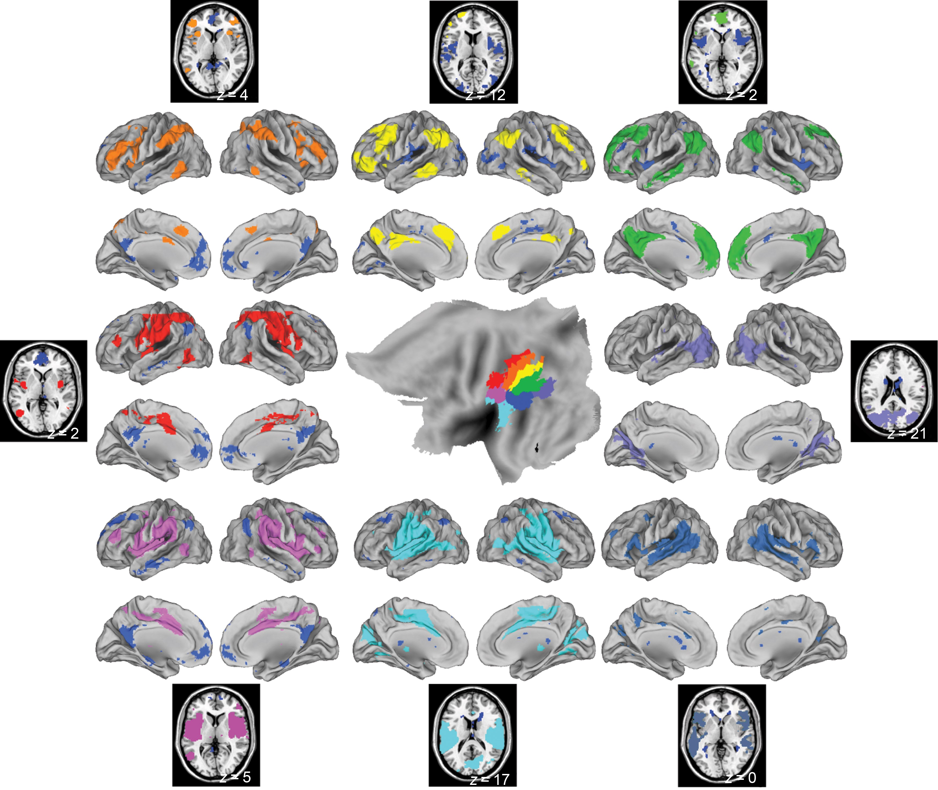
Figure 2. TPJ clusters and associated networks for 8-cluster solution, left hemisphere. Central panels show TPJ ...
Notes:
Figure 2. TPJ clusters and associated networks for 8-cluster solution, left hemisphere. Central panels show TPJ clusters for the left hemisphere overlaid on an inflated hemisphere (posterior pointed toward the right). Detailed information about seed clusters is presented in Table 3. Each cluster was used as a seed to identify the associated network across the group. These are shown around the periphery, on cortical surfaces, color-coded to match central clusters. Significant negative associations are shown in dark blue across all panels. These networks resemble the DMN (green), DAN (orange), salience (violet), similar to the 3-cluster solution. Visual (light purple) and STS (blue) networks emerged, as well as networks with connectivity patterns that do not correspond to canonical networks (red, yellow, cyan). Network overlays are thresholded at P < 0.05 FWE-corrected. DMN, default-mode network; DAN, dorsal attention network; STS, superior temporal sulcus; TPJ, temporo-parietal junction.
Unless provided in the caption above, the following copyright applies to the content of this slide: © The Author 2015. Published by Oxford University Press. All rights reserved. For Permissions, please e-mail: journals.permissions@oup.com

Slide 3
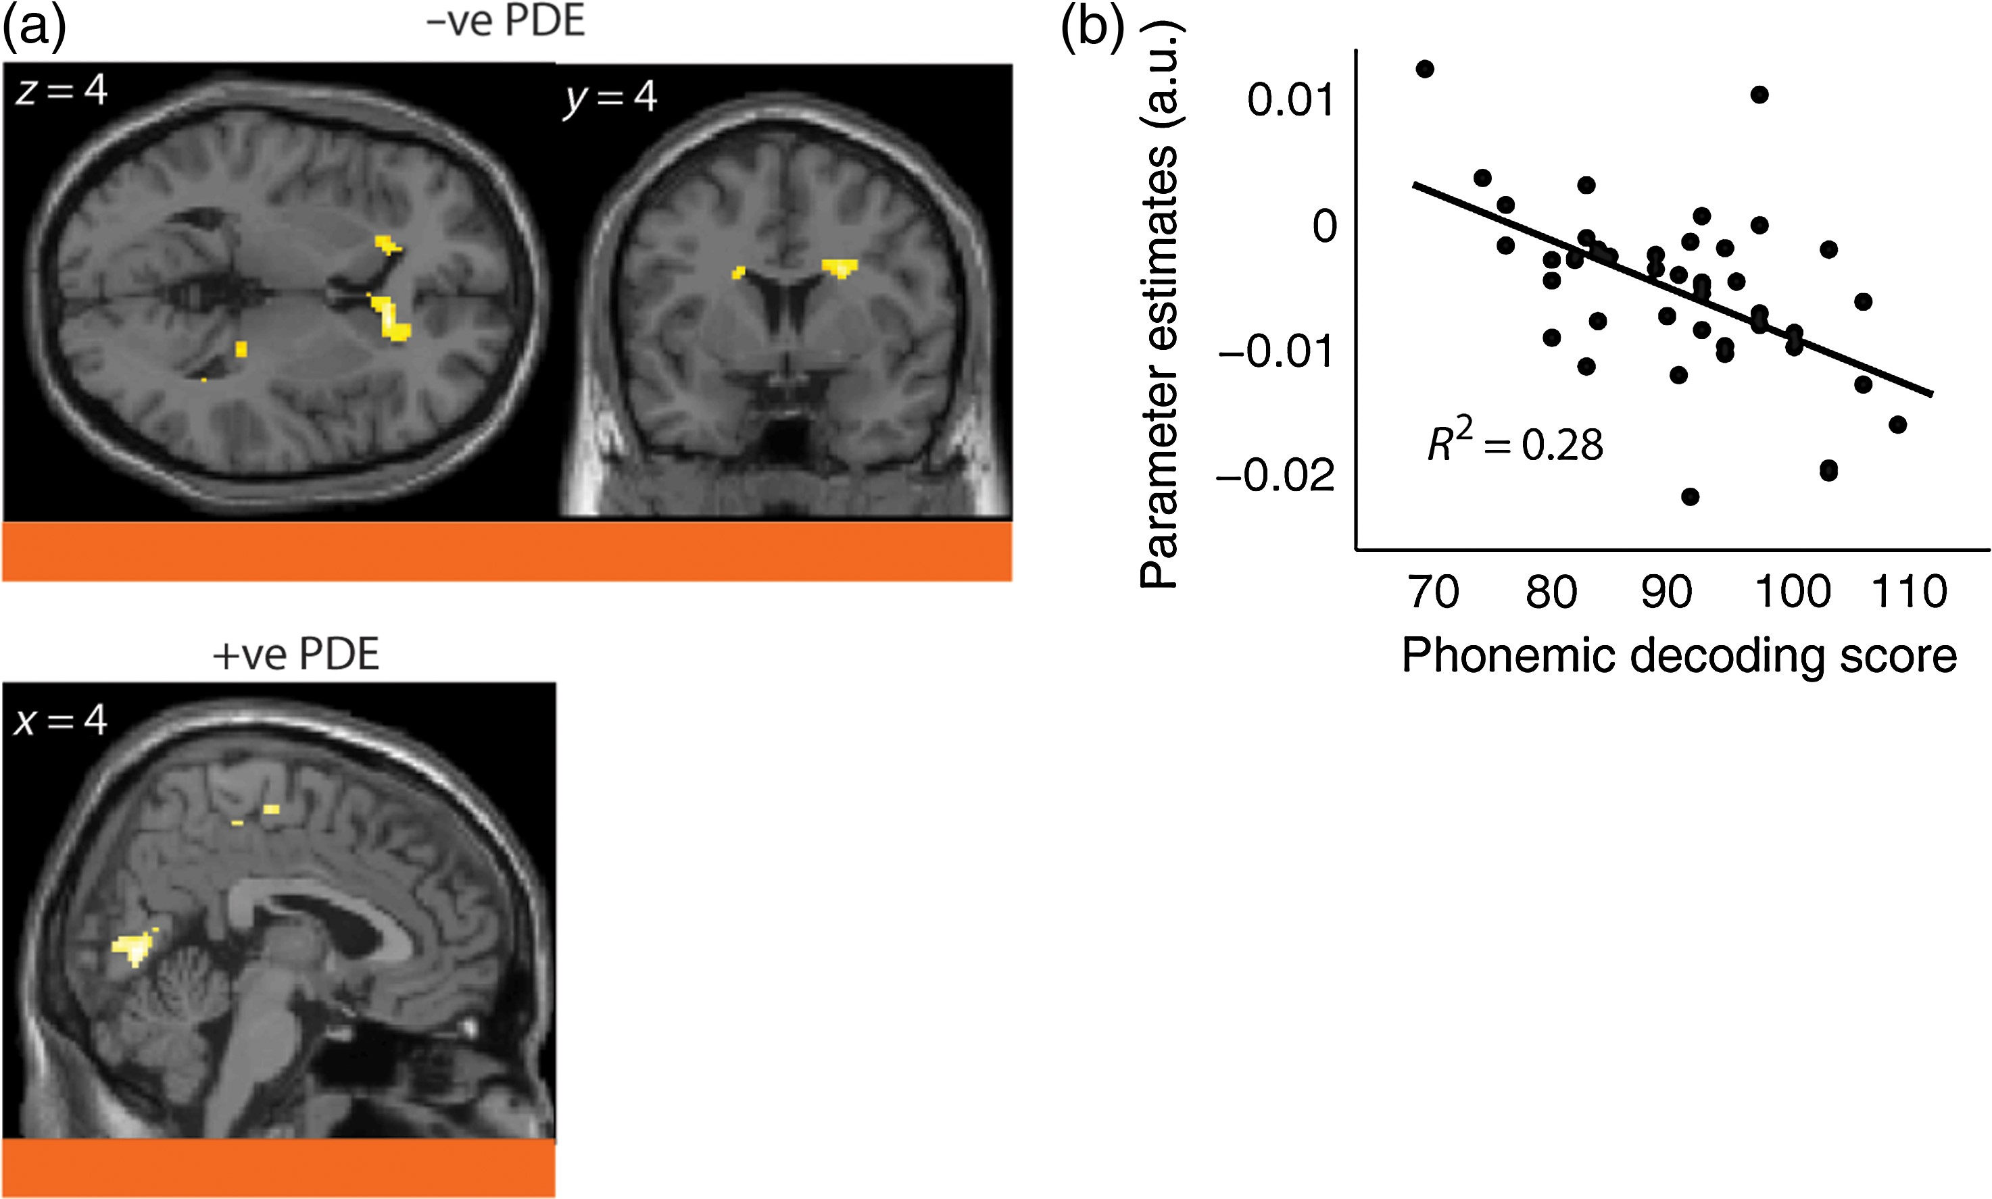
Figure 3. Correlations between 3-cluster seeds and phonemic decoding scores. (a) Negative correlation between left ...
Notes:
Figure 3. Correlations between 3-cluster seeds and phonemic decoding scores. (a) Negative correlation between left SMG/IPL seed and bilateral caudate head ([12, 26, 6], n = 245, Z = 4.78), and right dorsal caudate ([22, 4, 28], n = 142, Z = 4.26); positive association for this cluster with PDE scores in pericalcarine cortex ([4, −72, 4], n = 152, Z = 3.76) in lower panel. Panels are color-coded to match seed regions from Figure 1. (b) Scatter plot of parameter estimates from the peak anterior caudate voxel against phonemic decoding scores, with least squares regression line. IPL, inferior parietal lobule; SMG, supramarginal gyrus; PDE, phonemic decoding efficiency.
Unless provided in the caption above, the following copyright applies to the content of this slide: © The Author 2015. Published by Oxford University Press. All rights reserved. For Permissions, please e-mail: journals.permissions@oup.com

Slide 4
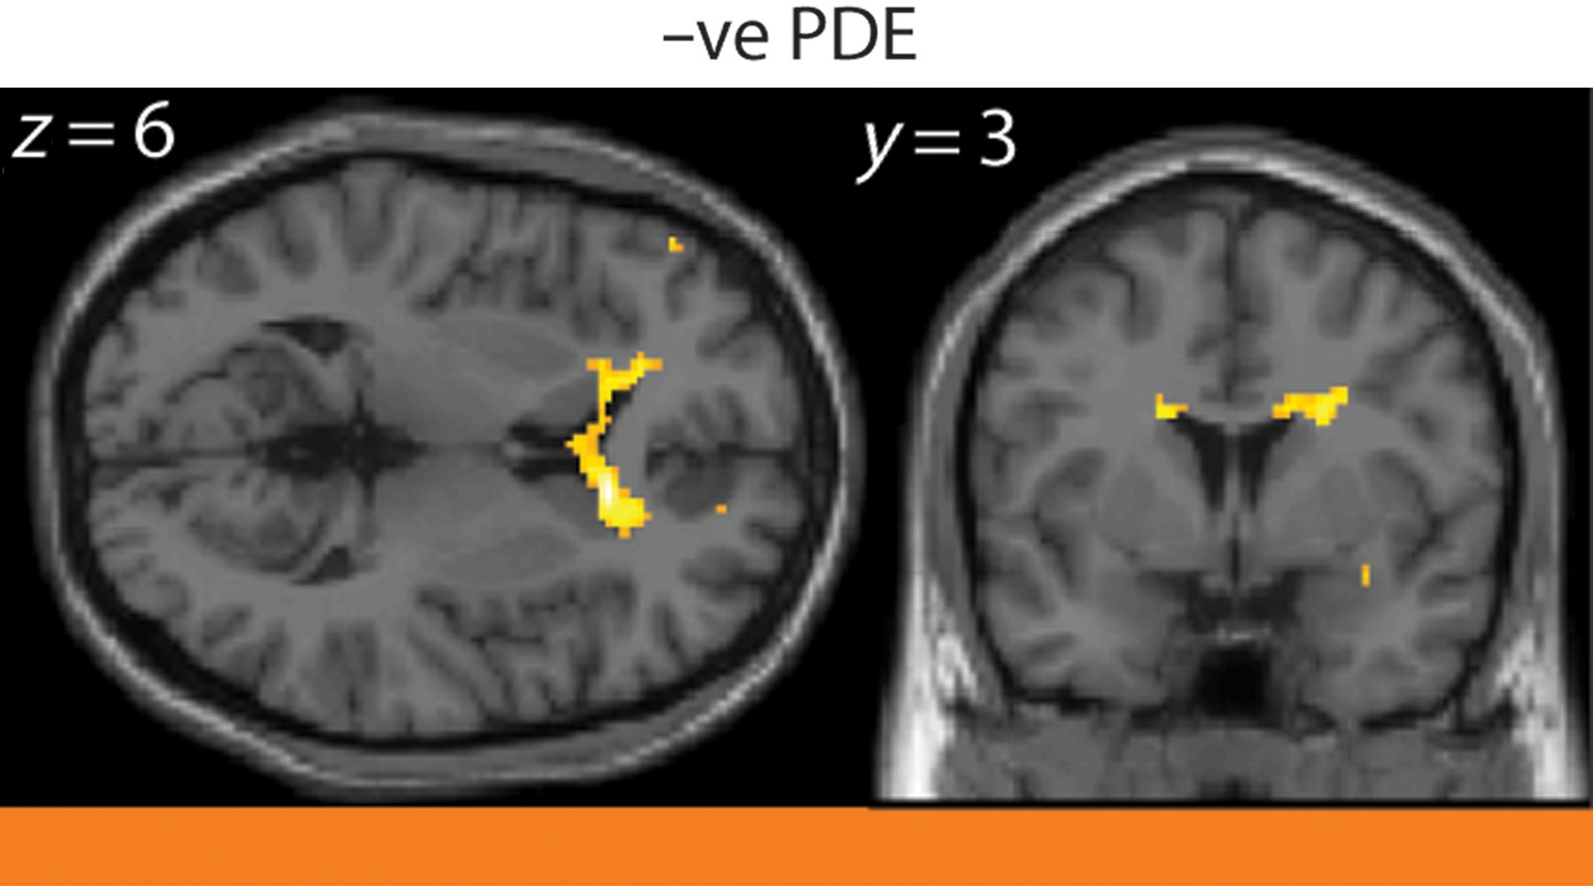
Figure 4. Correlations between left hemisphere 8-cluster seeds and phonemic decoding scores. Significant negative ...
Notes:
Figure 4. Correlations between left hemisphere 8-cluster seeds and phonemic decoding scores. Significant negative association between IPL to bilateral caudate head ([12, 26, 6], Z = 5.19 and [−18, 28, 0], Z = 4.4, n = 506) and right dorsal caudate ([22, 4, 28], n = 215, Z = 4.42) connectivity and phonemic decoding scores. Panel is color-coded to match TPJ cluster seed regions from Figure 2. TPJ, temporo-parietal junction; PDE, phonemic decoding efficiency; IPL, inferior parietal lobule.
Unless provided in the caption above, the following copyright applies to the content of this slide: © The Author 2015. Published by Oxford University Press. All rights reserved. For Permissions, please e-mail: journals.permissions@oup.com

Slide 5
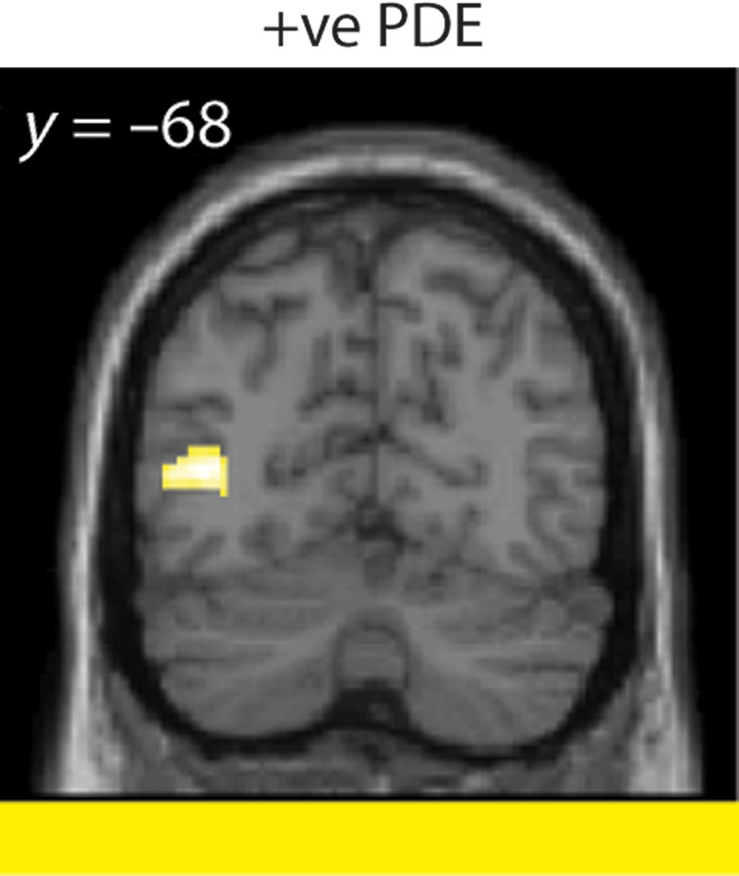
Figure 5. Correlations between right hemisphere 8-cluster seeds and phonemic decoding scores. Significant positive ...
Notes:
Figure 5. Correlations between right hemisphere 8-cluster seeds and phonemic decoding scores. Significant positive association between AG to left occipito-temporal ([12, 28, 6], n = 133, Z = 4.5) connectivity and phonemic decoding scores. Panel is color-coded to match TPJ cluster seed regions from Figure 2. AG, angular gyrus; PDE, phonemic decoding efficiency; TPJ, temporo-parietal junction.
Unless provided in the caption above, the following copyright applies to the content of this slide: © The Author 2015. Published by Oxford University Press. All rights reserved. For Permissions, please e-mail: journals.permissions@oup.com

