Slide 1
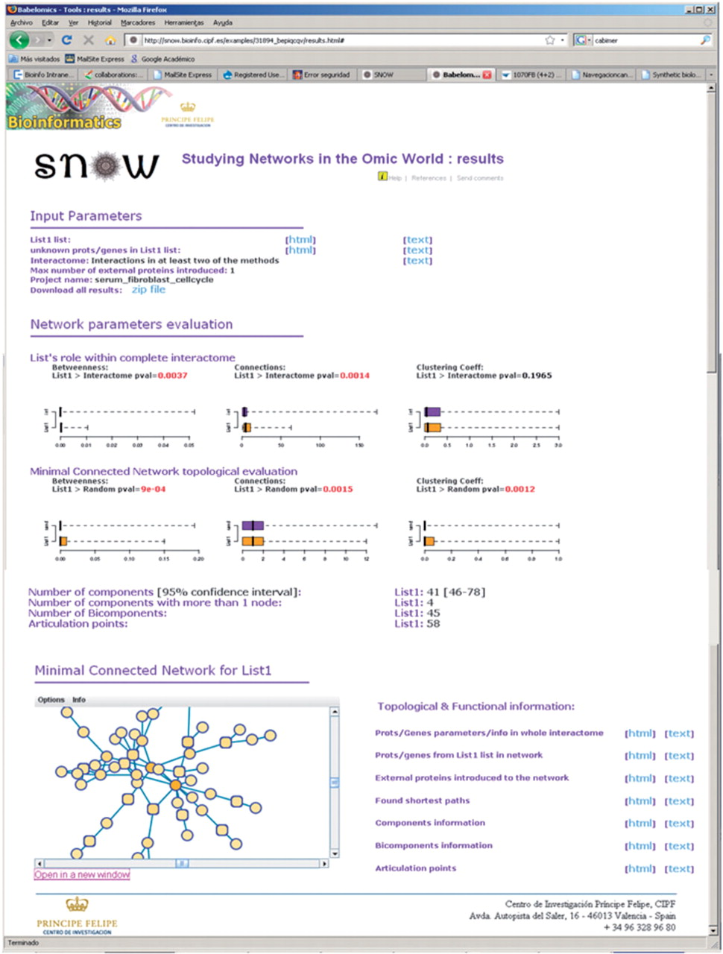
Figure 2. Output of SNOW—the web page contains a summary of the input data and the network parameters estimated along ...
Notes:
Figure 2. Output of SNOW—the web page contains a summary of the input data and the network parameters estimated along with the statistical significance for the connectivity, betweenness and clustering coefficient. Top boxplots represent the comparison of the network to the complete interactome and bottom boxplots account for the comparison of the network to a random network of the same size (see text). Component, bicomponents and articulation points are also provided. In addition, detailed information of genes in the list, genes included in the analysis, shortest pathways is also accessible from the web page. Finally an interactive network viewer can be launched from the page.
Unless provided in the caption above, the following copyright applies to the content of this slide: © 2009 The Author(s)This is an Open Access article distributed under the terms of the Creative Commons Attribution Non-Commercial License (http://creativecommons.org/licenses/by-nc/2.0/uk/) which permits unrestricted non-commercial use, distribution, and reproduction in any medium, provided the original work is properly cited.

Slide 2
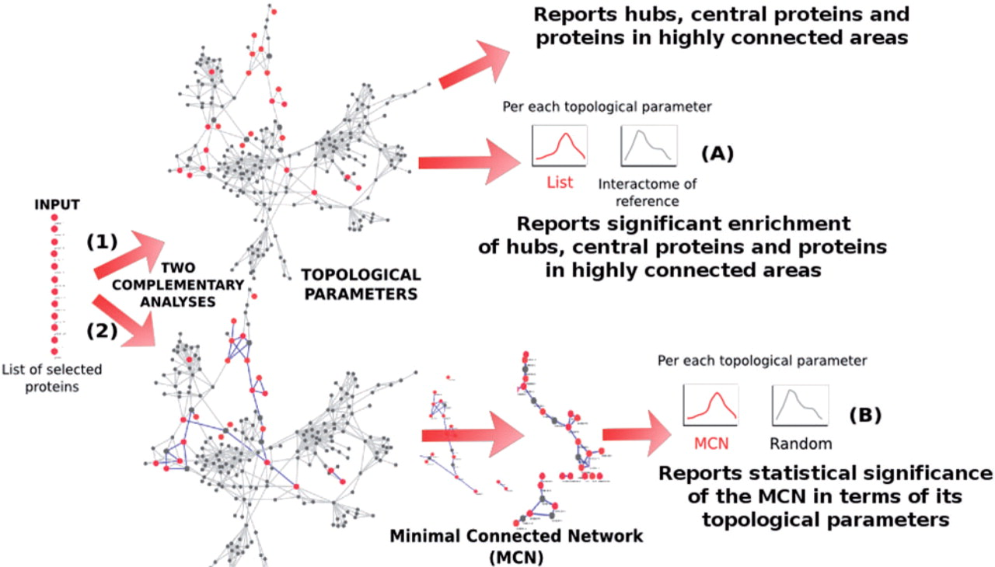
Figure 1. Schema of the analysis steps implemented in SNOW. Two complementary analyses are carried out: (1) the ...
Notes:
Figure 1. Schema of the analysis steps implemented in SNOW. Two complementary analyses are carried out: (1) the distribution of parameters (connection degree, betweenness centrality, clustering coefficient and number of components) of the list of proteins are tested against the rest of proteins of the interactome of reference within the context of connections of the complete interactome of reference and (2) The list of proteins is mapped onto the reference interactome and the MCN is found. The distributions of networks parameters in this MCN are tested against their random expectation (see ‘Testing strategy for the network parameters’ section in the Supplementary Data). See Supplementary Figure 2 for a more detailed schema.
Unless provided in the caption above, the following copyright applies to the content of this slide: © 2009 The Author(s)This is an Open Access article distributed under the terms of the Creative Commons Attribution Non-Commercial License (http://creativecommons.org/licenses/by-nc/2.0/uk/) which permits unrestricted non-commercial use, distribution, and reproduction in any medium, provided the original work is properly cited.

