Slide 1
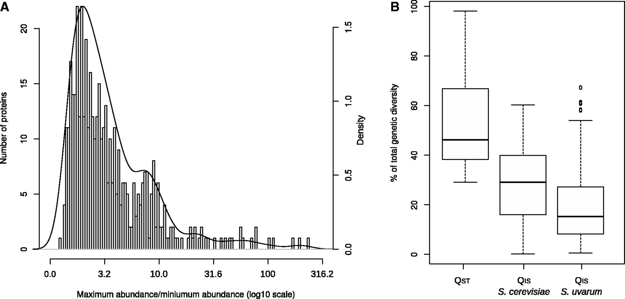
Fig. 1. Variations of protein abundances. (A) Distribution of maximum protein variations for 445 proteins quantified ...
Notes:
Fig. 1. Variations of protein abundances. (A) Distribution of maximum protein variations for 445 proteins quantified in at least four strains among nine Saccharomyces cerevisiae strains and six S. uvarum strains. Black line represents the density. (B) Box plot presenting the proportion of total genetic diversity explained by interspecies genetic diversity (QST) and intraspecies genetic diversity (QIS) calculated for 401 proteins quantified in all the 15 strains (44 proteins were not considered because of missing data).
Unless provided in the caption above, the following copyright applies to the content of this slide: © The Author 2013. Published by Oxford University Press on behalf of the Society for Molecular Biology and Evolution. All rights reserved. For permissions, please e-mail: journals.permissions@oup.com

Slide 2
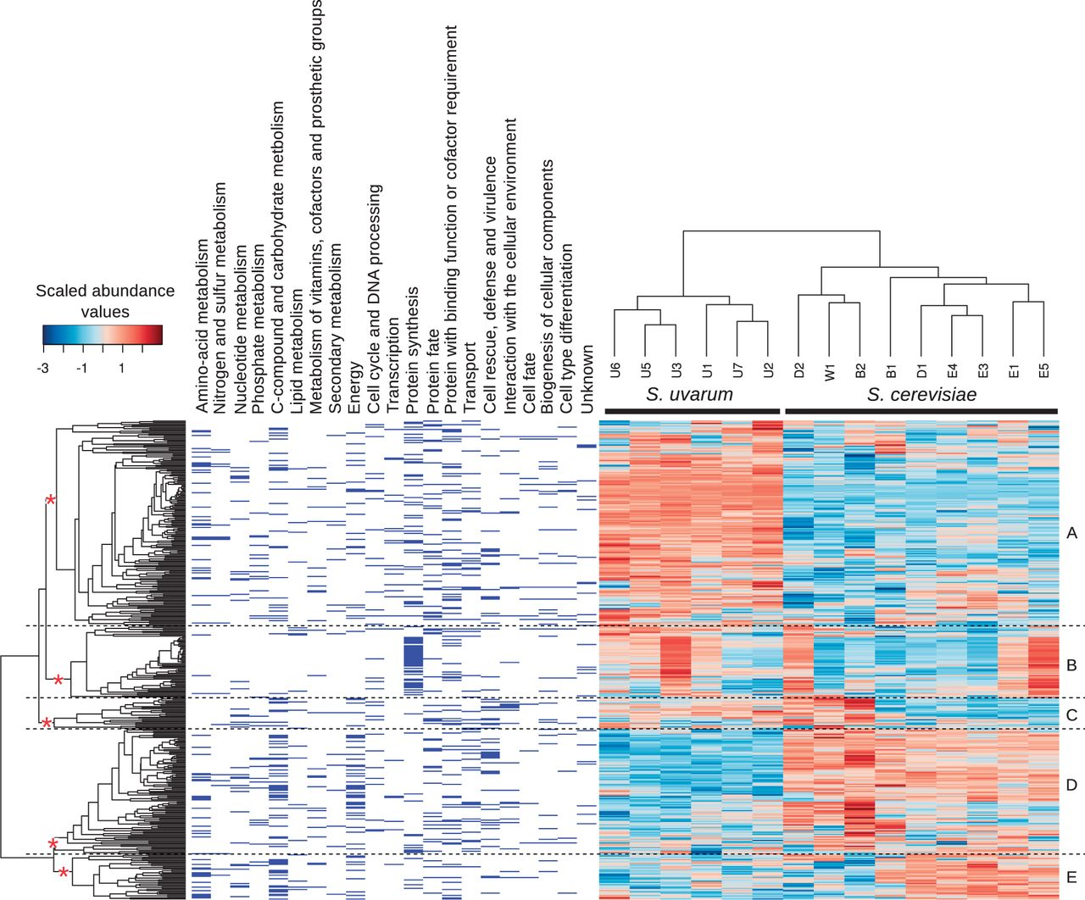
Fig. 2. Heatmap representation of the protein abundances. Each line corresponds to a protein and each column to a ...
Notes:
Fig. 2. Heatmap representation of the protein abundances. Each line corresponds to a protein and each column to a strain. Abundance values are indicated by the color key bar at the top left: low abundances are in blue and high abundances in red. Of 445 proteins, 401 proteins quantified in all the six S. uvarum strains and nine S. cerevisiae strains are represented (44 proteins were not included because of missing data). Membership of a protein to a functional category is shown on the left. Letters of the right indicate clusters of proteins exhibiting similar abundance patterns. These clusters were defined from the branches designated by a red star on the hierarchical clustering on the left. Note that cluster B contains mainly ribosomal proteins.
Unless provided in the caption above, the following copyright applies to the content of this slide: © The Author 2013. Published by Oxford University Press on behalf of the Society for Molecular Biology and Evolution. All rights reserved. For permissions, please e-mail: journals.permissions@oup.com

Slide 3
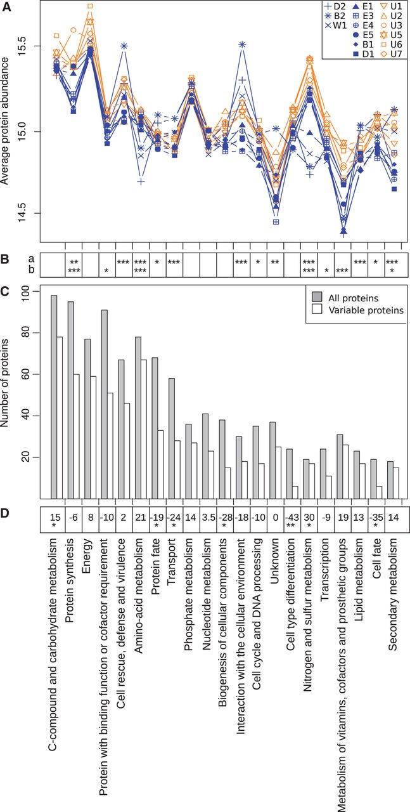
Fig. 3. Distribution of proteins by functional categories. (A) Average protein abundances in each functional category ...
Notes:
Fig. 3. Distribution of proteins by functional categories. (A) Average protein abundances in each functional category and each strain. (B) Significance of statistical tests comparing, for each functional category, average protein abundances between B2, D2, W1 and B1, D1, E1, E2, E3, and E5 (a) and between S. cerevisiae and S. uvarum (b). (C) Number of proteins in each functional category. One protein can belong to several functional categories. (D) Rate of enrichment (positive values) or depletion (negative values) for each functional categories of the set variable proteins compared with the whole set of quantified proteins. See Materials and Methods for the details of calculation. Asterisks indicate the significance of enrichment or depletion. *5 × 10−2 > P value ≥ 5 × 10−3; **5 × 10−3 > P value ≥ 5 × 10−4; ***5 × 10−4 > P value.
Unless provided in the caption above, the following copyright applies to the content of this slide: © The Author 2013. Published by Oxford University Press on behalf of the Society for Molecular Biology and Evolution. All rights reserved. For permissions, please e-mail: journals.permissions@oup.com

Slide 4
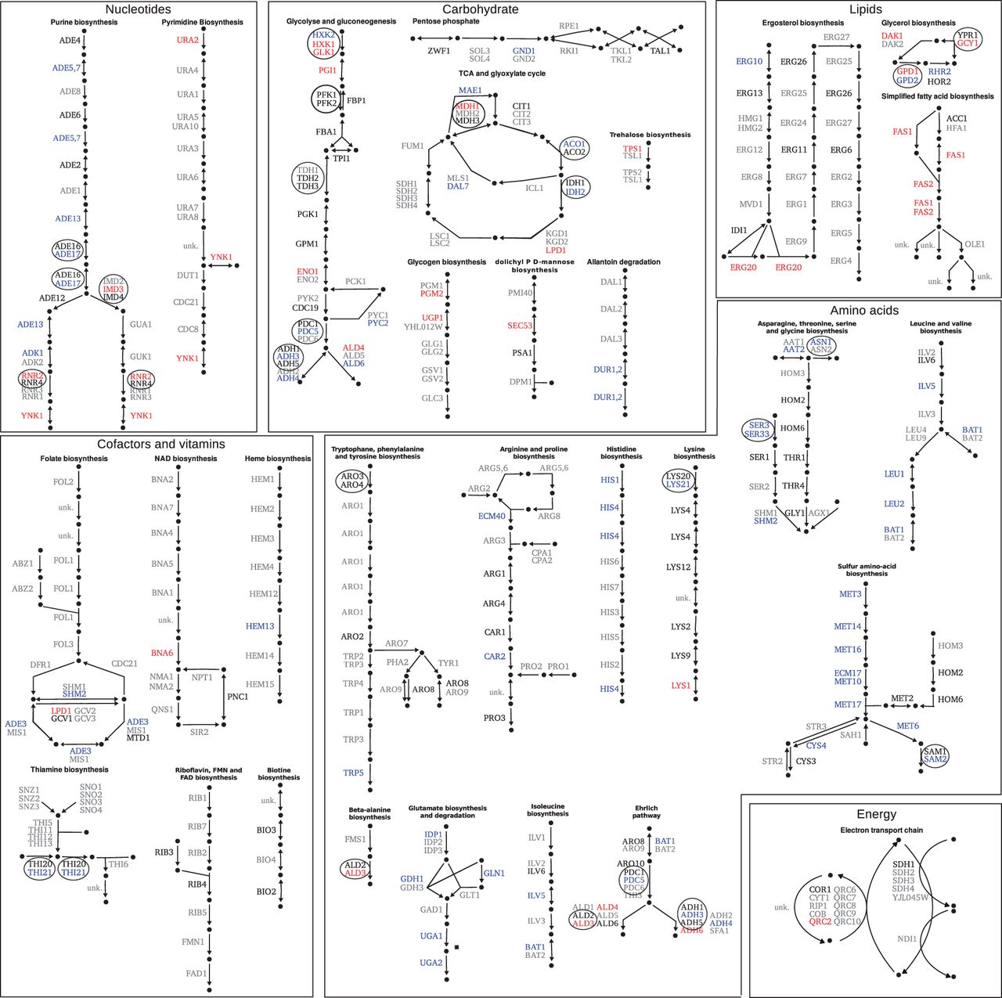
Fig. 4. Metabolic map of the proteins exhibiting significant abundance changes between two groups of Saccharomyces ...
Notes:
Fig. 4. Metabolic map of the proteins exhibiting significant abundance changes between two groups of Saccharomyces cerevisiae strains. Proteins that are significantly more and less abundant in the strains B2, D2, and W1 compared with E1, E2, E3, E5, B1, and D1 are represented in red and blue, respectively. The proteins exhibiting no significant abundance changes are shown in black; the proteins not quantified are shown in gray. Black circles indicate proteins encoded by duplicated genes.
Unless provided in the caption above, the following copyright applies to the content of this slide: © The Author 2013. Published by Oxford University Press on behalf of the Society for Molecular Biology and Evolution. All rights reserved. For permissions, please e-mail: journals.permissions@oup.com

Slide 5
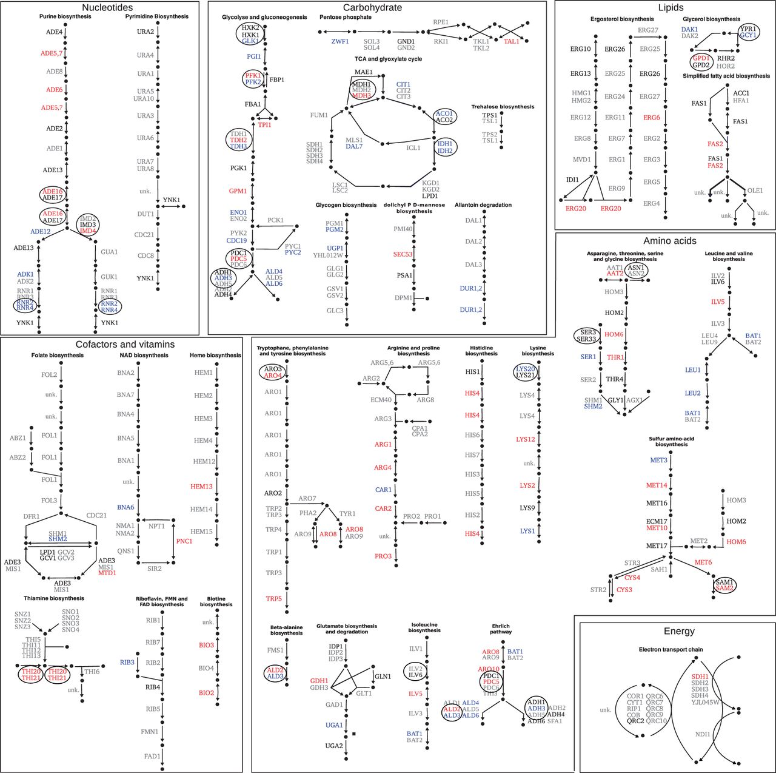
Fig. 5. Metabolic map of the proteins exhibiting significant abundance changes between Saccharomyces cerevisiae and ...
Notes:
Fig. 5. Metabolic map of the proteins exhibiting significant abundance changes between Saccharomyces cerevisiae and S. uvarum strains. Proteins that are significantly more and less abundant in six S. uvarum strains compared with nine S. cerevisiae strains are represented in red and blue, respectively. The proteins exhibiting no significant abundance changes are shown in black; the proteins not quantified are shown in gray. Black circles indicate proteins encoded by duplicated genes.
Unless provided in the caption above, the following copyright applies to the content of this slide: © The Author 2013. Published by Oxford University Press on behalf of the Society for Molecular Biology and Evolution. All rights reserved. For permissions, please e-mail: journals.permissions@oup.com

Slide 6
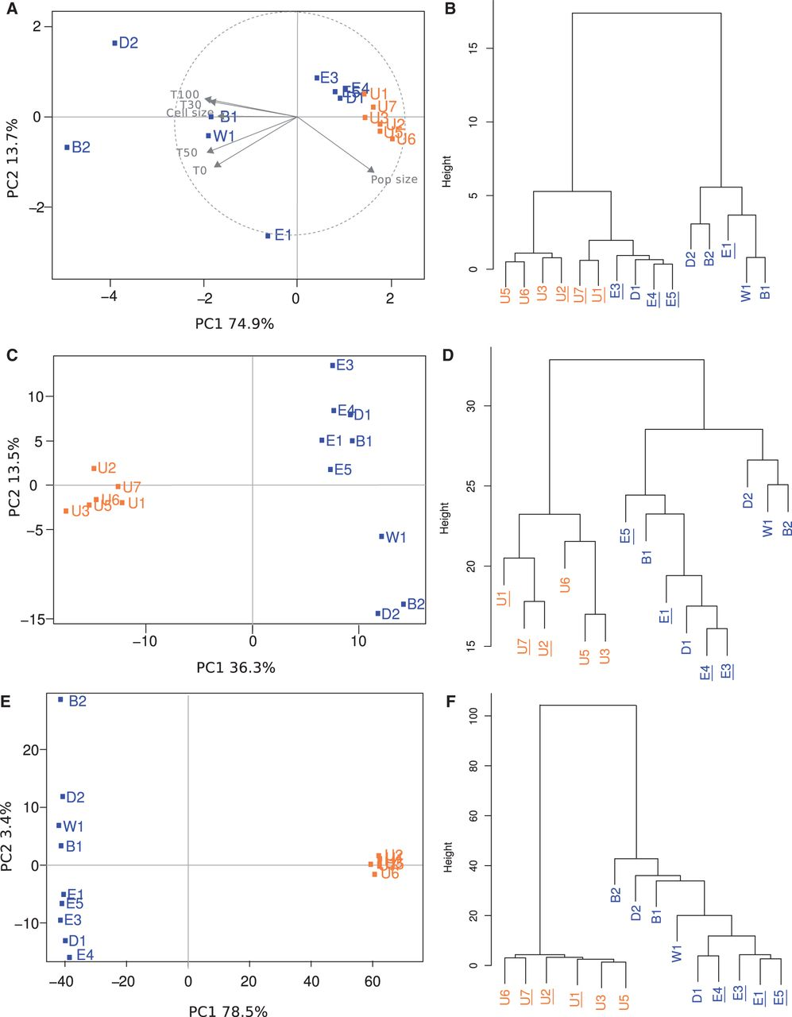
Fig. 6. Integrative analysis of the strain differentiation. Differentiation of six strains of Saccharomyces uvarum ...
Notes:
Fig. 6. Integrative analysis of the strain differentiation. Differentiation of six strains of Saccharomyces uvarum (green) and nine strains of S. cerevisiae (red) was based on the phenotypic variability assessed from lag phase time (T0), times to complete 30%, 50%, and 100% of fermentation (T30, T50, and T100, respectively), cell size, and population size (pop size) at 30% of CO2 release (A and B), on the proteome variability assessed from abundances of 401 proteins (C and D) and on sequence variability inferred from 498 SNPs and 2,681 SAPs (E and F). A, C, and E are principal component analyses and B, D, and F are phylogenetic trees obtained by hierarchical clustering.
Unless provided in the caption above, the following copyright applies to the content of this slide: © The Author 2013. Published by Oxford University Press on behalf of the Society for Molecular Biology and Evolution. All rights reserved. For permissions, please e-mail: journals.permissions@oup.com

