Slide 1
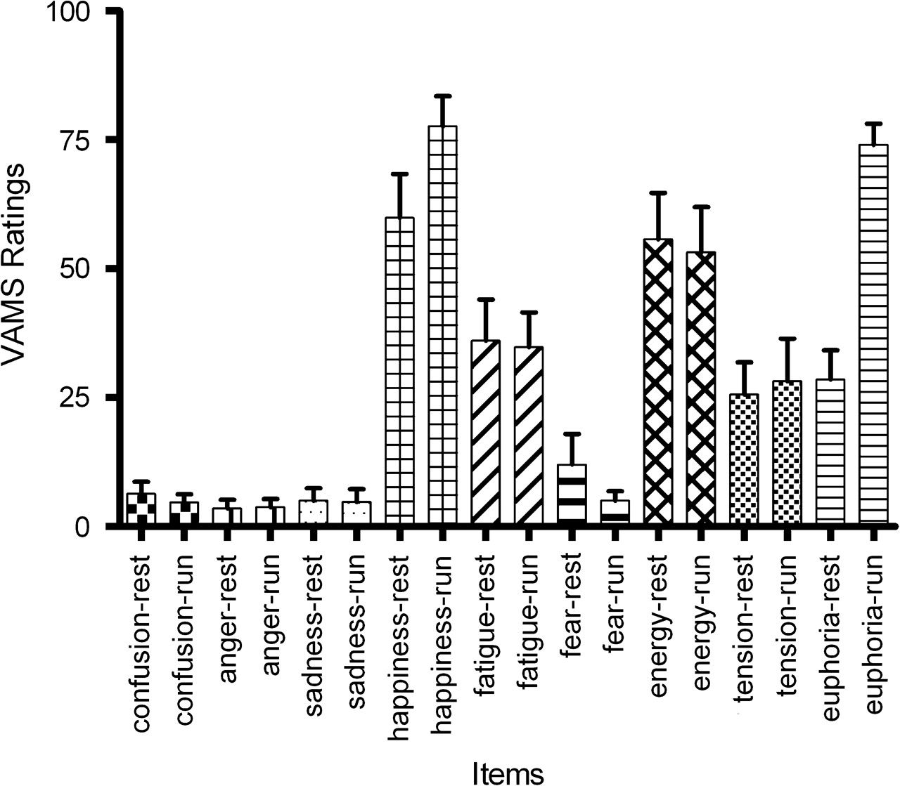
Figure 1. Box plot of euphoria VAS scores. Mean and standard error of VAMS ratings (0–100) during 2 conditions (left ...
Notes:
Figure 1. Box plot of euphoria VAS scores. Mean and standard error of VAMS ratings (0–100) during 2 conditions (left column of each item represents rest, right column postexercise). Differences between the conditions were significant for the items euphoria and happiness (Student's paired t-test, P < 0.05, corrected for multiple comparisons).
Unless provided in the caption above, the following copyright applies to the content of this slide: © The Author 2008. Published by Oxford University Press. All rights reserved. For permissions, please e-mail: journals.permissions@oxfordjournals.org

Slide 2
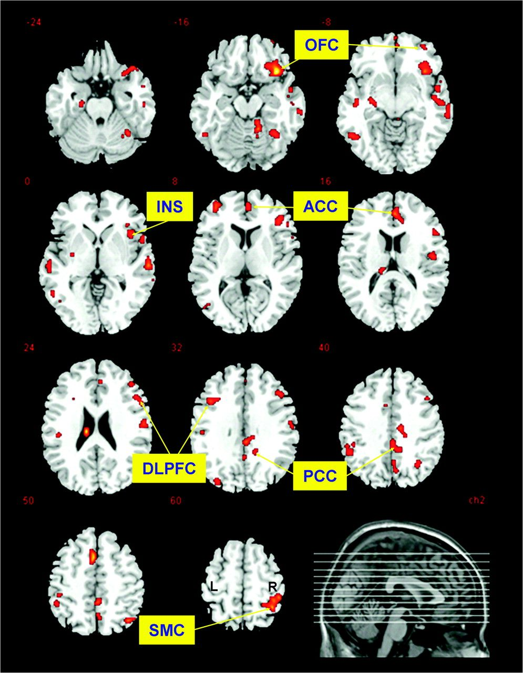
Figure 2. Reductions in opioidergic receptor availability after endurance running in comparison with the rest ...
Notes:
Figure 2. Reductions in opioidergic receptor availability after endurance running in comparison with the rest condition. Statistical parametric maps of the categorical comparison (regions where [18F]FDPN binding is reduced after physical exercise) in standard stereotactic space (Montreal Neurological Institute [MNI] space) are overlaid in color on axial slices of a skull-stripped normalized brain (MNI single subject brain as provided by MRIcro program). Z values indicate the location of the slice planes relative to the AC–PC line. For display purposes, the statistical analysis is thresholded at an uncorrected height threshold of P < 0.001. L, left side of figure; R, right side of figure. The signal in the left ventricle is supposed to represent an artifact because this region is devoid of opioid receptors.
Unless provided in the caption above, the following copyright applies to the content of this slide: © The Author 2008. Published by Oxford University Press. All rights reserved. For permissions, please e-mail: journals.permissions@oxfordjournals.org

Slide 3
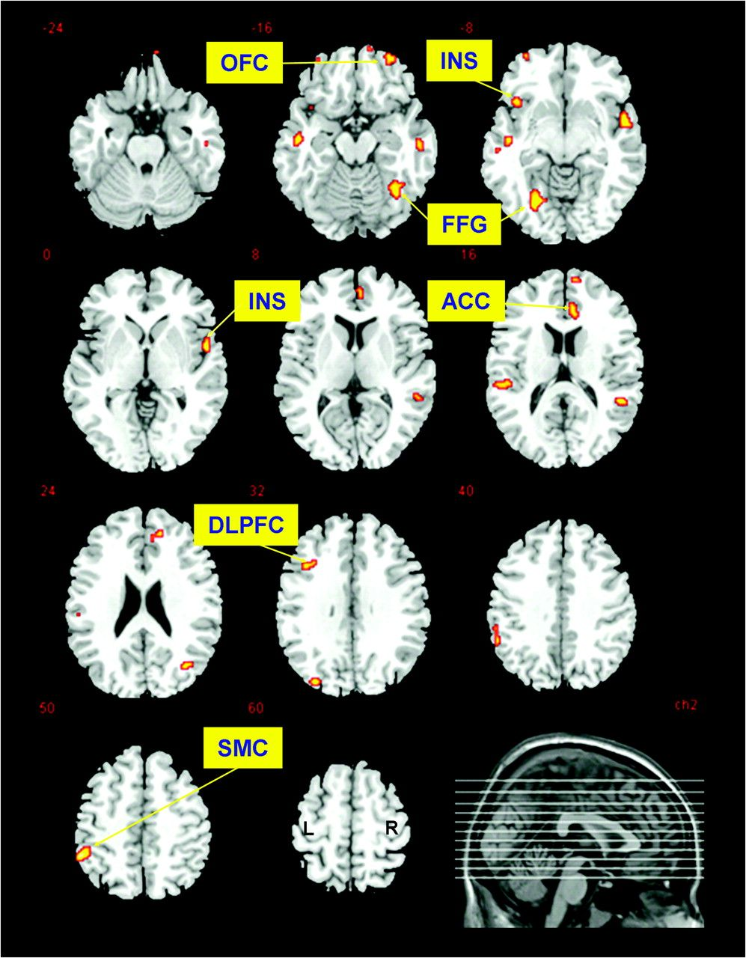
Figure 3. Correlation of opioidergic binding in runners with VAS ratings of euphoria. Statistical parametric maps of ...
Notes:
Figure 3. Correlation of opioidergic binding in runners with VAS ratings of euphoria. Statistical parametric maps of the regression analysis (regions where VAS ratings of euphoria are inversely correlated with [18F]FDPN binding) in standard stereotactic space (Montreal Neurological Institute [MNI] space) are overlaid in color on axial slices of a skull-stripped normalized brain (MNI single subject brain as provided by MRIcro program). Z values indicate the location of the slice planes relative to the AC–PC line. For display purposes, the statistical analysis is thresholded at an uncorrected height threshold of P < 0.001. All regions are also significant after small volume correction (10 voxel sphere). L, left side of figure; R, right side of figure.
Unless provided in the caption above, the following copyright applies to the content of this slide: © The Author 2008. Published by Oxford University Press. All rights reserved. For permissions, please e-mail: journals.permissions@oxfordjournals.org

Slide 4
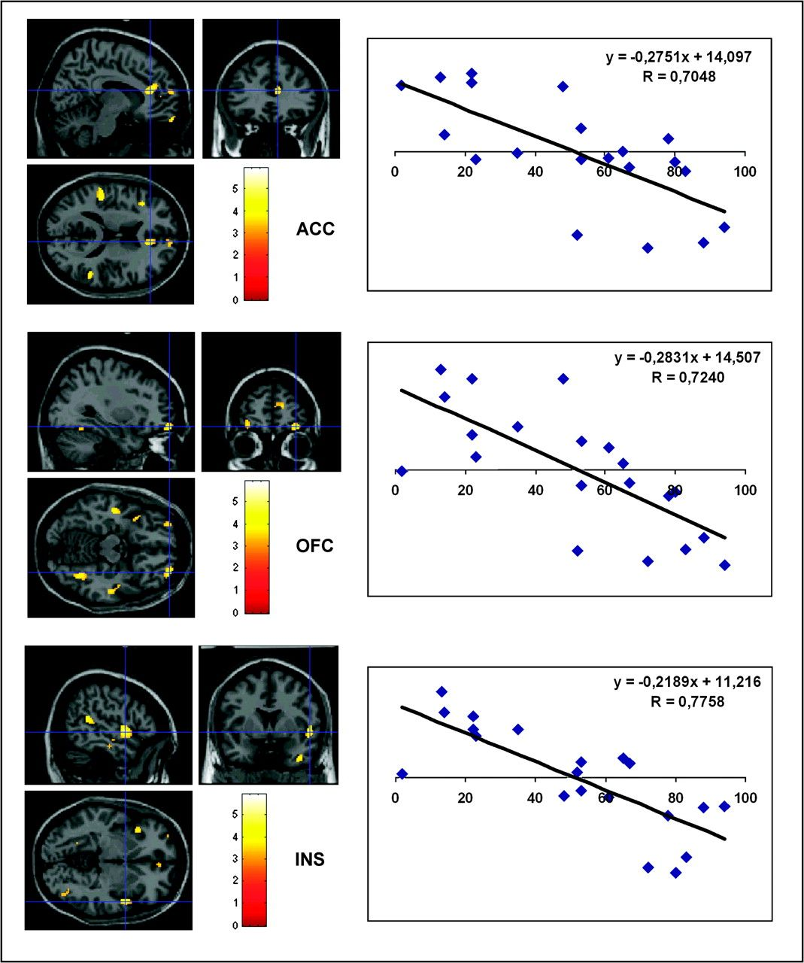
Figure 4. Correlation of opioidergic binding in runners with VAS ratings of euphoria. Scatter plots of opioid receptor ...
Notes:
Figure 4. Correlation of opioidergic binding in runners with VAS ratings of euphoria. Scatter plots of opioid receptor binding (DV) with individual VAS euphoria ratings (VAS post run) are shown from 3 regions (top row: right anterior cingulate cortex, ACC; middle row: right orbitofrontal cortex, OFC; bottom row: right insula, INS). The [18F]FDPN binding in the respective areas is plotted in relation to perceived euphoria (abscissa: VAS rating from 0–100, ordinate: SPM-scaled DV values). The SPMs are overlaid in color on axial, coronal, and transversal sections of a stereotactically normalized brain (Montreal Neurological Institute single subject brain as provided by SPM2). For display purposes, the statistical analysis is thresholded at an uncorrected height threshold of P < 0.001.
Unless provided in the caption above, the following copyright applies to the content of this slide: © The Author 2008. Published by Oxford University Press. All rights reserved. For permissions, please e-mail: journals.permissions@oxfordjournals.org

