Slide 1
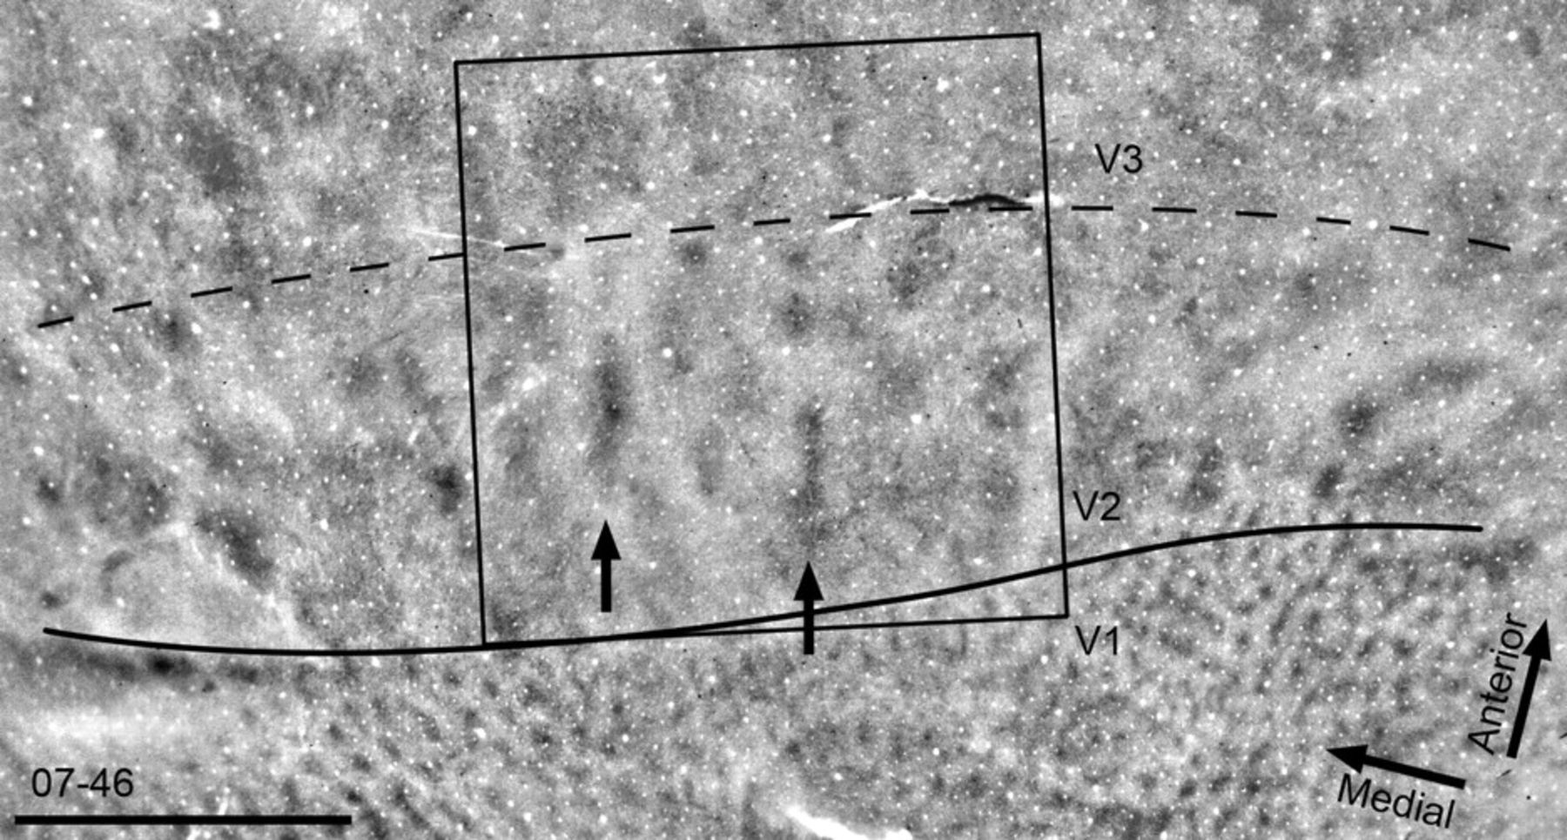
Figure 1. Irregular CO stripes in V2. A flattened section of the visual cortex from owl monkey 07-46, stained for CO ...
Notes:
Figure 1. Irregular CO stripes in V2. A flattened section of the visual cortex from owl monkey 07-46, stained for CO revealed the borders between V1 and V2 (solid line) and between V2 and V3 (dashed line). In V1, a pattern of CO blobs was evident. In V2, larger irregular CO-dark bands or stripes running roughly perpendicular to the V1/V2 border were present. Two thinner CO-dense regions are indicated with arrows. The large box represents the 8 × 8 mm field of view centered over V2 shown in Figures 2 and 4. Scale bar: 5 mm.
Unless provided in the caption above, the following copyright applies to the content of this slide: © The Author 2008. Published by Oxford University Press. All rights reserved. For permissions, please e-mail: journals.permissions@oxfordjournals.org

Slide 2
Figure 2. Alignment method. The panels in this figure demonstrate the procedures used to align flattened sections of ...
Notes:
Figure 2. Alignment method. The panels in this figure demonstrate the procedures used to align flattened sections of the visual cortex to the optical imaging camera frame. Each panel corresponds to the boxed region shown in Figure 1. In A, an image of the surface vasculature taken with the imaging camera in vivo is shown. Panel B is the most superficial CO-stained section. Blood vessels from panel A have been outlined and are shown overlaid on panel B. Panel C is a photograph of a CO-stained section approximately 500 μm deep. Radial blood vessels used for alignment are indicated with arrows in B and C. Panel D is a horizontal–vertical orientation preference map; the blood vessel pattern traced from panel A is included. Blood vessel patterns in A, B, and C were used to align the CO-processed sections with the imaging frames. Scale bar: 5 mm.
Unless provided in the caption above, the following copyright applies to the content of this slide: © The Author 2008. Published by Oxford University Press. All rights reserved. For permissions, please e-mail: journals.permissions@oxfordjournals.org

Slide 3
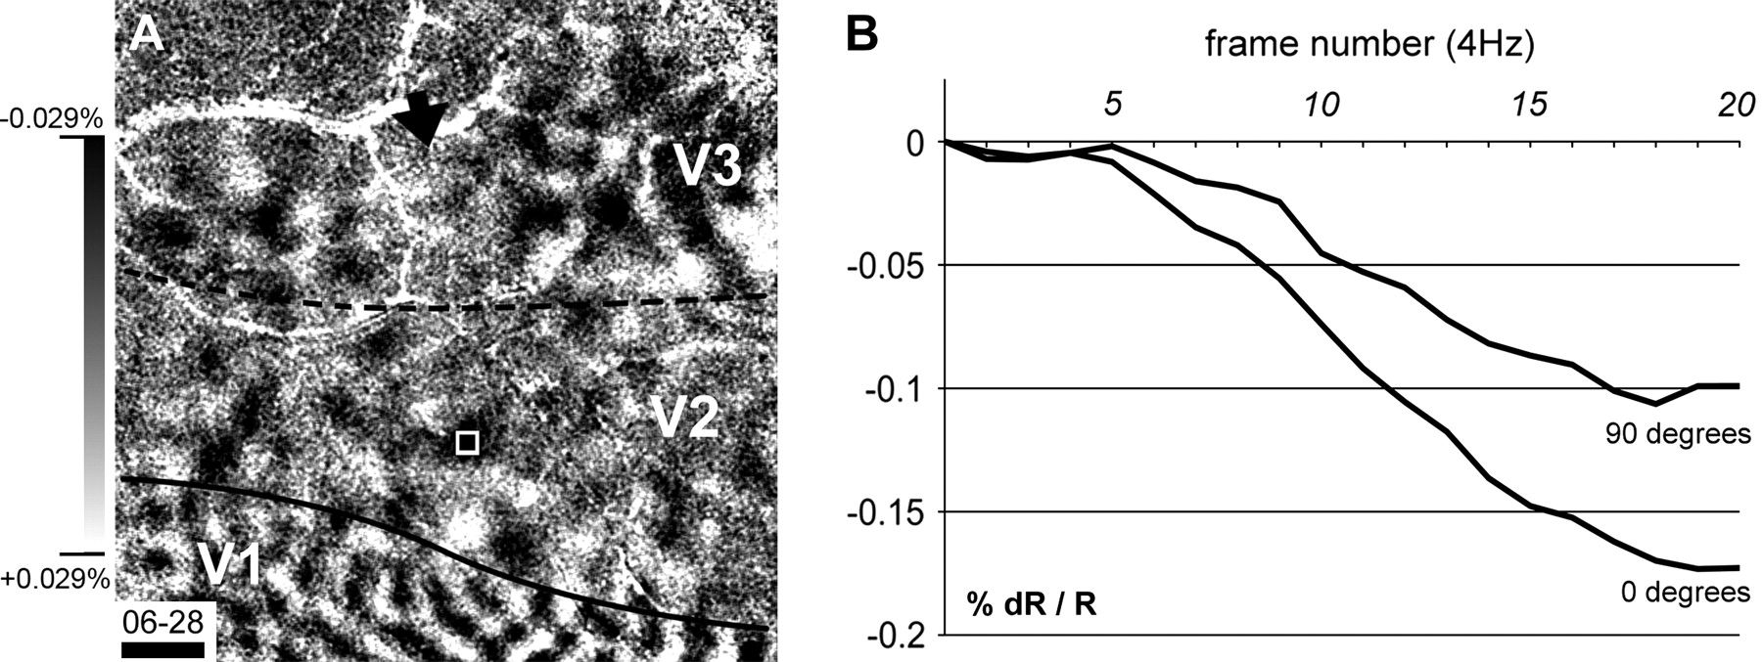
Figure 3. Orientation preference map and timecourse. In panel A, an acute-oblique orientation preference map is shown ...
Notes:
Figure 3. Orientation preference map and timecourse. In panel A, an acute-oblique orientation preference map is shown for owl monkey 06-28. The camera frame is 8 × 8 mm. The approximate borders between V1 and V2 (solid line) and between V2 and V3 (dotted line) are indicated. The white box indicates a superpixel placed within a horizontal (0 deg) orientation domain within V2. The black arrow indicates a portion of V3 that lacked orientation preference domains. Percent signal change for the map shown in panel A is shown to the left of A. The signal strength (% change in reflectance) from the superpixel indicated in A for 0 and 90 deg orientations is shown in panel B during a 5-s period of stimulation (4 Hz frame rate) with drifting gratings. Numbers at the top of the timecourse data in B indicate frame number. Scale bar: 1 mm.
Unless provided in the caption above, the following copyright applies to the content of this slide: © The Author 2008. Published by Oxford University Press. All rights reserved. For permissions, please e-mail: journals.permissions@oxfordjournals.org

Slide 4
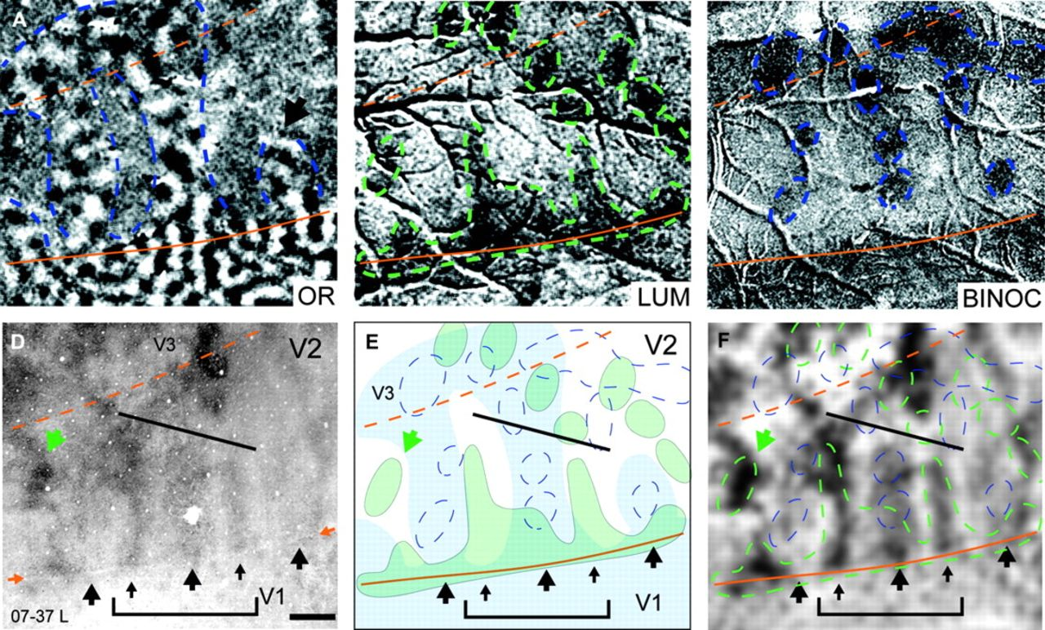
Figure 4. Orientation, luminance-change, and binocular domains in V2 and V3, and their relationship to CO-dense stripes ...
Notes:
Figure 4. Orientation, luminance-change, and binocular domains in V2 and V3, and their relationship to CO-dense stripes in case 07-37L. An acute-oblique orientation preference map is shown in A. The borders between areas V1 and V2 (solid lines) and between V2 and V3 (dashed lines) are shown in orange. Stripes of well-organized orientation preference (OR stripes) are indicated with blue-dashed lines in V2. Two OR stripes ran across the extent of V2 and joined with a region of V3 containing OR domains. The OR stripe on the right stopped short of the V2/V3 border (black arrow). In B, a map of luminance change is shown (see Materials and Methods), and luminance-change domains in V2 and V3 are indicated with green-dashed lines. Panel C shows a binocular–monocular imaging map; binocular domains in V2 and V3 are highlighted with blue-dashed lines. In a section stained for CO, D, alternating CO-thick (large arrows) and CO-thin stripes (small arrows) are apparent. The hole in the center thick stripe is the site of an injection of anatomical tracer. The V1/V2 border is indicated with 2 small orange arrows. In E, a diagram showing the relative locations of OR stripes (blue shading), luminance-change domains (green shading), and binocular domains (blue dashed lines) is shown. Binocular domains coregistered with OR stripes in V2 and V3. In V2, luminance-change domains (light green shading) occupied regions of V2 adjacent to OR stripes and binocular domains (blue shading and blue-dashed lines, respectively). In V3, luminance-change domains and binocular domains were found within regions containing orientation preference domains, but luminance-change domains and binocular domains were found to occupy adjacent regions of V3. In F, luminance-change domains and binocular domains are shown in relation to a “filtered” (see Materials and Methods) CO-processed section of visual cortex. CO-thick stripes (wide arrows, panels E, D, and F) coregistered with orientation preference domains and binocular domains, and CO-thin stripes (narrow arrows) coregistered with luminance-change domains. This relationship was most obvious within the bracketed region (panels E, D, and F); note the correspondence between the optically imaged domains and the CO architecture, indicated between the brackets and the black line in panels E, D, and F. The green arrow in panels D, E, and F indicates the location of luminance-change domain and a corresponding CO-dense spot in V2. Scale bar: 1 mm.
Unless provided in the caption above, the following copyright applies to the content of this slide: © The Author 2008. Published by Oxford University Press. All rights reserved. For permissions, please e-mail: journals.permissions@oxfordjournals.org

Slide 5
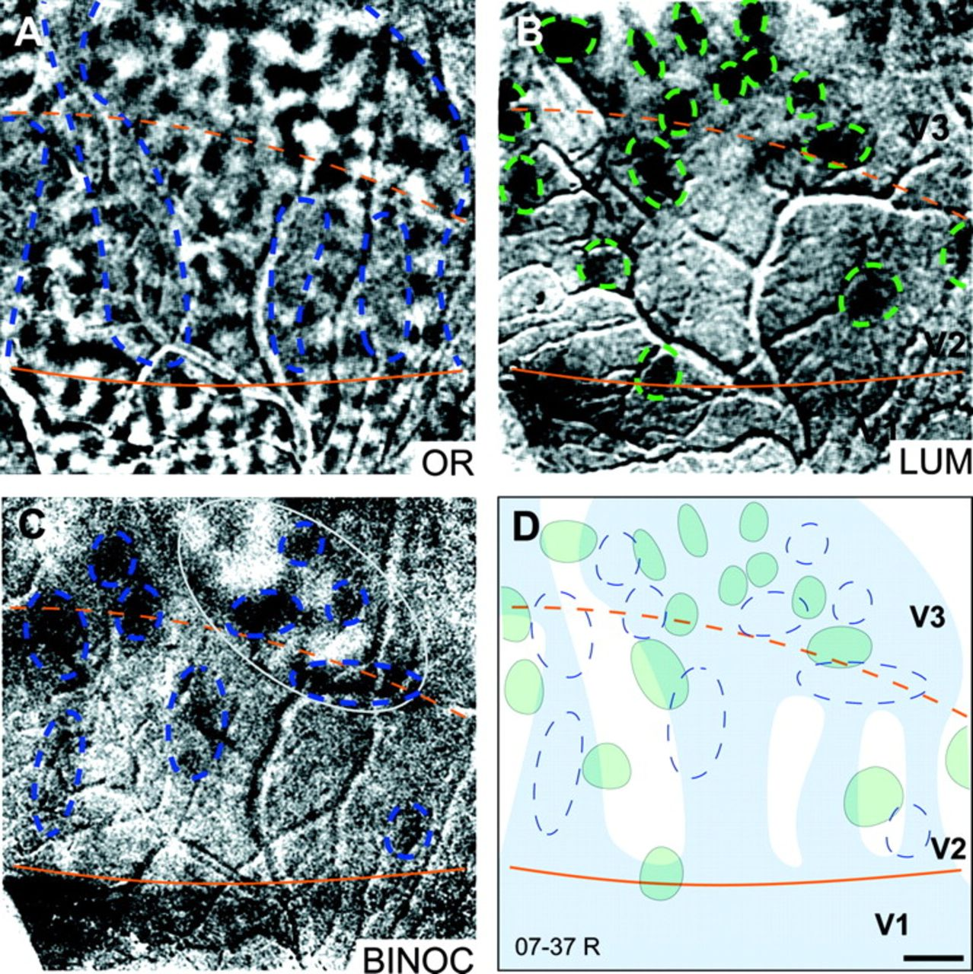
Figure 5. Orientation and luminance-change domains in V2 and V3 in case 07-37R. An acute-oblique orientation preference ...
Notes:
Figure 5. Orientation and luminance-change domains in V2 and V3 in case 07-37R. An acute-oblique orientation preference map is shown in A. The borders between areas V1 and V2 (solid lines) and between V2 and V3 (dashed lines) are shown in orange. In V2, regions of well-organized orientation preference (OR stripes) are indicated with blue-dashed lines. OR stripes in V2 were coextensive with regions of V3 (also indicated with blue-dashed lines) containing orientation preference domains. In B, a map of luminance change is shown, where luminance-change domains are circled with green-dashed lines in V2 and V3. In C, a binocular–monocular map demonstrated the presence of binocular preferring domains, circled in blue in V2 and V3. The light gray oval indicates a “zebra stripe-like” region in V3 that includes alternating binocularly biased domains. In diagrammatic form in D, orientation-preference domains are indicated with blue shading, binocular preferring domains are circled in blue, and luminance-change domains are indicated in green. In V2, binocular domains were found within regions containing orientation preference domains that were adjacent to luminance-change domains. In V3, luminance-change domains occupied regions of cortex adjacent to binocular domains. Each panel is 8 × 8 mm. Scale bar: 1 mm.
Unless provided in the caption above, the following copyright applies to the content of this slide: © The Author 2008. Published by Oxford University Press. All rights reserved. For permissions, please e-mail: journals.permissions@oxfordjournals.org

Slide 6
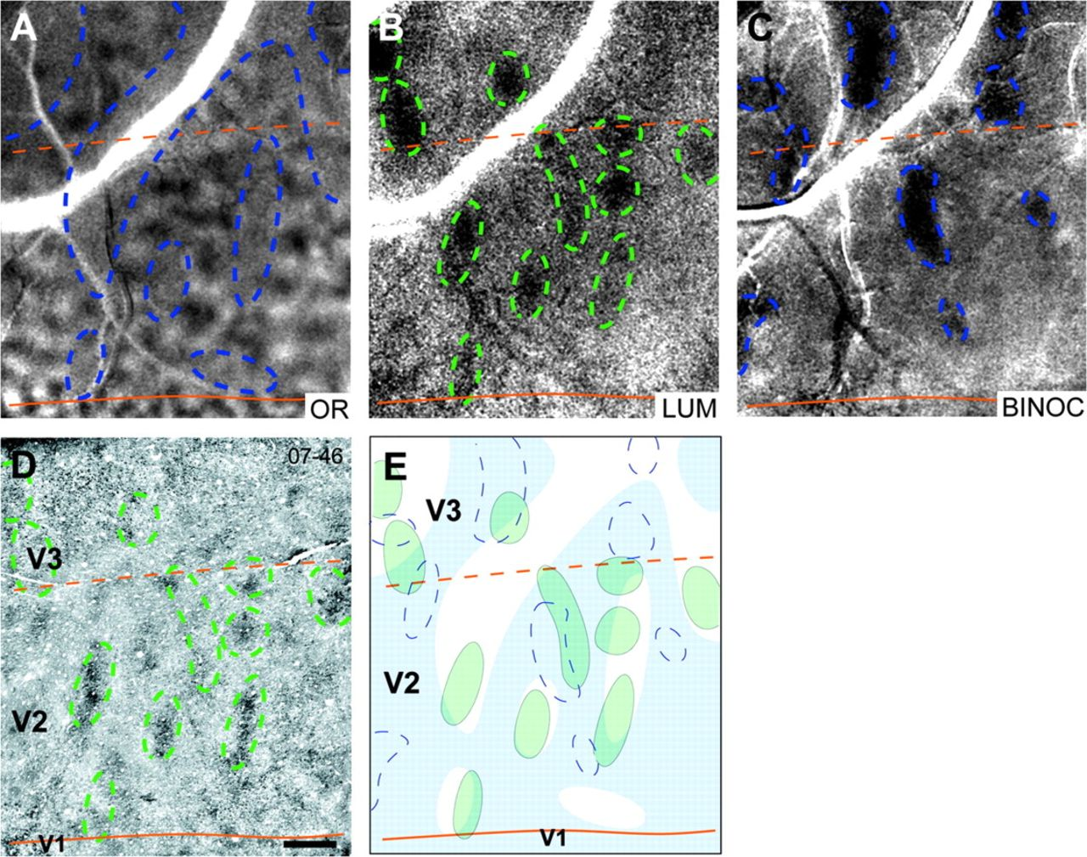
Figure 6. Orientation, luminance-change, and binocular domains in V2 and V3 and their relationship to CO-dense stripes ...
Notes:
Figure 6. Orientation, luminance-change, and binocular domains in V2 and V3 and their relationship to CO-dense stripes in case 07-46. In A, an acute-oblique orientation preference map is shown; the borders between areas V1, V2, and V3 are indicated in orange. Orientation domains in V2 clustered to form stripes (blue-dashed lines) that were continuous with orientation domains in V3. In V2, gaps or spaces in the map of orientation preference were evident (circled, blue-dashed lines). The blue-dashed lines distinguish regions with orientation-selective domains from those without. In B, a map of luminance change is shown; luminance-change domains, present in V2 and V3, are indicated with green-dashed lines. In C, binocular domains were apparent within V2 and V3 (blue-dashed lines). In D, a section stained for CO revealed CO-dark regions that appeared as spots or ovals in V2; the borders of luminance-change domains (marked with green-dashed lines) are shown in relation to the CO section. Several luminance-change domains indicated with green-dashed lines in B corresponded to CO-dense regions in V2. In E, a diagram showing the relative locations of OR stripes (blue shading), binocular domains (blue-dashed lines), and luminance-change domains (green-dashed lines) in V2 and V3 is shown. Scale bar: 1 mm.
Unless provided in the caption above, the following copyright applies to the content of this slide: © The Author 2008. Published by Oxford University Press. All rights reserved. For permissions, please e-mail: journals.permissions@oxfordjournals.org

Slide 7
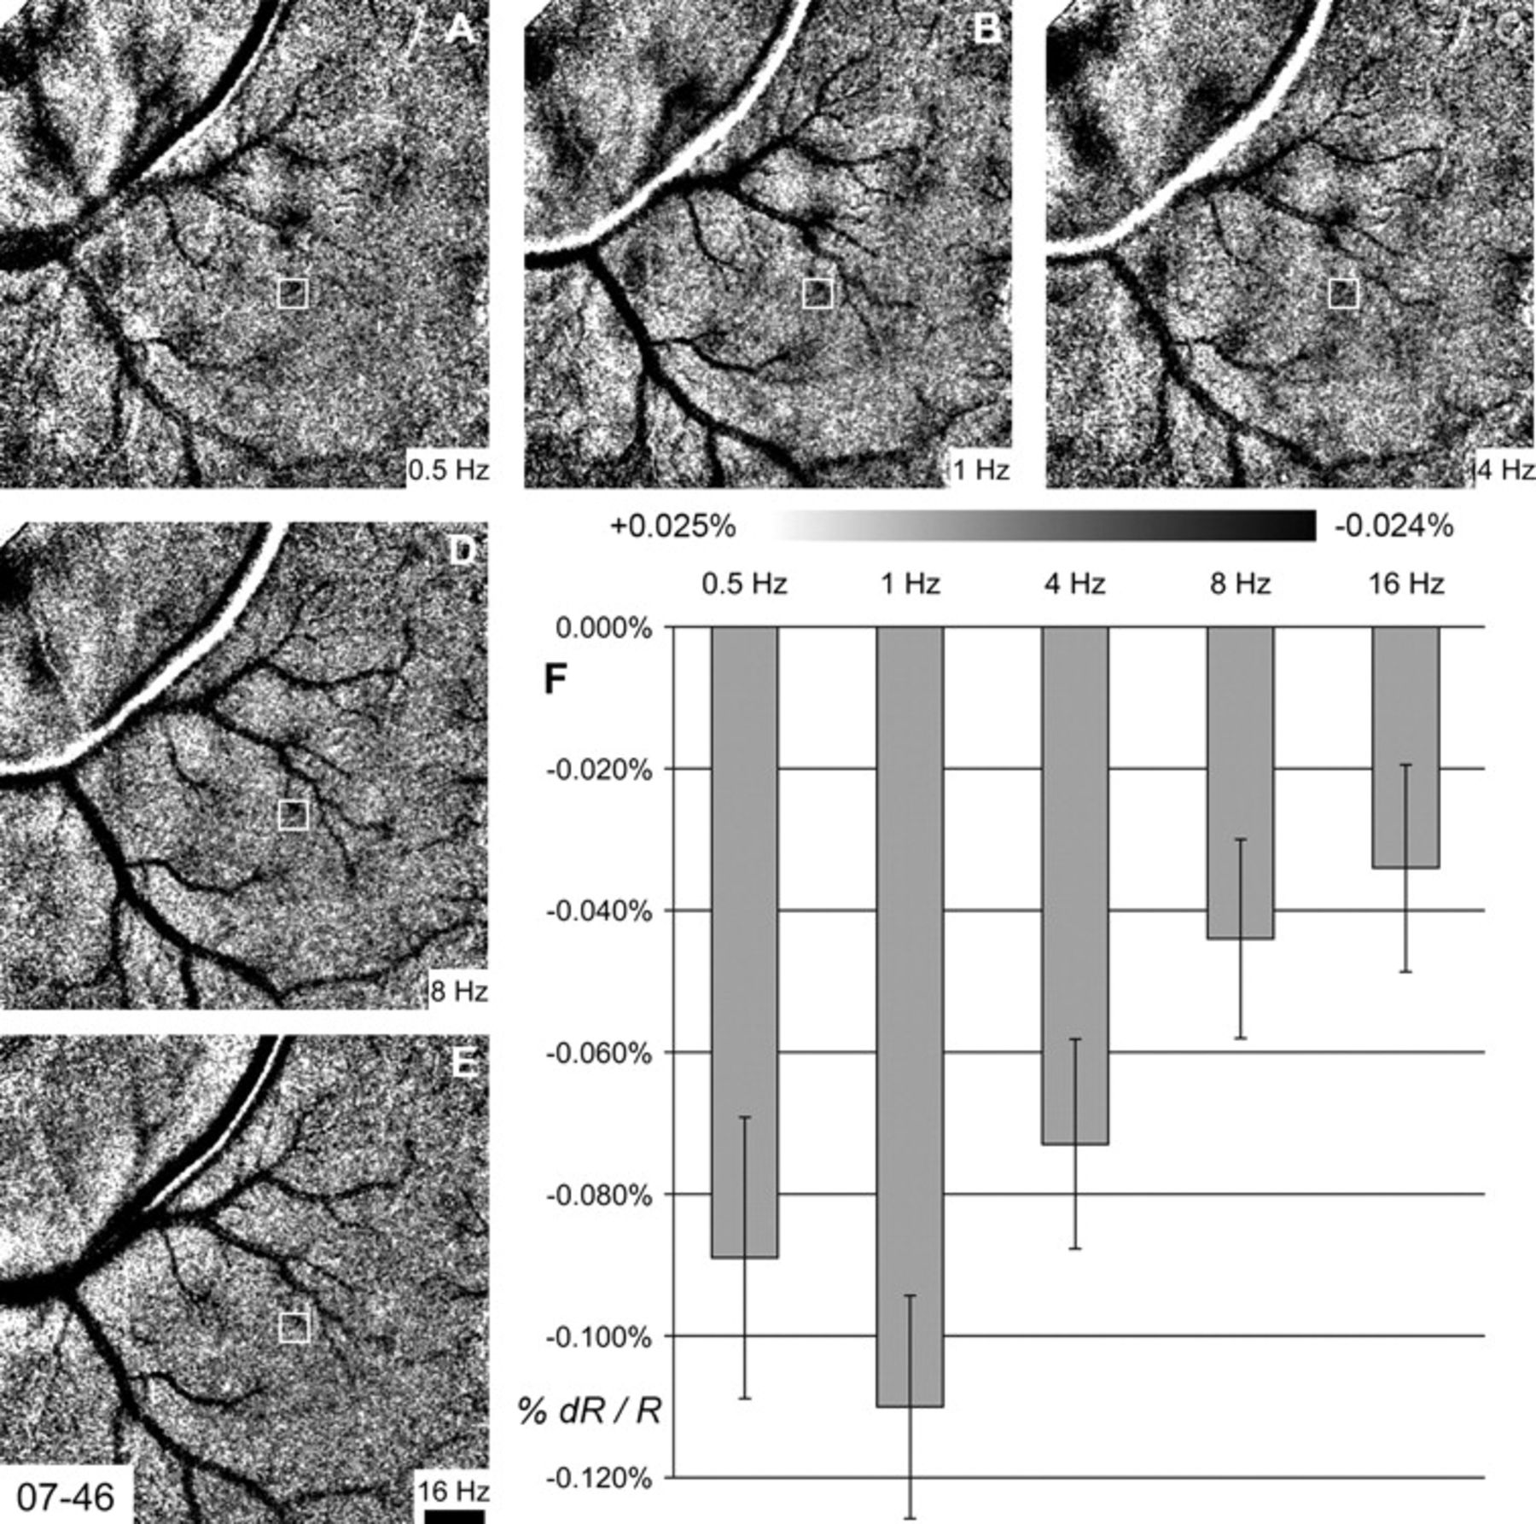
Figure 7. Signal strength related to luminance modulation. Five luminance-change maps taken from the boxed region shown ...
Notes:
Figure 7. Signal strength related to luminance modulation. Five luminance-change maps taken from the boxed region shown in Figure 1 are displayed. Each panel is a map of sinusoidally varying frequencies minus equiluminant blank control. Frequencies are A, 0.5 Hz; B, 1 Hz; C, 4 Hz; D, 8 Hz, and E, 16 Hz. Percent signal change for the 5 maps is shown below panels B and C. A superpixel placed within a luminance-change domain within V2 is indicated with a small box in each of the maps. In F, the signal strength (% change in reflectance) from this superpixel for each of the 5 temporal frequencies is shown following 5 s of stimulation. The camera frame shown in A–E is 8 × 8 mm. Scale bar: 1 mm.
Unless provided in the caption above, the following copyright applies to the content of this slide: © The Author 2008. Published by Oxford University Press. All rights reserved. For permissions, please e-mail: journals.permissions@oxfordjournals.org

