Slide 1
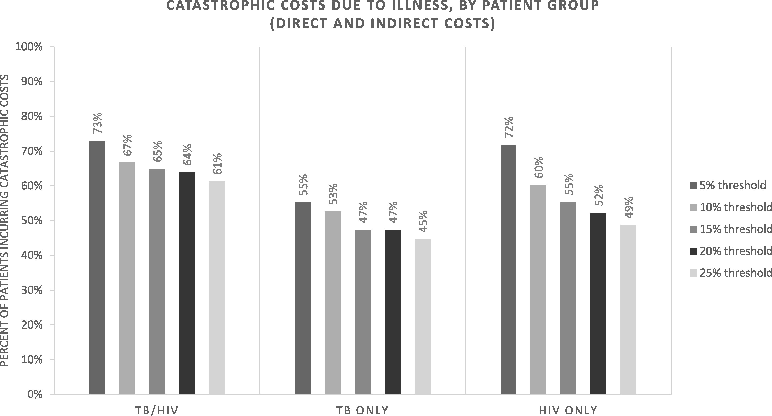
Figure 1. Catastrophic costs due to illness, by participant group
Notes:
Figure 1. Catastrophic costs due to illness, by participant group
Unless provided in the caption above, the following copyright applies to the content of this slide: © The Author 2017. Published by Oxford University Press in association with The London School of Hygiene and Tropical Medicine.This is an Open Access article distributed under the terms of the Creative Commons Attribution License (http://creativecommons.org/licenses/by/4.0/), which permits unrestricted reuse, distribution, and reproduction in any medium, provided the original work is properly cited.

