Slide 1
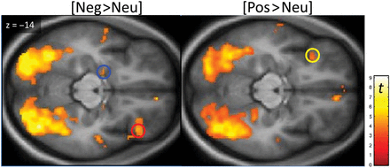
Figure 1. Brain regions showing significant [Neg>Neu] and [Pos>Neu] BOLD activation to IAPS images, with a priori ...
Notes:
Figure 1. Brain regions showing significant [Neg>Neu] and [Pos>Neu] BOLD activation to IAPS images, with a priori regions of interest denoted by circles (blue: left amygdala, yellow and red: left and right OFC, respectively). Display height P = 0.001, k = 5. For more details see Table 1. No activation was found for [Neu>Neg] and [Neu>Pos] contrasts. Color bar scale represents the t-statistic.
Unless provided in the caption above, the following copyright applies to the content of this slide: © The Author 2014. Published by Oxford University Press. All rights reserved. For Permissions, please e-mail: journals.permissions@oup.com

Slide 2
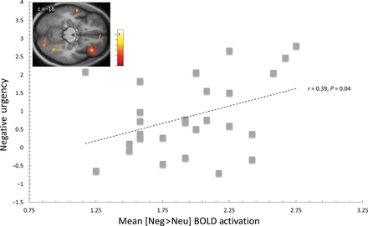
Figure 2. Positive correlation between negative urgency and [Neg>Neu] BOLD activation in 8-mm-radius spherical region ...
Notes:
Figure 2. Positive correlation between negative urgency and [Neg>Neu] BOLD activation in 8-mm-radius spherical region centered ([40, 32, −12]) in the right lateral OFC. For reference, voxel-wise map of the correlation between [Neg>Neu] BOLD contrast and negative urgency is illustrated by inset (display threshold P = 0.01, k = 30, masked for [Neg>Neu] BOLD activation).
Unless provided in the caption above, the following copyright applies to the content of this slide: © The Author 2014. Published by Oxford University Press. All rights reserved. For Permissions, please e-mail: journals.permissions@oup.com

Slide 3
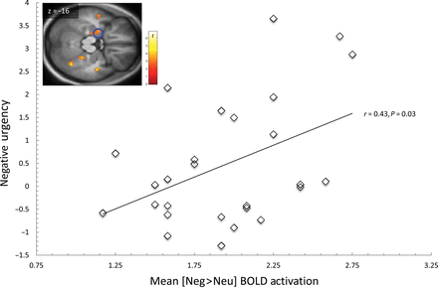
Figure 3. Positive correlation between negative urgency and [Neg>Neu] BOLD activation in 8-mm-radius spherical region ...
Notes:
Figure 3. Positive correlation between negative urgency and [Neg>Neu] BOLD activation in 8-mm-radius spherical region centered ([−20, −6, −18]) in the left amygdala. For reference, voxel-wise map of the correlation between [Neg>Neu] BOLD contrast and negative urgency is illustrated by inset (display threshold P = 0.01, k = 30, masked for [Neg>Neu] BOLD activation).
Unless provided in the caption above, the following copyright applies to the content of this slide: © The Author 2014. Published by Oxford University Press. All rights reserved. For Permissions, please e-mail: journals.permissions@oup.com

Slide 4
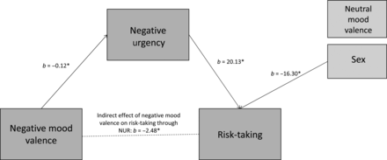
Figure 4. Mediation of negative mood valence and risk-taking through negative urgency. For clarity, only pathways with ...
Notes:
Figure 4. Mediation of negative mood valence and risk-taking through negative urgency. For clarity, only pathways with significant (*P < 0.05) regression weight (b) are depicted. Mediation was examined with the SPSS INDIRECT macro provided by Preacher and Hayes (2008) using the 95% confidence intervals. Risk-taking was assessed by total score on the Risky Behavior Scale.
Unless provided in the caption above, the following copyright applies to the content of this slide: © The Author 2014. Published by Oxford University Press. All rights reserved. For Permissions, please e-mail: journals.permissions@oup.com

Slide 5
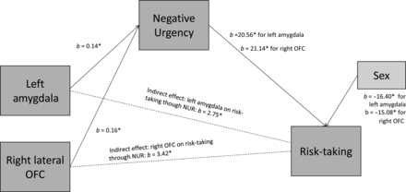
Figure 5. The relationship of BOLD response to [Neg>Neu] images and risk-taking as mediated by negative urgency. For ...
Notes:
Figure 5. The relationship of BOLD response to [Neg>Neu] images and risk-taking as mediated by negative urgency. For clarity, only pathways with significant (*P < 0.05) regression weights (b) are depicted. Two separate mediation models were examined with the SPSS INDIRECT macro provided by Preacher and Hayes (2008) using the 95% confidence intervals. OFC, orbitofrontal cortex. Risk-taking assessed as total score on the Risky Behavior Scale.
Unless provided in the caption above, the following copyright applies to the content of this slide: © The Author 2014. Published by Oxford University Press. All rights reserved. For Permissions, please e-mail: journals.permissions@oup.com

