Slide 1
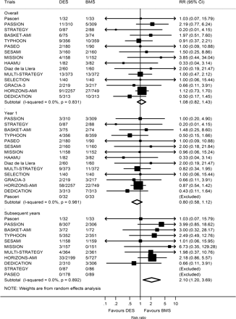
Figure 1 Number of patients experiencing definite ST out of the total patients DES and BMS. Risk ratios with 95% CI ...
Notes:
Figure 1 Number of patients experiencing definite ST out of the total patients DES and BMS. Risk ratios with 95% CI for definite stent thrombosis comparing DES vs. BMS for individual trials and the pooled trials. DES, drug-eluting stent; BMS, bare-metal stent; ST, stent thrombosis.
Unless provided in the caption above, the following copyright applies to the content of this slide: Published on behalf of the European Society of Cardiology. All rights reserved. © The Author 2012. For permissions please email: journals.permissions@oup.com

Slide 2
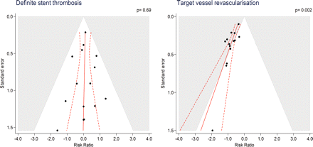
Figure 2 Contour enhanced funnel plots for definite ST and TVR with log of the RR of individual trials on the x-axis ...
Notes:
Figure 2 Contour enhanced funnel plots for definite ST and TVR with log of the RR of individual trials on the x-axis scattered against the corresponding standard error on the y-axis. The larger a trial, the more events accumulated, the smaller the standard error as a measure of statistical precision. In the absence of bias, the scatter of trials should have the shape of an inverted funnel, with large trials scattering little at the top and small trials scattering considerably at the bottom. If the funnel plot is asymmetrical, this suggests the presence of small study effects, suggesting that methodological problems, selective reporting of outcomes in small trials, and publication bias may have resulted in an overestimation of effects. Red solid lines are prediction lines from univariable meta-regression models with standard error as explanatory variable and red broken lines are corresponding 95% prediction intervals. The more the prediction line deviates from the vertical line, the more pronounced is asymmetry. Contours distinguish between grey areas of significance at a two-sided P ≤ 0.05 and white areas of non-significance at a two-sided P > 0.05. If trials seem to be missing in areas of non-significance, this adds to the notion of the presence of bias. The prediction lines should be interpreted independently of contours. P-values are from the Harbord test. ST, stent thrombosis; TVR, target vessel revascularization.
Unless provided in the caption above, the following copyright applies to the content of this slide: Published on behalf of the European Society of Cardiology. All rights reserved. © The Author 2012. For permissions please email: journals.permissions@oup.com

Slide 3
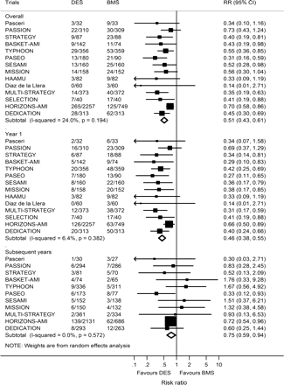
Figure 3 Number of patients requiring TVR among all total patients in DES and BMS. Risk ratios for definite stent ...
Notes:
Figure 3 Number of patients requiring TVR among all total patients in DES and BMS. Risk ratios for definite stent thrombosis comparing DES vs. BMS for individual trials and the pooled population. DES, drug-eluting stent; BMS, bare-metal stent; ST, stent thrombosis; TVR, target vessel revascularization.
Unless provided in the caption above, the following copyright applies to the content of this slide: Published on behalf of the European Society of Cardiology. All rights reserved. © The Author 2012. For permissions please email: journals.permissions@oup.com

Slide 4
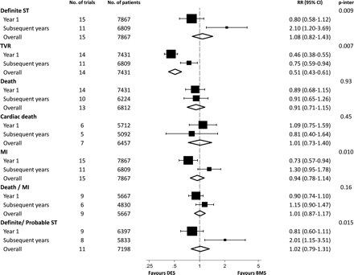
Figure 4 Risk of clinical outcomes comparing DES with BMS stratified according to time. DES, drug-eluting stent; BMS, ...
Notes:
Figure 4 Risk of clinical outcomes comparing DES with BMS stratified according to time. DES, drug-eluting stent; BMS, bare-metal stent. P-inter: P for interaction between year 1 and subsequent years using meta-regression.
Unless provided in the caption above, the following copyright applies to the content of this slide: Published on behalf of the European Society of Cardiology. All rights reserved. © The Author 2012. For permissions please email: journals.permissions@oup.com

