Slide 1
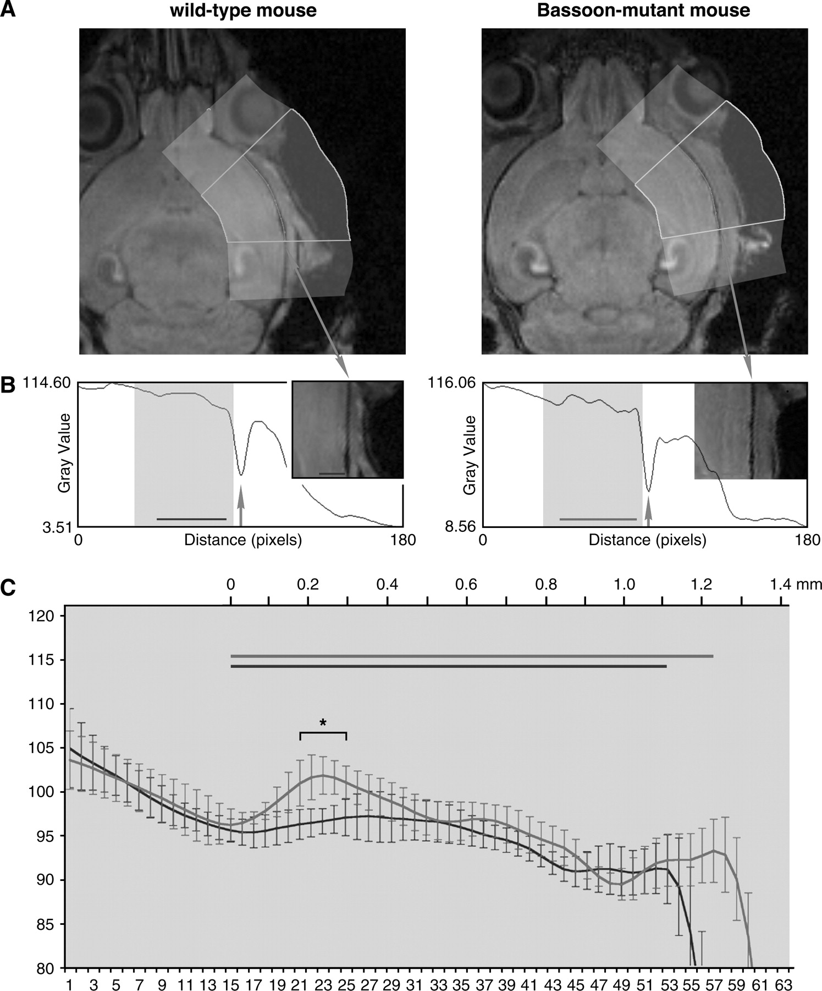
Figure 4 Manganese concentration within deep cortical layers is enhanced in Bassoon mutant mice. (A) To compare the ...
Notes:
Figure 4 Manganese concentration within deep cortical layers is enhanced in Bassoon mutant mice. (A) To compare the manganese distribution within different cortical layers in wild-type and Bassoon mutant mice, the cortex was straightened using an ImageJ-based algorithm. For the alignment, the cranium (recognizable by the very low signal intensity) was used as the landmark. (B) The straightened cortex (insert) was then used to measure the average signal intensities in each layer. The arrow indicates the localization of the cranium, and the bars indicate the location of the cortex in each plot. (C) This graph shows the average signal intensities calculated from each 7 control (black line) and 7 Bassoon mutant mice (gray line) of the area highlighted by a beige box in (B). The signal intensities were referred to the mean signal intensity of the striatum (100%). Significantly enhanced signal intensity could be observed in deep cortical layers, indicating an enhanced accumulation of manganese especially in these layers (asterisk: P < 0.05). The bars indicate again the localization of the cortex in control as shown in (B) (dark control mouse, gray Bassoon mutant mice). In the measured area, the determined cortex thickness is significantly higher in Bassoon mutant mice (1.23 ± 0.07 mm) compared with control mice (1.11 ± 0.08 mm, P < 0.01).
Unless provided in the caption above, the following copyright applies to the content of this slide: © The Author 2006. Published by Oxford University Press. All rights reserved. For permissions, please e-mail: journals.permissions@oxfordjournals.org

Slide 2
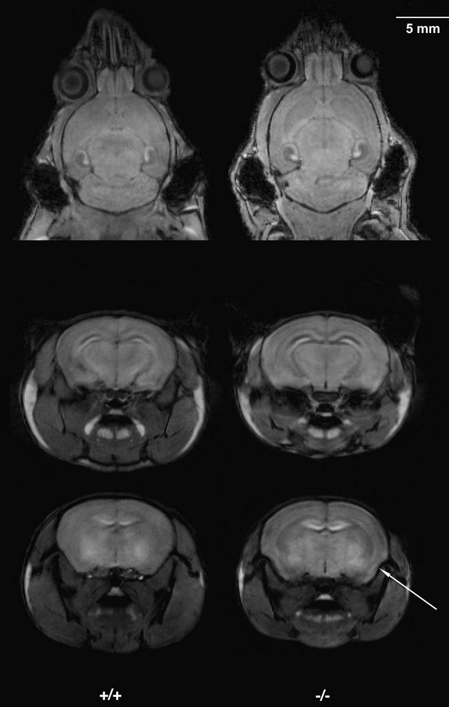
Figure 3 Comparison of manganese uptake into brain structures of wild-type and Bassoon mutant mice. ME-MRI was used to ...
Notes:
Figure 3 Comparison of manganese uptake into brain structures of wild-type and Bassoon mutant mice. ME-MRI was used to detect differences in the manganese distribution within the brain 2 days after subcutaneous injection of 1 μmol/g MnCl2. The main difference in manganese uptake was found within the cortex. Both in horizontal sections (upper row) and in frontal sections (lower 2 rows), the cortex appears more laminated, pointing to a cortex layer–dependent variation in total manganese uptake. In addition, the piriform cortex (arrow, lower row) is detectable in Bassoon mutant mice.
Unless provided in the caption above, the following copyright applies to the content of this slide: © The Author 2006. Published by Oxford University Press. All rights reserved. For permissions, please e-mail: journals.permissions@oxfordjournals.org

Slide 3
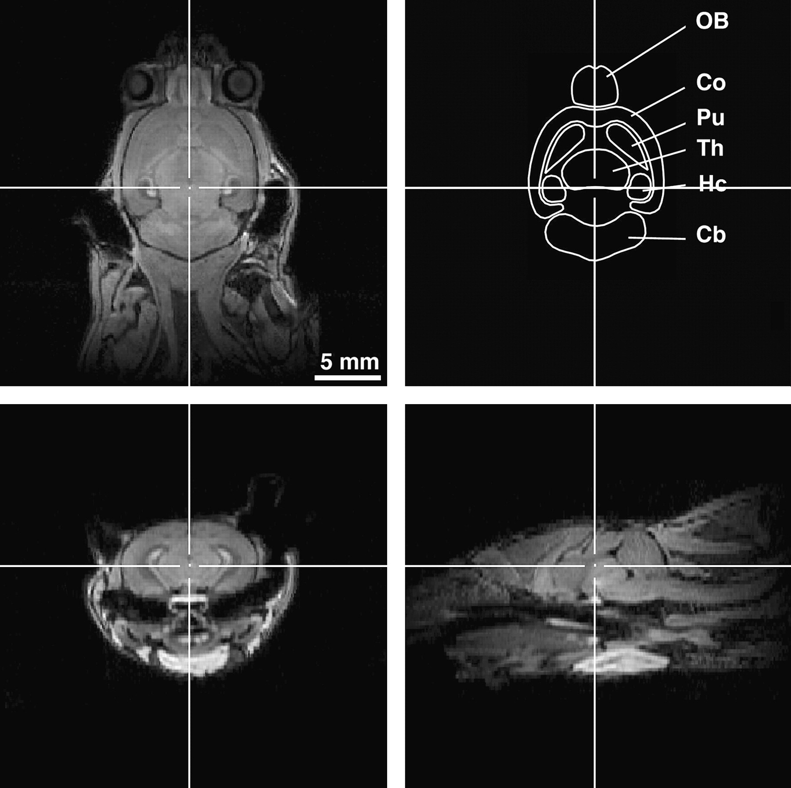
Figure 2 Volumetric analysis of various brain structures using ME-MRI. The volume of each recognizable brain structure ...
Notes:
Figure 2 Volumetric analysis of various brain structures using ME-MRI. The volume of each recognizable brain structure was calculated by measuring the area in each horizontal section multiplied by slice thickness. Based on the used parameters: FOV = 30 × 30 × 20 mm and matrix = 256 × 256 × 64, the calculated in-plane resolution is 117 × 117 μm and the slice thickness is 312.5 μm. The calculated frontal and sagittal section (lower panels) were used to facilitate the assignment of each structure. OB, olfactory bulb; Co, cortex; Pu, putamen; Th, thalamus; Hc, hippocampus; Cb, cerebellum.
Unless provided in the caption above, the following copyright applies to the content of this slide: © The Author 2006. Published by Oxford University Press. All rights reserved. For permissions, please e-mail: journals.permissions@oxfordjournals.org

Slide 4
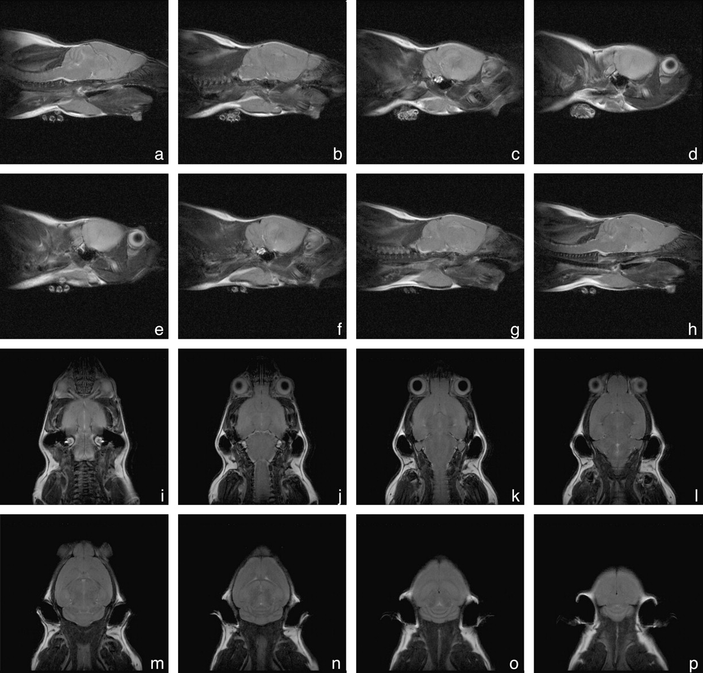
Figure 1 Anatomical survey of Bassoon mutant mice by T₂-weighted MRI. No obvious abnormalities in the gross ...
Notes:
Figure 1 Anatomical survey of Bassoon mutant mice by T2-weighted MRI. No obvious abnormalities in the gross brain structure, such as ventricle enlargement, local atrophies, or distortions are detectable in 2-month-old Bassoon mutant mice. Eight T2-weighted spin-echo images were obtained simultaneously using a RARE sequence (Hennig and others 1986), with the following parameters: TR 2000 ms, TE 15 ms, RARE factor 8, number of averages 8. Total scanning time for each direction was 9 min. Shown are consecutive sagittal (a–h) and horizontal (i–p) sections, slice thickness = 800 μm, interslice distance = 100 μm, FOV = 30 × 30 mm, matrix = 256 × 256 (nominal in-plane resolution = 117 × 117 μm).
Unless provided in the caption above, the following copyright applies to the content of this slide: © The Author 2006. Published by Oxford University Press. All rights reserved. For permissions, please e-mail: journals.permissions@oxfordjournals.org

Slide 5
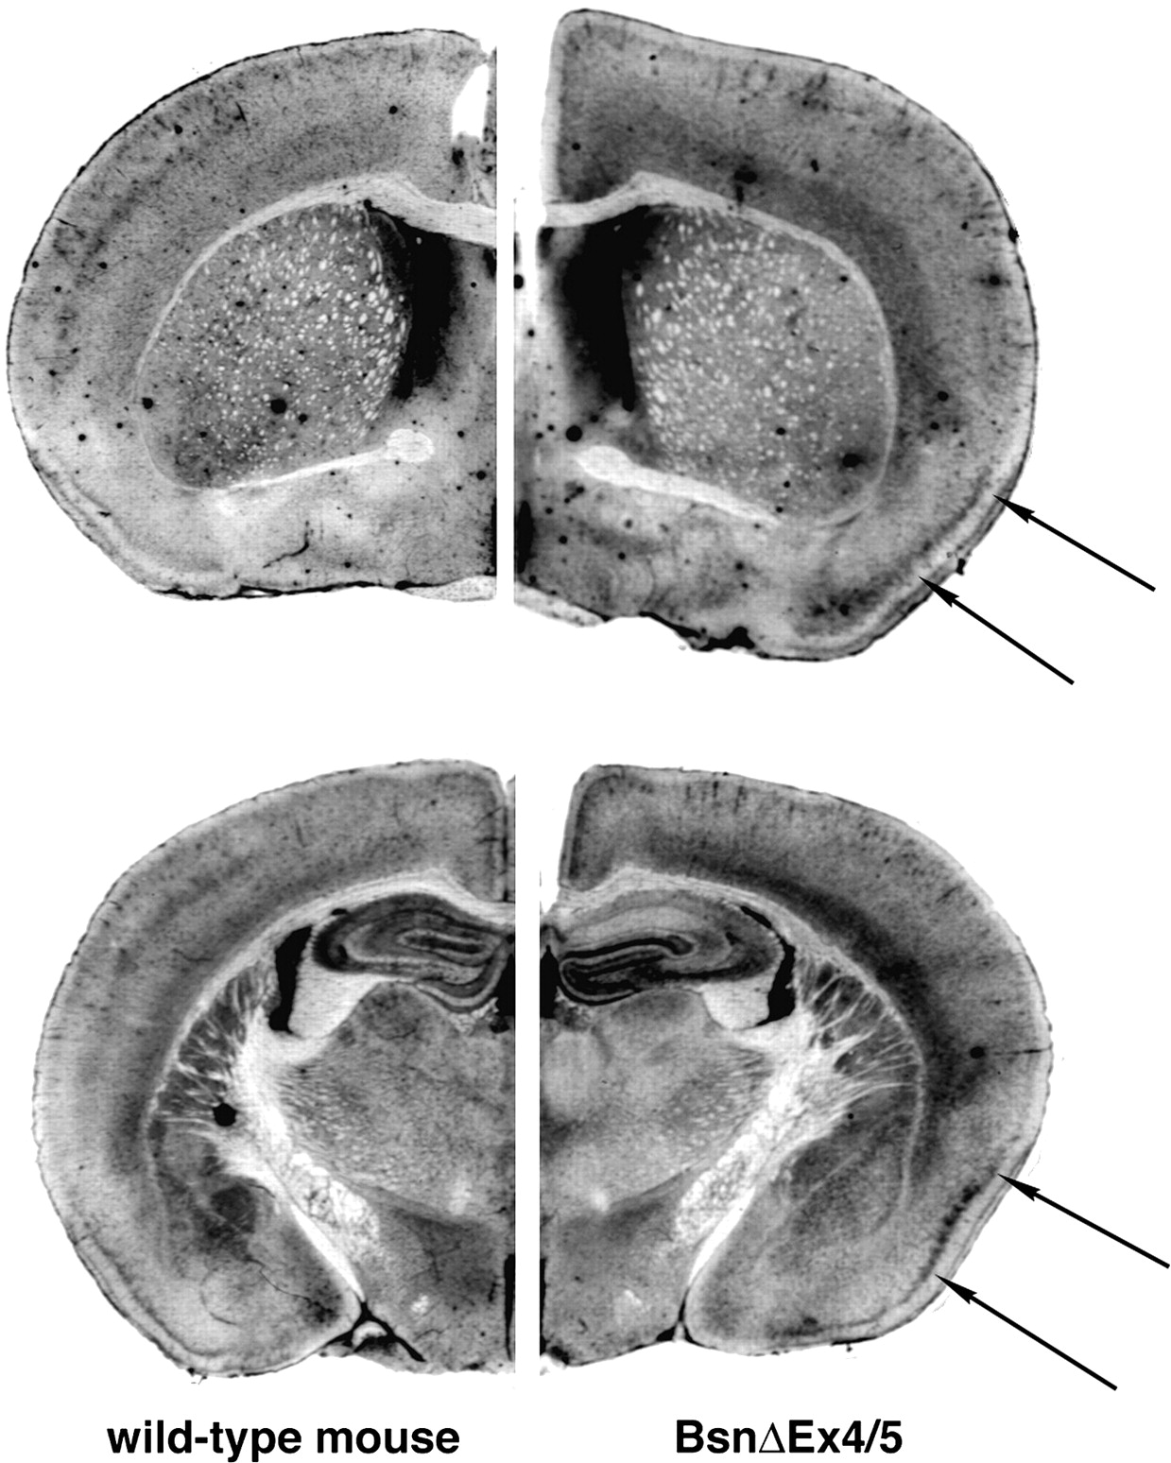
Figure 5 Detection of manganese distribution by Mn-AMG. Comparable with ME-MRI, an increased concentration of ...
Notes:
Figure 5 Detection of manganese distribution by Mn-AMG. Comparable with ME-MRI, an increased concentration of manganese was found in deep cortical layer and within the piriform cortex (arrows, right side) of Bassoon mutant mice. In contrast to ME-MRI, no clear staining was found in a superficial and central layers, indicating that in these layers the signal intensity changes detected by ME-MRI are caused by manganese that is not precipitable by sodium sulfide. In control mice, a clear staining of layer IV cells especially within somatosensory areas (arrow, left side) could be observed.
Unless provided in the caption above, the following copyright applies to the content of this slide: © The Author 2006. Published by Oxford University Press. All rights reserved. For permissions, please e-mail: journals.permissions@oxfordjournals.org

Slide 6
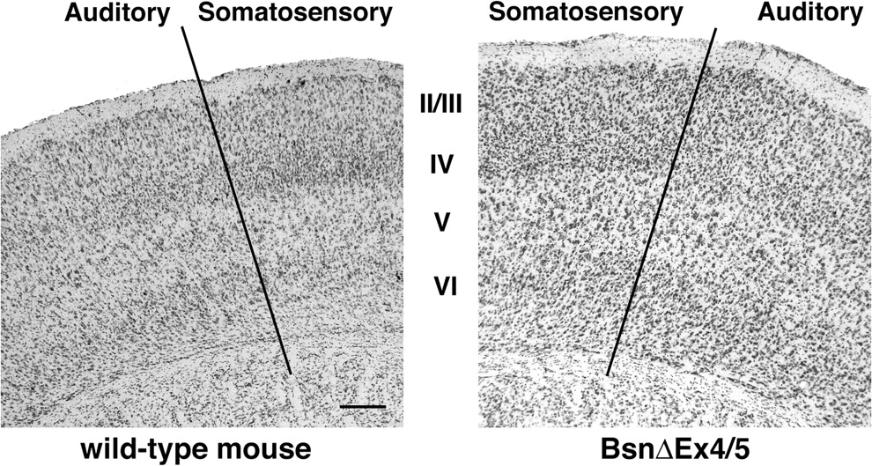
Figure 6 Nissl staining of the cortex. No obvious change in cortical layer organization is detectable within the ...
Notes:
Figure 6 Nissl staining of the cortex. No obvious change in cortical layer organization is detectable within the auditory and somatosensory cortex of Bassoon mutant mouse. Scale bar = 200 μm.
Unless provided in the caption above, the following copyright applies to the content of this slide: © The Author 2006. Published by Oxford University Press. All rights reserved. For permissions, please e-mail: journals.permissions@oxfordjournals.org

Slide 7
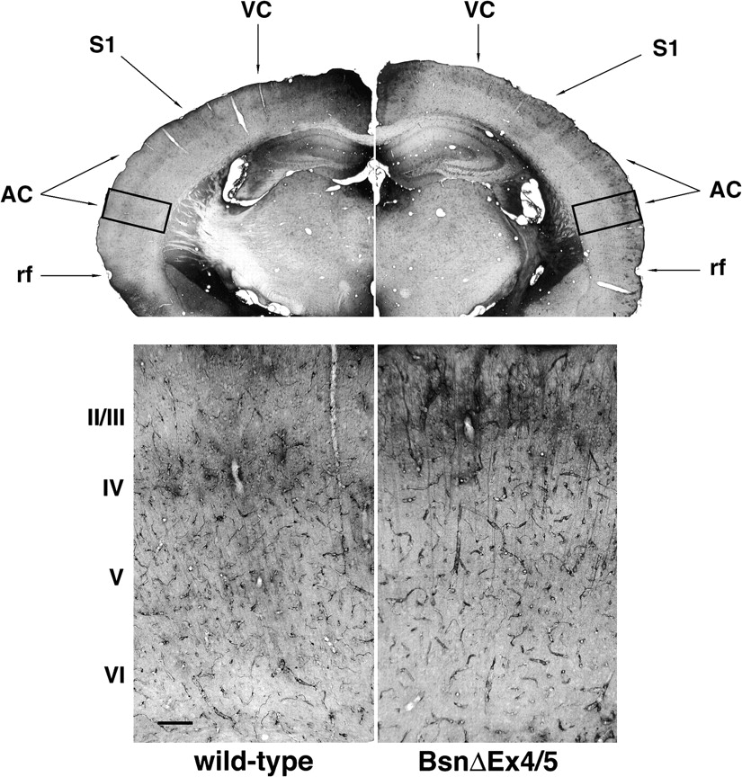
Figure 7 Thallium uptake into different layers of the cortex in Bassoon mutant mice and wild-type littermates. Whereas ...
Notes:
Figure 7 Thallium uptake into different layers of the cortex in Bassoon mutant mice and wild-type littermates. Whereas in wild-type mice cortical layer IV is predominantly stained, in Bassoon mutant mice supragranular layers are more intensely labeled (top). Higher magnification of the auditory cortex (bottom) revealed a staining of the neuropil in layer II/III in Basson mutant mice. In contrast to ME-MRI, Tl-AMG visualizes the ongoing neuronal activity only in a time period of 15 min, namely, between thallium injection and the beginning of the perfusion. Within this period, no convulsive activity was observed; hence, the detected differences do not reflect an occurring epileptic seizure. rf, rhinal fissure; AC, auditory cortex; S1, primary somatosensory cortex; VC, visual cortex.
Unless provided in the caption above, the following copyright applies to the content of this slide: © The Author 2006. Published by Oxford University Press. All rights reserved. For permissions, please e-mail: journals.permissions@oxfordjournals.org

Slide 8
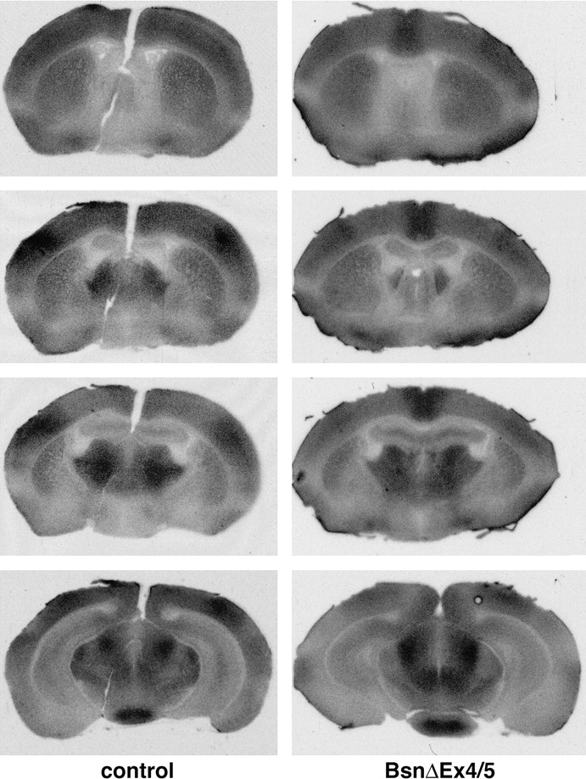
Figure 8 [¹⁴C]-2-deoxyglucose autoradiographs of axial sections of control and Bassoon mutant mice. Both in ...
Notes:
Figure 8 [14C]-2-deoxyglucose autoradiographs of axial sections of control and Bassoon mutant mice. Both in wild-type and in mutant mice, the metabolic activity is not evenly distributed across the cortex. In wild-type mice, a high metabolic activity occurs especially within somatosensory areas (arrows), whereas in Bassoon mutant mice, a strong metabolic activity was found in the cingulate cortex (arrow) and to a lesser extent within the somatosensory cortex.
Unless provided in the caption above, the following copyright applies to the content of this slide: © The Author 2006. Published by Oxford University Press. All rights reserved. For permissions, please e-mail: journals.permissions@oxfordjournals.org

