Slide 1
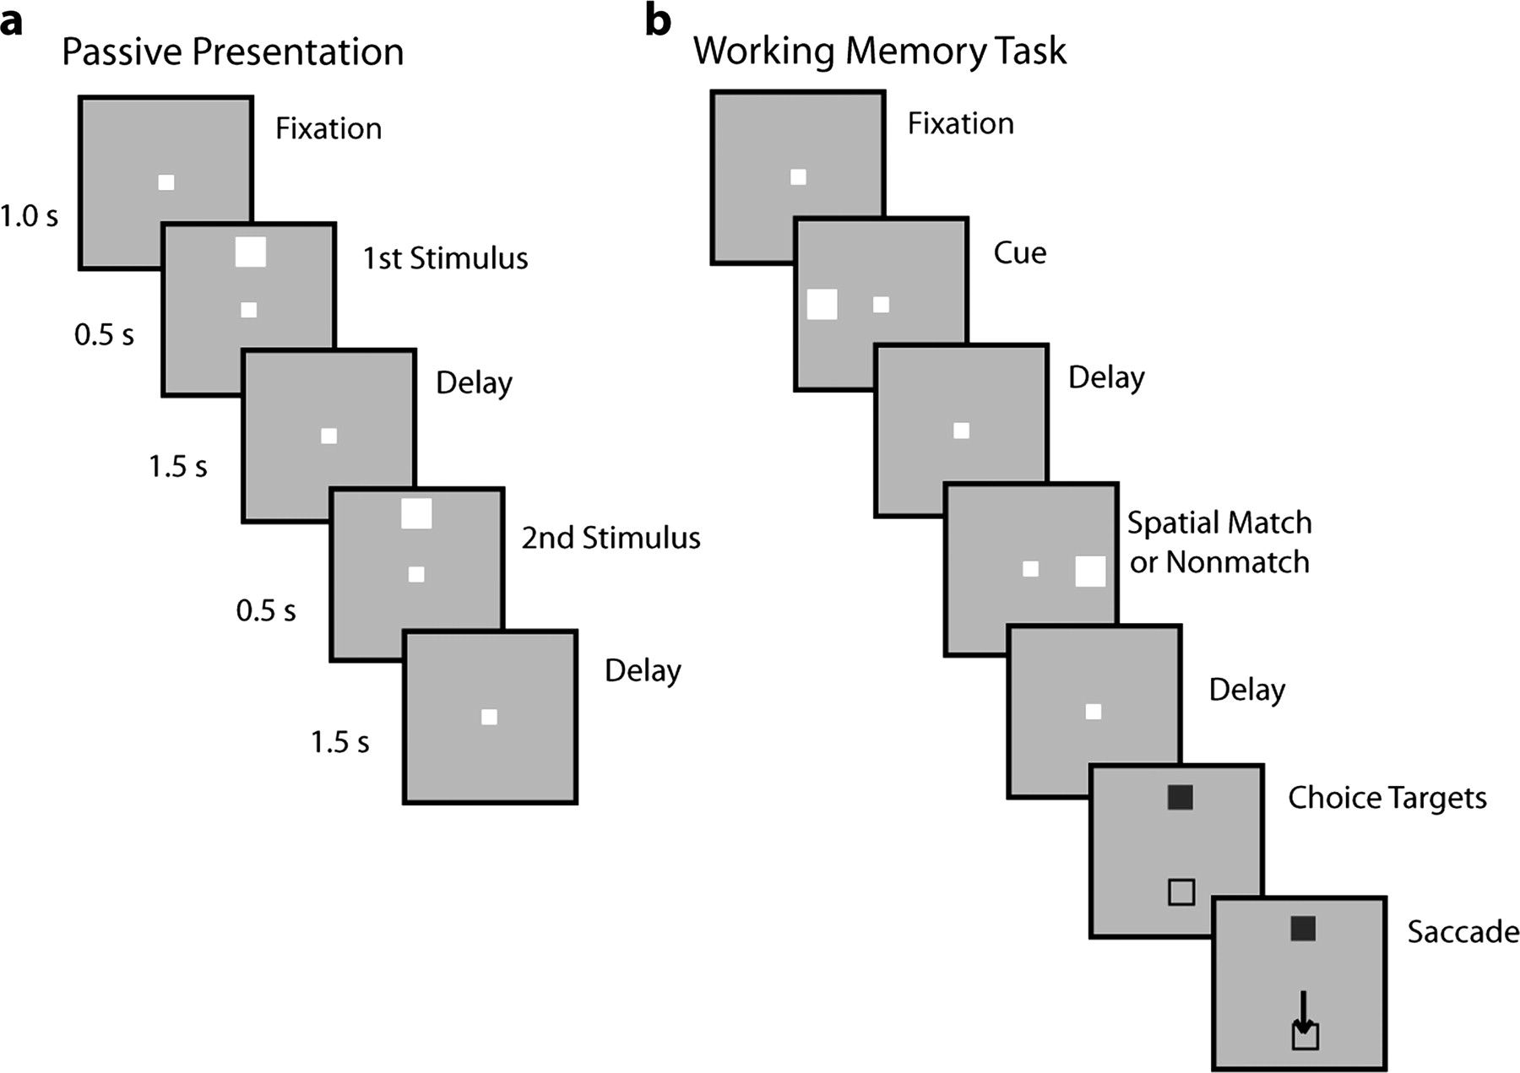
Figure 1. Behavioral task. Successive frames represent sequence of stimulus presentation on the screen. (a) Passive ...
Notes:
Figure 1. Behavioral task. Successive frames represent sequence of stimulus presentation on the screen. (a) Passive presentation. Stimuli were presented passively, while the monkey was simply required to fixate. (b) Working memory task. The monkey was required to remember the spatial location of the first stimulus and saccade to a green choice target (shown as filled square) if the second stimulus appeared at a matching location. If the 2 stimuli appeared at different locations, the monkey was required to the blue target, instead (shown as an open square). The relative position of the 2 choice targets varied randomly from trial to trial.
Unless provided in the caption above, the following copyright applies to the content of this slide: © The Author 2011. Published by Oxford University Press. All rights reserved. For permissions, please e-mail: journals.permissions@oup.com

Slide 2
Figure 2. Distribution of spike waveforms. (a–c) Histogram of neuronal spike widths before (closed bars) and after ...
Notes:
Figure 2. Distribution of spike waveforms. (a–c) Histogram of neuronal spike widths before (closed bars) and after training (open bars) for the 3 monkeys included in the study. FS and RS units were identified based on spike width. (d) Cumulative distribution of spike widths before and after training for all units.
Unless provided in the caption above, the following copyright applies to the content of this slide: © The Author 2011. Published by Oxford University Press. All rights reserved. For permissions, please e-mail: journals.permissions@oup.com

Slide 3
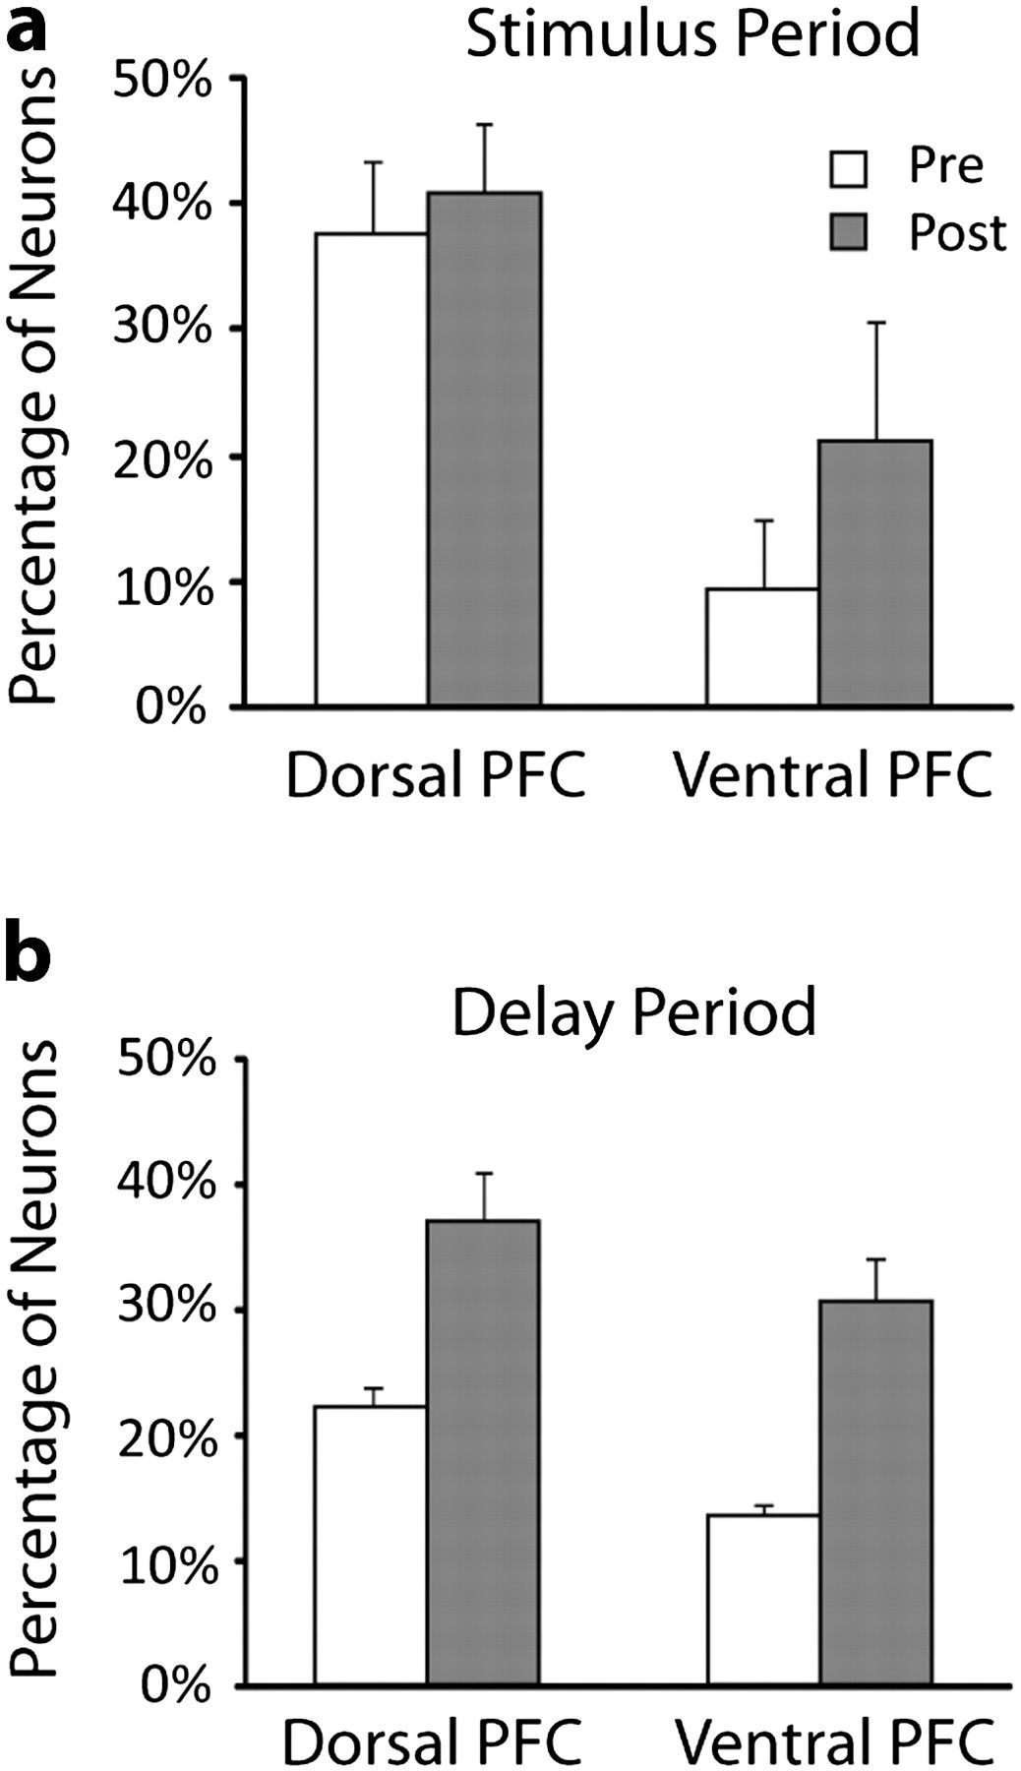
Figure 3. Percentage of activated neurons before and after training. (a) Percentage of neurons with significantly ...
Notes:
Figure 3. Percentage of activated neurons before and after training. (a) Percentage of neurons with significantly elevated firing rate during the presentation of visual stimuli before and after training. Average percentages are shown for results pooled across all monkeys. Error bars denote standard error of percentages observed between monkeys. Responses from dorsal and ventral prefrontal regions are shown separately. (b) Percentage of neurons active during the delay period after the stimulus presentation. N = 735 and 851 for dorsal PFC, pretraining, and posttraining, respectively. N = 589 and 500 for ventral PFC, pretraining, and posttraining, respectively.
Unless provided in the caption above, the following copyright applies to the content of this slide: © The Author 2011. Published by Oxford University Press. All rights reserved. For permissions, please e-mail: journals.permissions@oup.com

Slide 4
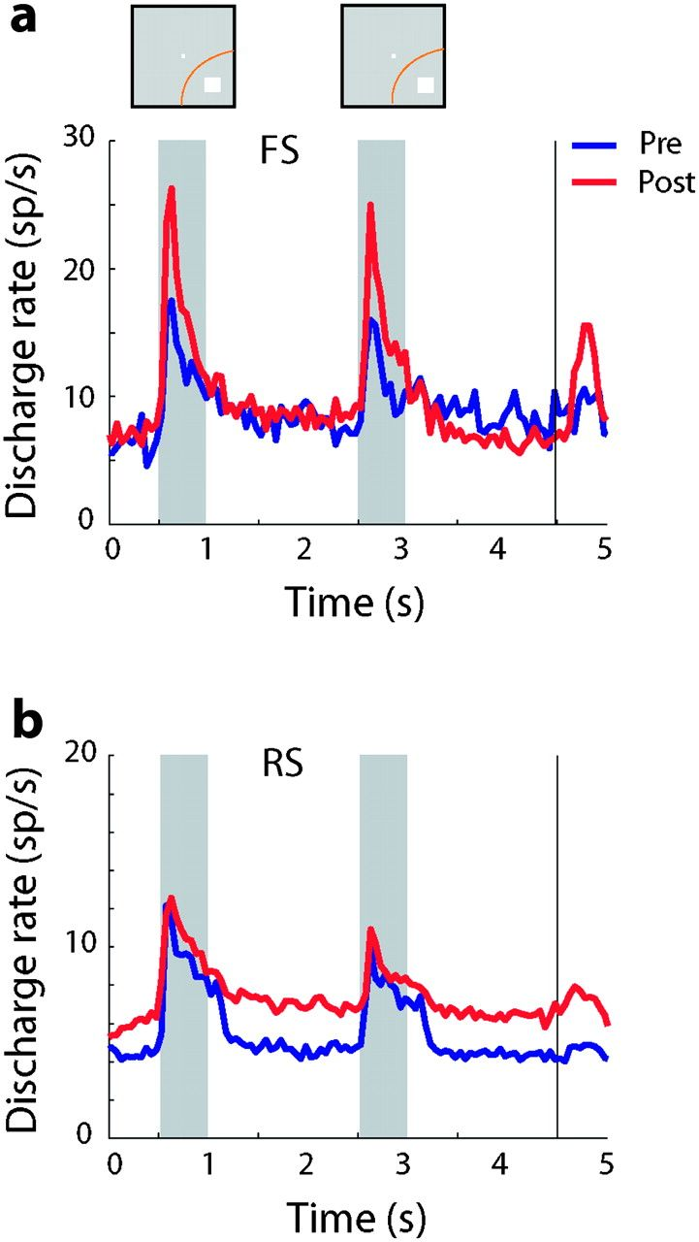
Figure 4. Average population response. (a) Population PST histograms averaging discharges from FS neurons with ...
Notes:
Figure 4. Average population response. (a) Population PST histograms averaging discharges from FS neurons with significant elevated responses. Blue lines, responses prior to training (N = 25); Red lines, responses after training (N = 44). Insets above Peri-Stimulus Time Histogram indicate appearance of the first and second stimulus in the best location in the receptive field; the actual locations of the stimuli differed for each neuron. (b) Population PST histograms for RS neurons prior to (N = 290) and after training (N = 381).
Unless provided in the caption above, the following copyright applies to the content of this slide: © The Author 2011. Published by Oxford University Press. All rights reserved. For permissions, please e-mail: journals.permissions@oup.com

Slide 5
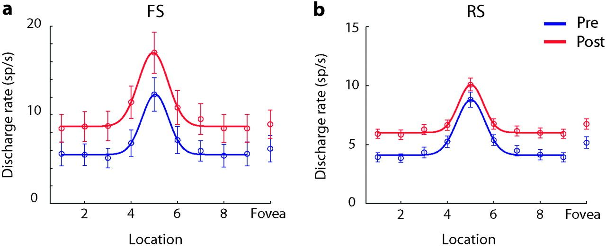
Figure 5. Stimulus selectivity. (a) Average discharge rate of FS neurons with significantly elevated responses are ...
Notes:
Figure 5. Stimulus selectivity. (a) Average discharge rate of FS neurons with significantly elevated responses are plotted before (N = 25) and after training (N = 44). The arrangement of spatial locations has been rotated so that the best response is at location 5 for every neuron; responses at the foveal location are plotted separately. Line represents Gaussian fit. Points 1 and 9 represent the same location. Error bars represent standard errors. (b) Average discharge rate of RS neurons prior to (N = 290) and after training (N = 381).
Unless provided in the caption above, the following copyright applies to the content of this slide: © The Author 2011. Published by Oxford University Press. All rights reserved. For permissions, please e-mail: journals.permissions@oup.com

Slide 6
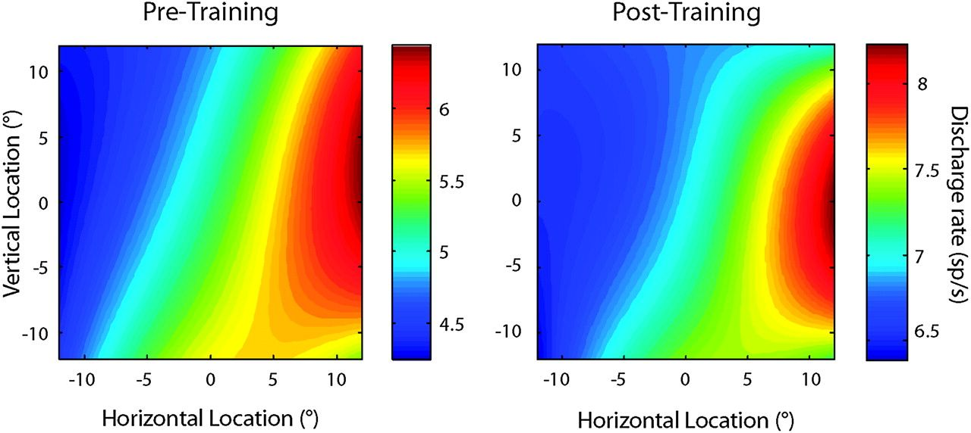
Figure 6. Population firing rate maps. The color map indicates population discharge rate at each spatial location by ...
Notes:
Figure 6. Population firing rate maps. The color map indicates population discharge rate at each spatial location by averaging responses from all neurons with significantly elevated responses recorded before (N = 315) and after (N = 425) training. The contralateral location is depicted as positive horizontal location; responses from the right hemisphere have been reflected.
Unless provided in the caption above, the following copyright applies to the content of this slide: © The Author 2011. Published by Oxford University Press. All rights reserved. For permissions, please e-mail: journals.permissions@oup.com

Slide 7
Figure 7. Discriminability of stimuli. (a) The average value of the area under the ROC curve is plotted comparing ...
Notes:
Figure 7. Discriminability of stimuli. (a) The average value of the area under the ROC curve is plotted comparing responses between the best spatial location and - its opposite. Data are plotted in a time-resolved fashion, using a 100-ms moving window centered on the time point plotted in the graph. Results are averaged from all neurons with significant elevated responses before training (N = 315) and after training (N = 425). Gray bar represents time of stimulus presentation. (b). ROC analysis for FS units only (N = 25 pretraining and 44 posttraining). (c) ROC analysis for data obtained prior to training from the left hemisphere of one monkey (N = 211) and after training from the left hemisphere (N = 93) and the right hemisphere (N = 170). (d) ROC analysis for data obtained before training (N = 315) and after training, from sessions divided into 2 groups, based on high (N = 212) and low (N = 213) performance.
Unless provided in the caption above, the following copyright applies to the content of this slide: © The Author 2011. Published by Oxford University Press. All rights reserved. For permissions, please e-mail: journals.permissions@oup.com

Slide 8
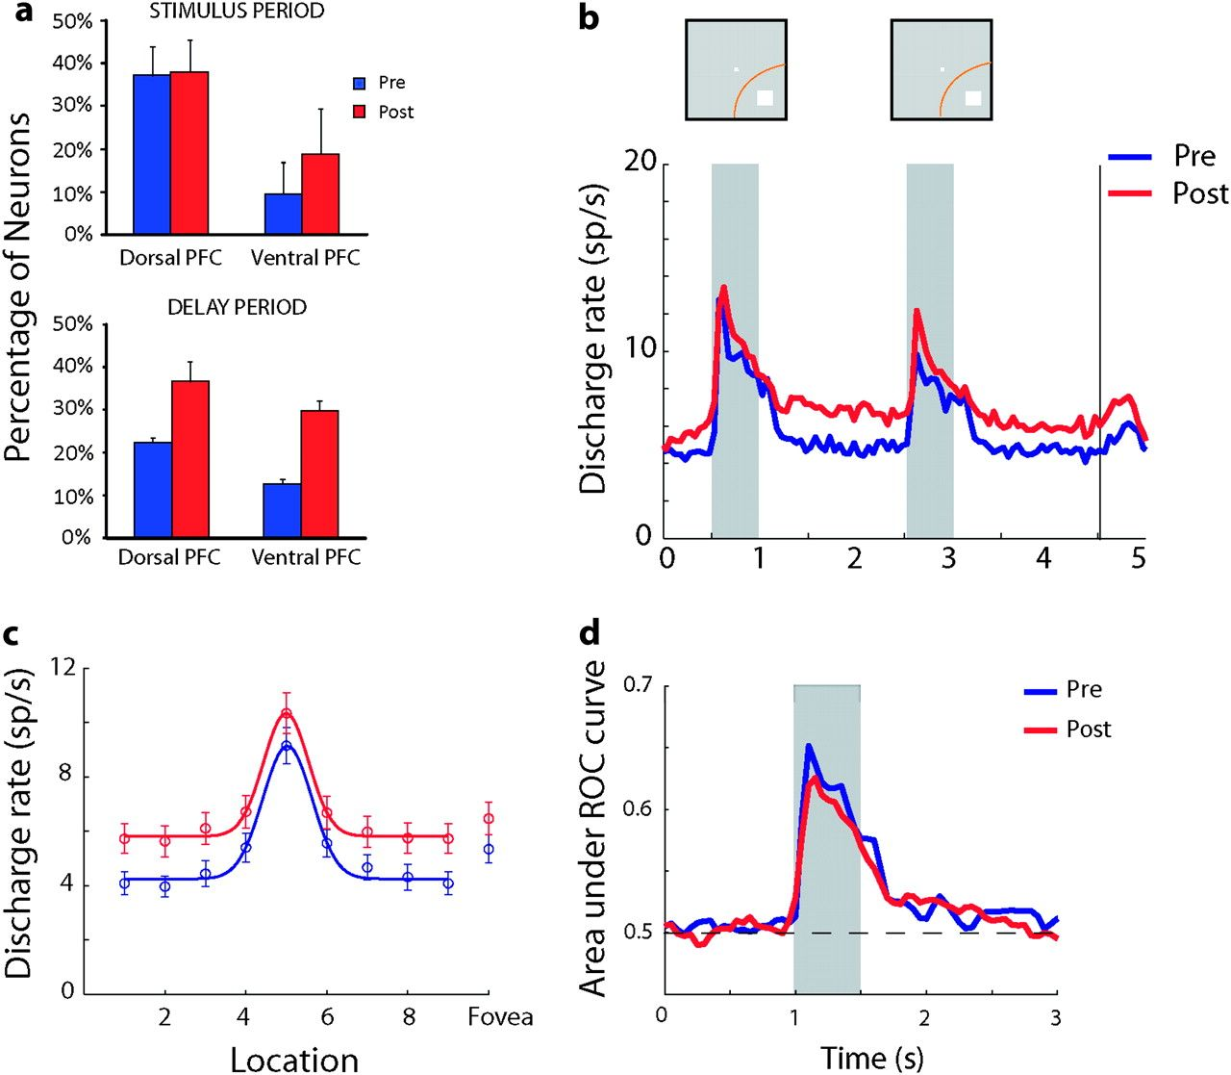
Figure 8. Analysis of neurons matched for SNR. (a) Percentage of records with neurons matched for SNR with ...
Notes:
Figure 8. Analysis of neurons matched for SNR. (a) Percentage of records with neurons matched for SNR with significantly elevated firing rate during the presentation of visual stimuli and delay period. N = 656 and 523 for dorsal PFC, pretraining, and posttraining, respectively. N = 557 and 346 for ventral PFC, pretraining, and posttraining, respectively. (b–d) Average discharge rate, selectivity, and discriminability based on responses from neurons matched for SNR with significantly elevated responses before (N = 243) and after training (N = 258). Conventions are the same as in Figures 3–5 and 7.
Unless provided in the caption above, the following copyright applies to the content of this slide: © The Author 2011. Published by Oxford University Press. All rights reserved. For permissions, please e-mail: journals.permissions@oup.com

Slide 9
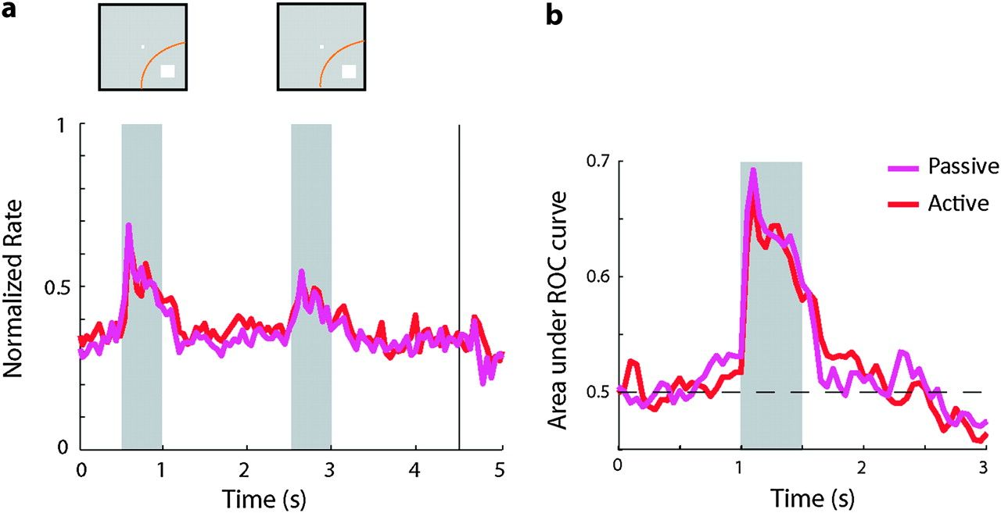
Figure 9. Passive presentation of stimuli after training. (a) Population Peri-Stimulus Time Histogram for responses ...
Notes:
Figure 9. Passive presentation of stimuli after training. (a) Population Peri-Stimulus Time Histogram for responses collected during execution of the working memory task and during passive presentation of the same stimuli to the same neurons (N = 90). Responses are normalized to the maximum firing rate of each neuron (b) ROC analysis based on the working memory task and passively presented stimuli, after training.
Unless provided in the caption above, the following copyright applies to the content of this slide: © The Author 2011. Published by Oxford University Press. All rights reserved. For permissions, please e-mail: journals.permissions@oup.com

Slide 10
Figure 10. Effect of behavioral performance on neuronal firing rate. Each data point represents responses of a single ...
Notes:
Figure 10. Effect of behavioral performance on neuronal firing rate. Each data point represents responses of a single neuron during the delay period averaged from all stimulus presentations and conditions. Data are plotted against the behavioral performance observed during the recording of the data set. Results are shown from the 3 monkeys tested in the experiment. Solid line represents linear regression.
Unless provided in the caption above, the following copyright applies to the content of this slide: © The Author 2011. Published by Oxford University Press. All rights reserved. For permissions, please e-mail: journals.permissions@oup.com

Slide 11
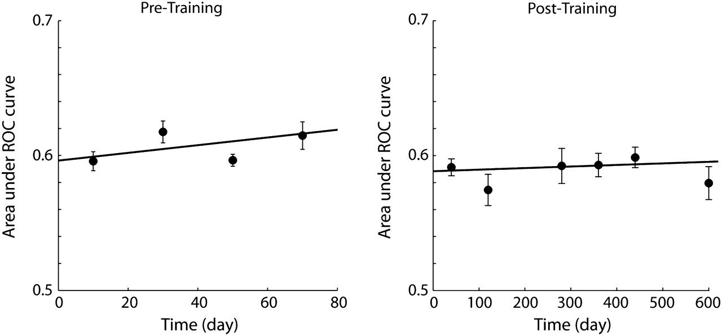
Figure 11. Discriminability as a function of time. Area under the ROC curve is plotted as a function of time (days). ...
Notes:
Figure 11. Discriminability as a function of time. Area under the ROC curve is plotted as a function of time (days). Each data point represents average across all neurons recorded in a bin of 20 days (before training) or 80 days long (after training). Error bars represent standard error of the mean. Solid line represents the regression line; the slope of neither curve was significantly different than zero.
Unless provided in the caption above, the following copyright applies to the content of this slide: © The Author 2011. Published by Oxford University Press. All rights reserved. For permissions, please e-mail: journals.permissions@oup.com

