Slide 1
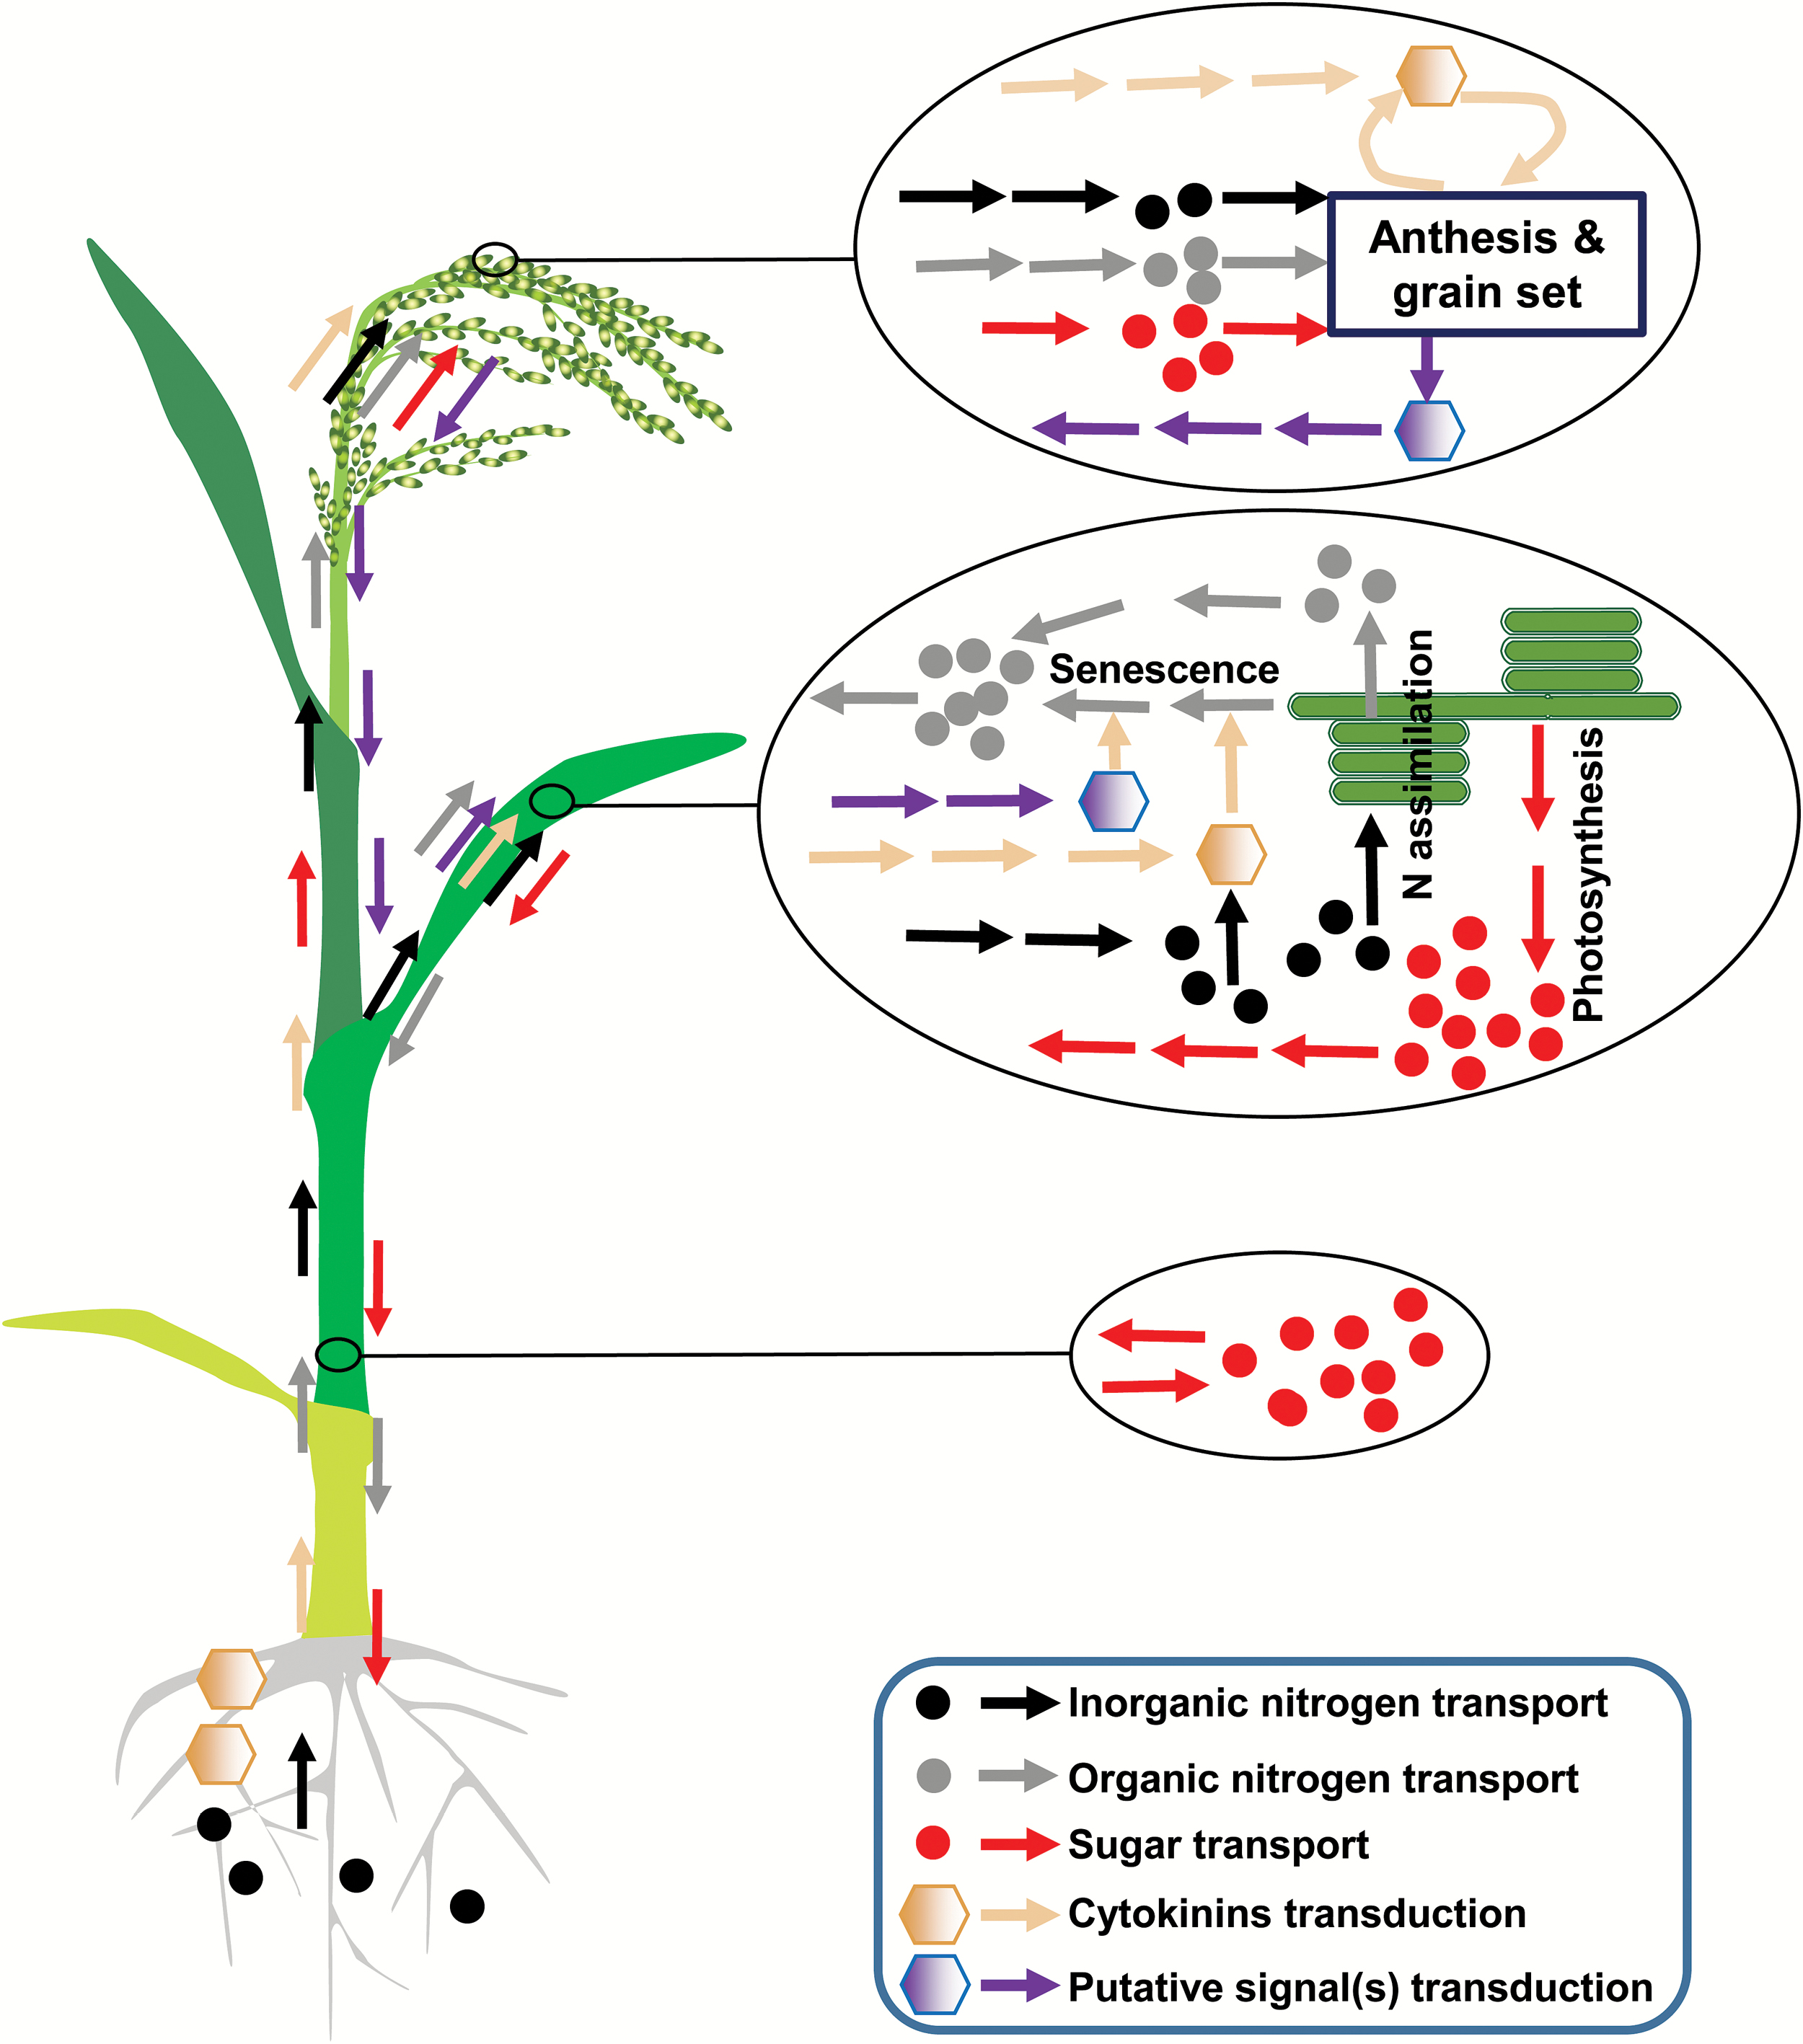
Fig. 1. Schematic diagram showing material transport and signal transduction-mediated source–sink interaction of ...
Notes:
Fig. 1. Schematic diagram showing material transport and signal transduction-mediated source–sink interaction of cereal crops after heading. Root is the only source of inorganic nitrogen, and a major source of CKs. Root can produce a proportion of organic nitrogen and transport it to the shoot through the xylem, but it may also import amino acids from the shoot through the phloem. The growth and functional maintenance of the root depend on sugar supply from the shoot. Mature leaf is the major source of carbon and organic nitrogen. Leaf senescence can be regulated by root, grains, and the leaf itself through source–sink interaction with or without environmental stresses (see the text). During leaf senescence, a large amount of organic nitrogen can also be remobilized and reused. Storage cells located in the stem and leaf sheath (e.g. phloem parenchyma cells) form the temporary reserve pool, which can store carbon and nitrogen when the phloem carbon and nitrogen level is high and release them when the opposite is the case. Grains gradually become the major sink of carbon and nitrogen after anthesis. Carbon and nitrogen supply can greatly influence grain number during panicle formation, floret fertility at anthesis, and grain setting during grain filling. During anthesis and grain filling, a substantial amount of CKs can be synthesized to regulate grain cell proliferation and starch accumulation. Developing florets and/or grains may produce certain (unknown) signal(s) to regulate leaf senescence directly, in spite of their drain of leaf nitrogen (see the text).
Unless provided in the caption above, the following copyright applies to the content of this slide: © The Author 2017. Published by Oxford University Press on behalf of the Society for Experimental Biology. All rights reserved. For permissions, please email: journals.permissions@oup.com

Slide 2
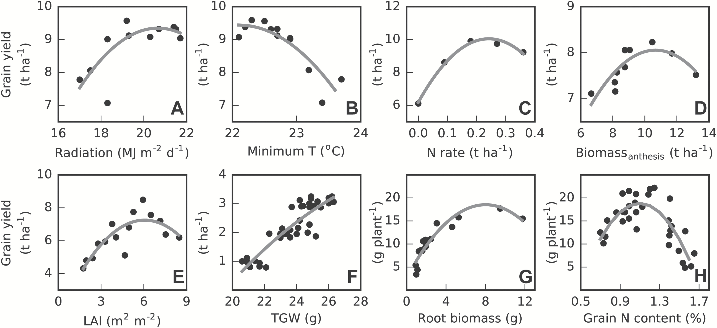
Fig. 2. Relationship between crop grain yield and potential influencing factors. Whole growth-season average daily ...
Notes:
Fig. 2. Relationship between crop grain yield and potential influencing factors. Whole growth-season average daily radiation (A) and minimum temperature (B), data from Peng et al. (2004) for rice; nitrogen application rates (C), data from Yang (2015) for rice; the amount of dry matter accumulation at anthesis (D), data from Zi et al. (2015) for waxy wheat; heading stage leaf area index (E), data from Chen et al. (1991) for rice; thousand grain weight (F), data from Dogbe et al. (2015) for rice; root biomass at harvest (G), data from Waines (2012) for spring bread wheat; grain nitrogen content at harvest (H), data from Fageria et al. (2011) for rice.
Unless provided in the caption above, the following copyright applies to the content of this slide: © The Author 2017. Published by Oxford University Press on behalf of the Society for Experimental Biology. All rights reserved. For permissions, please email: journals.permissions@oup.com

Slide 3
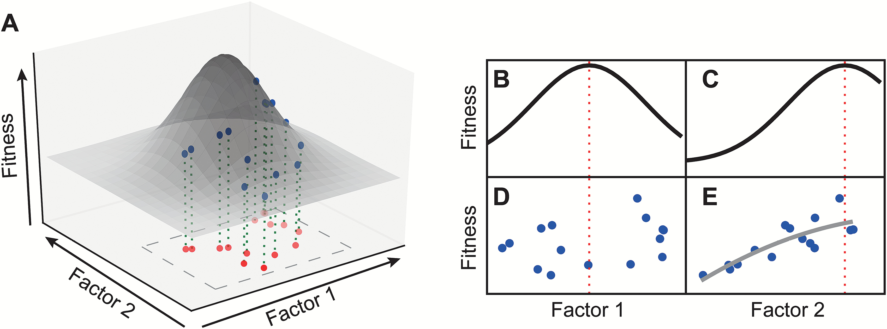
Fig. 3. A holistic view is needed for optimization of a complex trait with multiple causal factors. A hypothetical ...
Notes:
Fig. 3. A holistic view is needed for optimization of a complex trait with multiple causal factors. A hypothetical relationship of target function (‘Fitness’) with two causal factors is shown in panel A. ‘Fitness’ score trends versus factor 1 and factor 2 with the other one fixed are shown in panel B and C, respectively. Relationship of ‘Fitness’ score with factor 1 (D) and factor 2 (E) using random samples in the rectangular region in panel A are shown in panel D and E, respectively.. Dashed lines in (B), (D) and (C), (E) represent values of factor 1 and factor 2 at which the global maximal ‘Fitness’ can be reached.
Unless provided in the caption above, the following copyright applies to the content of this slide: © The Author 2017. Published by Oxford University Press on behalf of the Society for Experimental Biology. All rights reserved. For permissions, please email: journals.permissions@oup.com

