Slide 1
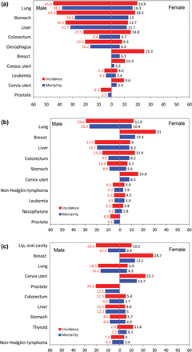
Figure 1. Ten most common cancers by sex and sub-region, GLOBOCAN 2008. (a) Eastern Asia. (b) South Eastern Asia. (c) ...
Notes:
Figure 1. Ten most common cancers by sex and sub-region, GLOBOCAN 2008. (a) Eastern Asia. (b) South Eastern Asia. (c) Pacific Island.
Unless provided in the caption above, the following copyright applies to the content of this slide: © The Author 2012. Published by Oxford University Press. All rights reserved. For Permissions, please email: journals.permissions@oup.com

Slide 2
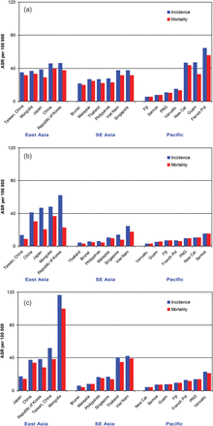
Figure 2. Age-standardized rate of leading cancers by country and sub-region, males, GLOBOCAN 2008; (a) lung cancer, ...
Notes:
Figure 2. Age-standardized rate of leading cancers by country and sub-region, males, GLOBOCAN 2008; (a) lung cancer, (b) stomach cancer, (c) liver cancer, (d) colorectum cancer and (e) prostrate cancer.
Unless provided in the caption above, the following copyright applies to the content of this slide: © The Author 2012. Published by Oxford University Press. All rights reserved. For Permissions, please email: journals.permissions@oup.com

Slide 3
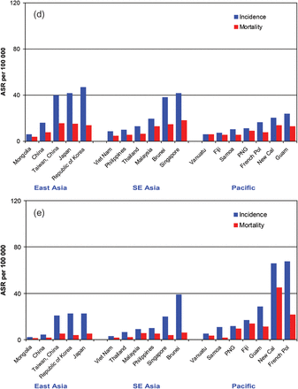
Figure 2. Age-standardized rate of leading cancers by country and sub-region, males, GLOBOCAN 2008; (a) lung cancer, ...
Notes:
Figure 2. Age-standardized rate of leading cancers by country and sub-region, males, GLOBOCAN 2008; (a) lung cancer, (b) stomach cancer, (c) liver cancer, (d) colorectum cancer and (e) prostrate cancer.
Unless provided in the caption above, the following copyright applies to the content of this slide: © The Author 2012. Published by Oxford University Press. All rights reserved. For Permissions, please email: journals.permissions@oup.com

Slide 4
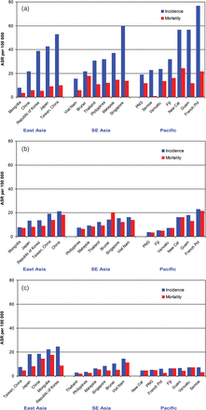
Figure 3. Age-standardized rate of leading cancers by country and sub-region, females, GLOBOCAN 2008; (a) breast ...
Notes:
Figure 3. Age-standardized rate of leading cancers by country and sub-region, females, GLOBOCAN 2008; (a) breast cancer, (b) lung cancer, (c) stomach cancer, (d) colon cancer and (e) cervix cancer.
Unless provided in the caption above, the following copyright applies to the content of this slide: © The Author 2012. Published by Oxford University Press. All rights reserved. For Permissions, please email: journals.permissions@oup.com

Slide 5
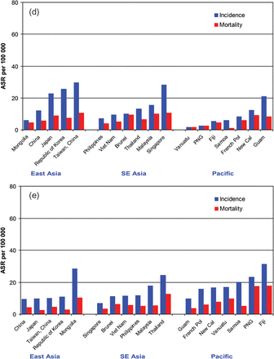
Figure 3. Age-standardized rate of leading cancers by country and sub-region, females, GLOBOCAN 2008; (a) breast ...
Notes:
Figure 3. Age-standardized rate of leading cancers by country and sub-region, females, GLOBOCAN 2008; (a) breast cancer, (b) lung cancer, (c) stomach cancer, (d) colon cancer and (e) cervix cancer.
Unless provided in the caption above, the following copyright applies to the content of this slide: © The Author 2012. Published by Oxford University Press. All rights reserved. For Permissions, please email: journals.permissions@oup.com

