Slide 1
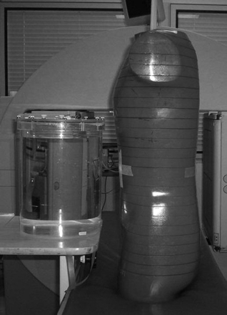
Figure 1. Experimental set-up of anthropomorphic phantom with TLDs attached and scattering phantom (not actual ...
Notes:
Figure 1. Experimental set-up of anthropomorphic phantom with TLDs attached and scattering phantom (not actual experimental distances shown).
Unless provided in the caption above, the following copyright applies to the content of this slide: © The Author 2007. Published by Oxford University Press. All rights reserved. For Permissions, please email: journals.permissions@oxfordjournals.org

Slide 2
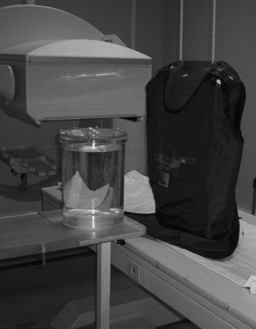
Figure 2. The anthropomorphic phantom wearing a Roland composite apron with TLDs attached to outside surface.
Notes:
Figure 2. The anthropomorphic phantom wearing a Roland composite apron with TLDs attached to outside surface.
Unless provided in the caption above, the following copyright applies to the content of this slide: © The Author 2007. Published by Oxford University Press. All rights reserved. For Permissions, please email: journals.permissions@oxfordjournals.org

Slide 3
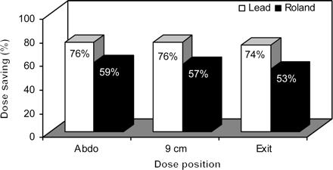
Figure 3. Relative efficiency of lead versus Roland composite aprons in reducing dose at abdomen, 9cm and exit.
Notes:
Figure 3. Relative efficiency of lead versus Roland composite aprons in reducing dose at abdomen, 9cm and exit.
Unless provided in the caption above, the following copyright applies to the content of this slide: © The Author 2007. Published by Oxford University Press. All rights reserved. For Permissions, please email: journals.permissions@oxfordjournals.org

Slide 4
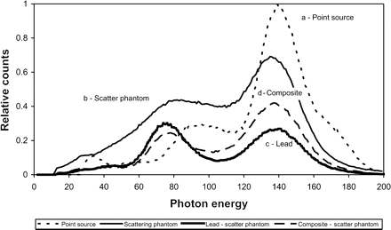
Figure 4. Energy spectra of a point source of ^{99m}Tc (a); scattering phantom with no apron (b); scattering ...
Notes:
Figure 4. Energy spectra of a point source of 99mTc (a); scattering phantom with no apron (b); scattering phantom with lead apron (c); scattering phantom with Roland apron (d).
Unless provided in the caption above, the following copyright applies to the content of this slide: © The Author 2007. Published by Oxford University Press. All rights reserved. For Permissions, please email: journals.permissions@oxfordjournals.org

