Slide 1
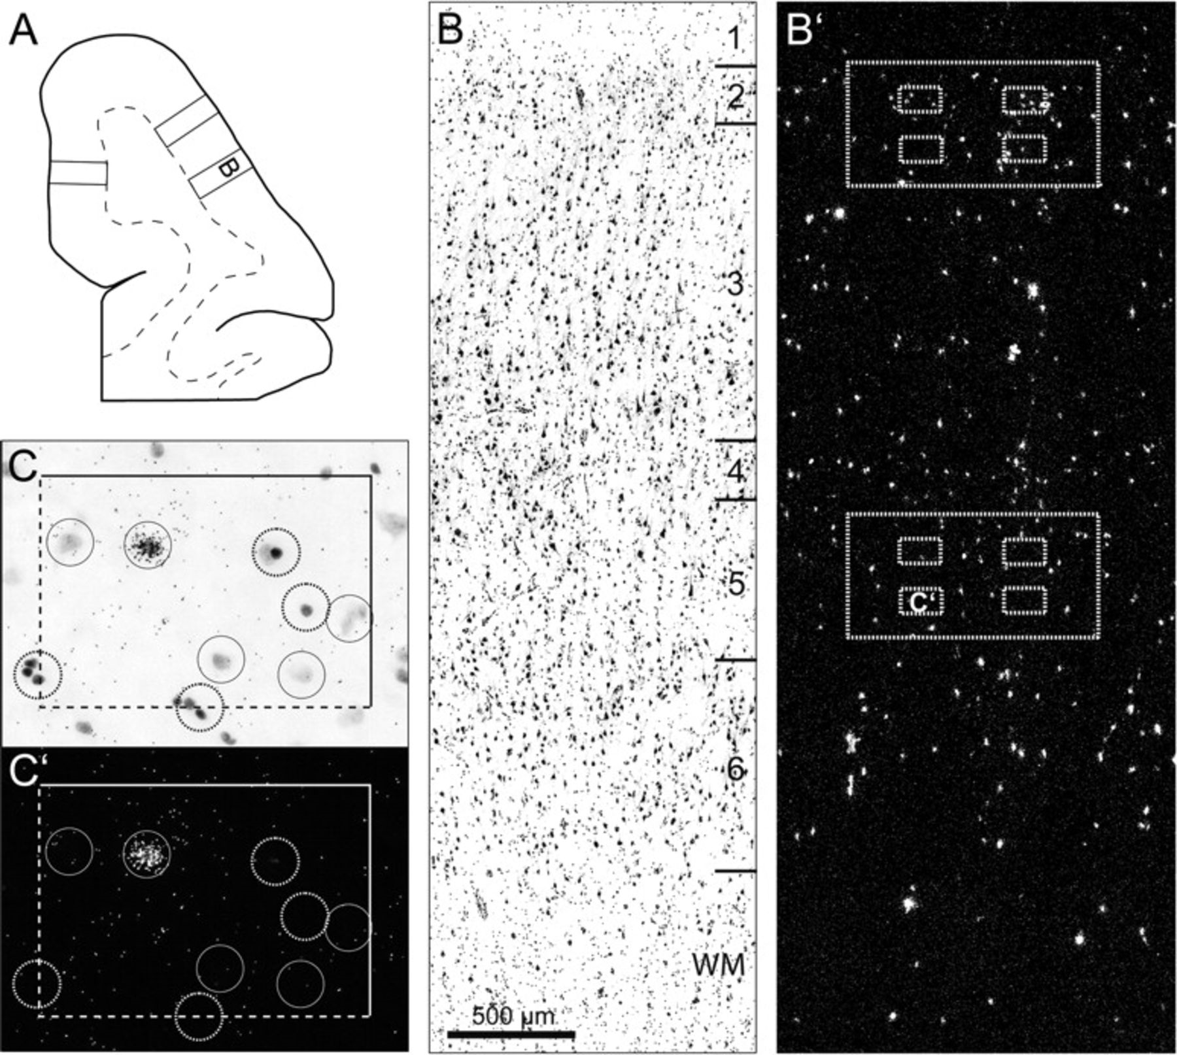
Figure 1. Schematic representation of the sampling strategy for grain analysis of SST mRNA expression. (A) Camera ...
Notes:
Figure 1. Schematic representation of the sampling strategy for grain analysis of SST mRNA expression. (A) Camera lucida drawing of the portion of DLPFC containing area 9, with the dotted line indicating the gray/white matter border. Three cortical traverses from the pial surface to white matter were placed in each section. (B) Brightfield photomicrograph of a representative traverse from a Nissl-stained section. (B′) Darkfield photomicrograph of an adjacent emulsion-dipped section illustrating silver grain accumulation over neuronal nuclei. Two ROIs (large dashed rectangles) were placed in layers 2/3s and 5. Four sampling frames (smaller dashed rectangles) were placed in each zone. (C) Representative brightfield image in which Nissl-stained neuronal nuclei were identified and sampled based upon unbiased inclusion and exclusion rules. Each 120 × 170-μm counting frame had broken and solid lines indicating inclusion and exclusion boundaries, respectively. Circles with a 22 μm diameter were centered over all neuronal nuclei (solid circles) and 4 glia nuclei (dashed circles) in every counting frame, and the number of grains in each circle was counted in the corresponding darkfield image (C′).
Unless provided in the caption above, the following copyright applies to the content of this slide: © The Author 2008. Published by Oxford University Press. All rights reserved. For permissions, please e-mail: journals.permissions@oxfordjournals.org

Slide 2
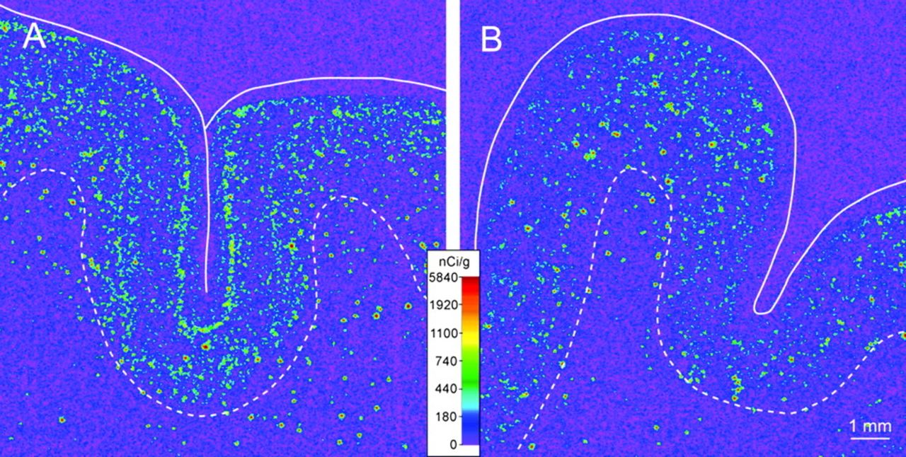
Figure 2. Representative film autoradiograms from 1 pair of subjects illustrating SST mRNA expression in human DLPFC. ...
Notes:
Figure 2. Representative film autoradiograms from 1 pair of subjects illustrating SST mRNA expression in human DLPFC. The densities of hybridization signals are represented in a pseudocolor manner according to the calibration scale (center). The solid and dashed lines indicate the pial surface and the gray/white matter border, respectively. Expression of SST mRNA in the cortical gray matter is reduced in the subject with schizophrenia (B) relative to the matched control subject (A).
Unless provided in the caption above, the following copyright applies to the content of this slide: © The Author 2008. Published by Oxford University Press. All rights reserved. For permissions, please e-mail: journals.permissions@oxfordjournals.org

Slide 3
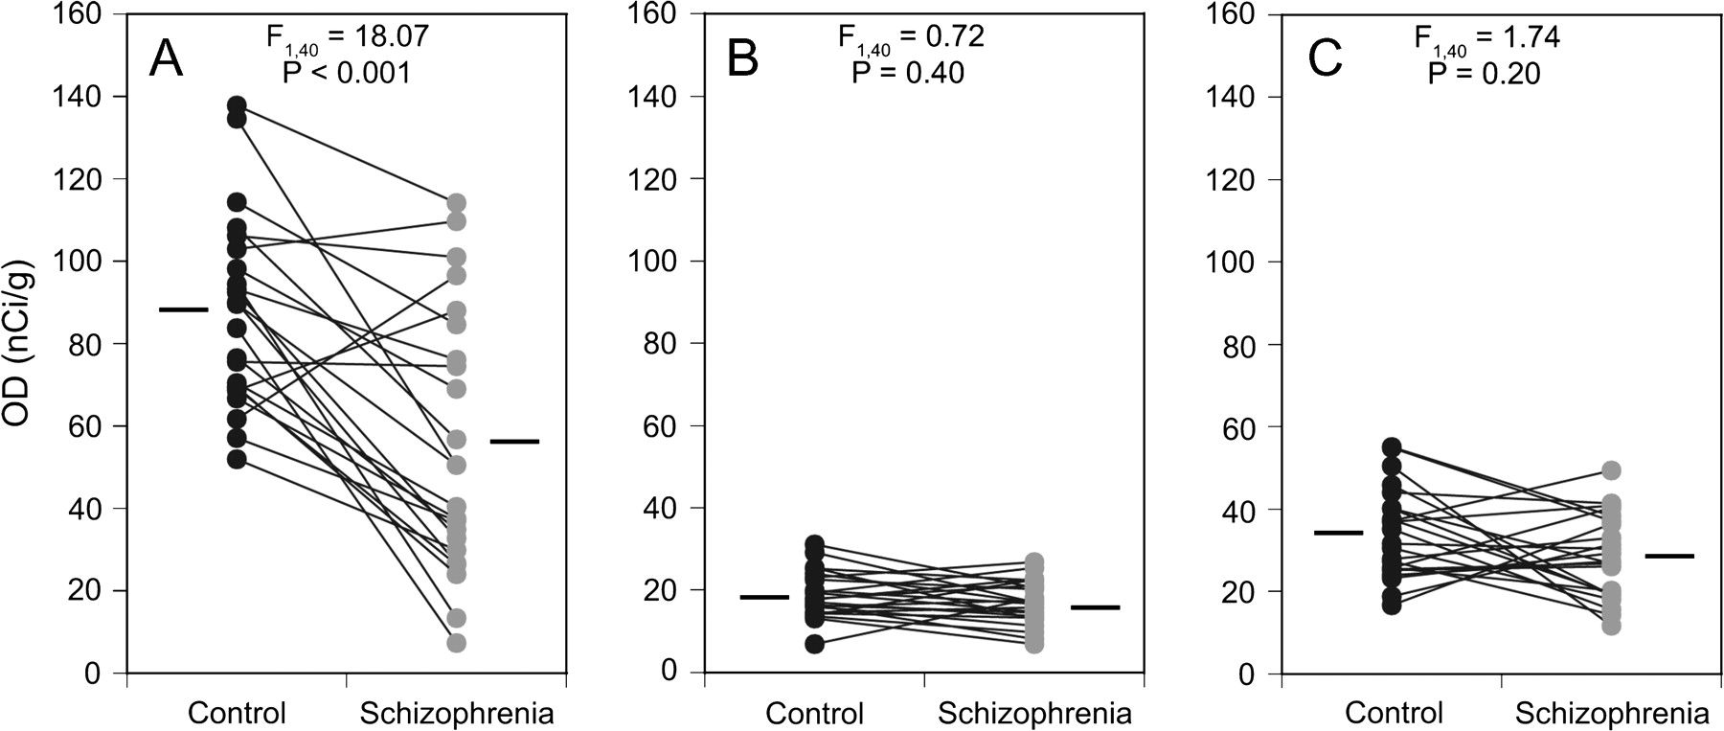
Figure 3. SST mRNA expression levels assessed by autoradiographic film OD measures in DLPFC area 9 of subjects with ...
Notes:
Figure 3. SST mRNA expression levels assessed by autoradiographic film OD measures in DLPFC area 9 of subjects with schizophrenia (gray circles) and control subjects (black circles). Subjects in each pair are connected by black lines and the mean expression levels for each subject group are represented by a horizontal line. The expression of SST mRNA is significantly reduced in the gray matter (A), but not in the total white matter (B) or the superficial white matter (C) of the schizophrenia subjects.
Unless provided in the caption above, the following copyright applies to the content of this slide: © The Author 2008. Published by Oxford University Press. All rights reserved. For permissions, please e-mail: journals.permissions@oxfordjournals.org

Slide 4
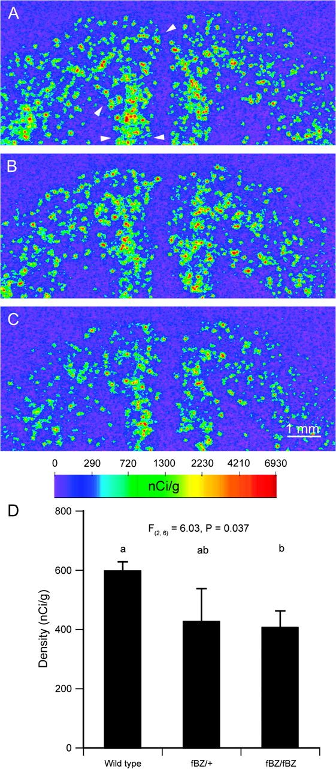
Figure 10. Representative film autoradiograms illustrating SST mRNA expression in a wild-type mouse (A), a mouse ...
Notes:
Figure 10. Representative film autoradiograms illustrating SST mRNA expression in a wild-type mouse (A), a mouse heterozygous for the fBZ locus (fBZ/+) (B), and a mouse homozygous for the fBZ locus (fBZ/fBZ) (C). The arrowheads (apply to all sections) in A indicate the quantified regions in the frontal cortex. The densities of hybridization signals are presented in a pseudocolor manner according to the calibration scale (below C). (D) Bar graph representing mean ± SD of SST mRNA in the PFC in each genotype. Bars not sharing the same letter are significantly different (P < 0.05; post hoc Tukey's multiple comparison).
Unless provided in the caption above, the following copyright applies to the content of this slide: © The Author 2008. Published by Oxford University Press. All rights reserved. For permissions, please e-mail: journals.permissions@oxfordjournals.org

Slide 5
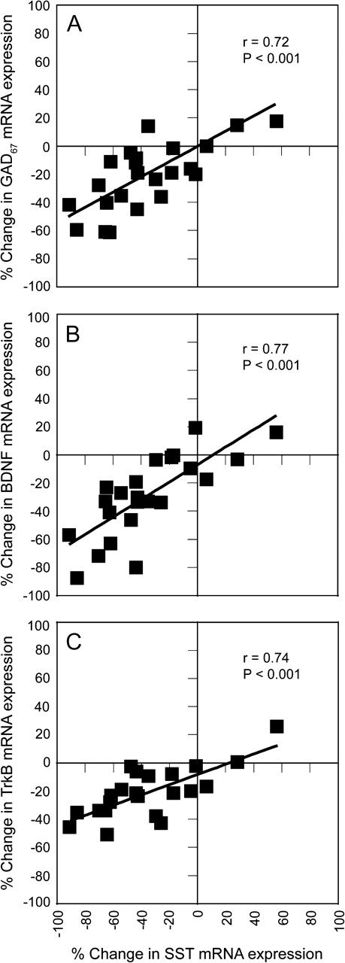
Figure 9. Correlations of within-subject pair percent differences in SST mRNA expression with GAD67 (A), BDNF (B), and ...
Notes:
Figure 9. Correlations of within-subject pair percent differences in SST mRNA expression with GAD67 (A), BDNF (B), and TrkB (C) mRNA expression.
Unless provided in the caption above, the following copyright applies to the content of this slide: © The Author 2008. Published by Oxford University Press. All rights reserved. For permissions, please e-mail: journals.permissions@oxfordjournals.org

Slide 6
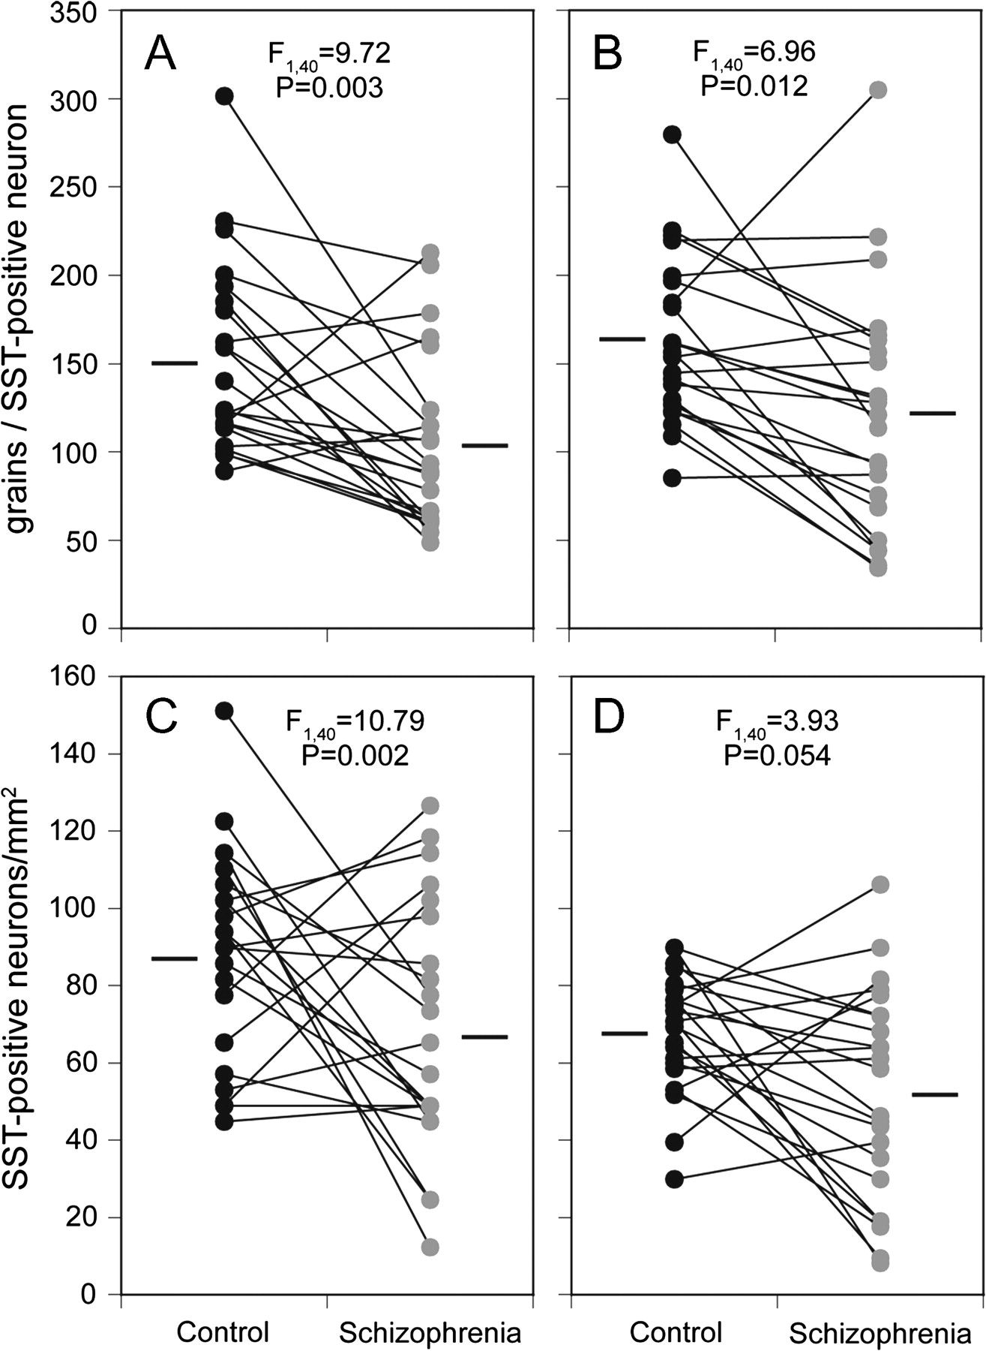
Figure 8. Cellular SST mRNA measurements in the DLPFC area 9 of subjects with schizophrenia (gray circles) and control ...
Notes:
Figure 8. Cellular SST mRNA measurements in the DLPFC area 9 of subjects with schizophrenia (gray circles) and control subjects (black circles) as expressed by grains per positive neuron (A, B) in layer 2/3s (A) and layer 5 (B) and positive neuron density (C, D) in layer 2/3s (C) and layer 5 (D). Subjects in each pair are connected by black lines and the mean values for each subject group are indicated by a horizontal line.
Unless provided in the caption above, the following copyright applies to the content of this slide: © The Author 2008. Published by Oxford University Press. All rights reserved. For permissions, please e-mail: journals.permissions@oxfordjournals.org

Slide 7
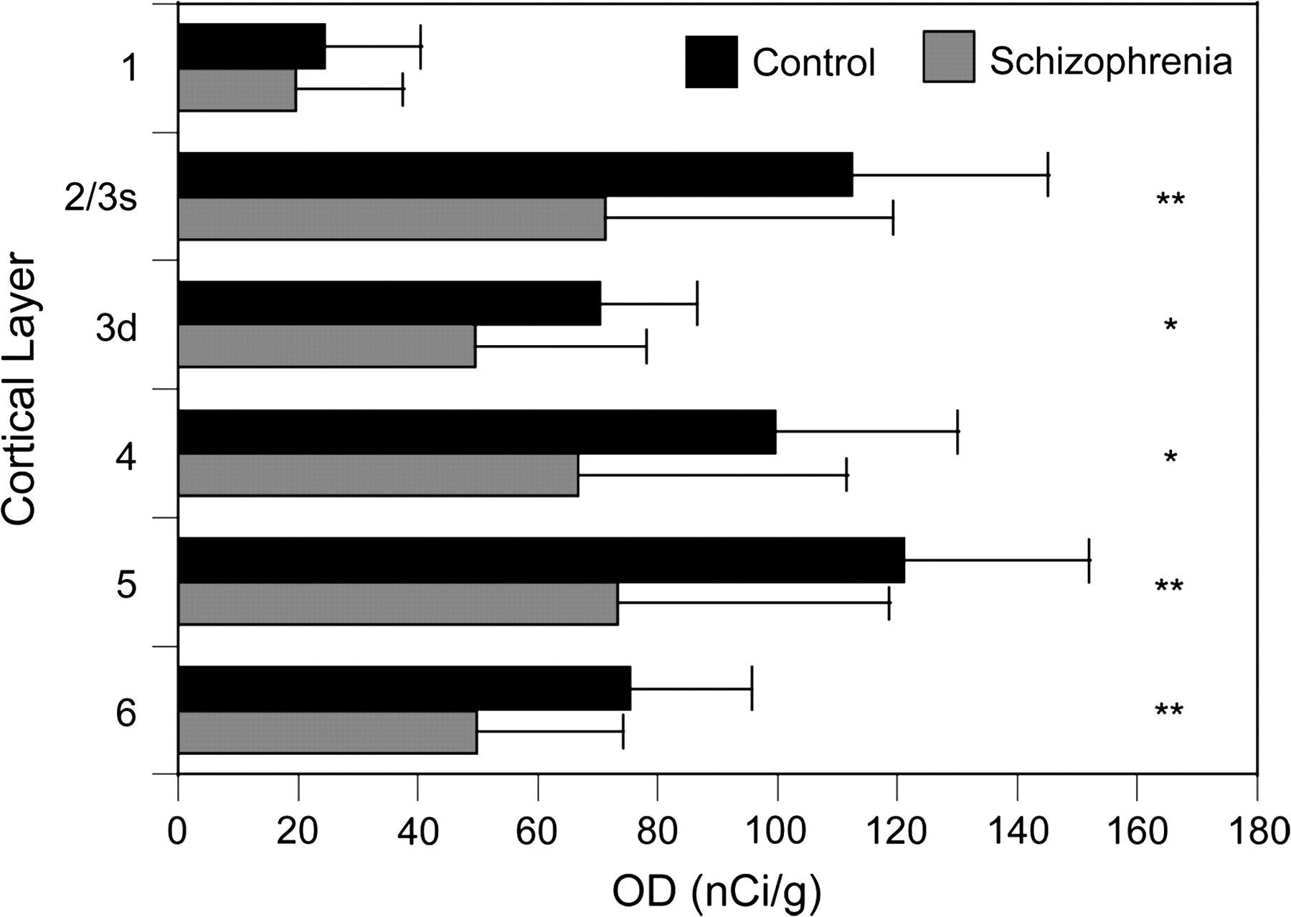
Figure 7. Mean (SD) expression levels of SST mRNA by layer as assessed by film autoradiography OD measures in each ...
Notes:
Figure 7. Mean (SD) expression levels of SST mRNA by layer as assessed by film autoradiography OD measures in each cortical layer. *P < 0.05, after Holm's correction. **P < 0.01, after Holm's correction.
Unless provided in the caption above, the following copyright applies to the content of this slide: © The Author 2008. Published by Oxford University Press. All rights reserved. For permissions, please e-mail: journals.permissions@oxfordjournals.org

Slide 8
Figure 6. Representative film autoradiograms illustrating the expression of SST mRNA in the dorsal PFC of a control ...
Notes:
Figure 6. Representative film autoradiograms illustrating the expression of SST mRNA in the dorsal PFC of a control monkey (A) and an age-, sex-, and body weight–matched monkey chronically exposed to haloperidol (B). The densities of the hybridization signal are presented in a pseudocolor manner according to the calibration scale (in A). The signal density appears to be unchanged in the haloperidol-exposed monkey (B) relative to the control monkey (A). Solid and dashed lines indicate the pial surface and the gray/white matter border, respectively. Open and filled arrowheads indicate the principal and cingulate sulci, respectively.
Unless provided in the caption above, the following copyright applies to the content of this slide: © The Author 2008. Published by Oxford University Press. All rights reserved. For permissions, please e-mail: journals.permissions@oxfordjournals.org

Slide 9
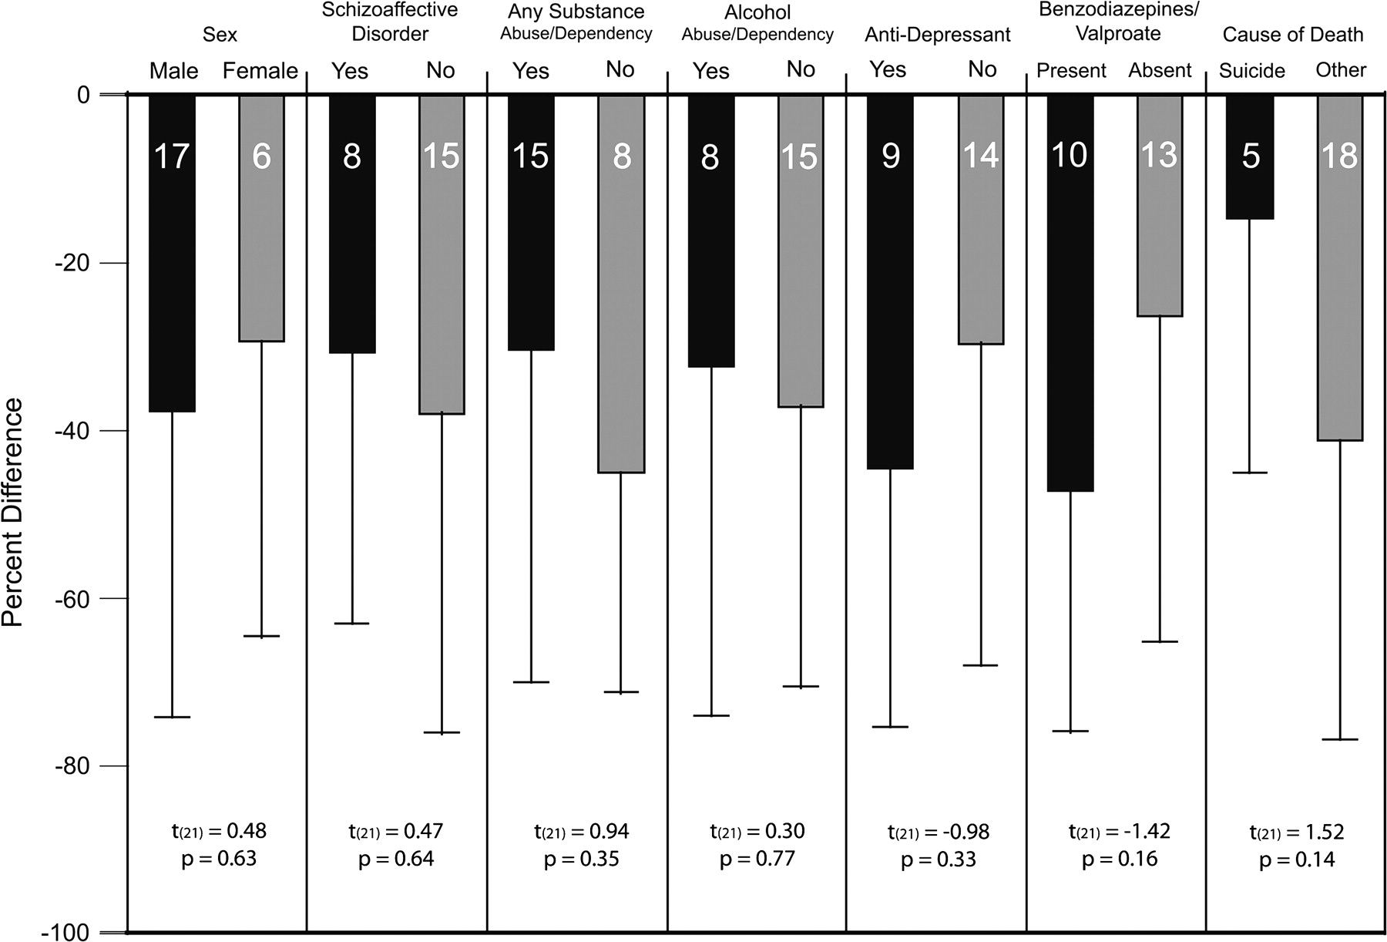
Figure 5. The effects of potential confounding factors on the expression changes in SST mRNA in subjects with ...
Notes:
Figure 5. The effects of potential confounding factors on the expression changes in SST mRNA in subjects with schizophrenia. The bars represent the mean (SD) percent differences from control subjects for SST mRNA within-subject pairs, and the numbers within each bar indicate the number of subject pairs. Neither sex, diagnosis of schizoaffective disorder, lifetime history of any substance abuse or dependence, diagnosis of alcohol abuse or dependence at time of death, history of antidepressant medications, the presence of benzodiazepines/valproate at time of death, nor cause of death significantly affected the expression changes in SST mRNA.
Unless provided in the caption above, the following copyright applies to the content of this slide: © The Author 2008. Published by Oxford University Press. All rights reserved. For permissions, please e-mail: journals.permissions@oxfordjournals.org

Slide 10
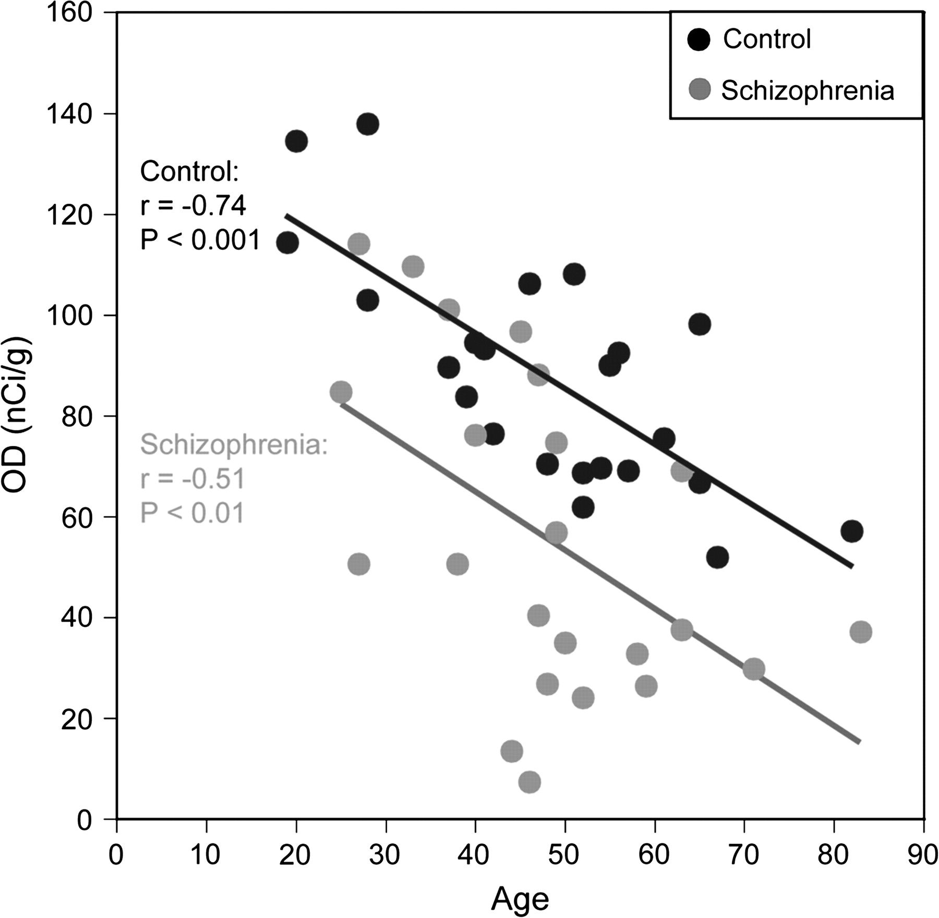
Figure 4. OD measures of SST mRNA expression in human area 9 as a function of age. SST mRNA expression levels are ...
Notes:
Figure 4. OD measures of SST mRNA expression in human area 9 as a function of age. SST mRNA expression levels are significantly negatively correlated with age in both subject groups. The regression line for subjects with schizophrenia (gray line) is parallel to and shifted downward from that for control subjects (black line), suggesting that the decreased expression of SST mRNA is similar in magnitude across adult life.
Unless provided in the caption above, the following copyright applies to the content of this slide: © The Author 2008. Published by Oxford University Press. All rights reserved. For permissions, please e-mail: journals.permissions@oxfordjournals.org

