Slide 1
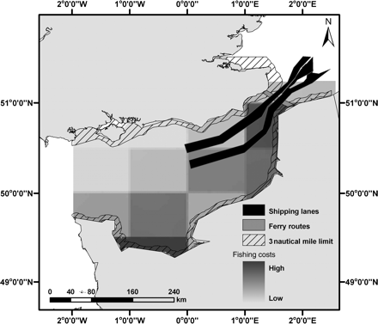
Figure 1. Parameters used to define the planning-unit costs.
Notes:
Figure 1. Parameters used to define the planning-unit costs.
Unless provided in the caption above, the following copyright applies to the content of this slide: © 2011 International Council for the Exploration of the Sea. Published by Oxford University Press. All rights reserved. For Permissions, please email: journals.permissions@oup.com

Slide 2
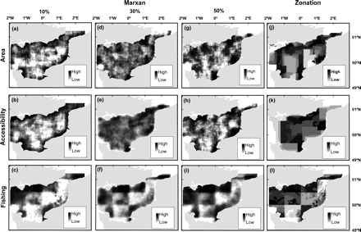
Figure 2. Conservation-value maps for (a)–(i) Marxan and (j)–(l) Zonation based on the three different targets and cost ...
Notes:
Figure 2. Conservation-value maps for (a)–(i) Marxan and (j)–(l) Zonation based on the three different targets and cost metrics. The conservation value for Marxan is based on the selection frequency and for Zonation on the hierarchical solution output. There are only three maps for Zonation because the hierarchical solution output is a nested output and does not change when using different targets.
Unless provided in the caption above, the following copyright applies to the content of this slide: © 2011 International Council for the Exploration of the Sea. Published by Oxford University Press. All rights reserved. For Permissions, please email: journals.permissions@oup.com

Slide 3
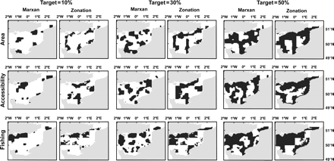
Figure 3. Priority-area maps identified using Marxan and Zonation based on the three different targets and cost ...
Notes:
Figure 3. Priority-area maps identified using Marxan and Zonation based on the three different targets and cost metrics.
Unless provided in the caption above, the following copyright applies to the content of this slide: © 2011 International Council for the Exploration of the Sea. Published by Oxford University Press. All rights reserved. For Permissions, please email: journals.permissions@oup.com

Slide 4
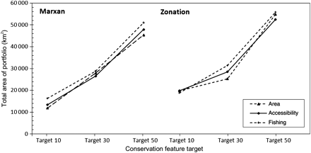
Figure 4. Area of priority areas identified by Marxan and Zonation based on the three different cost metrics and ...
Notes:
Figure 4. Area of priority areas identified by Marxan and Zonation based on the three different cost metrics and increasing targets.
Unless provided in the caption above, the following copyright applies to the content of this slide: © 2011 International Council for the Exploration of the Sea. Published by Oxford University Press. All rights reserved. For Permissions, please email: journals.permissions@oup.com

