Slide 1
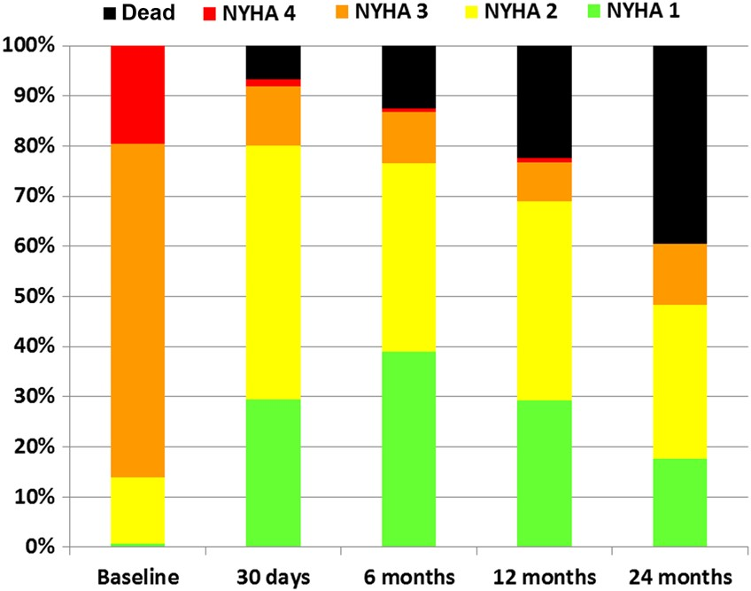
Figure 1 Evolution of New York Heart Association functional class after transcatheter aortic valve implantation.
Notes:
Figure 1 Evolution of New York Heart Association functional class after transcatheter aortic valve implantation.
Unless provided in the caption above, the following copyright applies to the content of this slide: Published on behalf of the European Society of Cardiology. All rights reserved. © The Author 2016. For permissions please email: journals.permissions@oup.com.

Slide 2
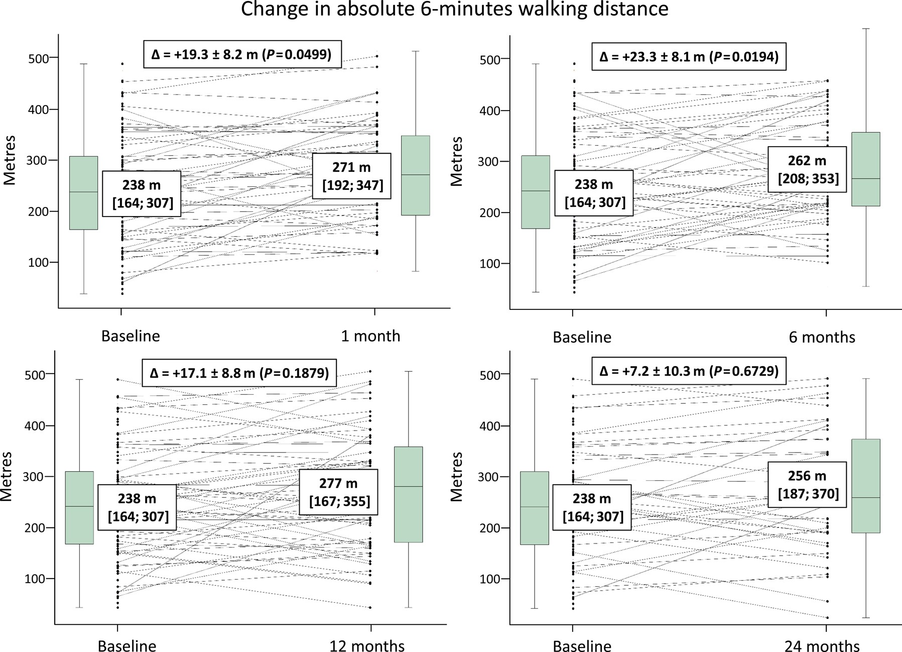
Figure 2 Evolution of 6-minute walking distance after transcatheter aortic valve implantation. Absolute 6-minute ...
Notes:
Figure 2 Evolution of 6-minute walking distance after transcatheter aortic valve implantation. Absolute 6-minute walking distance in metres at baseline and follow-up is presented as median [interquartile range]. Change from baseline is presented as mean and standard deviation and 95% confidence interval.
Unless provided in the caption above, the following copyright applies to the content of this slide: Published on behalf of the European Society of Cardiology. All rights reserved. © The Author 2016. For permissions please email: journals.permissions@oup.com.

Slide 3
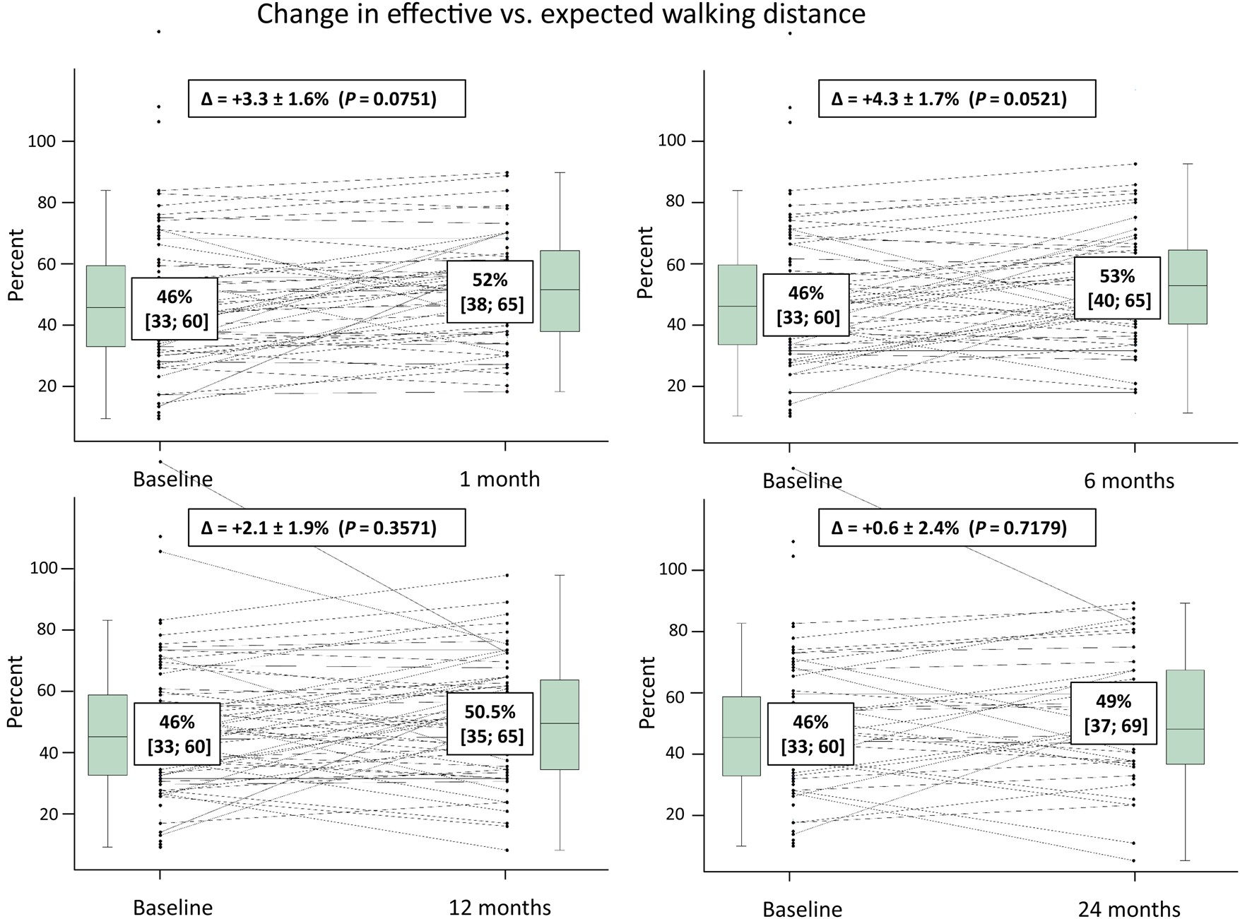
Figure 3 Evolution of effective vs. expected 6-minute walking distance after transcatheter aortic valve implantation. ...
Notes:
Figure 3 Evolution of effective vs. expected 6-minute walking distance after transcatheter aortic valve implantation. Proportional 6-minute walking distance (percent of expected distance) at baseline and follow-up is presented as median [interquartile range]. Change from baseline is presented as mean and standard deviation and 95% confidence interval.
Unless provided in the caption above, the following copyright applies to the content of this slide: Published on behalf of the European Society of Cardiology. All rights reserved. © The Author 2016. For permissions please email: journals.permissions@oup.com.

Slide 4
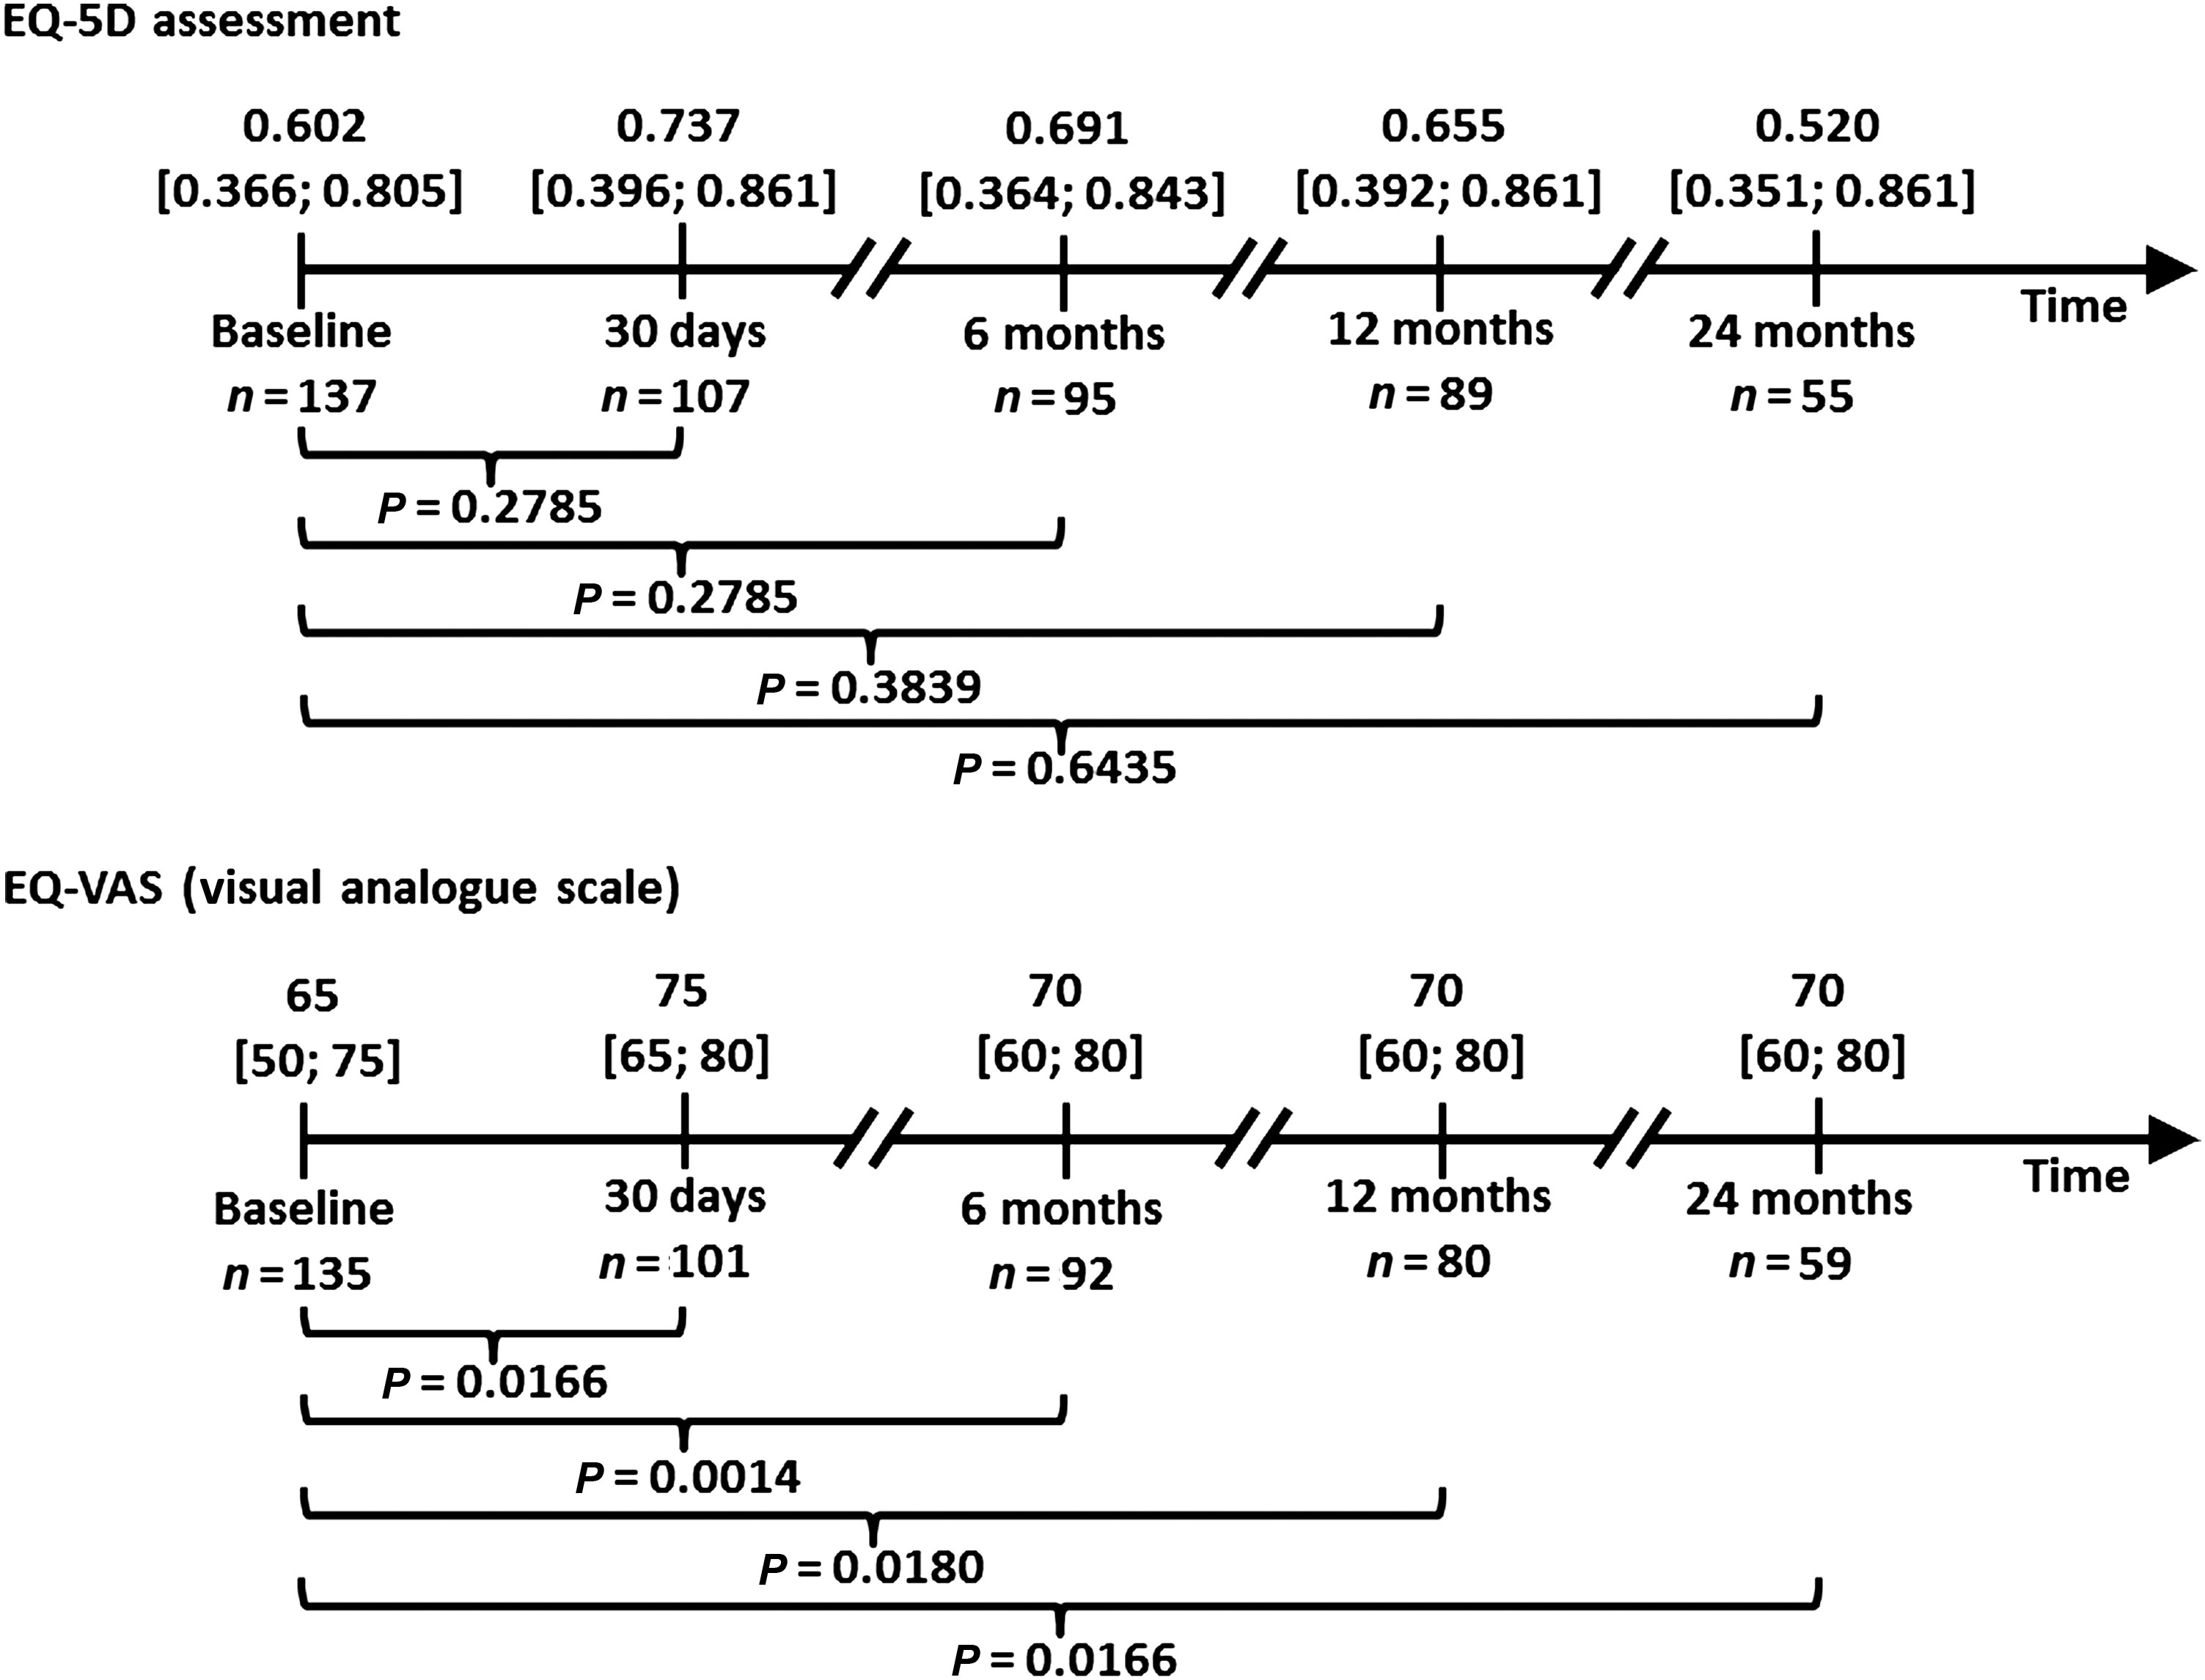
Figure 4 EuroQol-5D and visual analogue scale quality-of-life scores before and after transcatheter aortic valve ...
Notes:
Figure 4 EuroQol-5D and visual analogue scale quality-of-life scores before and after transcatheter aortic valve implantation. EuroQol-5D and visual analogue scale indices at baseline and follow-up are presented as median [interquartile range] values.
Unless provided in the caption above, the following copyright applies to the content of this slide: Published on behalf of the European Society of Cardiology. All rights reserved. © The Author 2016. For permissions please email: journals.permissions@oup.com.

