Slide 1
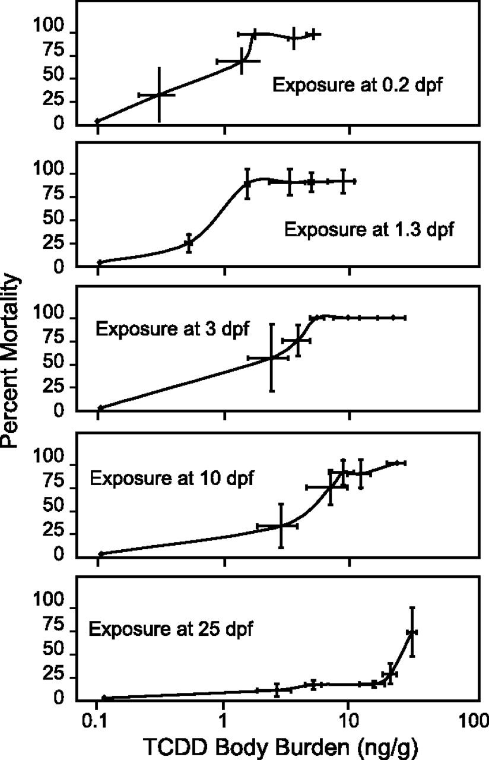
FIG. 1. Sensitivity to TCDD decreases with age at exposure. Zebrafish were exposed to graded concentrations of ...
Notes:
FIG. 1. Sensitivity to TCDD decreases with age at exposure. Zebrafish were exposed to graded concentrations of 3H-TCDD as described in the Materials and Methods section and evaluated for mortality 10 days after exposure. Cumulative mortality was corrected for control mortality. Error bars indicate SEM for both mortality and TCDD concentration.
Unless provided in the caption above, the following copyright applies to the content of this slide: © The Author 2012. Published by Oxford University Press on behalf of the Society of Toxicology. All rights reserved. For permissions, please email: journals.permissions@oup.com

Slide 2
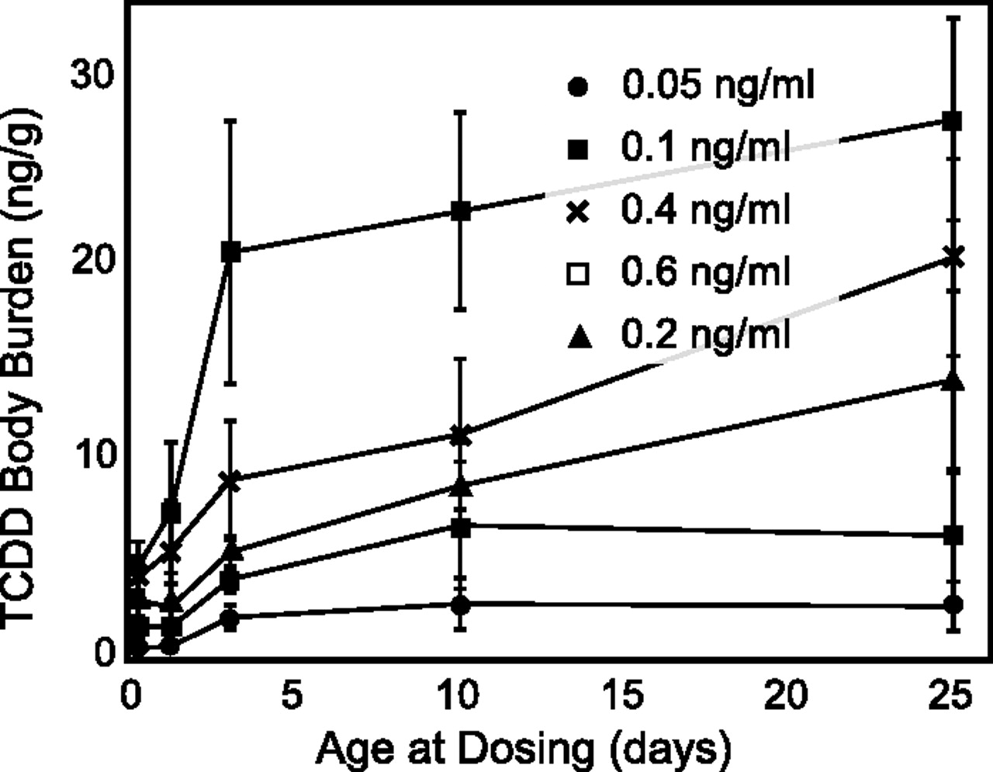
FIG. 2. Waterborne TCDD exposure: body burden increases with age at exposure. Zebrafish were exposed to graded ...
Notes:
FIG. 2. Waterborne TCDD exposure: body burden increases with age at exposure. Zebrafish were exposed to graded concentrations of 3H-TCDD (0.05 ng/ml, solid circles; 0.1 ng/ml, solid squares; 0.2 ng/ml, solid triangles; 0.4 ng/ml, ×; 0.6 ng/ml, open squares) at 5 ages—0.2, 1.3, 3, 10, and 25 dpf. Samples were collected at 1-h post-exposure and body burdens (ng/g) of TCDD were calculated using liquid scintillation counting. Error bars indicate SEM.
Unless provided in the caption above, the following copyright applies to the content of this slide: © The Author 2012. Published by Oxford University Press on behalf of the Society of Toxicology. All rights reserved. For permissions, please email: journals.permissions@oup.com

Slide 3
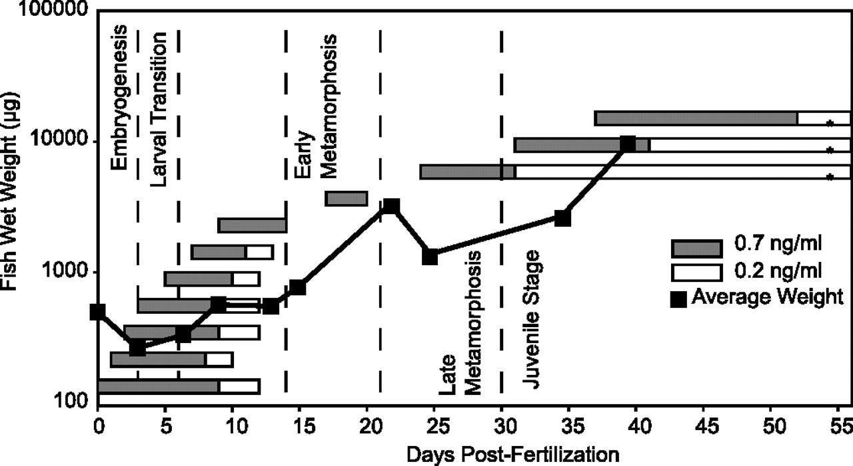
FIG. 3. Relationship between age, growth, and response to TCDD exposure. Separate groups of fish were exposed to a ...
Notes:
FIG. 3. Relationship between age, growth, and response to TCDD exposure. Separate groups of fish were exposed to a low dose (0.2 ng/ml, light boxes) and a high dose (0.7 ng/ml, shaded boxes) at the indicated time during development. The x-axis indicates time. The boxes indicate the time of dosing (left edge) and the time at 50% mortality (right edge). For reference, the average weight of control vehicle-exposed fish is plotted on the y-axis, and the stages of development are indicated along the time line. To establish weight, 10 individuals were placed in a preweighed plastic weighing boat, and excess water was removed with a micropipette and then weighed on a microbalance to obtain an average wet weight.
Unless provided in the caption above, the following copyright applies to the content of this slide: © The Author 2012. Published by Oxford University Press on behalf of the Society of Toxicology. All rights reserved. For permissions, please email: journals.permissions@oup.com

Slide 4
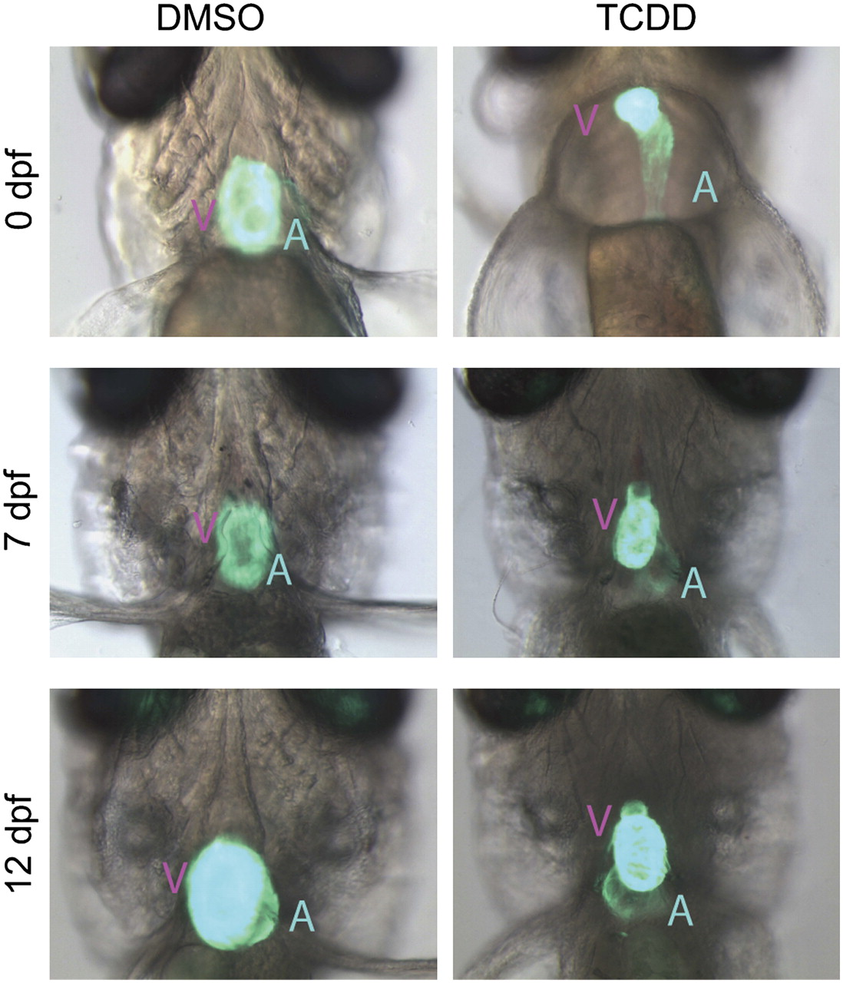
FIG. 4. Changing cardiotoxicity with age at exposure. Albino Tg(cmlc2: GFP) zebrafish were exposed to TCDD (1 ng/ml) ...
Notes:
FIG. 4. Changing cardiotoxicity with age at exposure. Albino Tg(cmlc2: GFP) zebrafish were exposed to TCDD (1 ng/ml) or vehicle at 0 hpf, 7 dpf, and 12 dpf as described in the Materials and Methods section. At 4 days after exposure, ventral bright field and fluorescence images were taken and merged to show changes in heart morphology in situ. V indicates ventricle; A indicates atrium.
Unless provided in the caption above, the following copyright applies to the content of this slide: © The Author 2012. Published by Oxford University Press on behalf of the Society of Toxicology. All rights reserved. For permissions, please email: journals.permissions@oup.com

Slide 5
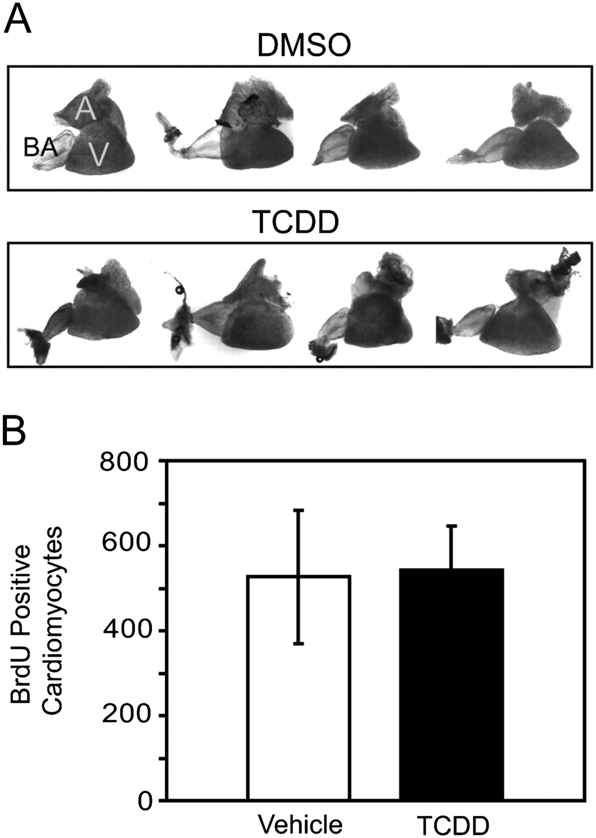
FIG. 5. Lethal exposure to TCDD produces no signs of cardiotoxicity in juveniles. Zebrafish juveniles (30 dpf) were ...
Notes:
FIG. 5. Lethal exposure to TCDD produces no signs of cardiotoxicity in juveniles. Zebrafish juveniles (30 dpf) were statically exposed in water to either TCDD (1 ng/ml) or vehicle (DMSO) in 20 ml glass scintillation vials for 1 h. After exposure, fish were rinsed in TCDD-free water and placed in housing aquaria. (A) Hearts were isolated at 2 weeks post-exposure and four representative hearts from each group are shown. BA indicates bulbus arteriosus; A, the atrium; and V, the ventricle. (B) Juvenile zebrafish exposed to vehicle or TCDD as above were raised in water with 10nM BrdU for 1 week, and hearts were extracted for counting BrdU positive cardiomyocytes. The y-axis indicates positive cells/heart. Error bars indicate SEM, n = 5.
Unless provided in the caption above, the following copyright applies to the content of this slide: © The Author 2012. Published by Oxford University Press on behalf of the Society of Toxicology. All rights reserved. For permissions, please email: journals.permissions@oup.com

Slide 6
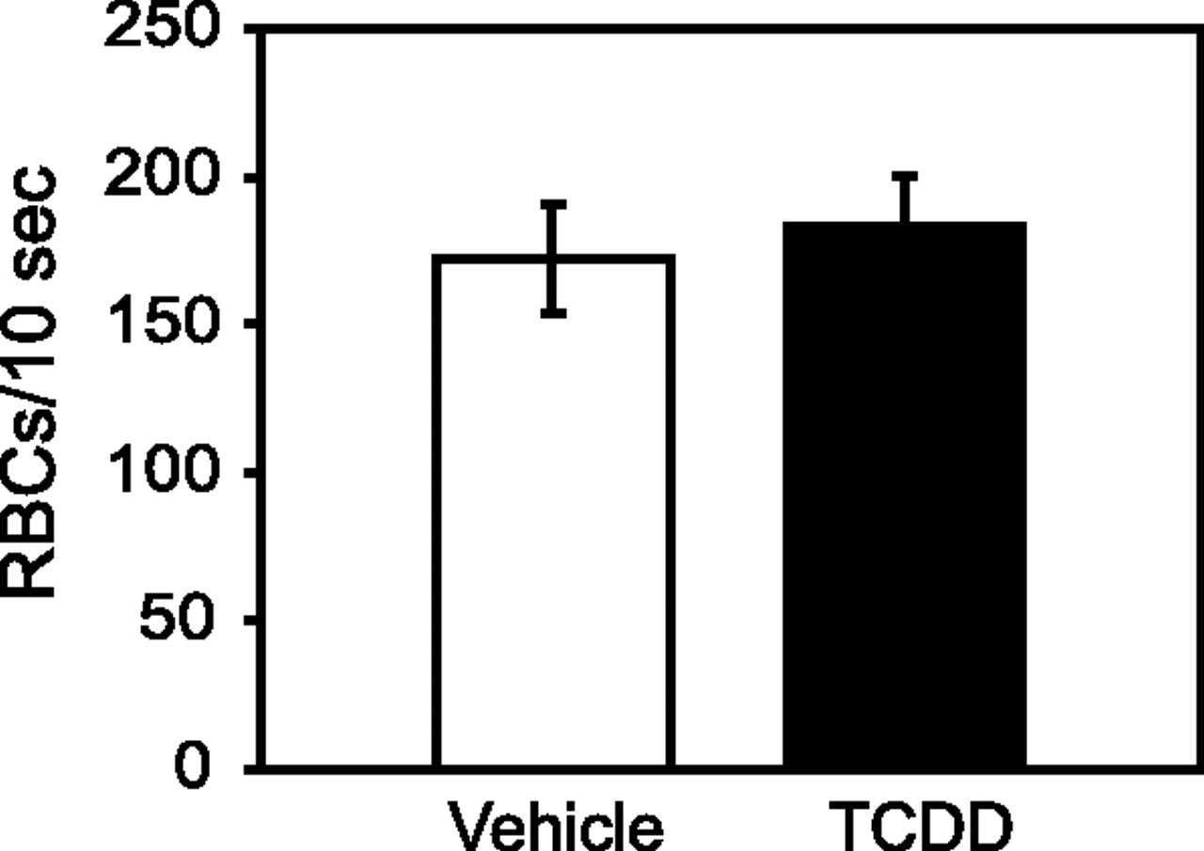
FIG. 6. Lethal exposure to TCDD produces no signs of circulation collapse in juveniles. Zebrafish juveniles (30 dpf) ...
Notes:
FIG. 6. Lethal exposure to TCDD produces no signs of circulation collapse in juveniles. Zebrafish juveniles (30 dpf) were statically exposed in water to either TCDD (1 ng/ml) or vehicle (DMSO) in 20 ml glass scintillation vials for 1 h. After exposure, fish were rinsed in TCDD-free water and placed in housing aquaria. Peripheral blood flow was assessed at 2 weeks post-exposure as described in the Materials and Methods section. The y-axis scale indicates the average number of red blood cells perfusing a segment of caudal fin vessel in 10 s. Error bars indicate SEM with n = 4.
Unless provided in the caption above, the following copyright applies to the content of this slide: © The Author 2012. Published by Oxford University Press on behalf of the Society of Toxicology. All rights reserved. For permissions, please email: journals.permissions@oup.com

Slide 7
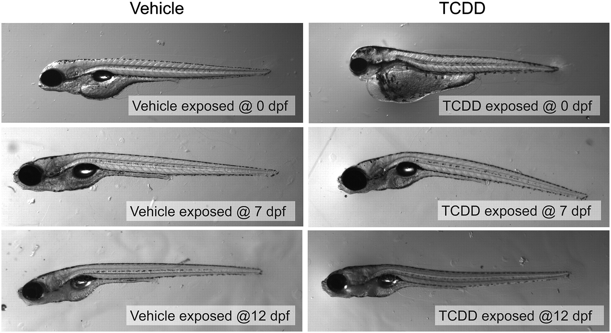
FIG. 7. Morphological changes produced by TCDD in embryonic and larval zebrafish. Zebrafish were exposed to TCDD (1 ...
Notes:
FIG. 7. Morphological changes produced by TCDD in embryonic and larval zebrafish. Zebrafish were exposed to TCDD (1 ng/ml) or vehicle at 0 hpf, 7 dpf, and 12 dpf as described in the Materials and Methods section. At 4 days after exposure, fish were collected for lateral imaging with a dissecting microscope. Representative images are shown.
Unless provided in the caption above, the following copyright applies to the content of this slide: © The Author 2012. Published by Oxford University Press on behalf of the Society of Toxicology. All rights reserved. For permissions, please email: journals.permissions@oup.com

Slide 8
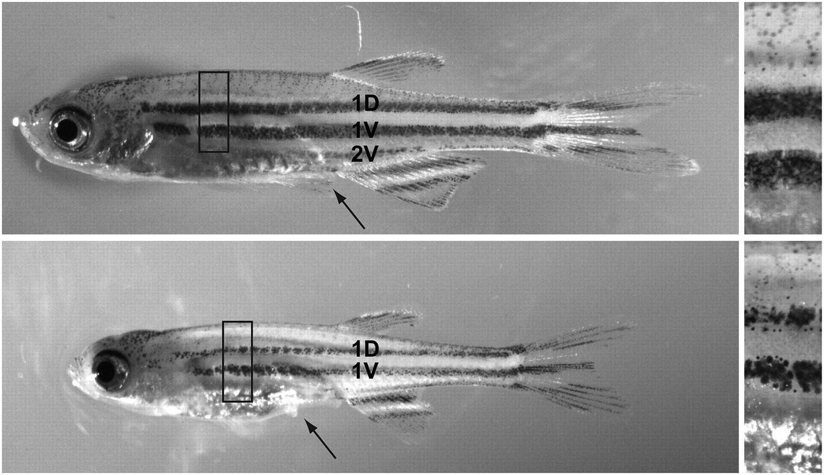
FIG. 8. Juvenile zebrafish exposed to TCDD show altered pigmentation. Zebrafish juveniles (30 dpf) were statically ...
Notes:
FIG. 8. Juvenile zebrafish exposed to TCDD show altered pigmentation. Zebrafish juveniles (30 dpf) were statically exposed in water to either TCDD (1 ng/ml) or vehicle (DMSO) in 20 ml glass scintillation vials for 1 h. After exposure, fish were rinsed in TCDD-free water and placed in housing aquaria. Representative control (upper panel) and TCDD-exposed juvenile (lower panel) zebrafish are shown at 3 weeks post-exposure. Arrow shows the missing pelvic fin and the dorsal (1D) and ventral (1V, 2V) lateral stripes are indicated. The black box indicates the region that was magnified to highlight differences in pigmentation in the adjacent panels.
Unless provided in the caption above, the following copyright applies to the content of this slide: © The Author 2012. Published by Oxford University Press on behalf of the Society of Toxicology. All rights reserved. For permissions, please email: journals.permissions@oup.com

Slide 9
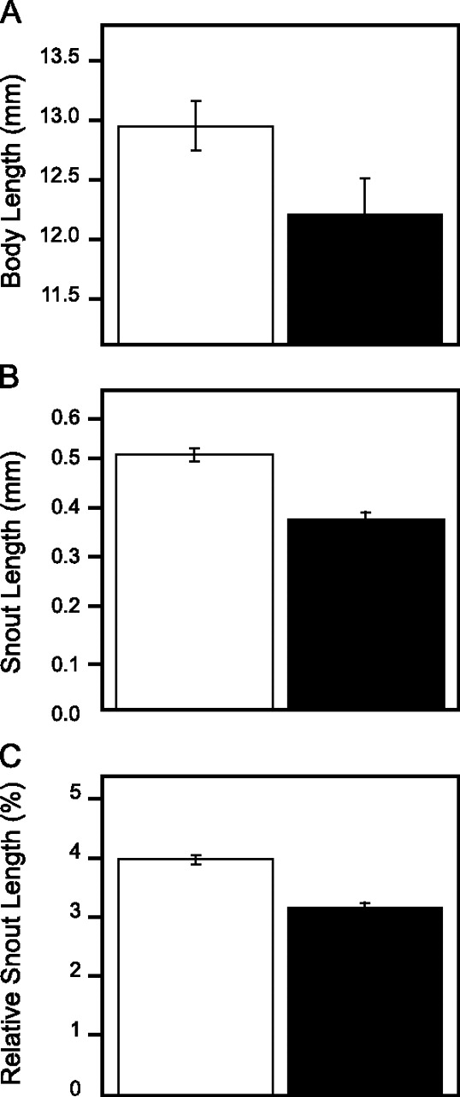
FIG. 9. TCDD exposure reduces snout length in the juvenile. Zebrafish juveniles (30 dpf) were statically exposed in ...
Notes:
FIG. 9. TCDD exposure reduces snout length in the juvenile. Zebrafish juveniles (30 dpf) were statically exposed in water to either TCDD (1 ng/ml) or vehicle (DMSO) in 20 ml glass scintillation vials for 1 h. After exposure, fish were rinsed in TCDD-free water and placed in housing aquaria. Body and snout lengths were measured using images taken with a dissecting microscope as described in the Materials and Methods section. (A) Total length, (B) Snout length, (C) Snout length relative to body length. Averages of three experiments (n = 3), with five individuals per experimental group. Bars indicate mean ± SEM.
Unless provided in the caption above, the following copyright applies to the content of this slide: © The Author 2012. Published by Oxford University Press on behalf of the Society of Toxicology. All rights reserved. For permissions, please email: journals.permissions@oup.com

Slide 10
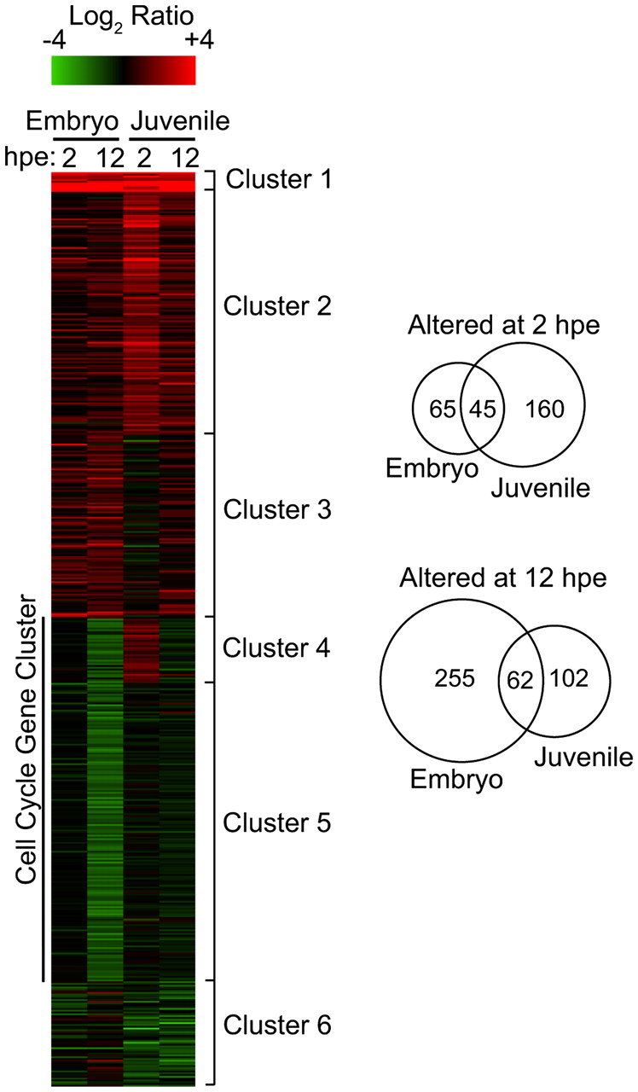
FIG. 10. Gene expression changes produced by TCDD in the juvenile heart do not match those in the embryonic heart. ...
Notes:
FIG. 10. Gene expression changes produced by TCDD in the juvenile heart do not match those in the embryonic heart. Zebrafish juveniles (30 dpf) were statically exposed in water to either TCDD (1 ng/ml) or vehicle (DMSO) in 20 ml glass scintillation vials for 1 h. After exposure, fish were rinsed in TCDD-free water and collected at 2 and 12 h post-exposure, and hearts were removed for microarray analysis. The heat map shows a comparison of the results published by Carney et al. (2006a) of microarray data comparing transcriptional changes in the hearts of embryonic zebrafish and juveniles (hpe) to 1 ng/ml of TCDD. The CCGC that is downregulated in the embryonic heart is indicated. Venn diagrams indicate the number of unique or overlapping transcripts at each time point between embryonic and juvenile hearts.
Unless provided in the caption above, the following copyright applies to the content of this slide: © The Author 2012. Published by Oxford University Press on behalf of the Society of Toxicology. All rights reserved. For permissions, please email: journals.permissions@oup.com

