Slide 1
Fig. 1 Detection of EBNA1 expression by RT–PCR in the same total RNA of NPC samples served in the cDNA microarray ...
Notes:
Fig. 1 Detection of EBNA1 expression by RT–PCR in the same total RNA of NPC samples served in the cDNA microarray analysis GAPDH served as an internal control for each reaction. All 22 NPC biopsies were positive for EBNA1 expression. M, DL2, 000 DNA marker. T1–T22 represent the 22 NPC tissues.
Unless provided in the caption above, the following copyright applies to the content of this slide: © The Author 2009. Published by ABBS Editorial Office in association with Oxford University Press on behalf of the Institute of Biochemistry and Cell Biology, Shanghai Institutes for Biological Sciences, Chinese Academy of Sciences.

Slide 2
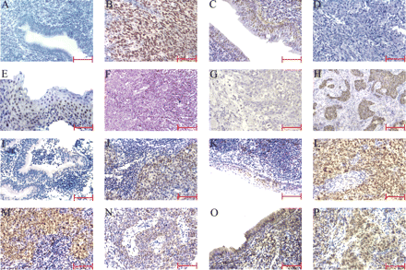
Fig. 2 Representative images of EBER-1 and cell cycle regulators detected by ISH and ICH Brown denote positive ...
Notes:
Fig. 2 Representative images of EBER-1 and cell cycle regulators detected by ISH and ICH Brown denote positive signal. Expression of EBER-1 mRNA in the columnar epithelia cells (A) and differentiated non-keratinizing NPC (B). Expression of p16 in chronic inflammation of nasopharyngeal mucosa (C) and differentiated non-keratinizing NPC (D). Expression of p27 in squamous epithelium (E) and differentiated non-keratinizing NPC (F). Expression of p19 (G) and cyclin D1 (H) in differentiated non-keratinizing NPC. Expression of Rb in chronic inflammation of nasopharyngeal mucosa (I) and differentiated non-keratinizing NPC (J). Expression of phosphorylated Rb in chronic inflammation of nasopharyngeal mucosa (K) and differentiated non-keratinizing NPC (L). Expression of CDK4 (M) and DP2 (N) in differentiated non-keratinizing NPC. Expression of E2F6 in the columnar epithelia cells (O) and differentiated non-keratinizing NPC (P). Bar = 200 µm.
Unless provided in the caption above, the following copyright applies to the content of this slide: © The Author 2009. Published by ABBS Editorial Office in association with Oxford University Press on behalf of the Institute of Biochemistry and Cell Biology, Shanghai Institutes for Biological Sciences, Chinese Academy of Sciences.

Slide 3
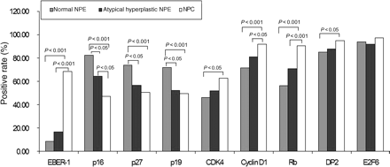
Fig. 3 Abnormal expression of EBER-1 hybridization signals and cell cycle regulators in histologically normal NPE, ...
Notes:
Fig. 3 Abnormal expression of EBER-1 hybridization signals and cell cycle regulators in histologically normal NPE, dysplastic NPE, and NPC Comparison of abnormal expression of EBER-1 hybridization signals, p16, p27, p19, CDK4, cyclin D1, Rb, DP2, and E2F6 proteins between NPC and various types of non-cancerous NPE. Here P-value denotes significant differences between the groups statistically evaluated by χ2 test.
Unless provided in the caption above, the following copyright applies to the content of this slide: © The Author 2009. Published by ABBS Editorial Office in association with Oxford University Press on behalf of the Institute of Biochemistry and Cell Biology, Shanghai Institutes for Biological Sciences, Chinese Academy of Sciences.

Slide 4
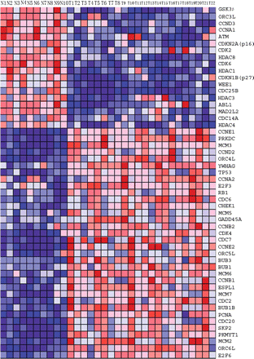
Fig. 4 An expression data set sorted of cell cycle pathway by correlation with phenotype N1–N10 represent the 10 ...
Notes:
Fig. 4 An expression data set sorted of cell cycle pathway by correlation with phenotype N1–N10 represent the 10 non-cancerous NPE tissues, T1–T22 represent the 22 NPC tissues. Signal intensities are illustrated by varying shades of red (up-regulation) and blue (down-regulation).
Unless provided in the caption above, the following copyright applies to the content of this slide: © The Author 2009. Published by ABBS Editorial Office in association with Oxford University Press on behalf of the Institute of Biochemistry and Cell Biology, Shanghai Institutes for Biological Sciences, Chinese Academy of Sciences.

Slide 5
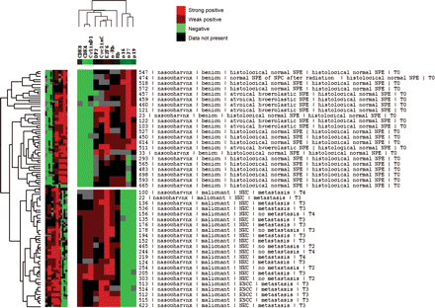
Fig. 5 Unsupervised hierarchical clustering algorithm was used to analyze and visualize the data for the amount of ...
Notes:
Fig. 5 Unsupervised hierarchical clustering algorithm was used to analyze and visualize the data for the amount of information generated in this pilot study by NPC-specific TMA A row corresponds to a single tumor, and each column corresponds to a single protein biomarker. Red means strongly positive, brown means weakly positive, green means negative, and black means data not present. For each tumor, the protein expression score is represented by the color of corresponding cell in the matrix. The length and pattern of the branches of the vertical and horizontal dendrograms reflect the similarity between the tumors and the similarity between the markers, respectively. The shorter the arm of the branches, the greater the similarity of the cases and markers.
Unless provided in the caption above, the following copyright applies to the content of this slide: © The Author 2009. Published by ABBS Editorial Office in association with Oxford University Press on behalf of the Institute of Biochemistry and Cell Biology, Shanghai Institutes for Biological Sciences, Chinese Academy of Sciences.

Slide 6
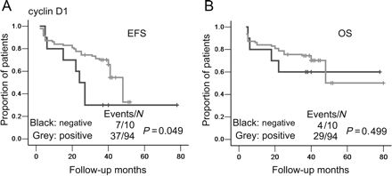
Fig. 6 Kaplan–Meier curve of the recurrence depending on the expression of cyclin D1 (A) EFS of the two groups of ...
Notes:
Fig. 6 Kaplan–Meier curve of the recurrence depending on the expression of cyclin D1 (A) EFS of the two groups of cyclin D1 expression is distinguished: positive expression (grey) and negative expression (black), P = 0.049, log-rank test. (B) OS of the two groups of cyclin D1 expression is not significant: positive expression (grey) and negative expression (black), P = 0.499, log-rank test.
Unless provided in the caption above, the following copyright applies to the content of this slide: © The Author 2009. Published by ABBS Editorial Office in association with Oxford University Press on behalf of the Institute of Biochemistry and Cell Biology, Shanghai Institutes for Biological Sciences, Chinese Academy of Sciences.

