Slide 1
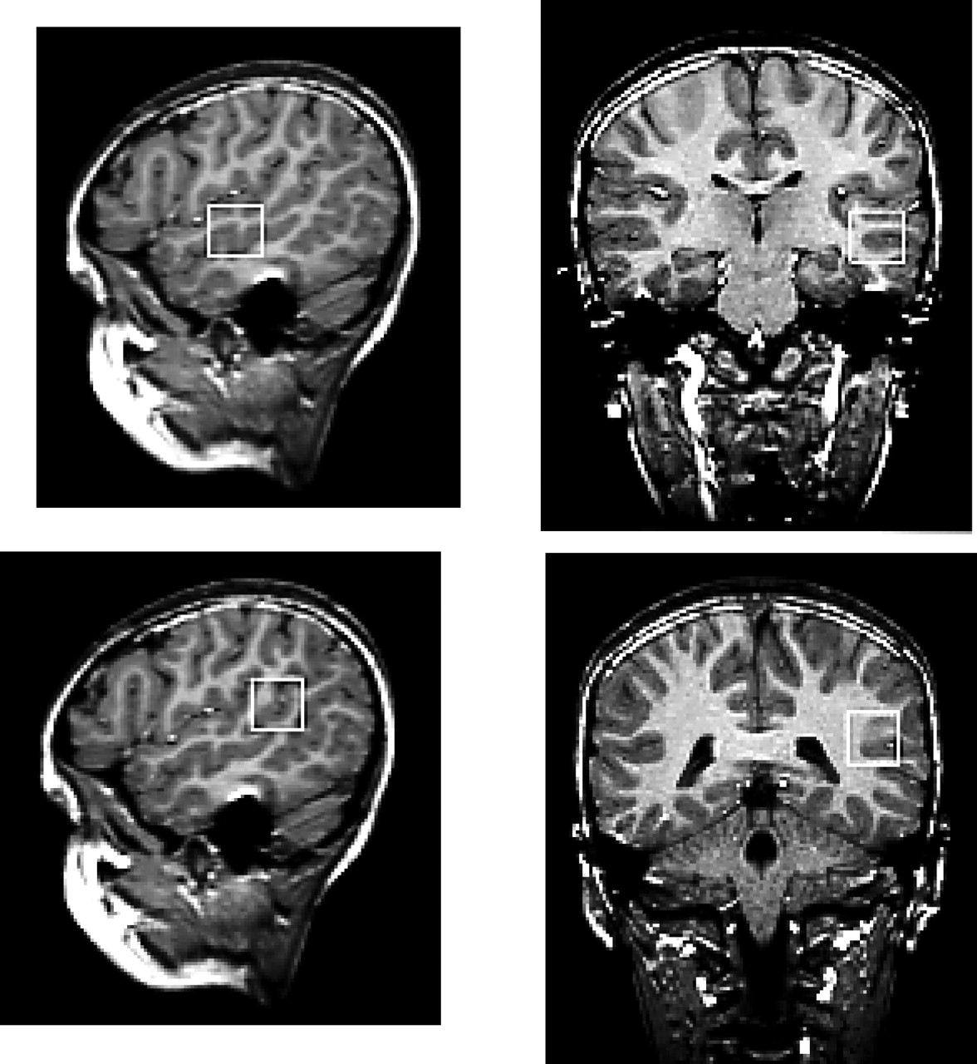
Figure 1. T₁-weighted gradient-echo magnetic resonance images showing placement of voxels for ...
Notes:
Figure 1. T1-weighted gradient-echo magnetic resonance images showing placement of voxels for spectral acquisition.
Unless provided in the caption above, the following copyright applies to the content of this slide:

Slide 2
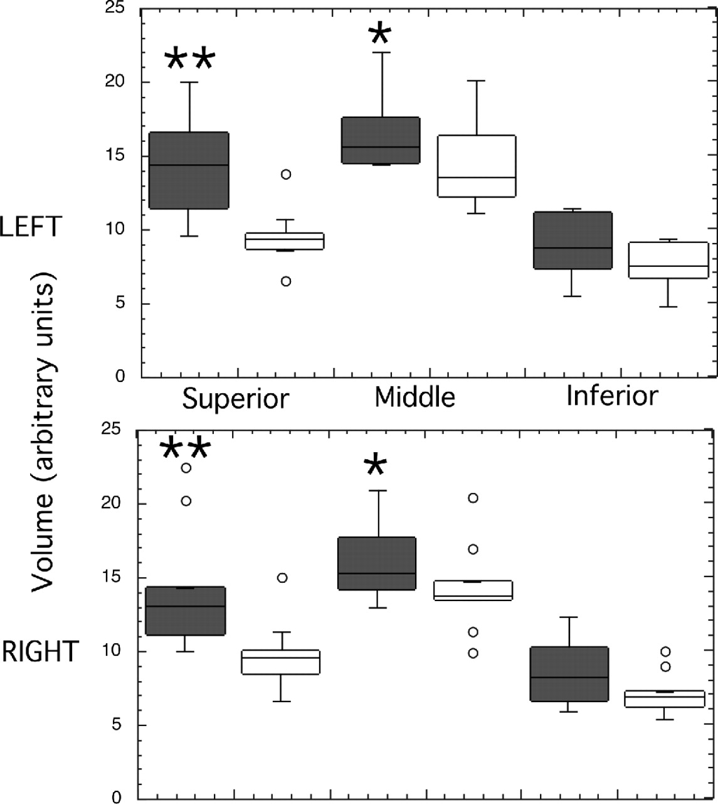
Figure 2. Box and whisker plot of temporal lobe grey matter volume. Dark boxes, Turner syndrome subjects; ...
Notes:
Figure 2. Box and whisker plot of temporal lobe grey matter volume. Dark boxes, Turner syndrome subjects; clear boxes, controls. The line through boxes indicates the median of the data. Boxes enclose 50% of the data and the whiskers show the range except where there are outliers, which are shown as open circles. **P < 0.01; *P < 0.05.
Unless provided in the caption above, the following copyright applies to the content of this slide:

Slide 3
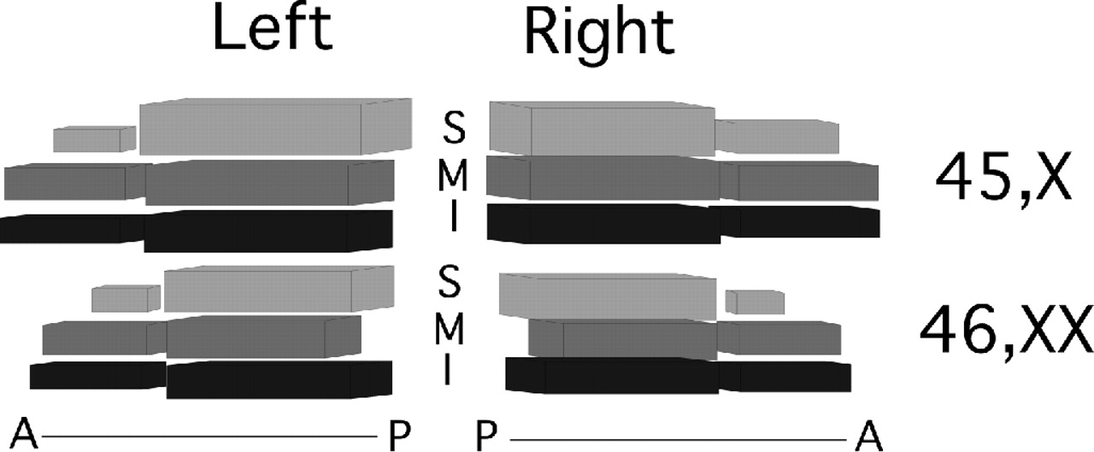
Figure 3. Relative mean amounts of grey matter in left and right superior, middle and inferior temporal gyri ...
Notes:
Figure 3. Relative mean amounts of grey matter in left and right superior, middle and inferior temporal gyri in Turner syndrome and controls. S, superior temporal grey matter; M, middle temporal grey matter; I, inferior temporal grey matter. Each gyrus was divided into anterior and posterior sections at Heschl’s sulcus where the superior temporal gyrus first bifurcates into planum temporale and Heschl’s gyrus. The anterior–posterior axis is indicated for each lobe. Blocks of grey matter are drawn to scale and represent mean length and area (width × depth) data for each group.
Unless provided in the caption above, the following copyright applies to the content of this slide:

