Slide 1
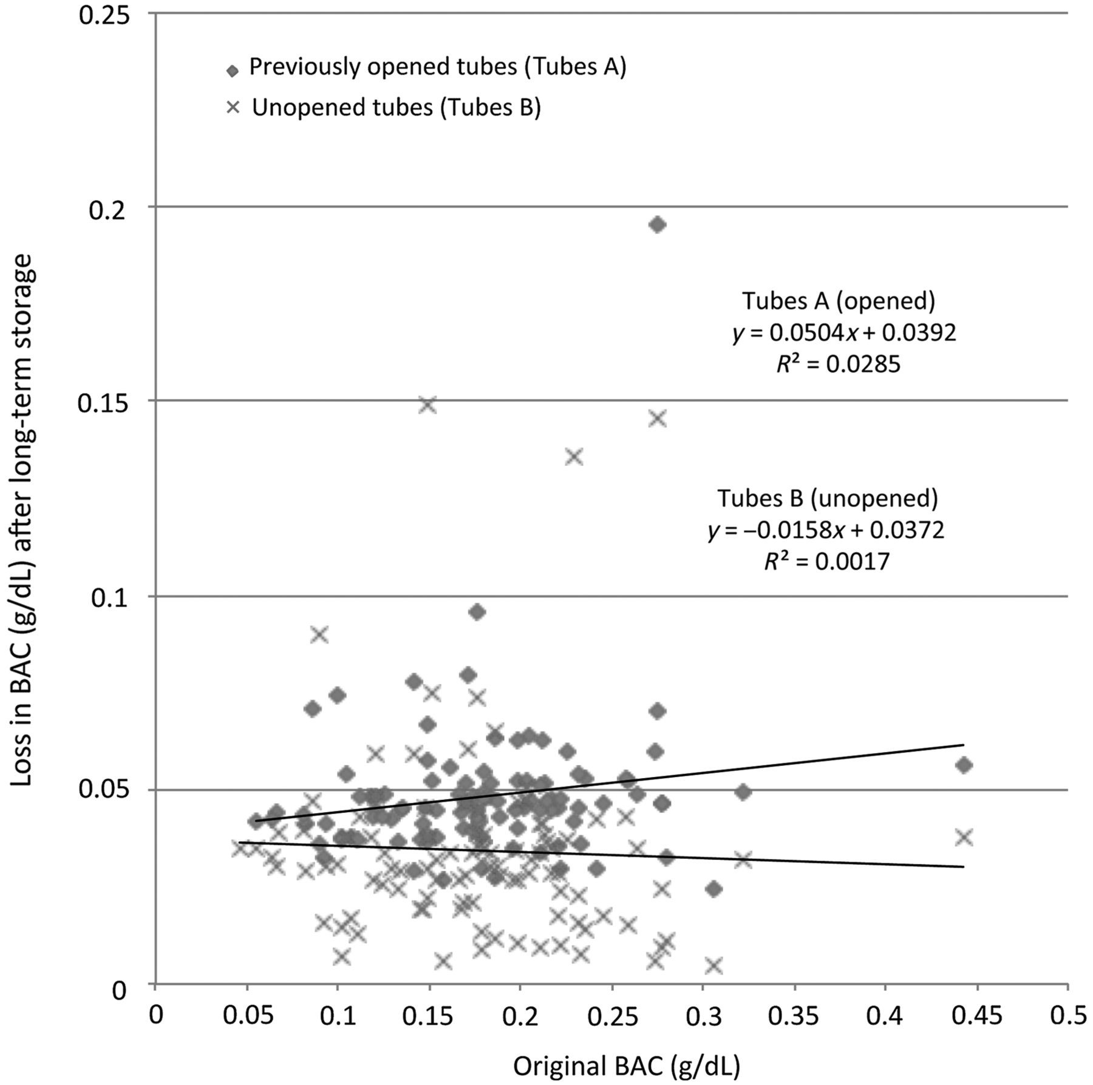
Figure 1. Lack of correlation between BAC loss and original BAC.
Notes:
Figure 1. Lack of correlation between BAC loss and original BAC.
Unless provided in the caption above, the following copyright applies to the content of this slide: © The Author 2015. Published by Oxford University Press. All rights reserved. For Permissions, please email: journals.permissions@oup.com

Slide 2
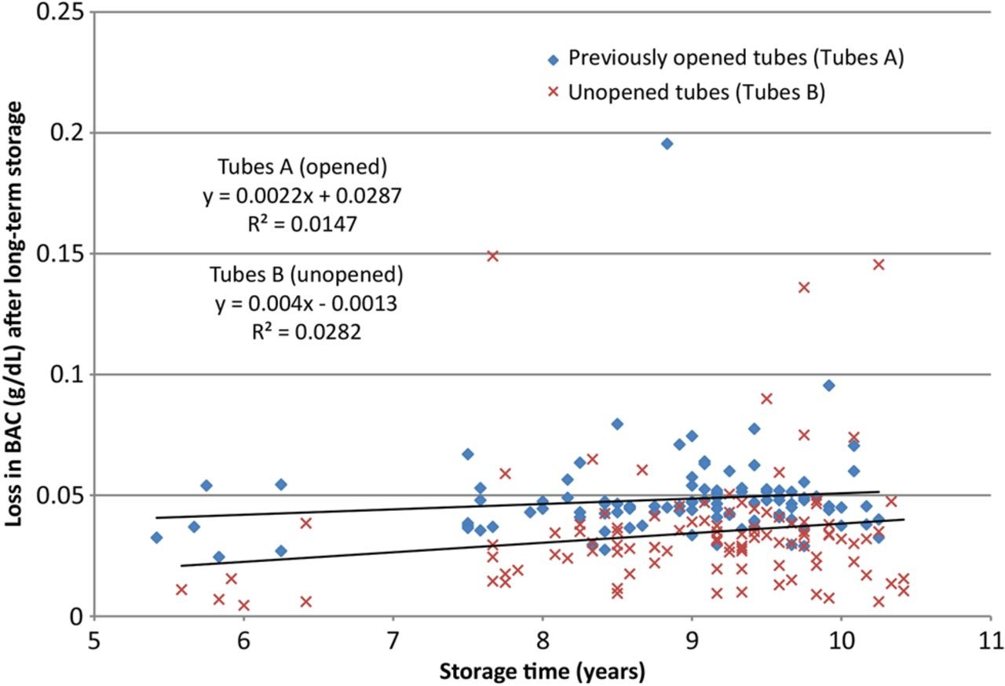
Figure 2. Lack of correlation between BAC loss and storage time.
Notes:
Figure 2. Lack of correlation between BAC loss and storage time.
Unless provided in the caption above, the following copyright applies to the content of this slide: © The Author 2015. Published by Oxford University Press. All rights reserved. For Permissions, please email: journals.permissions@oup.com

Slide 3
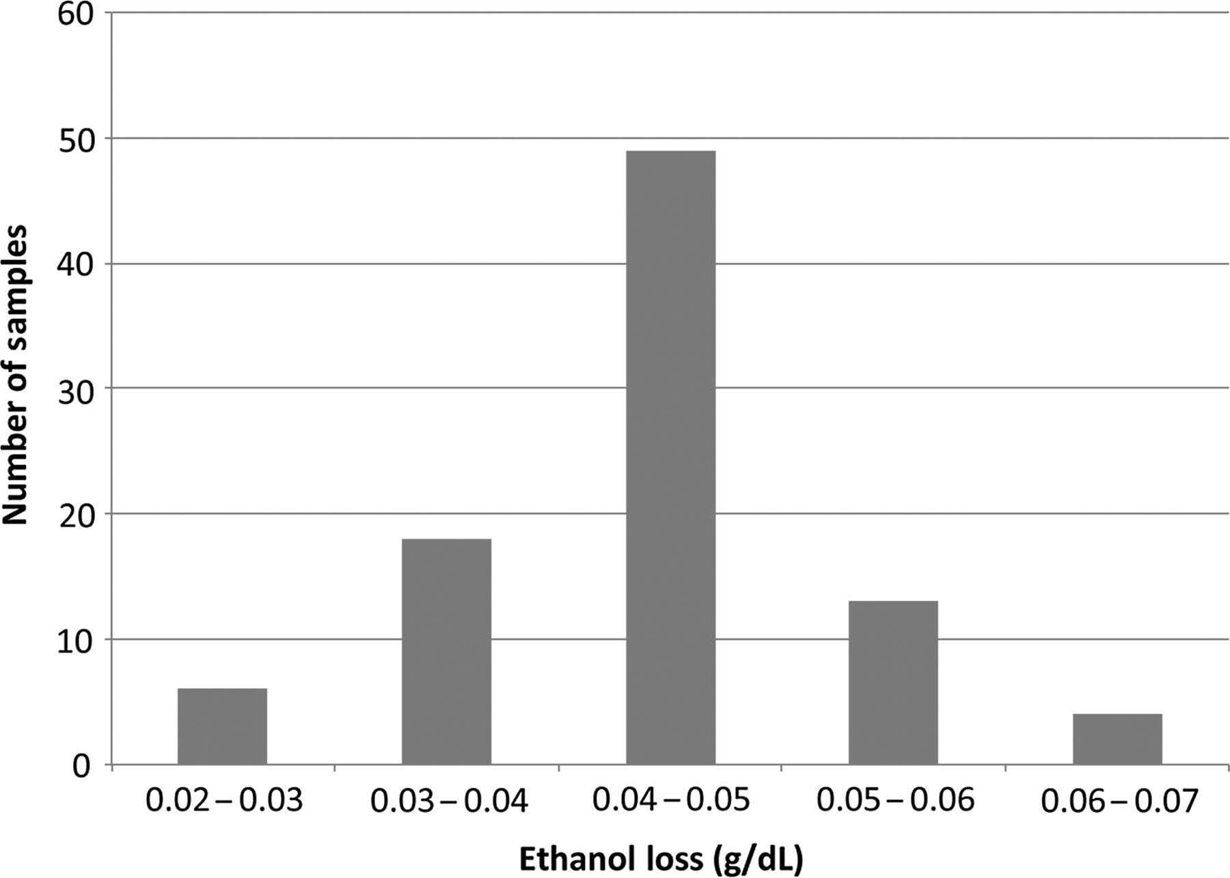
Figure 3. BAC loss of previously opened tubes containing >6 mL (n = 90).
Notes:
Figure 3. BAC loss of previously opened tubes containing >6 mL (n = 90).
Unless provided in the caption above, the following copyright applies to the content of this slide: © The Author 2015. Published by Oxford University Press. All rights reserved. For Permissions, please email: journals.permissions@oup.com

Slide 4
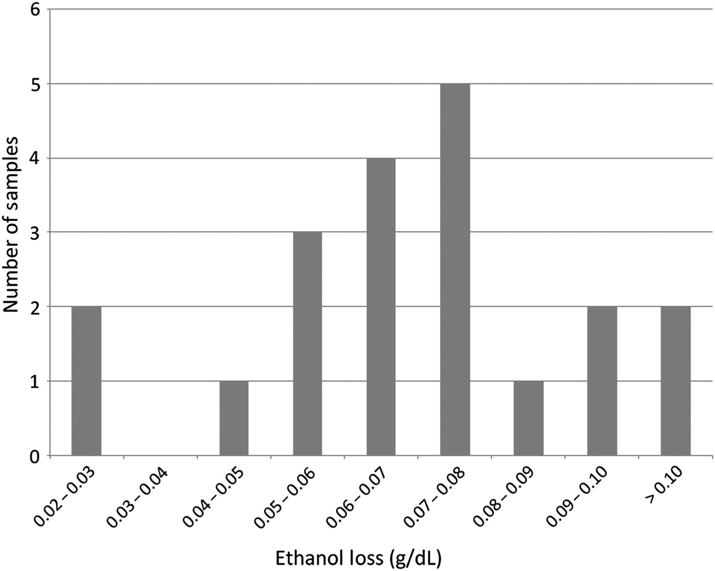
Figure 4. BAC loss of previously opened tubes containing ≤6 mL (n = 20).
Notes:
Figure 4. BAC loss of previously opened tubes containing ≤6 mL (n = 20).
Unless provided in the caption above, the following copyright applies to the content of this slide: © The Author 2015. Published by Oxford University Press. All rights reserved. For Permissions, please email: journals.permissions@oup.com

Slide 5
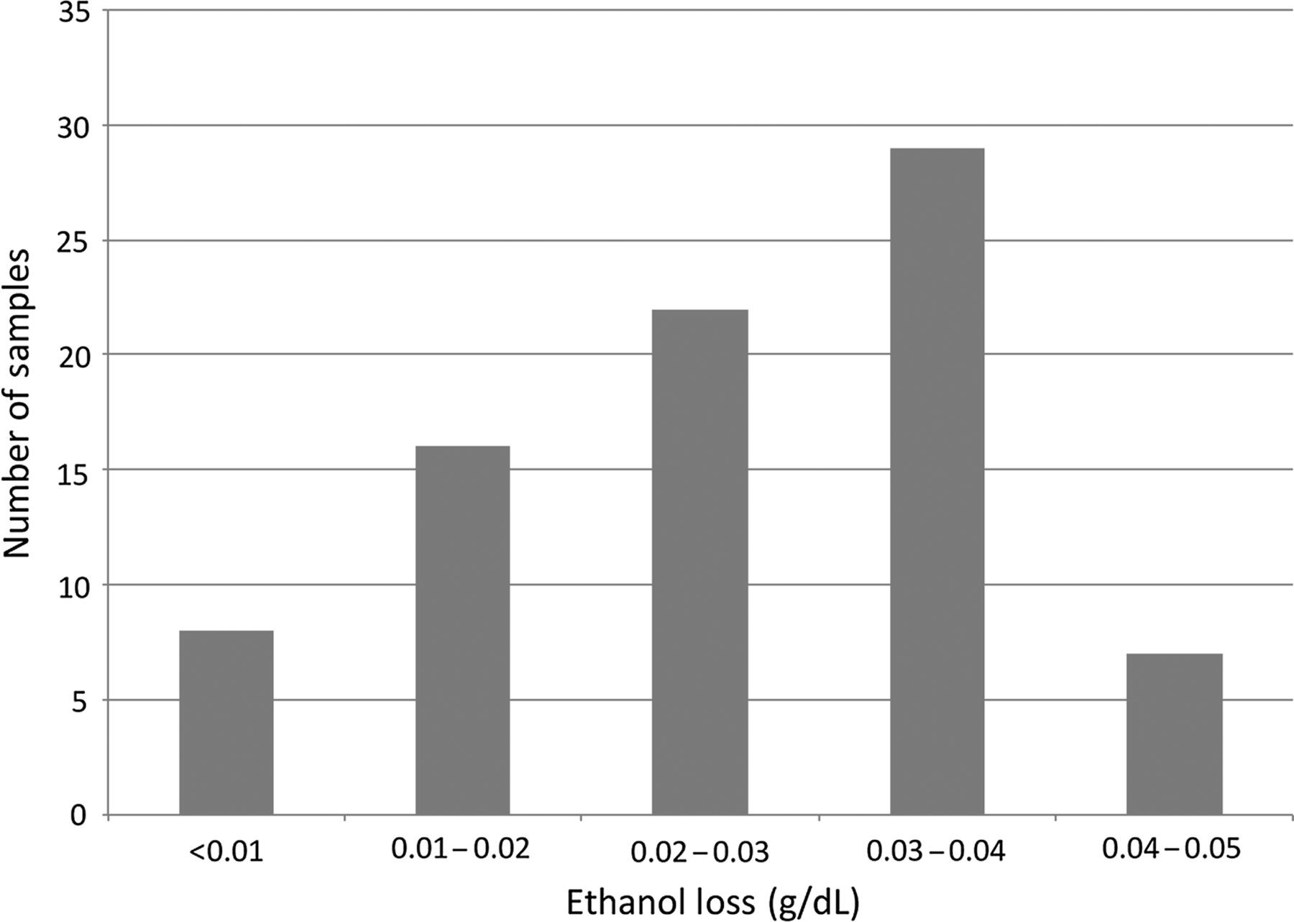
Figure 5. BAC loss of unopened tubes containing >6 mL (n = 82).
Notes:
Figure 5. BAC loss of unopened tubes containing >6 mL (n = 82).
Unless provided in the caption above, the following copyright applies to the content of this slide: © The Author 2015. Published by Oxford University Press. All rights reserved. For Permissions, please email: journals.permissions@oup.com

Slide 6
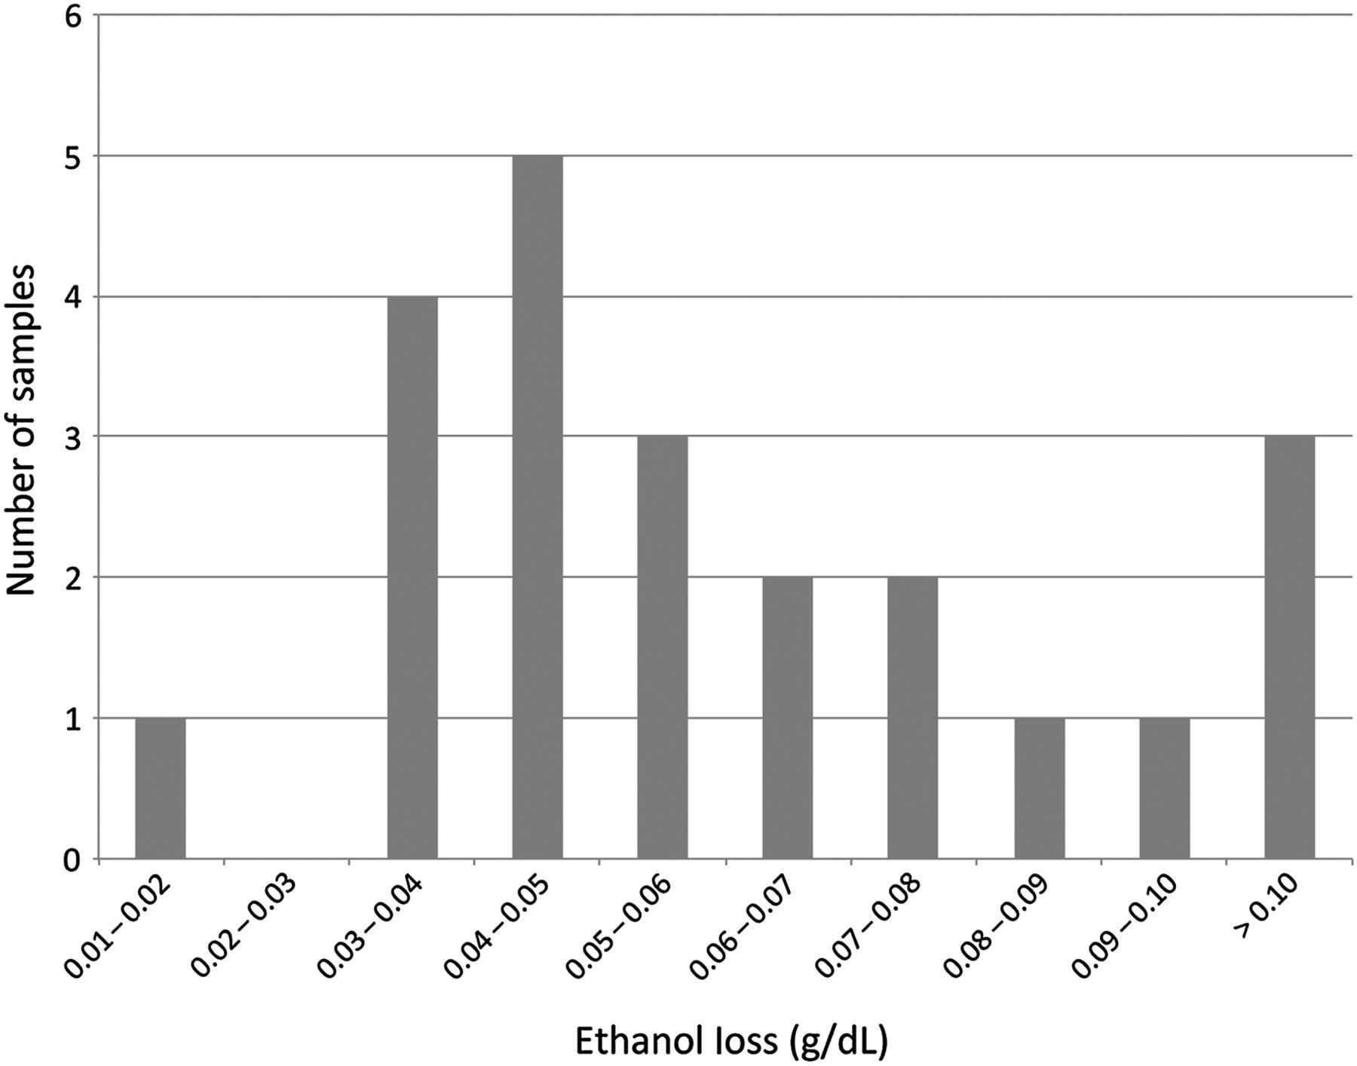
Figure 6. BAC loss of unopened tubes containing ≤6 mL (n = 22).
Notes:
Figure 6. BAC loss of unopened tubes containing ≤6 mL (n = 22).
Unless provided in the caption above, the following copyright applies to the content of this slide: © The Author 2015. Published by Oxford University Press. All rights reserved. For Permissions, please email: journals.permissions@oup.com

