Slide 1
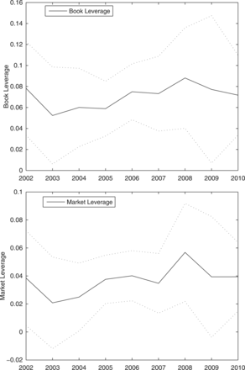
Figure 1 Impact of CDS Trading, by year These figures show the time series of estimated coefficients on the CDS ...
Notes:
Figure 1 Impact of CDS Trading, by year These figures show the time series of estimated coefficients on the CDS Trading dummy variable in the Book Leverage, Market Leverage and Debt Maturity regressions. We estimate parameters of the 2SLS specifications reported in Columns (3) and (7) of Panel A of Table 3 for leverage and of Panel (B) of Table 3 for maturity, obtaining four time-series of coefficients. The “Book Leverage” lines show the time series of estimated coefficients from the regressions using book leverage. The “Market Leverage” lines show the coefficients from the regressions using market leverage. The dotted lines indicate 5% and 95% confidence bands around the series of point estimates.
Unless provided in the caption above, the following copyright applies to the content of this slide: © The Author 2013. Published by Oxford University Press on behalf of The Society for Financial Studies. All rights reserved. For Permissions, please e-mail: journals.permissions@oup.com.

Slide 2
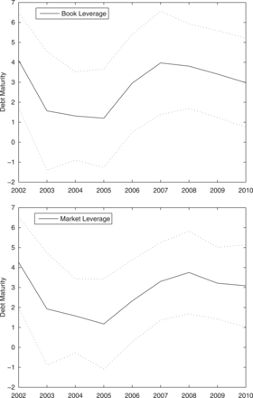
Figure 1 Impact of CDS Trading, by year These figures show the time series of estimated coefficients on the CDS ...
Notes:
Figure 1 Impact of CDS Trading, by year These figures show the time series of estimated coefficients on the CDS Trading dummy variable in the Book Leverage, Market Leverage and Debt Maturity regressions. We estimate parameters of the 2SLS specifications reported in Columns (3) and (7) of Panel A of Table 3 for leverage and of Panel (B) of Table 3 for maturity, obtaining four time-series of coefficients. The “Book Leverage” lines show the time series of estimated coefficients from the regressions using book leverage. The “Market Leverage” lines show the coefficients from the regressions using market leverage. The dotted lines indicate 5% and 95% confidence bands around the series of point estimates.
Unless provided in the caption above, the following copyright applies to the content of this slide: © The Author 2013. Published by Oxford University Press on behalf of The Society for Financial Studies. All rights reserved. For Permissions, please e-mail: journals.permissions@oup.com.

Slide 3
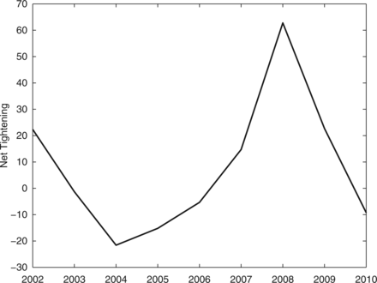
Figure 2 Net tightening of credit supply, by year This figure shows the net percentage of senior loan officers ...
Notes:
Figure 2 Net tightening of credit supply, by year This figure shows the net percentage of senior loan officers reporting commercial and industrial loan tightening to large- and medium-sized firms over the 2002–2010 sample period. The net percentage of loan officers is the number of respondents reporting that they have tightened standards on commercial and industrial loans minus the number that have loosened standards, divided by the total number of survey respondents. Higher values indicate tightening of credit supply. Data are from the Federal Reserve's Senior Loan Officer Opinion Survey.
Unless provided in the caption above, the following copyright applies to the content of this slide: © The Author 2013. Published by Oxford University Press on behalf of The Society for Financial Studies. All rights reserved. For Permissions, please e-mail: journals.permissions@oup.com.

Slide 4
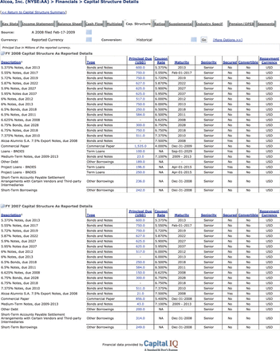
Notes:
Unless provided in the caption above, the following copyright applies to the content of this slide: © The Author 2013. Published by Oxford University Press on behalf of The Society for Financial Studies. All rights reserved. For Permissions, please e-mail: journals.permissions@oup.com.

