Slide 1
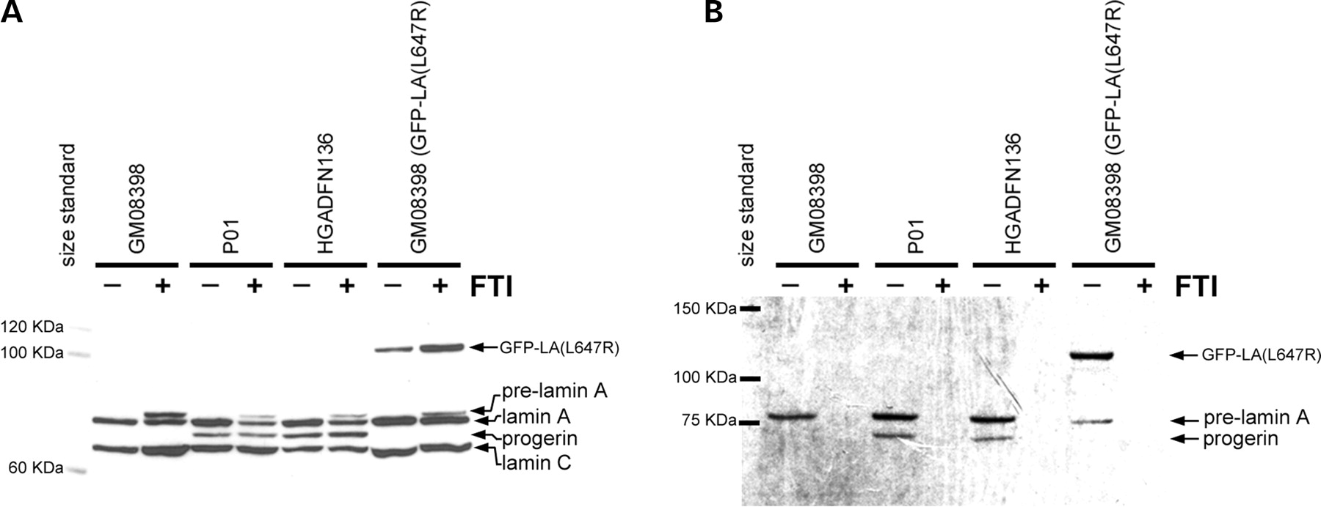
Figure 1. Normal (GM08398) and HGPS (P01 and HGADFN136) fibroblasts were plated in T25 flasks. One flask of ...
Notes:
Figure 1. Normal (GM08398) and HGPS (P01 and HGADFN136) fibroblasts were plated in T25 flasks. One flask of each line was labeled with 3H-mevalonate (125 µCi/ml) and mevinolin (25 µm). Cells were lysed in the flask with RIPA and 300 µg of cellular protein was immunoprecipitated with lamin A/C antibodies. Protein levels prior to immunoprecipitation are displayed in (A). Fluorography (B) of the immunoprecipitated proteins shows a unique band, progerin, in the HGPS lines demonstrating that progerin is farnesylated. Addition of 2 µm FTI (+) causes accumulation of pre-lamin A (A) and completely prevents incorporation of the 3H-labeled farnesyl precursor (B). Normal fibroblasts expressing an uncleavable form of lamin A (GFP–LA (L647R)) that remains farnesylated were included as a positive control.
Unless provided in the caption above, the following copyright applies to the content of this slide: © The Author 2005. Published by Oxford University Press. All rights reserved. For Permissions, please email: journals.permissions@oxfordjournals.org

Slide 2
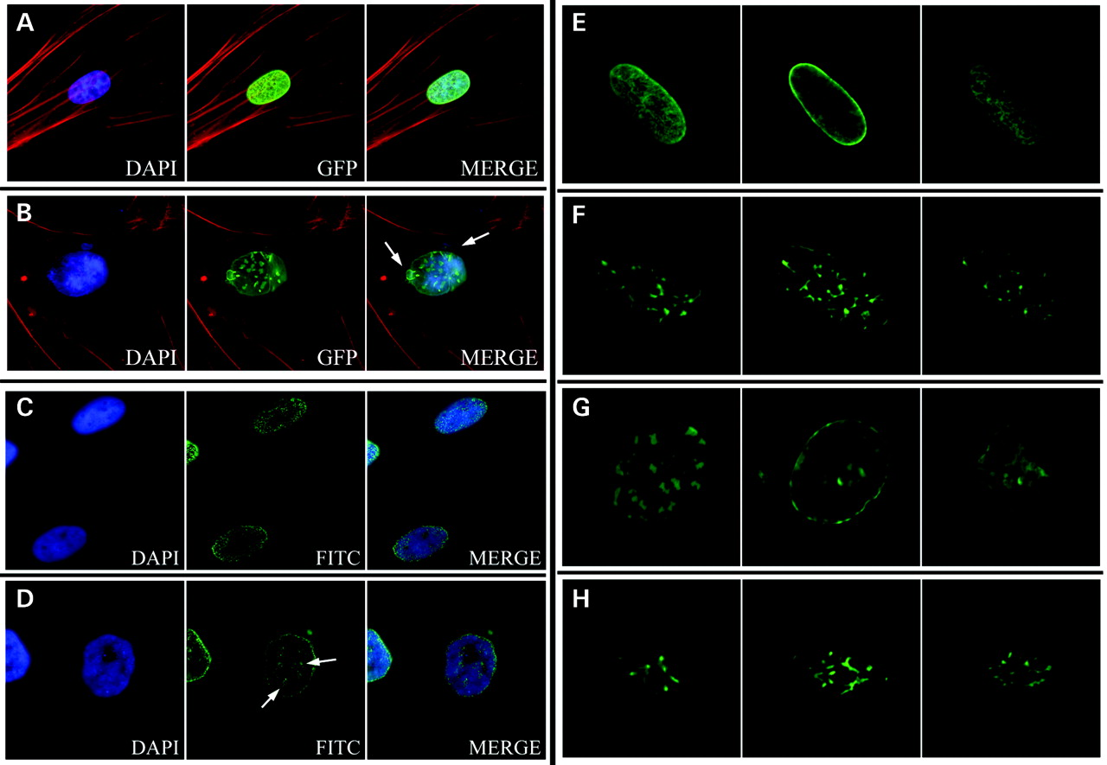
Figure 2. Localization of transiently-expressed GFP–lamin A and GFP–progerin. GFP–lamin A was evenly ...
Notes:
Figure 2. Localization of transiently-expressed GFP–lamin A and GFP–progerin. GFP–lamin A was evenly distributed around the nuclear periphery (A), whereas expression of GFP–progerin formed aggregates at the nuclear periphery and caused blebbing (arrows) (B). Immunocytochemistry using a lamin A-specific antibody to detect localization of endogenous lamin A is shown for normal (C) and HGPS (D) fibroblasts. Lamin A aggregates were observed in HGPS fibroblasts (arrows) (D). Images in (A) through (D) show focal planes at the near side of the nucleus. Signals were obtained with a Zeiss Axiophot Fluorescent microscope with a Sensys CCD camera and Applied Imaging digital imaging capture software. Localization of GFP–lamin A (E and F) and progerin (G and H) was analyzed using a Zeiss LSM 510 confocal microscope mounted on a Zeiss Axiovert 100M inverted microscope. Three focal planes are shown: top, middle and bottom (from left to right). These images show the location of the GFP–progerin aggregates as thicker regions at the nuclear periphery (G). Fibroblasts expressing normal GFP–lamin A have GFP signal around the nuclear periphery (E). Exposure to 100 nm FTI (PD169451) for 72 h caused a redistribution of the GFP–lamin A signal (F) and GFP–progerin (H) to intranuclear structures.
Unless provided in the caption above, the following copyright applies to the content of this slide: © The Author 2005. Published by Oxford University Press. All rights reserved. For Permissions, please email: journals.permissions@oxfordjournals.org

Slide 3
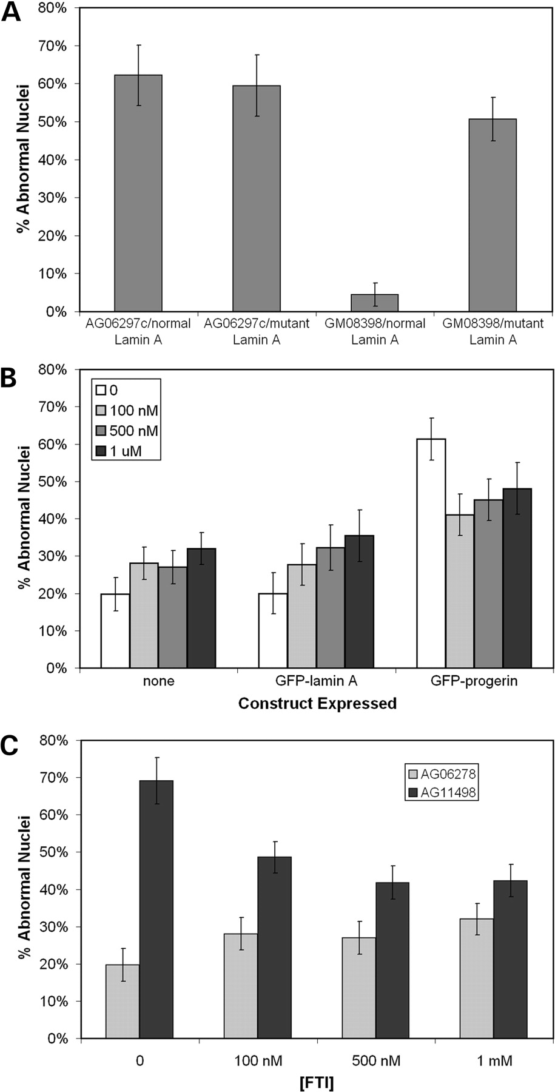
Figure 3. Quantitation of the effects on nuclear morphology of transiently expressing the GFP–lamin A and ...
Notes:
Figure 3. Quantitation of the effects on nuclear morphology of transiently expressing the GFP–lamin A and GFP–progerin constructs in HGPS (AG06297c) and normal (GM08398) fibroblasts (A). These constructs were transiently expressed in normal cells and exposed to various concentrations of FTI for 72 h (B). A significant drop in the percentage of abnormal nuclei was observed in cells expressing GFP–progerin when exposed to FTI for 72 h. However, increasing FTI concentrations caused increased percentage of cells with abnormal nuclear morphology in mock-transfected cells (none) and cells expressing GFP–lamin A. The same concentrations of FTI were applied to normal (AG06278) and HGPS (AG11498) fibroblasts for 72 h (C) and caused a significant drop in the percentage of abnormal nuclei in this HGPS cell line. Analysis of nuclear morphology were performed on blinded samples, independently by two individuals with no significant differences between individuals. At least 50 cells were analyzed per sample.
Unless provided in the caption above, the following copyright applies to the content of this slide: © The Author 2005. Published by Oxford University Press. All rights reserved. For Permissions, please email: journals.permissions@oxfordjournals.org

Slide 4
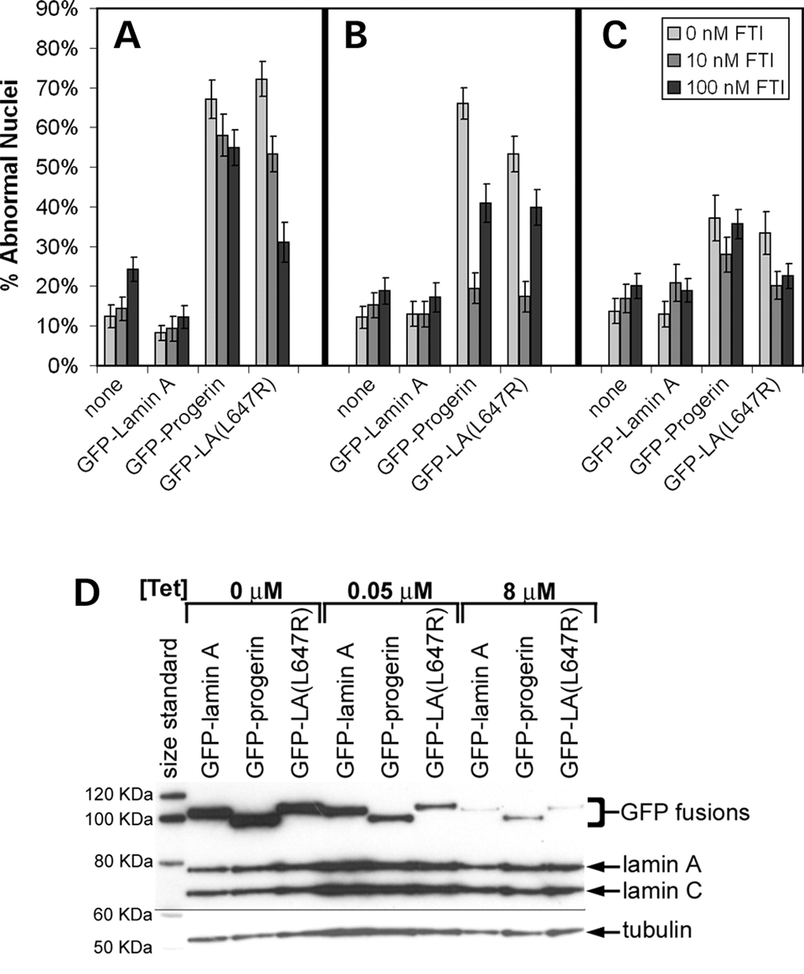
Figure 4. The effect of the FTI, PD169451, on the nuclear morphology of normal fibroblasts (GM08398) stably ...
Notes:
Figure 4. The effect of the FTI, PD169451, on the nuclear morphology of normal fibroblasts (GM08398) stably expressing GFP–lamin A, GFP–progerin and GFP–LA (L647R) using a retroviral Tet-off system (Clontech). Fibroblasts were maintained in medium with 0, 10 or 100 nm FTI for six days. Cultures were plated in chambered microscope slides 24 h prior to fixing with 4% paraformaldehyde for nuclear morphology studies. Cells were maintained in three predetermined tetracycline concentrations, 0 µm for full expression (A), 0.05 µm for intermediate expression levels (B), and 8 µm for very low expression levels (C). Using a Tet-off system allowed for modulation of expression levels with tetracycline concentration as demonstrated by immunoblot of cells from the previous experiment (D). When GFP–progerin and GFP–LA (L647R) mutant was stably expressed in normal fibroblasts at intermediate levels (0.05 µg/ml tetracycline), 10 nm FTI substantially reduced the percent abnormal nuclei by 71% and 67%, respectively (P<0.0001) (B). Analysis of nuclear morphology was performed in a double-blinded fashion with at least 70 cells analyzed per sample.
Unless provided in the caption above, the following copyright applies to the content of this slide: © The Author 2005. Published by Oxford University Press. All rights reserved. For Permissions, please email: journals.permissions@oxfordjournals.org

Slide 5
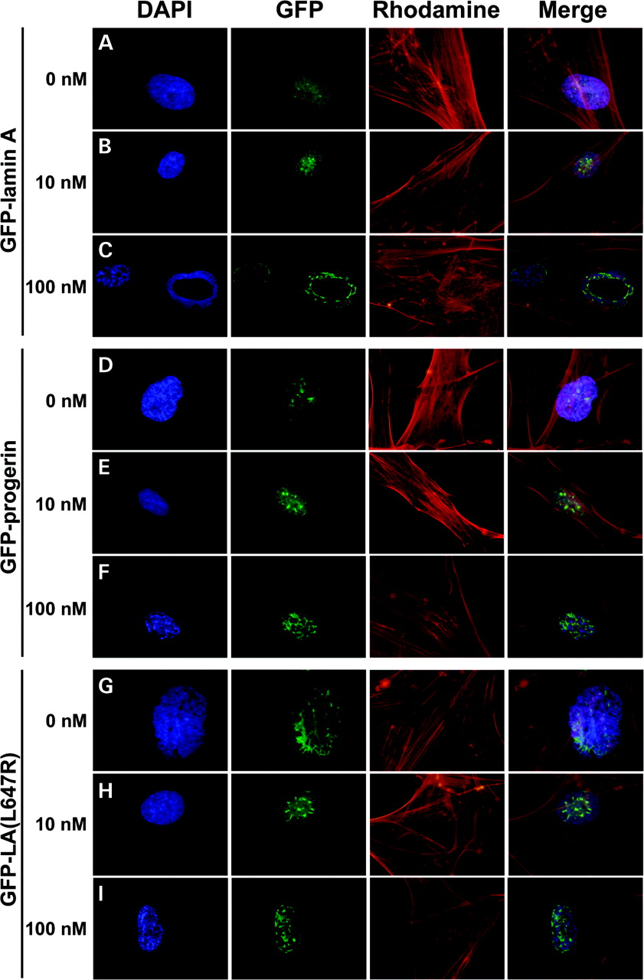
Figure 5. The effect of FTI on the distribution of GFP signal in normal fibroblasts (GM08398) expressing ...
Notes:
Figure 5. The effect of FTI on the distribution of GFP signal in normal fibroblasts (GM08398) expressing GFP–lamin A (A, B and C), GFP–progerin (D, E and F) and GFP–LA (L647R) (G, H and I) using a retroviral Tet-off system with various FTI concentrations. Fibroblasts were maintained in medium with 0 nm (A, D and G), 10 nm (B, E and H) or 100 nm (C, F and I) FTI for six days. Expression levels of the GFP fusions were maintained at levels similar to endogenous levels of lamin A by the addition of 0.05 mg/ml tetracycline. Signals were visualized with a Zeiss Axiophot Fluorescent microscope and imaging was performed using the Olympus DP70 Digital Camera System.
Unless provided in the caption above, the following copyright applies to the content of this slide: © The Author 2005. Published by Oxford University Press. All rights reserved. For Permissions, please email: journals.permissions@oxfordjournals.org

Slide 6
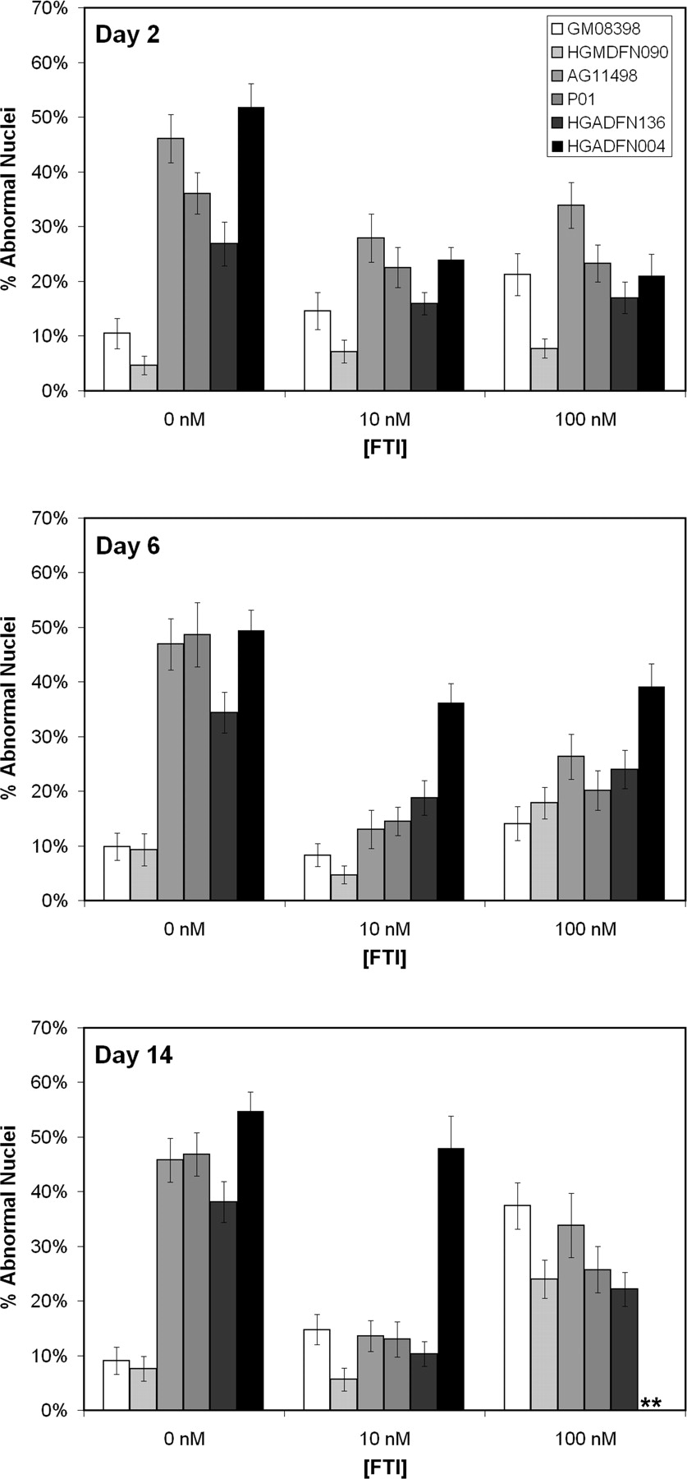
Figure 6. The effect of long-term exposure to low doses of FTI (PD169451) on the nuclear morphology of normal ...
Notes:
Figure 6. The effect of long-term exposure to low doses of FTI (PD169451) on the nuclear morphology of normal (GM08398 and HGMDFN090) and HGPS (AG11498, P01, HGADFN136 and HGADFN004) fibroblasts. Fibroblasts were maintained in medium with 0, 10 or 100 nm FTI. Cultures were plated in chambered microscope slides 24 h prior to fixing with 4% paraformaldehyde for nuclear morphology studies. After 14 days of exposure to 10 nm FTI, three of the HGPS lines had over a 70% reduction (P<0.0001) in the relative number of abnormal nuclei, reducing the occurrence of abnormal nuclei to that of normal controls. **Too few cells to count. The HGADFN004 line failed to grow in 100 nm FTI to the 14-day time point. Analysis of nuclear morphology was performed in a double-blinded fashion with over 100 cells analyzed per sample.
Unless provided in the caption above, the following copyright applies to the content of this slide: © The Author 2005. Published by Oxford University Press. All rights reserved. For Permissions, please email: journals.permissions@oxfordjournals.org

