Slide 1
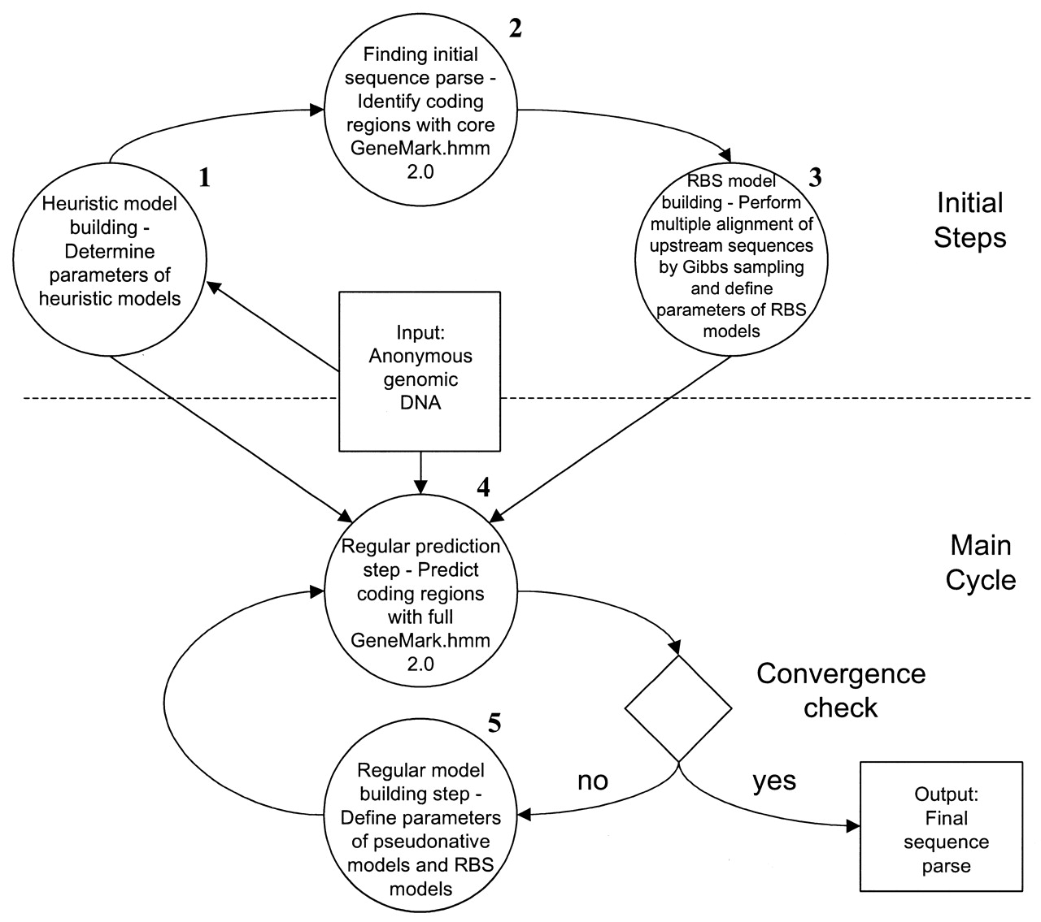
Figure 1. Step-by-step diagram of the GeneMarkS procedure.
Notes:
Figure 1. Step-by-step diagram of the GeneMarkS procedure.
Unless provided in the caption above, the following copyright applies to the content of this slide:

Slide 2
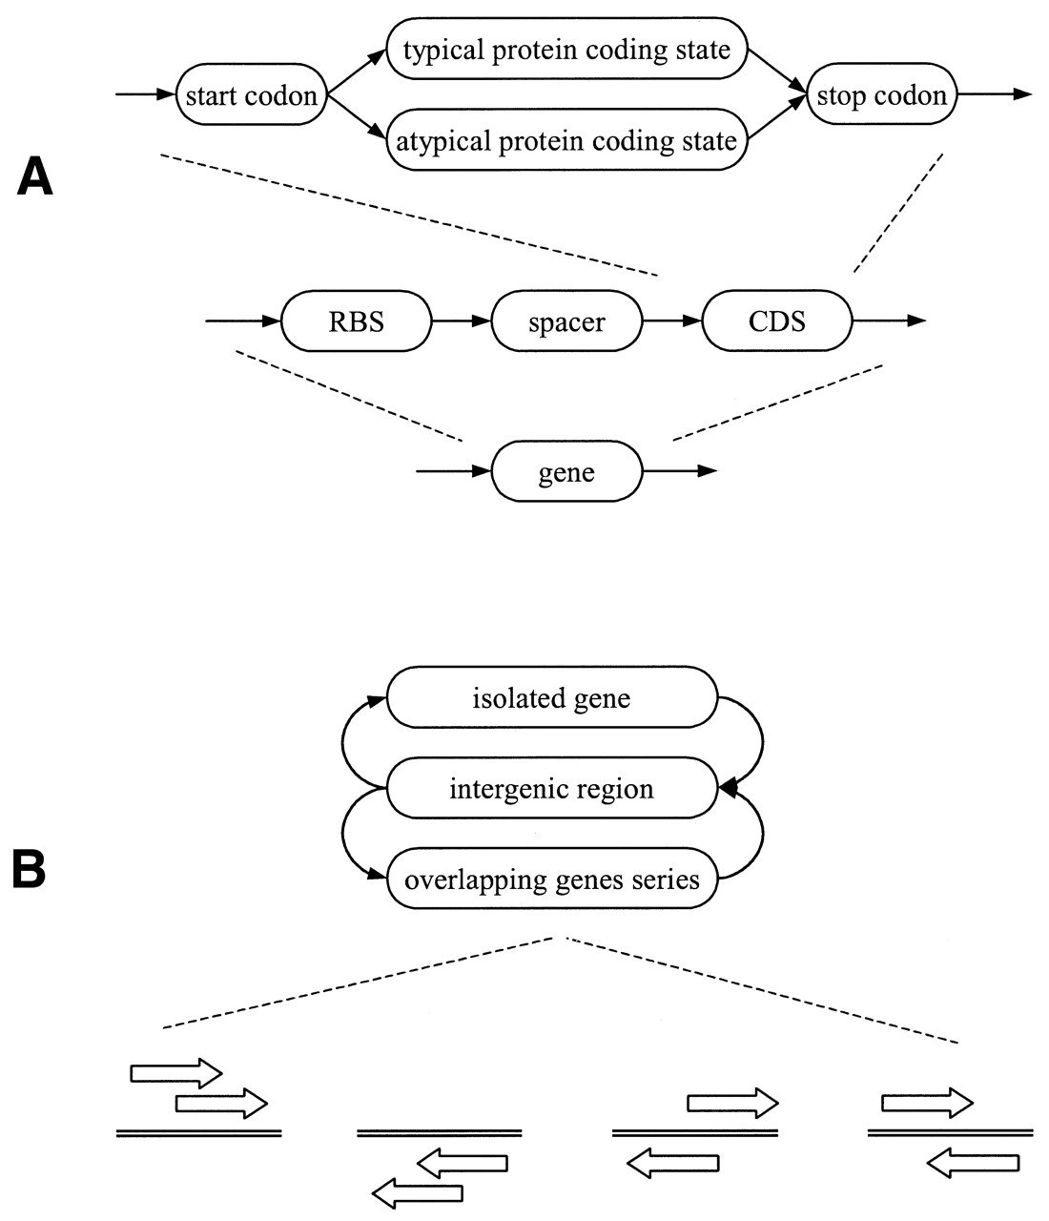
Figure 2. (A) In the process of GeneMarkS training there is no division of the coding sequence into two ...
Notes:
Figure 2. (A) In the process of GeneMarkS training there is no division of the coding sequence into two clusters. However, in applying the GeneMark.hmm 2.0 program, the model of coding region derived by GeneMarkS can be used as the Typical model along with a heuristic model used as the Atypical model (see Table 3). For simplicity, only the direct strand is shown. (B) In this simplified diagram of hidden state transitions in GeneMark.hmm 2.0, the state ‘gene’ represents a sequence composed of an RBS plus a spacer plus the protein-coding sequence (CDS). Gene overlaps encompass all possible types of superpositions: overlap of genes on the same strand (as observed in operons), overlap of genes on opposite strands, overlap of coding region with RBS, and so on.
Unless provided in the caption above, the following copyright applies to the content of this slide:

Slide 3
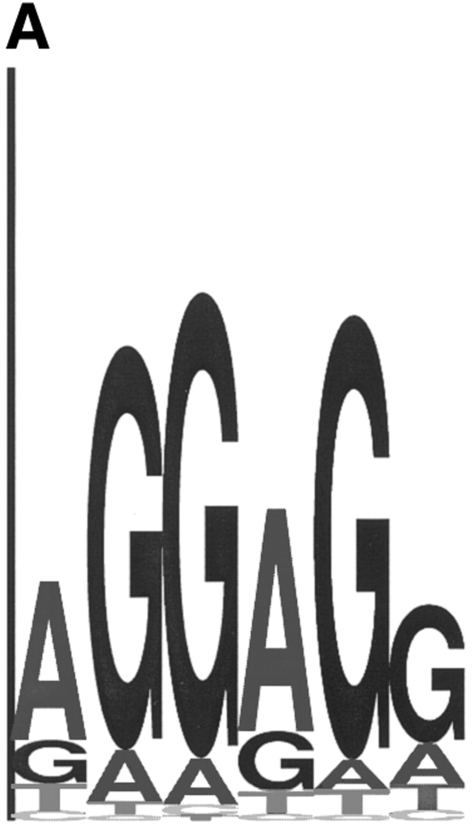
Figure 3. (A) Sequence logo representing the RBS positional frequency pattern detected by GeneMarkS in the ...
Notes:
Figure 3. (A) Sequence logo representing the RBS positional frequency pattern detected by GeneMarkS in the analysis of B.subtilis genomic data. The total height of the four letters in each position indicates the position specific information content, while the height of each letter is proportional to the nucleotide frequency (42). (B) Graph of probability distribution of spacer length, the sequence between the RBS sequence and the gene start.
Unless provided in the caption above, the following copyright applies to the content of this slide:

Slide 4
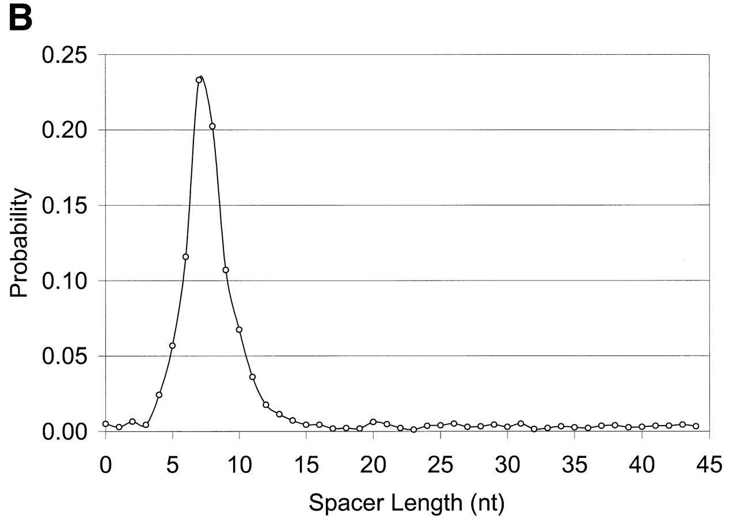
Figure 3. (A) Sequence logo representing the RBS positional frequency pattern detected by GeneMarkS in the ...
Notes:
Figure 3. (A) Sequence logo representing the RBS positional frequency pattern detected by GeneMarkS in the analysis of B.subtilis genomic data. The total height of the four letters in each position indicates the position specific information content, while the height of each letter is proportional to the nucleotide frequency (42). (B) Graph of probability distribution of spacer length, the sequence between the RBS sequence and the gene start.
Unless provided in the caption above, the following copyright applies to the content of this slide:

Slide 5
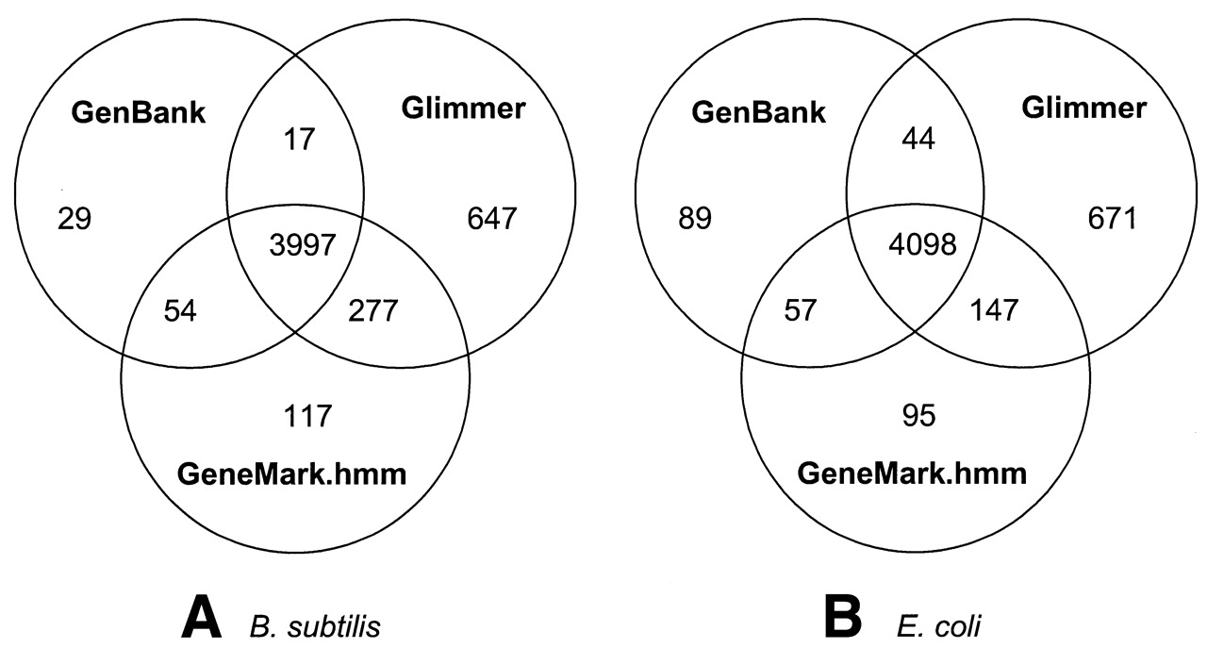
Figure 4. Venn diagram showing group relationships between the GenBank annotation and sets of genes detected ...
Notes:
Figure 4. Venn diagram showing group relationships between the GenBank annotation and sets of genes detected by GeneMark.hmm 2.0 and Glimmer 2.02 for the B.subtilis genome (A) and the E.coli genome (B).
Unless provided in the caption above, the following copyright applies to the content of this slide:

Slide 6
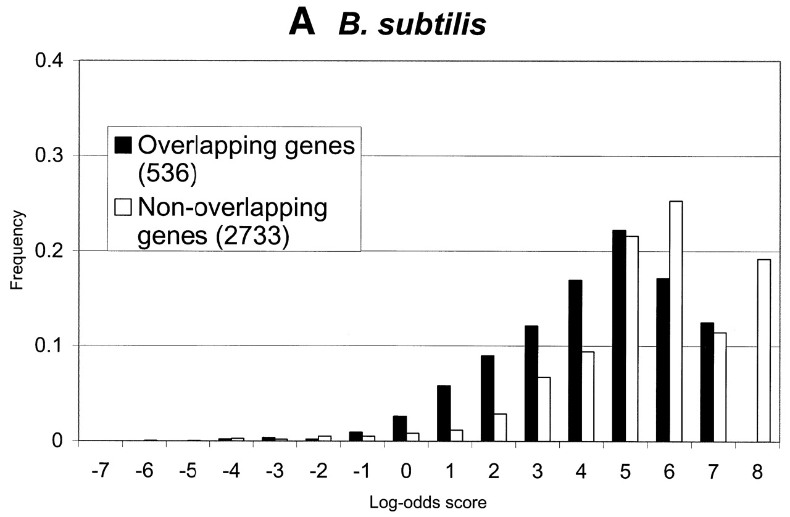
Figure 5. Distributions of log-odds scores of RBS sites, as detected by GeneMarkS, in sets of overlapping and ...
Notes:
Figure 5. Distributions of log-odds scores of RBS sites, as detected by GeneMarkS, in sets of overlapping and non-overlapping of genes of (A) B.subtilis, (B) E.coli and(C) M.jannaschii. As can be seen, the overlapping genes, which are likely to be located inside operons, frequently have strong RBS sites. Still, most strong sites of ribosome binding precede the non-overlapping genes (stand alone genes and genes leading operons). This tendency is much more apparent in the case of the archaeal genome of M.jannaschii than in the E.coli and B.subtilis genomes.
Unless provided in the caption above, the following copyright applies to the content of this slide:

Slide 7
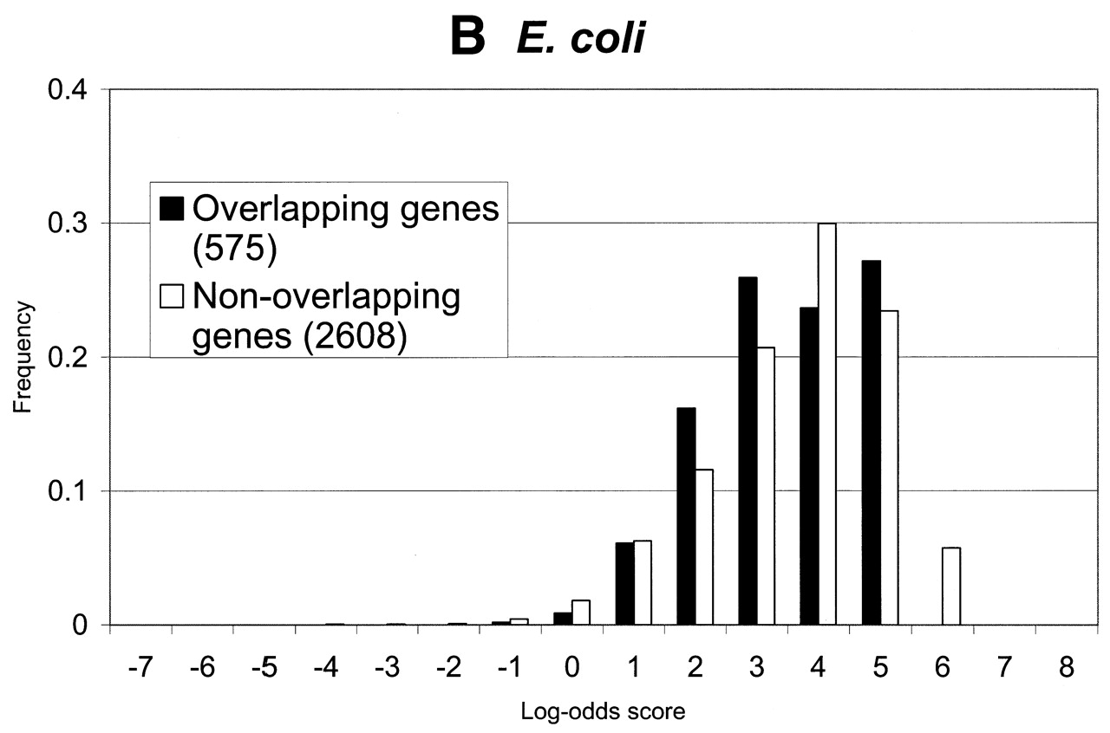
Figure 5. Distributions of log-odds scores of RBS sites, as detected by GeneMarkS, in sets of overlapping and ...
Notes:
Figure 5. Distributions of log-odds scores of RBS sites, as detected by GeneMarkS, in sets of overlapping and non-overlapping of genes of (A) B.subtilis, (B) E.coli and(C) M.jannaschii. As can be seen, the overlapping genes, which are likely to be located inside operons, frequently have strong RBS sites. Still, most strong sites of ribosome binding precede the non-overlapping genes (stand alone genes and genes leading operons). This tendency is much more apparent in the case of the archaeal genome of M.jannaschii than in the E.coli and B.subtilis genomes.
Unless provided in the caption above, the following copyright applies to the content of this slide:

Slide 8
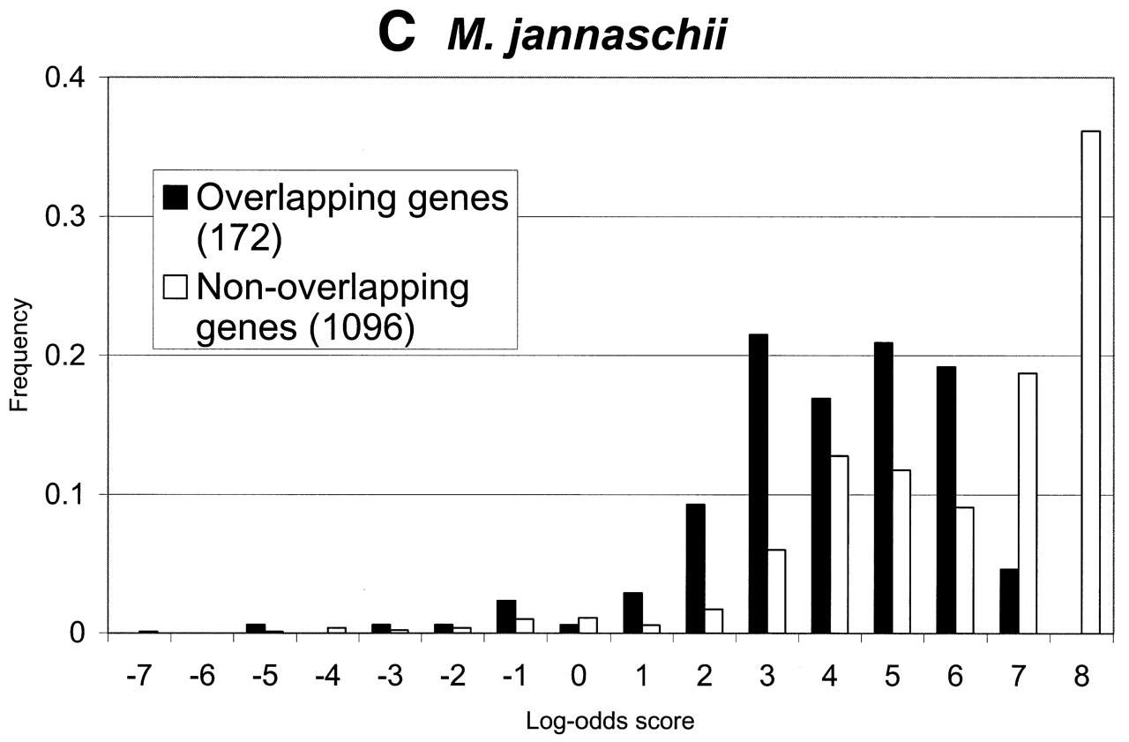
Figure 5. Distributions of log-odds scores of RBS sites, as detected by GeneMarkS, in sets of overlapping and ...
Notes:
Figure 5. Distributions of log-odds scores of RBS sites, as detected by GeneMarkS, in sets of overlapping and non-overlapping of genes of (A) B.subtilis, (B) E.coli and(C) M.jannaschii. As can be seen, the overlapping genes, which are likely to be located inside operons, frequently have strong RBS sites. Still, most strong sites of ribosome binding precede the non-overlapping genes (stand alone genes and genes leading operons). This tendency is much more apparent in the case of the archaeal genome of M.jannaschii than in the E.coli and B.subtilis genomes.
Unless provided in the caption above, the following copyright applies to the content of this slide:

Slide 9
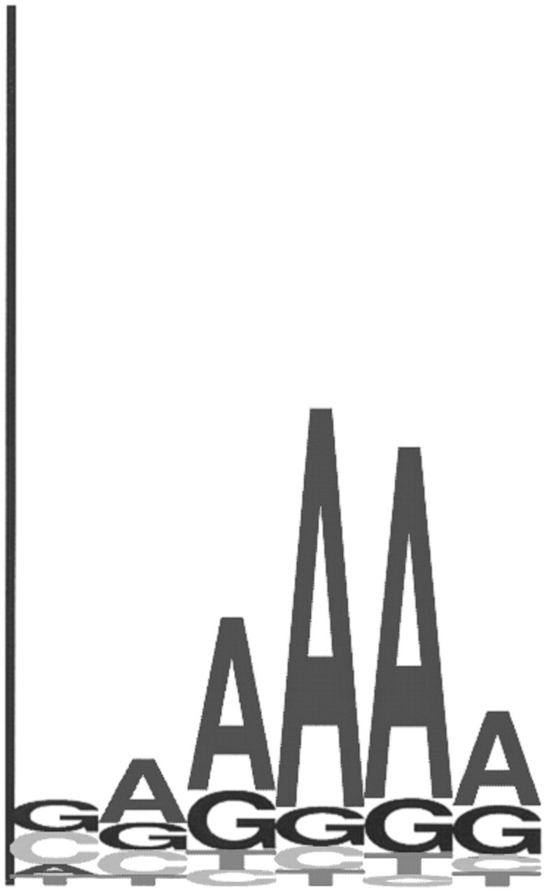
Figure 6. Sequence logo representing the upstream sequence motif detected by GeneMarkS for A.fulgidus. This ...
Notes:
Figure 6. Sequence logo representing the upstream sequence motif detected by GeneMarkS for A.fulgidus. This consensus sequence is rather indicative of a eukaryotic-like promoter element, than an RBS signal as often found in prokaryotes. Sites that match this pattern are ubiquitous in A.fulgidus, although further analysis of a subset of upstream sequences reveals a second motif (see Fig. 7) complementary to the 3′ terminal section of the A.fulgidus 16S rRNA.
Unless provided in the caption above, the following copyright applies to the content of this slide:

Slide 10
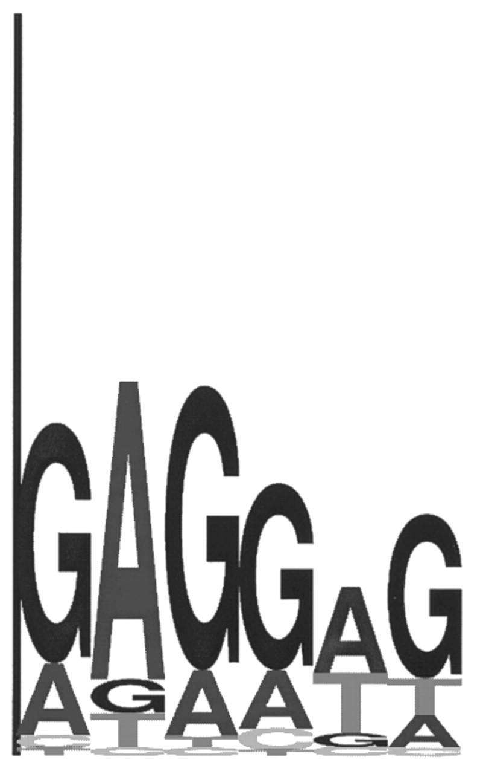
Figure 7. Sequence logo representing the RBS motif observed in a subset of upstream sequences of the ...
Notes:
Figure 7. Sequence logo representing the RBS motif observed in a subset of upstream sequences of the A.fulgidus genome. This subset consisted of 50 nt long upstream sequences overlapping the 3′ end of the preceding gene. The consensus of this motif is complementary to a section of the A.fulgidus 16S rRNA.
Unless provided in the caption above, the following copyright applies to the content of this slide:

Slide 11
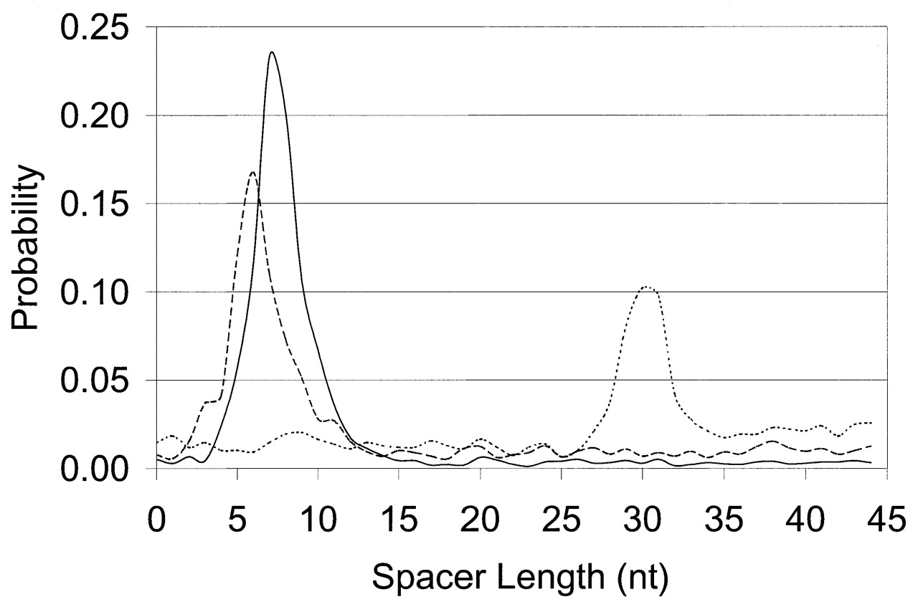
Figure 8. Distributions of spacer length for two species with strong RBS patterns, B.subtilis and E.coli ...
Notes:
Figure 8. Distributions of spacer length for two species with strong RBS patterns, B.subtilis and E.coli (solid and dashed lines, respectively), and one species with a strong eukaryotic promoter-like pattern, A.fulgidus (dotted line). The promoter-like pattern of A.fulgidus is localized much further upstream of the start codon than the RBS patterns of B.subtilis and E.coli.
Unless provided in the caption above, the following copyright applies to the content of this slide:

Slide 12
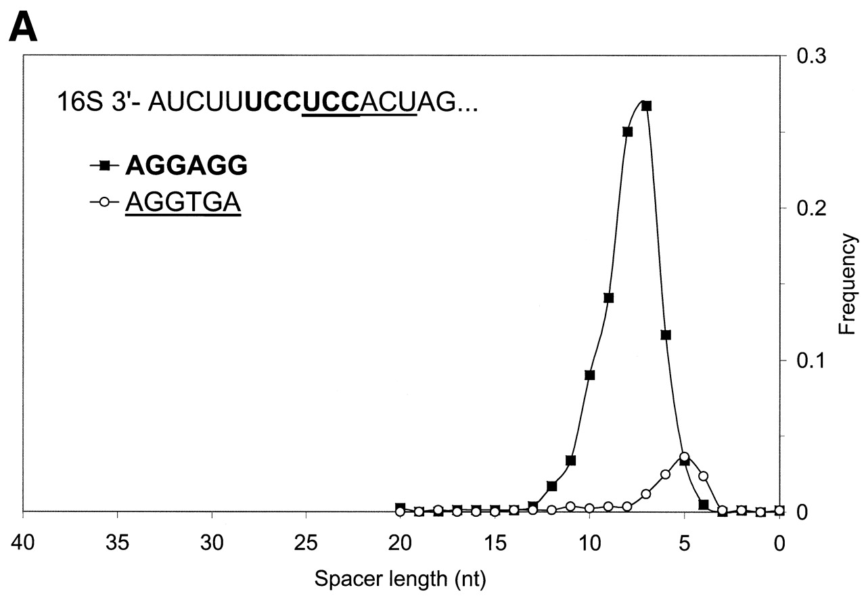
Figure 9. (A) Distribution of spacer lengths observed in the B.subtilis genome for two different types of ...
Notes:
Figure 9. (A) Distribution of spacer lengths observed in the B.subtilis genome for two different types of possible RBS hexamers: AGGAGG and AGGTGA. Multiple alignment allows these hexamers to be superimposed. In actual upstream sequences, these hexamers tend to occupy different locations relative to the start codon. This preference may be involved in the precise positioning of the ribosome at the translation initiation site when the 16S rRNA binds to mRNA. The more frequent hexamer was observed on average at a further distance from the gene start than the rare hexamer. (B) Distribution of spacer lengths observed in the M.thermoautotrophicum genome for two different types of RBS hexamers: GGAGGT and GGTGAT. Properties of these hexamers are similar to the two hexamers observed in the B.subtilis genome (A), except that more frequent hexamer is now found on average at a closer distance to the gene start than the rare hexamer.
Unless provided in the caption above, the following copyright applies to the content of this slide:

Slide 13
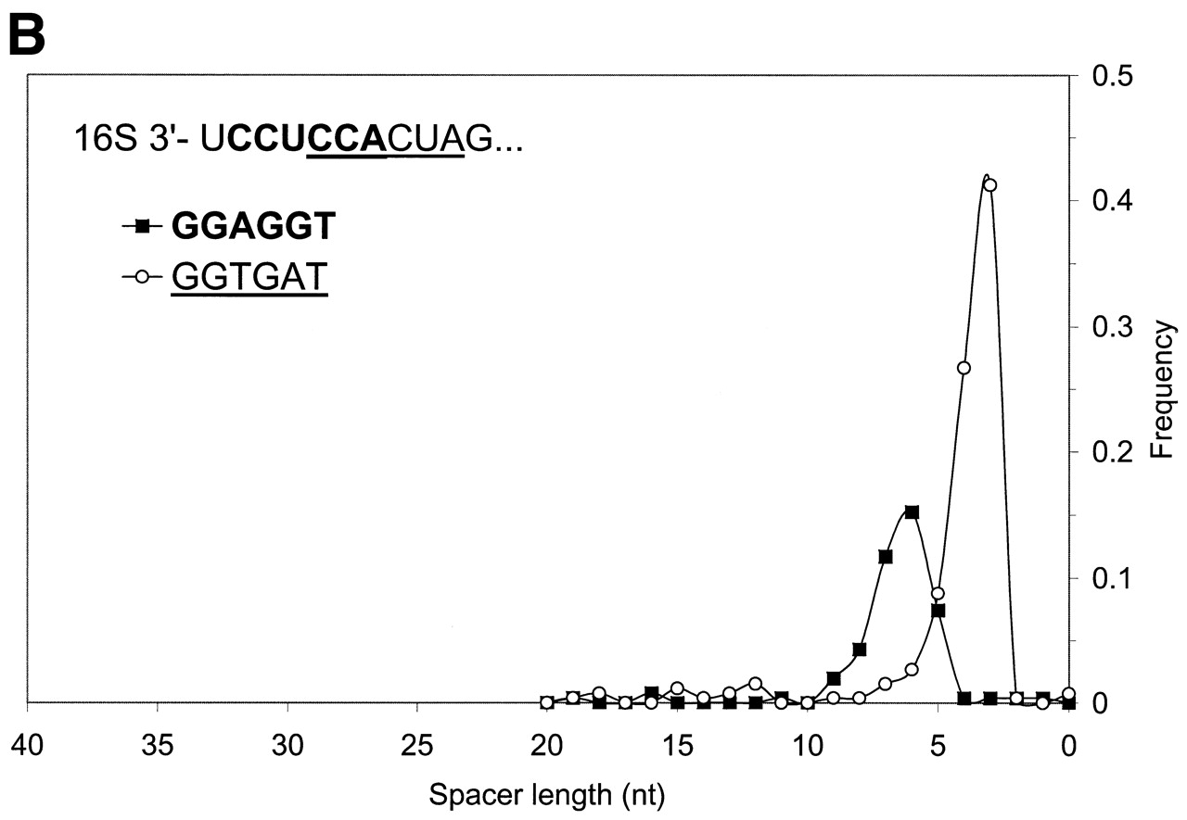
Figure 9. (A) Distribution of spacer lengths observed in the B.subtilis genome for two different types of ...
Notes:
Figure 9. (A) Distribution of spacer lengths observed in the B.subtilis genome for two different types of possible RBS hexamers: AGGAGG and AGGTGA. Multiple alignment allows these hexamers to be superimposed. In actual upstream sequences, these hexamers tend to occupy different locations relative to the start codon. This preference may be involved in the precise positioning of the ribosome at the translation initiation site when the 16S rRNA binds to mRNA. The more frequent hexamer was observed on average at a further distance from the gene start than the rare hexamer. (B) Distribution of spacer lengths observed in the M.thermoautotrophicum genome for two different types of RBS hexamers: GGAGGT and GGTGAT. Properties of these hexamers are similar to the two hexamers observed in the B.subtilis genome (A), except that more frequent hexamer is now found on average at a closer distance to the gene start than the rare hexamer.
Unless provided in the caption above, the following copyright applies to the content of this slide:

