Slide 1
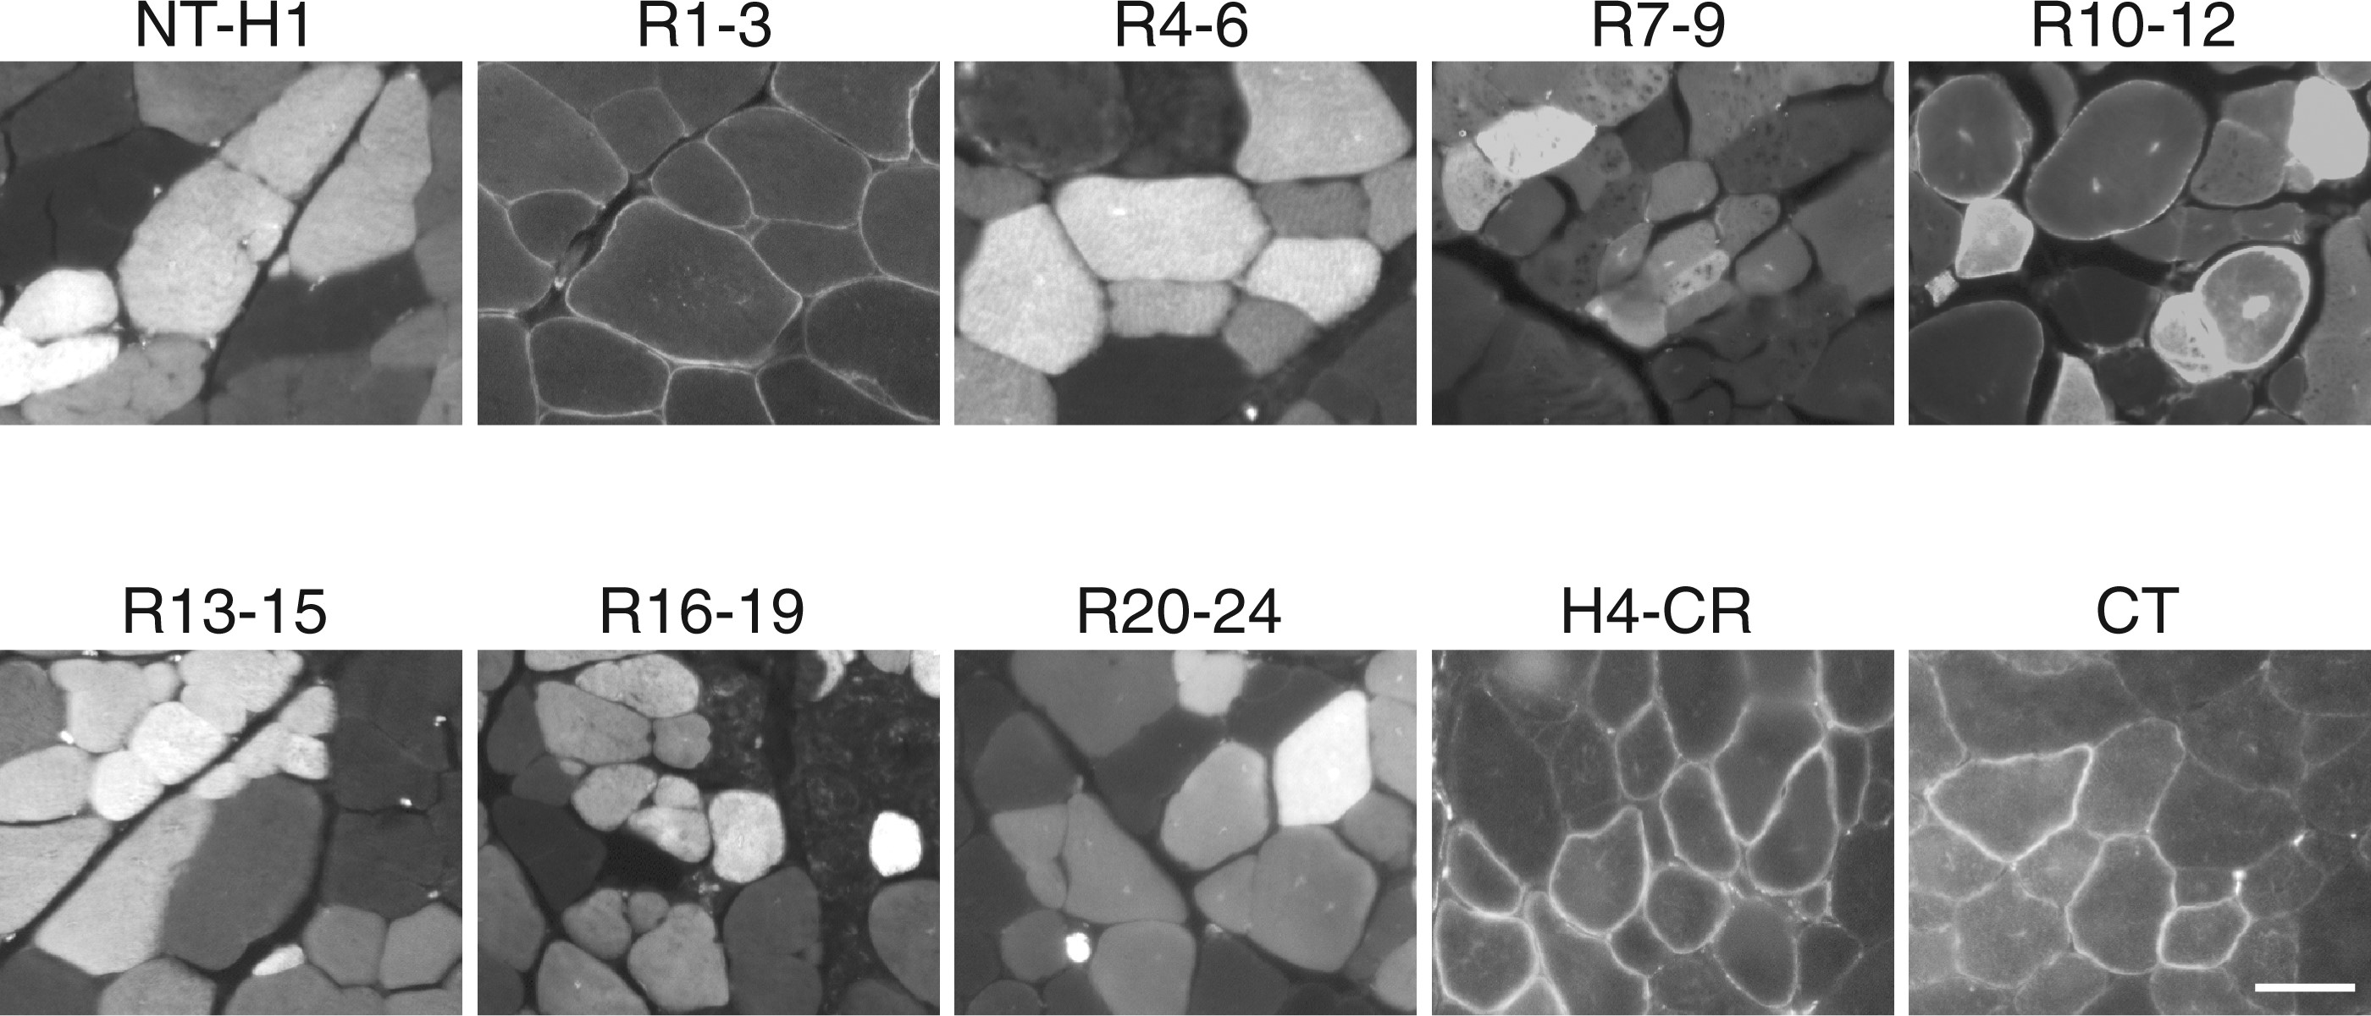
Figure 1. Dystrophin R1-3, R10-12, CR and CT are independent membrane-binding domains. Full-length human dystrophin was ...
Notes:
Figure 1. Dystrophin R1-3, R10-12, CR and CT are independent membrane-binding domains. Full-length human dystrophin was split into ten subdomains and each subdomain fused with a GFP tag. The fusion proteins were individually expressed in mdx muscle by AAV gene transfer. Representative GFP photomicrographs of each indicated dystrophin subdomain are shown. Dystrophin R1-3, H4-CR and CT were exclusively localized at the sarcolemma. R10-12 was found at the sarcolemma and in the cytosol. NT-H1, R4-6, R7-9, R13-15, R16-19 and R20-24 were exclusively localized in the cytosol. Scale bar: 50 μm.
Unless provided in the caption above, the following copyright applies to the content of this slide: © The Author 2016. Published by Oxford University Press. All rights reserved. For Permissions, please email: journals.permissions@oup.com

Slide 2
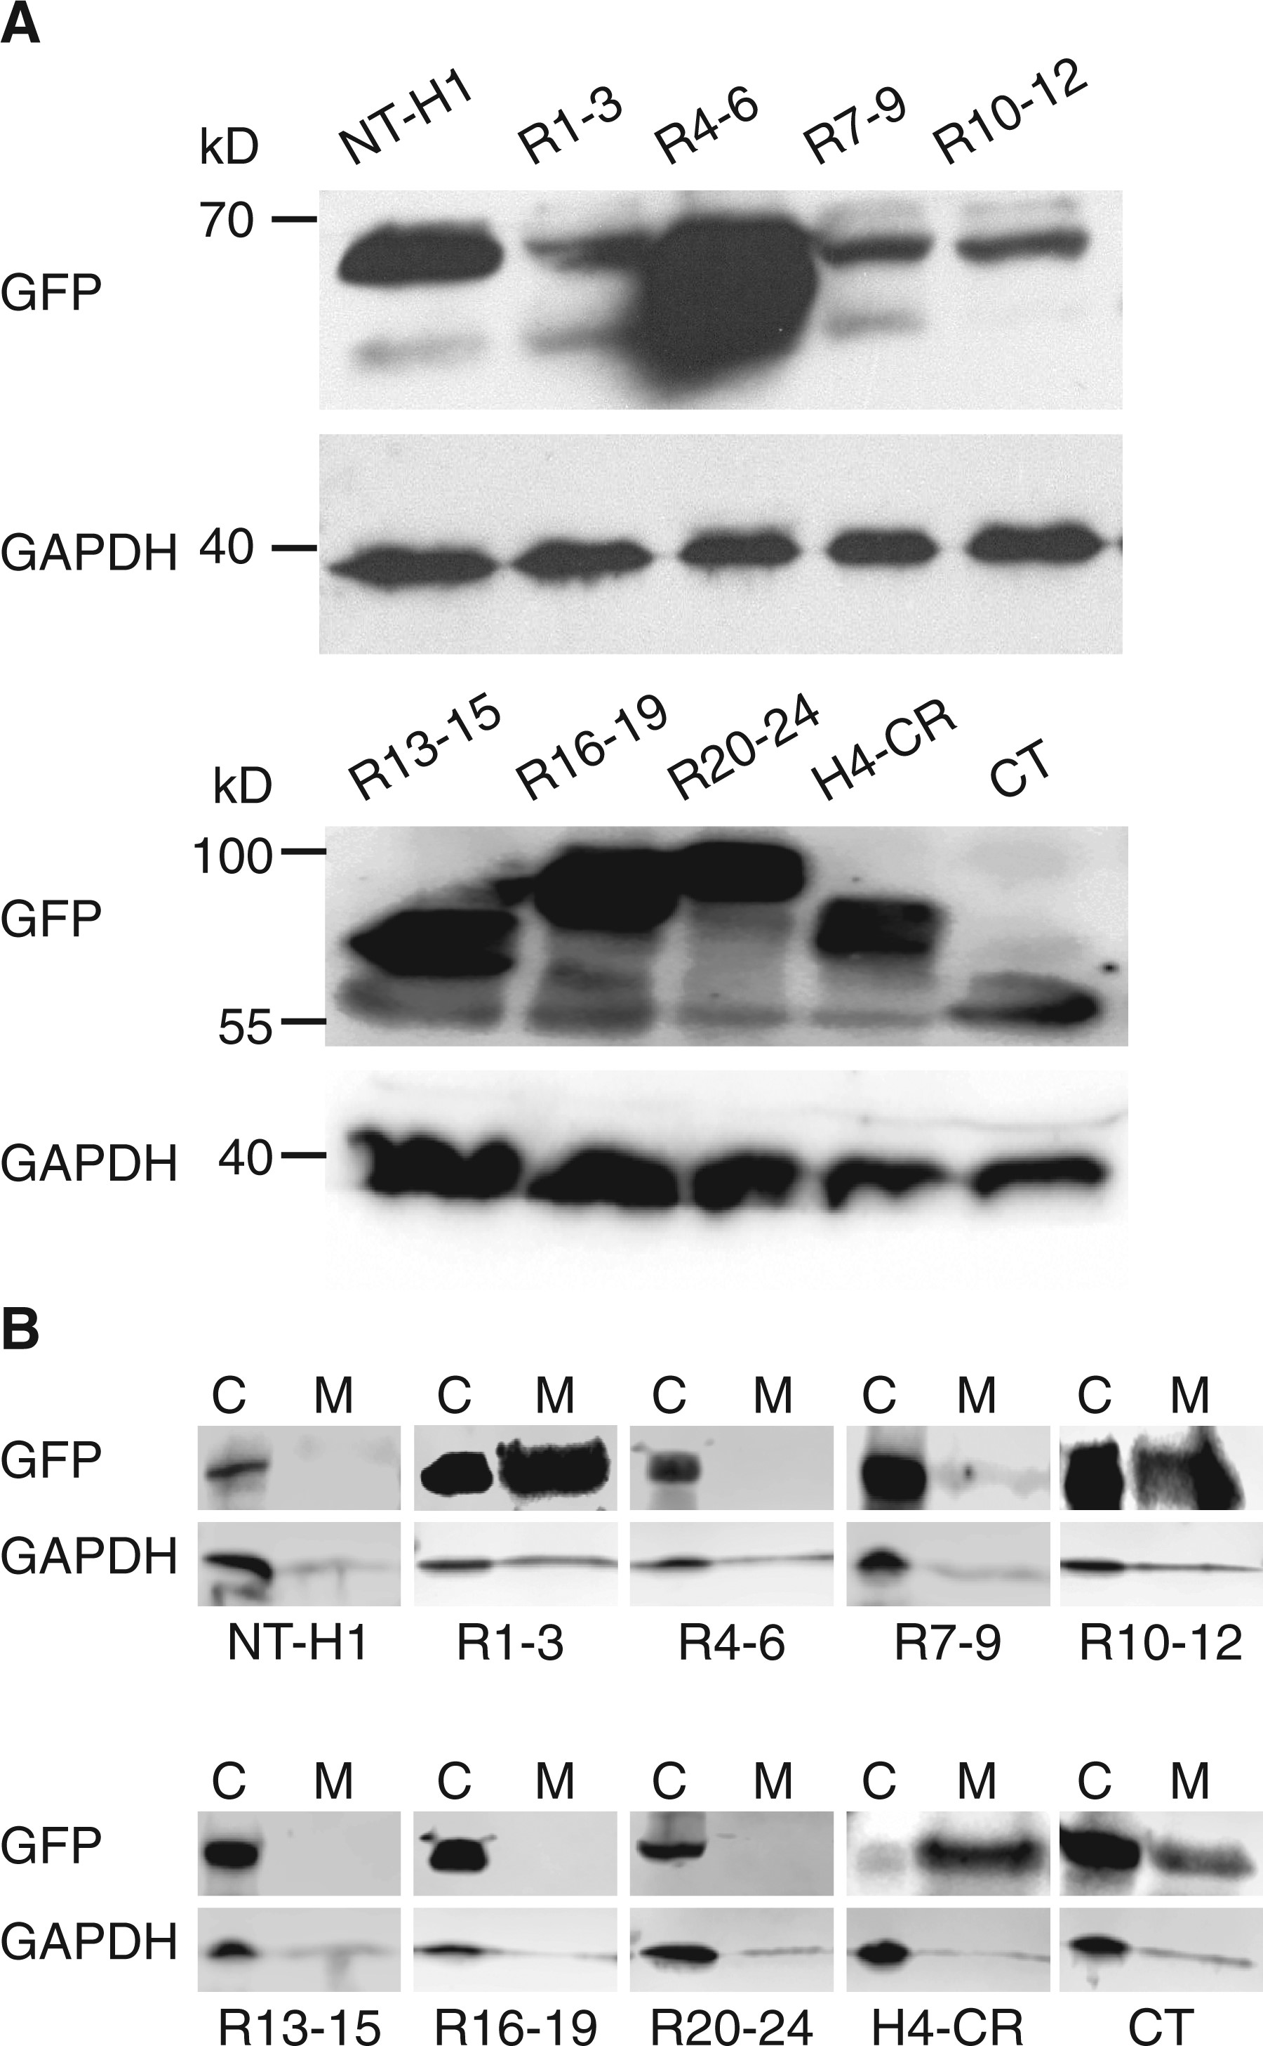
Figure 2. Microsomal western blot suggests the association of R1-3, R10-12, CR and CT with the sarcolemma. (A) Whole ...
Notes:
Figure 2. Microsomal western blot suggests the association of R1-3, R10-12, CR and CT with the sarcolemma. (A) Whole muscle lysate western blots revealing AAV-mediated expression of GFP-fused dystrophin subdomains in mdx muscle. (B) Detection of dystrophin R1-3, R10-12, H4-CR and CT in the membrane fraction by microsomal western blots. GAPDH marks the cytosolic fraction. (C) cytosolic fraction; M, membrane fraction.
Unless provided in the caption above, the following copyright applies to the content of this slide: © The Author 2016. Published by Oxford University Press. All rights reserved. For Permissions, please email: journals.permissions@oup.com

Slide 3
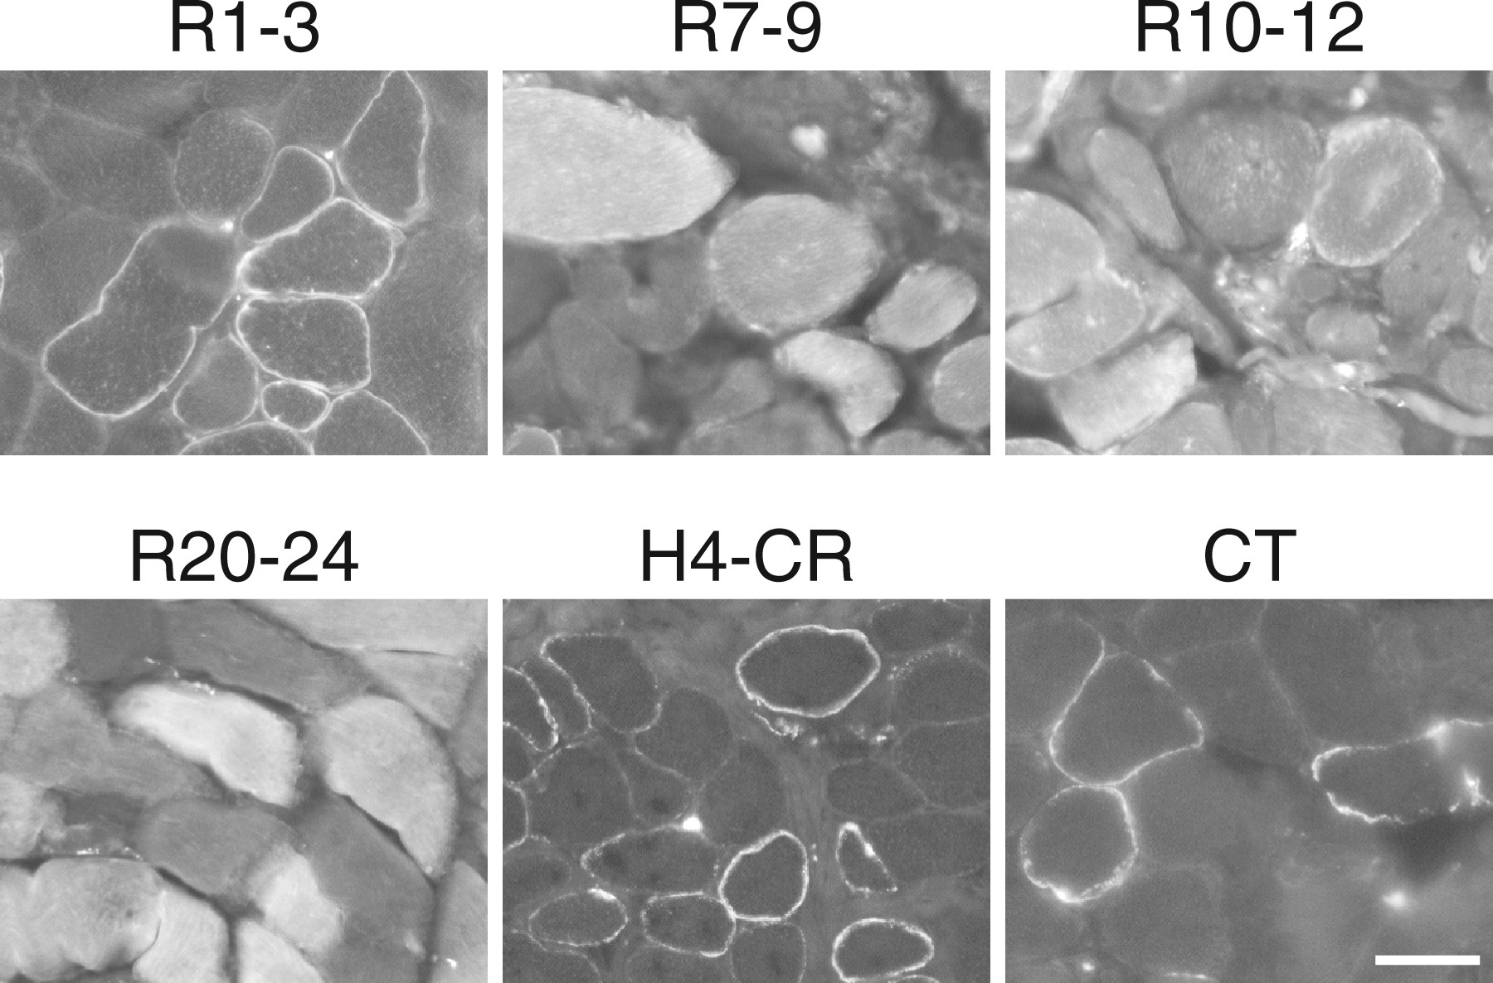
Figure 3. Dystrophin R1-3, R10-12, H4-CR and CT bind to the sarcolemma in canine muscle. Indicated GFP fusion ...
Notes:
Figure 3. Dystrophin R1-3, R10-12, H4-CR and CT bind to the sarcolemma in canine muscle. Indicated GFP fusion dystrophin subdomains were expressed in dystrophic dog muscle by AAV gene transfer. Representative GFP photomicrographs show the membrane binding of R1-3, R10-12, H4-CR and CT and cytosolic localization of R7-9 and R20-24. R10-12 is also seen in the cytosol. Scale bar: 50 μm.
Unless provided in the caption above, the following copyright applies to the content of this slide: © The Author 2016. Published by Oxford University Press. All rights reserved. For Permissions, please email: journals.permissions@oup.com

Slide 4
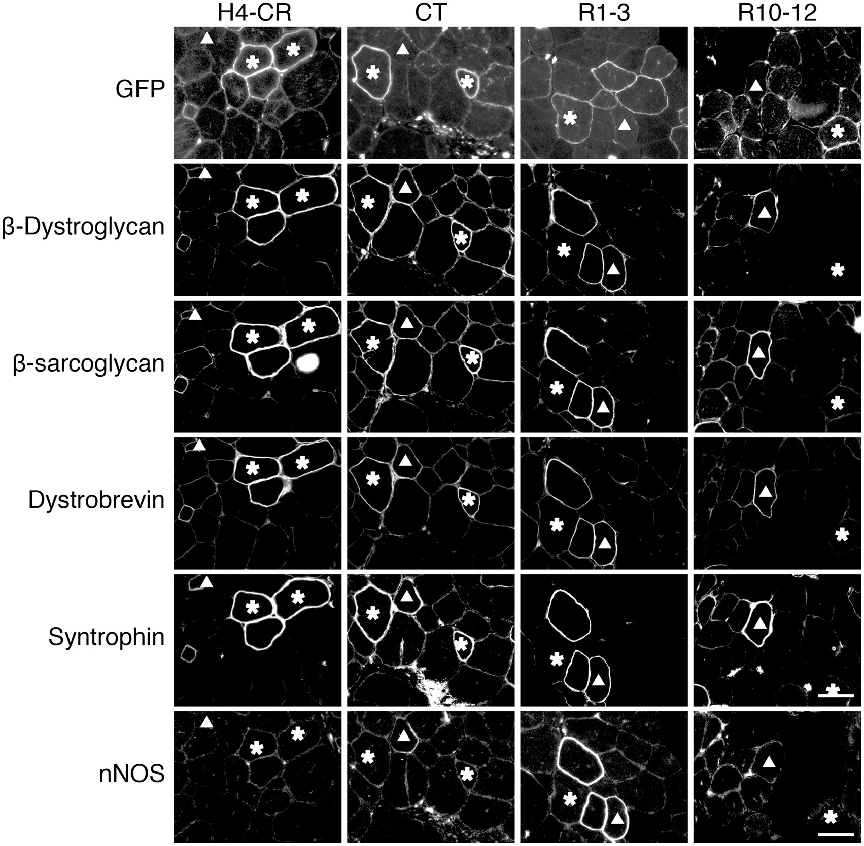
Figure 4. Dystrophin CT restores the DGC at the sarcolemma. Representative serial section photomicrographs of GFP and ...
Notes:
Figure 4. Dystrophin CT restores the DGC at the sarcolemma. Representative serial section photomicrographs of GFP and immunostaining for β-dystroglycan, β-sarcoglycan, dystrobrevin and syntrophin in mdx muscle expressing the indicated GFP-dystrophin subdomain fusion proteins. Asterisk, the GFP-positive myofiber in serial sections; Triangle, the GFP-negative revertant fiber in serial sections. GFP signals co-localize with DGC components in myofibers transduced by the H4-CR and CT but not R1-3 and R10-12 subdomain AAV vectors. Scale bar: 50 μm.
Unless provided in the caption above, the following copyright applies to the content of this slide: © The Author 2016. Published by Oxford University Press. All rights reserved. For Permissions, please email: journals.permissions@oup.com

Slide 5
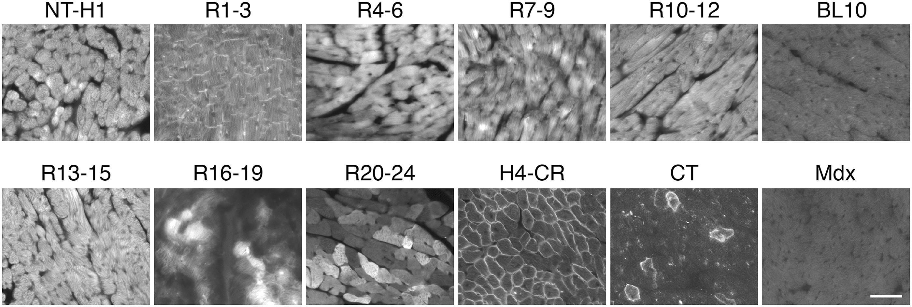
Figure 5. Dystrophin R1-3, CR and CT bind to the sarcolemma in the heart. Indicated GFP fusion dystrophin subdomains ...
Notes:
Figure 5. Dystrophin R1-3, CR and CT bind to the sarcolemma in the heart. Indicated GFP fusion dystrophin subdomains were delivered to the mdx heart by systemic AAV injection. Uninjected BL10 and mdx hearts were used as negative controls. Subdomain H4-CR and CT showed membrane localization. Subdomain R1-3 was found in the intercalated disk and cytosol. Remaining subdomains were only seen in the cytosol. Scale bar: 50 μm.
Unless provided in the caption above, the following copyright applies to the content of this slide: © The Author 2016. Published by Oxford University Press. All rights reserved. For Permissions, please email: journals.permissions@oup.com

Slide 6
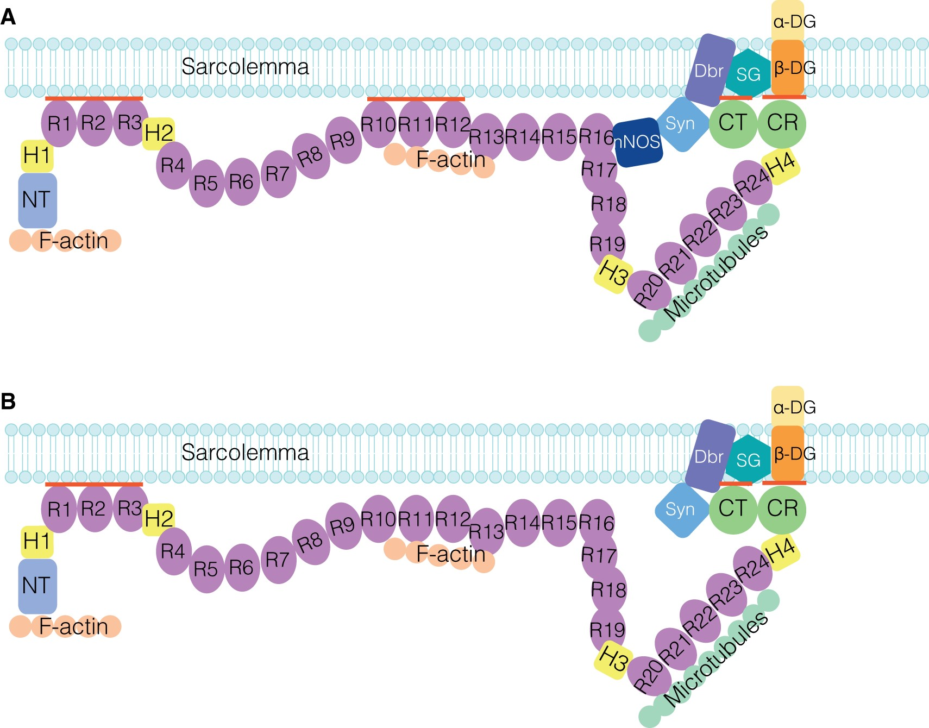
Figure 6. A new model of dystrophin-sarcolemma interaction. (A) In muscle, dystrophin binds to the sarcolemma through ...
Notes:
Figure 6. A new model of dystrophin-sarcolemma interaction. (A) In muscle, dystrophin binds to the sarcolemma through four independent membrane-binding subdomains. (B) In the heart, dystrophin binds to the sarcolemma through three independent membrane-binding domains. These subdomains are marked by thick red lines.
Unless provided in the caption above, the following copyright applies to the content of this slide: © The Author 2016. Published by Oxford University Press. All rights reserved. For Permissions, please email: journals.permissions@oup.com

