Slide 1
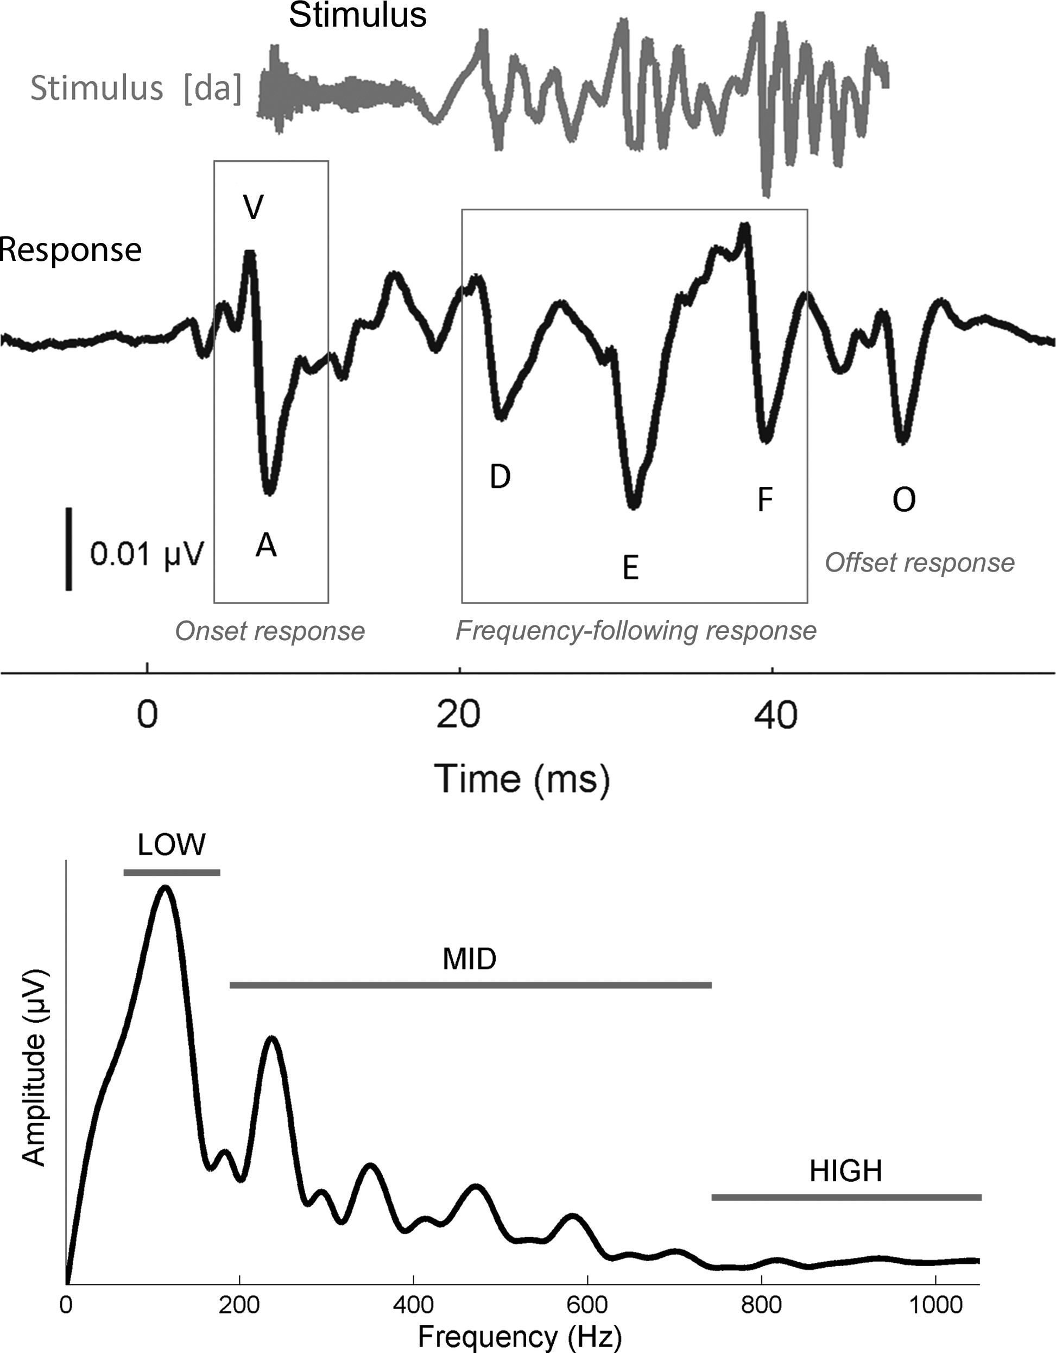
Figure 1. Characteristics of the speech-evoked auditory brainstem response. (Top) The complex stimulus [da] (gray) ...
Notes:
Figure 1. Characteristics of the speech-evoked auditory brainstem response. (Top) The complex stimulus [da] (gray) elicits a stereotyped auditory brainstem response (black) with 6 characteristic peaks (V, A, D, E, F, O). Waves V and A, which occur around 6.5 and 7.5 ms, respectively, represent the response to the onset of sound. Waves D, E, and F, which fall within the frequency-following response (FFR), occur roughly 9 ms apart. Wave O, the offset response, appears roughly 6–8 ms after the stimulus terminates. The stimulus waveform is shifted by ∼6.8 ms to maximize the visual coherence between the 2 signals in this figure. (Bottom) Frequency domain representation of the FFR (19.5–44.2 ms). Spectral amplitudes were calculated over 3 ranges of frequencies: Low (75–175), mid (175–750), and high (750–1050 Hz).
Unless provided in the caption above, the following copyright applies to the content of this slide: © The Author 2013. Published by Oxford University Press. All rights reserved. For Permissions, please e-mail: journals.permissions@oup.com

Slide 2
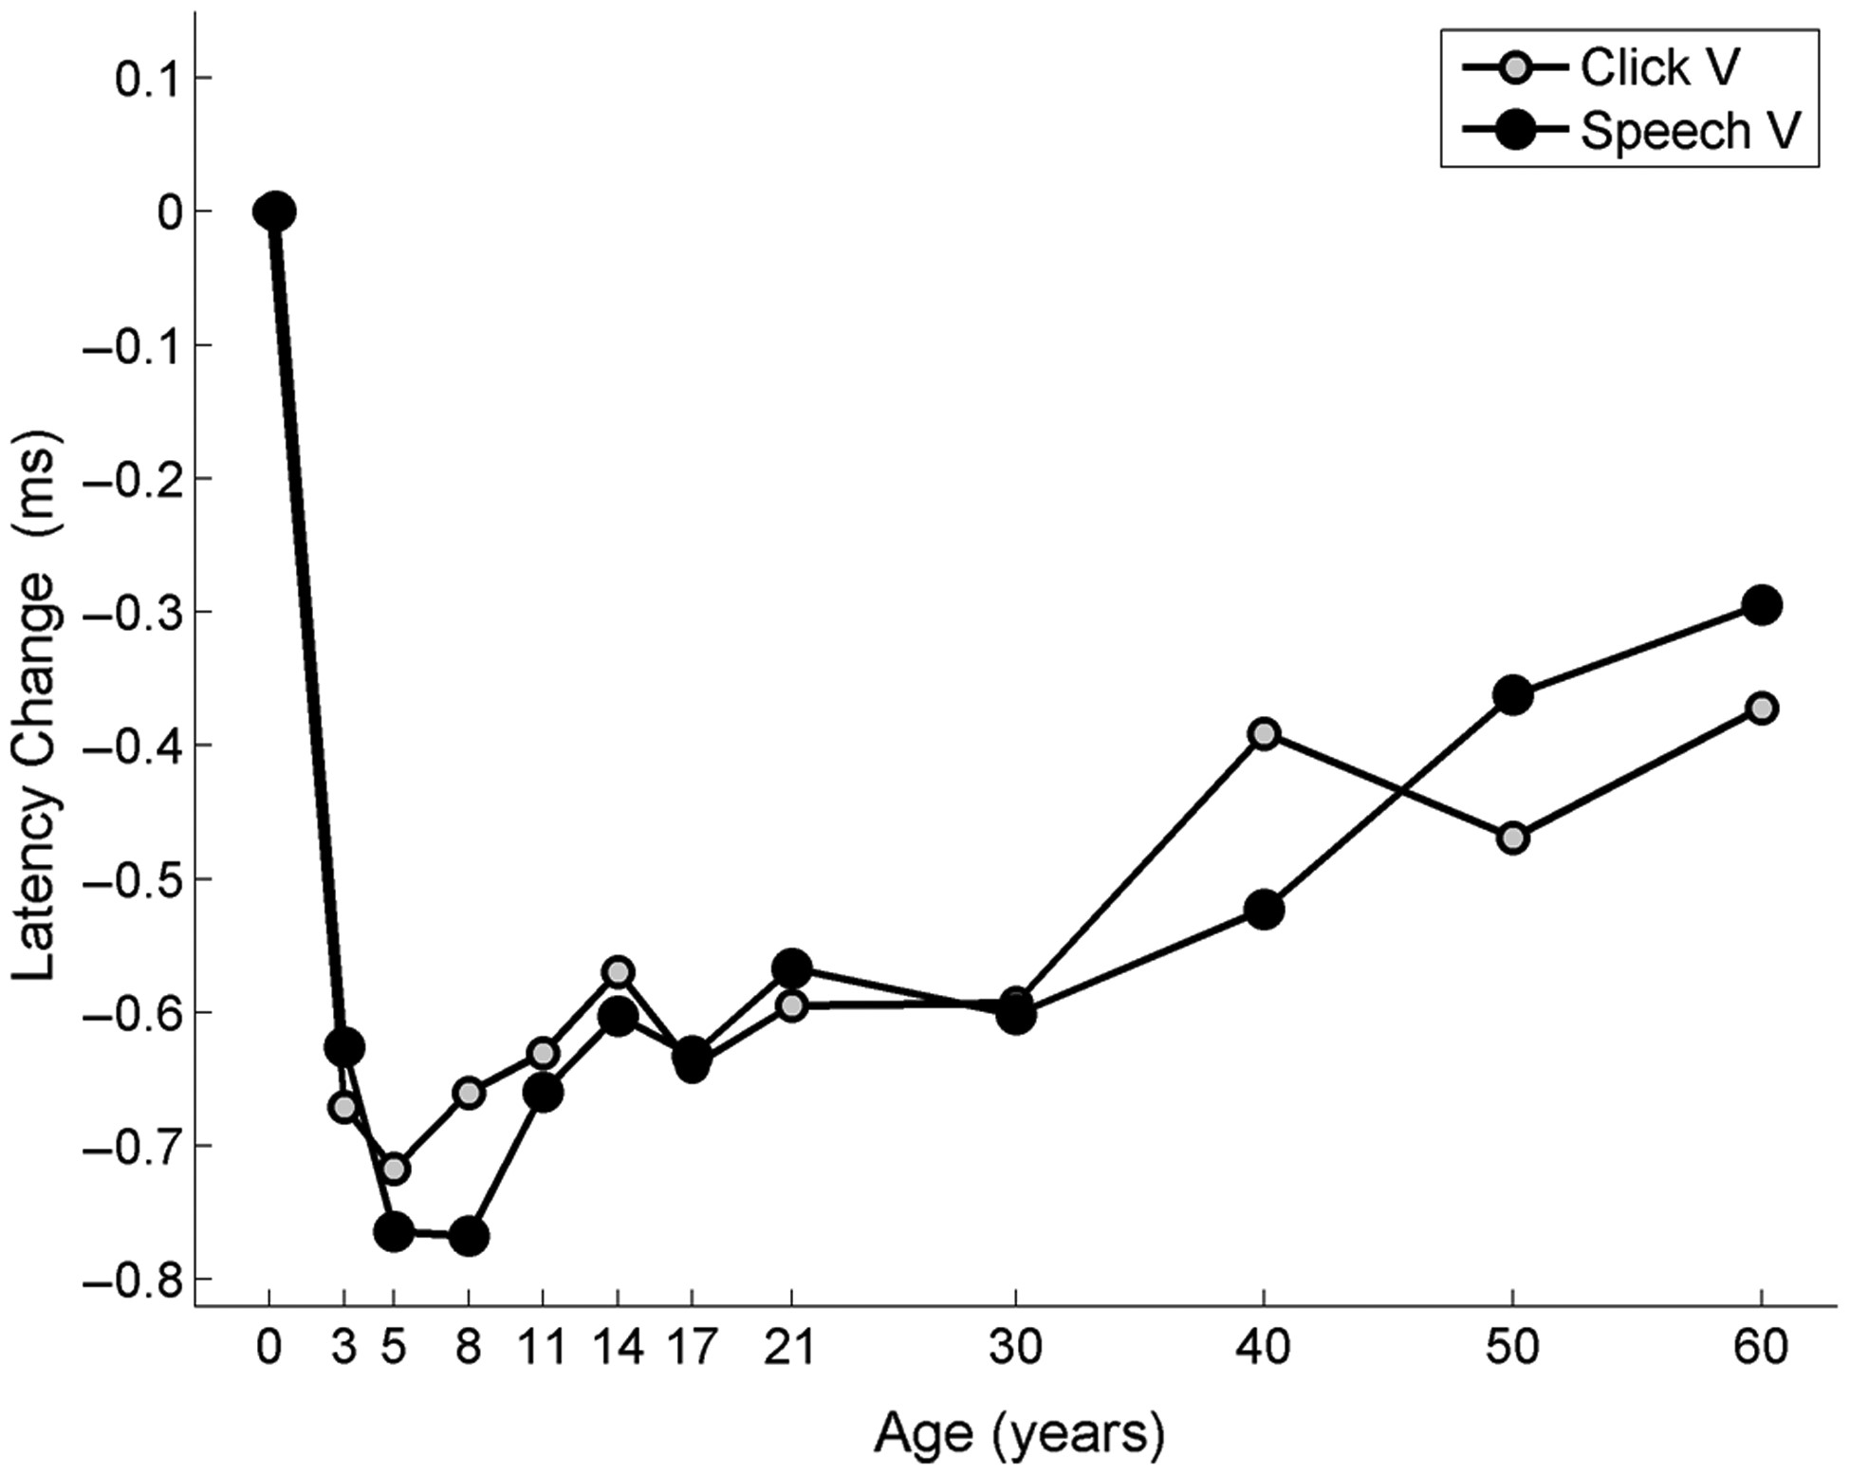
Figure 2. Developmental comparisons between click- and speech-evoked wave V of the auditory brainstem response (ABR). ...
Notes:
Figure 2. Developmental comparisons between click- and speech-evoked wave V of the auditory brainstem response (ABR). Age-dependent changes in latency are plotted for the click- (gray) and speech-evoked ABR (black). To graphically compare the developmental trajectories for these stimuli, the latency trajectories have been normalized such that the infant group is plotted at 0, with the y-axis representing the amount of change (ms) from the infants. The value reported on the x-axis represents the youngest age for each group; for example, 3 represents 3–5.
Unless provided in the caption above, the following copyright applies to the content of this slide: © The Author 2013. Published by Oxford University Press. All rights reserved. For Permissions, please e-mail: journals.permissions@oup.com

Slide 3
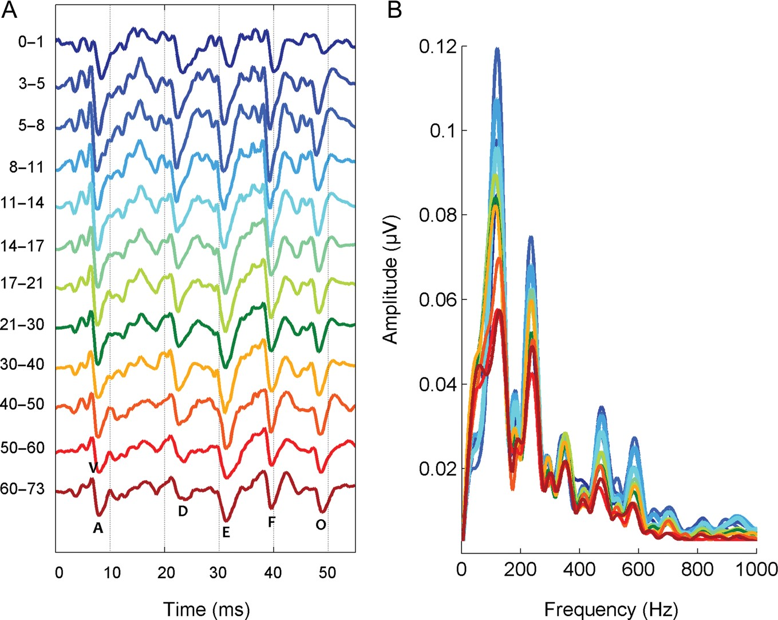
Figure 3. (A) Time- and (B) frequency- domain representations of the speech-evoked auditory brainstem response for each ...
Notes:
Figure 3. (A) Time- and (B) frequency- domain representations of the speech-evoked auditory brainstem response for each age group represented as different colors.
Unless provided in the caption above, the following copyright applies to the content of this slide: © The Author 2013. Published by Oxford University Press. All rights reserved. For Permissions, please e-mail: journals.permissions@oup.com

Slide 4
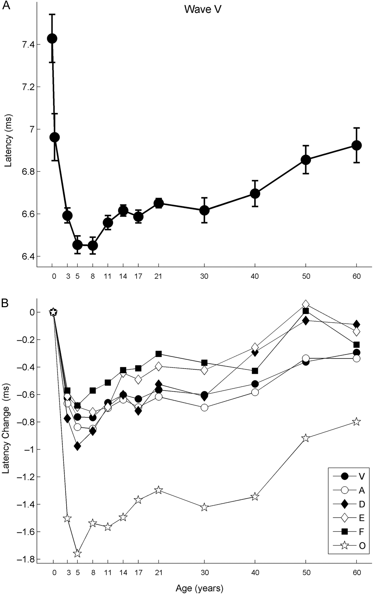
Figure 4. Latency trajectories for the 6 characteristic peaks of the speech-evoked auditory brainstem response (cABR) ...
Notes:
Figure 4. Latency trajectories for the 6 characteristic peaks of the speech-evoked auditory brainstem response (cABR) (A). Latency trajectory for wave V plotted as a function of age. Error bars represent 1 standard deviation of the mean. (B) Latency trajectory for the 6 characteristic peaks of the cABR. To compare across peaks, the trajectories have been normalized such that the infant group is plotted at 0, with the y-axis representing the amount of change (ms) from the infants. Across all peaks, the minimum latency occurs within the 5- to 11-year-old window.
Unless provided in the caption above, the following copyright applies to the content of this slide: © The Author 2013. Published by Oxford University Press. All rights reserved. For Permissions, please e-mail: journals.permissions@oup.com

Slide 5
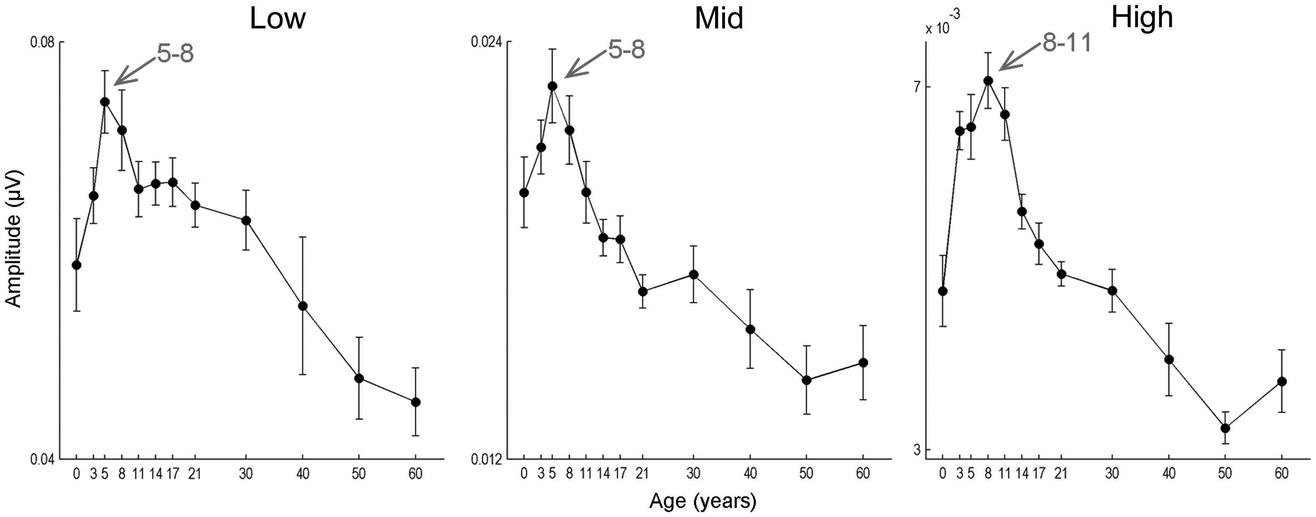
Figure 5. Developmental trajectories for the low-, mid-, and high-frequency components of the frequency-following ...
Notes:
Figure 5. Developmental trajectories for the low-, mid-, and high-frequency components of the frequency-following response of the speech-evoked auditory brainstem response. In all 3 frequency bands, the response amplitude peaks transitorily during school-age years.
Unless provided in the caption above, the following copyright applies to the content of this slide: © The Author 2013. Published by Oxford University Press. All rights reserved. For Permissions, please e-mail: journals.permissions@oup.com

Slide 6
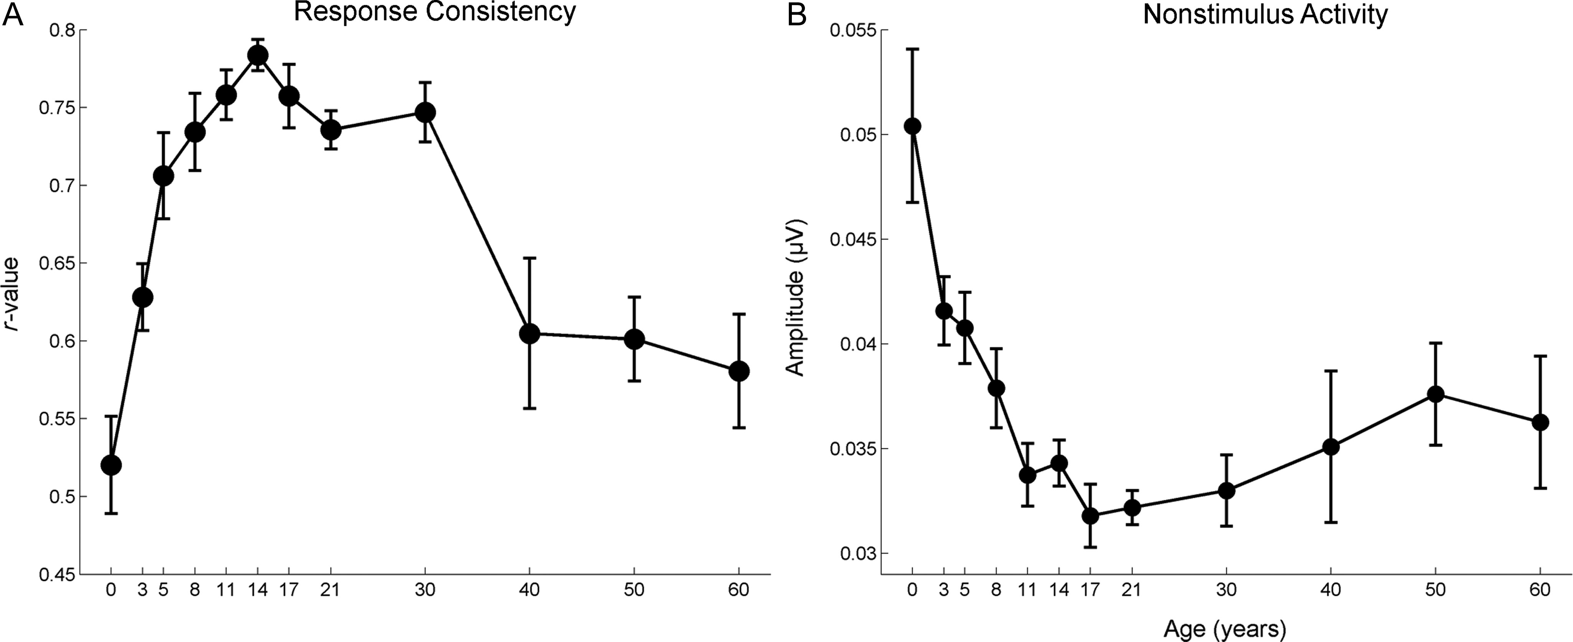
Figure 6. Developmental trajectories for the measures of within-session response consistency (A) and nonstimulus ...
Notes:
Figure 6. Developmental trajectories for the measures of within-session response consistency (A) and nonstimulus activity (B) of the speech-evoked auditory brainstem response. Compared with the latency and amplitude measures, the developmental trajectories are more symmetrical.
Unless provided in the caption above, the following copyright applies to the content of this slide: © The Author 2013. Published by Oxford University Press. All rights reserved. For Permissions, please e-mail: journals.permissions@oup.com

Slide 7
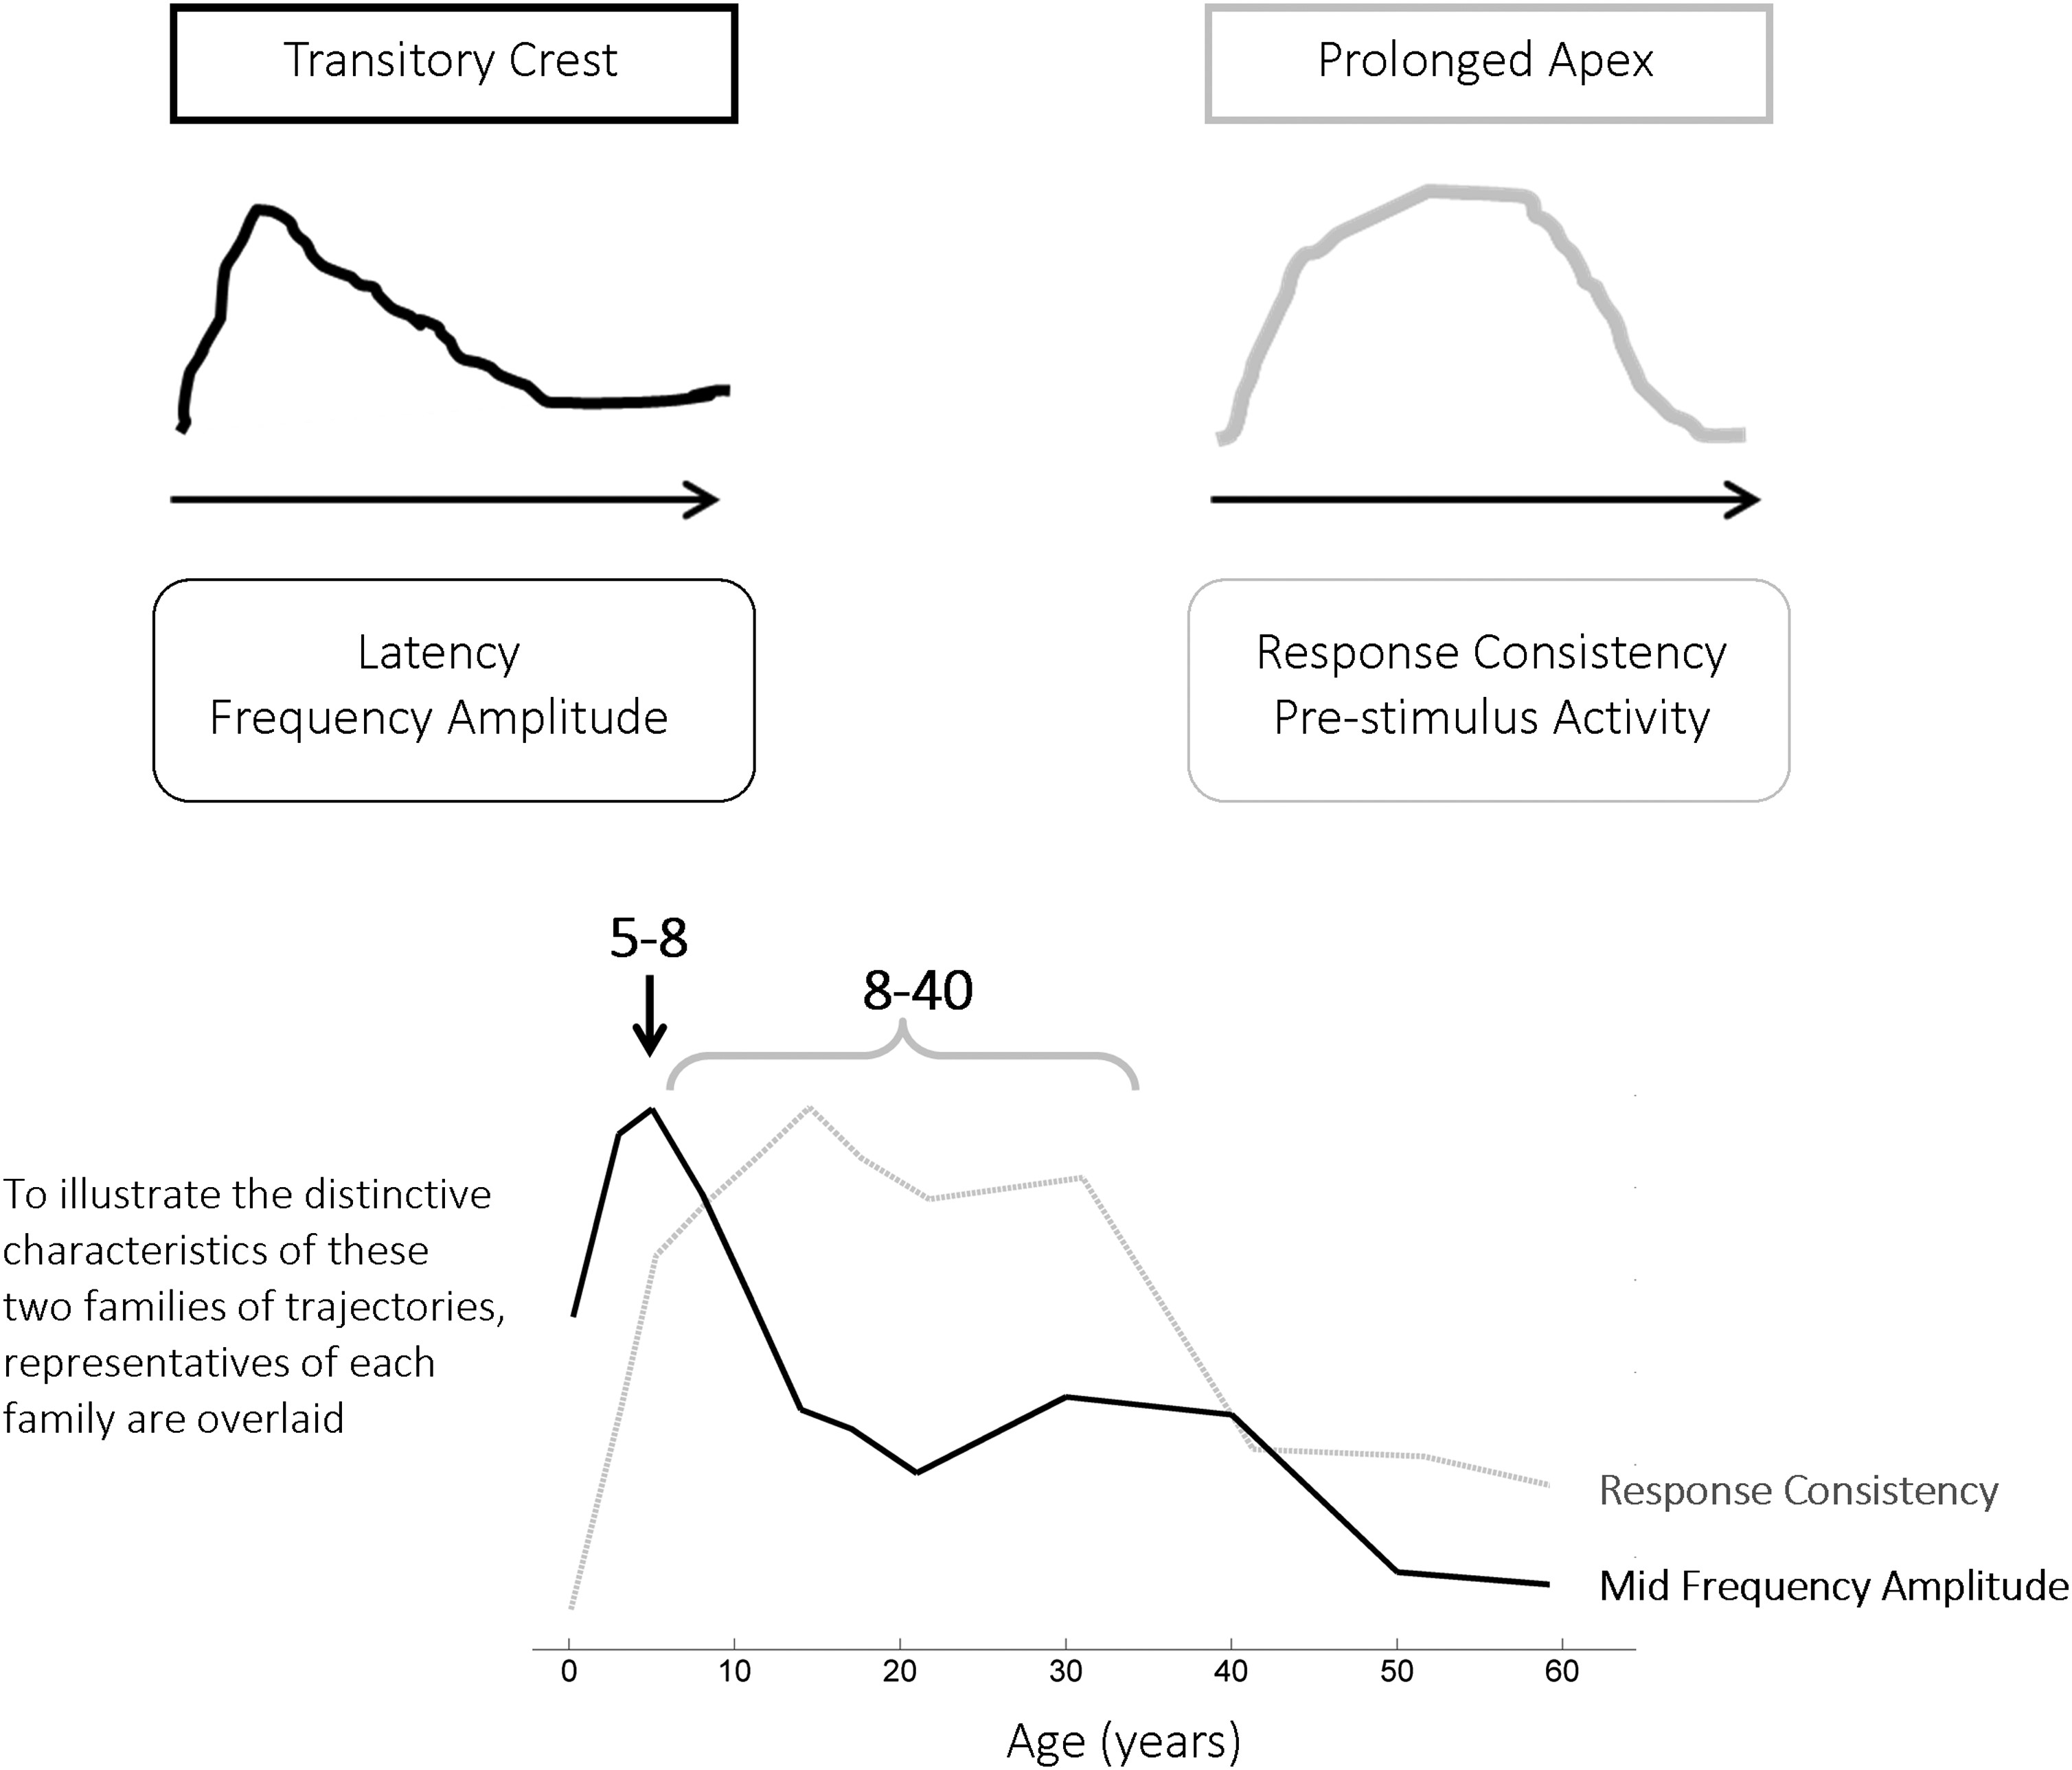
Figure 7. Two distinct developmental trajectories are evidenced in the auditory brainstem response: As illustrated in ...
Notes:
Figure 7. Two distinct developmental trajectories are evidenced in the auditory brainstem response: As illustrated in this stylized schematic, one has a brief apex (Transitory Crest) during school-age years that overshoots the adult pattern (Transitory Crest), and the other has a more symmetrical and broader trajectory that exhibits a longer plateau (Prolonged Apex).
Unless provided in the caption above, the following copyright applies to the content of this slide: © The Author 2013. Published by Oxford University Press. All rights reserved. For Permissions, please e-mail: journals.permissions@oup.com

