Slide 1
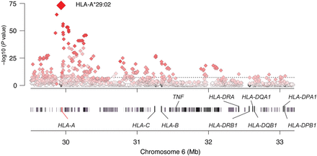
Table 1. HLA-A29:02 and newly associated loci identified in this study *This SNP failed genotyping by Sanger ...
Notes:
Table 1. HLA-A29:02 and newly associated loci identified in this study *This SNP failed genotyping by Sanger sequencing, so replication genotyping for this locus was at rs7159505, which had r2 = 0.83 as calculated from Go NL. Figure 1.Association tests within the MHC region to birdshot chorioretinopathy. The strongest MHC signal mapped to HLA-A*29:02 allele. The shading depicts the strength of the correlation (r2) between HLA-A*29:02 (red diamond) and the SNPs tested in the region. Gene positions are obtained from the human genome build 37 (GRCh37/hg19).
Unless provided in the caption above, the following copyright applies to the content of this slide: © The Author 2014. Published by Oxford University Press. All rights reserved. For Permissions, please email: journals.permissions@oup.com

Slide 2
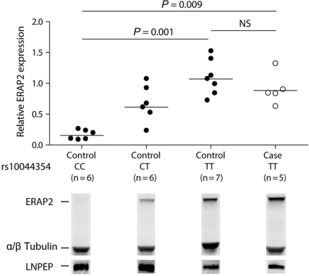
Figure 2. Expression of ERAP2 and LNPEP in CEPH control and BSCR according to rs10044354 genotype. B-cell lines from ...
Notes:
Figure 2. Expression of ERAP2 and LNPEP in CEPH control and BSCR according to rs10044354 genotype. B-cell lines from individuals from the CEPH panel (13) and five BSCR patients were lysed and ERAP2 and LNPEP expression was assessed after SDS–PAGE and western blotting with antibodies to ERAP2 and LNPEP. The endogenous levels of both α- and β-tubulin total protein were analyzed as a loading control. The horizontal lines indicate the means. Kruskal–Wallis test with Dunn's multiple-comparison posthoc test was used to assess differences in the levels of ERAP2 between B-cell line groups according to rs10044354 genotype.
Unless provided in the caption above, the following copyright applies to the content of this slide: © The Author 2014. Published by Oxford University Press. All rights reserved. For Permissions, please email: journals.permissions@oup.com

