Slide 1
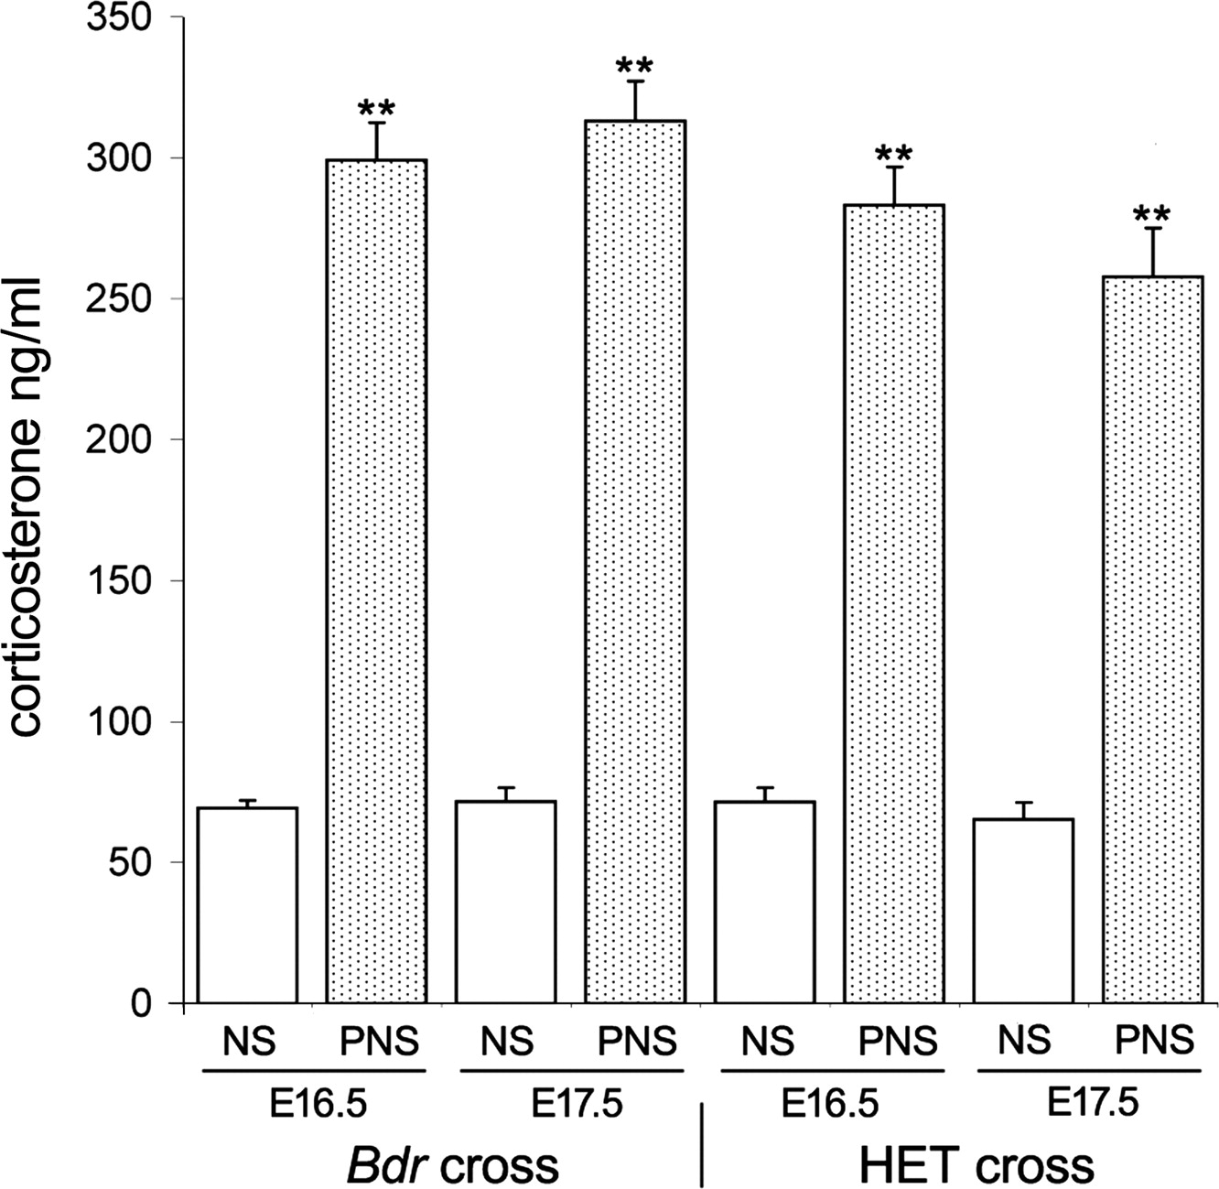
Figure 1. Corticosterone levels are increased in PNS over NS dams. Blood corticosterone levels were significantly ...
Notes:
Figure 1. Corticosterone levels are increased in PNS over NS dams. Blood corticosterone levels were significantly increased in pregnant dams at E14.5 and 15.5, 30 min after the administration of PNS, compared with NS control wild-type (WT) dams. Data are shown as mean ± SEM; NS versus PNS animals, **P < 0.01.
Unless provided in the caption above, the following copyright applies to the content of this slide: © The Author 2009. Published by Oxford University PressThis is an Open Access article distributed under the terms of the Creative Commons Attribution Non-Commercial License (http://creativecommons.org/licenses/by-nc/2.5/uk/) which permits unrestricted non-commercial use, distribution, and reproduction in any medium, provided the original work is properly cited.

Slide 2
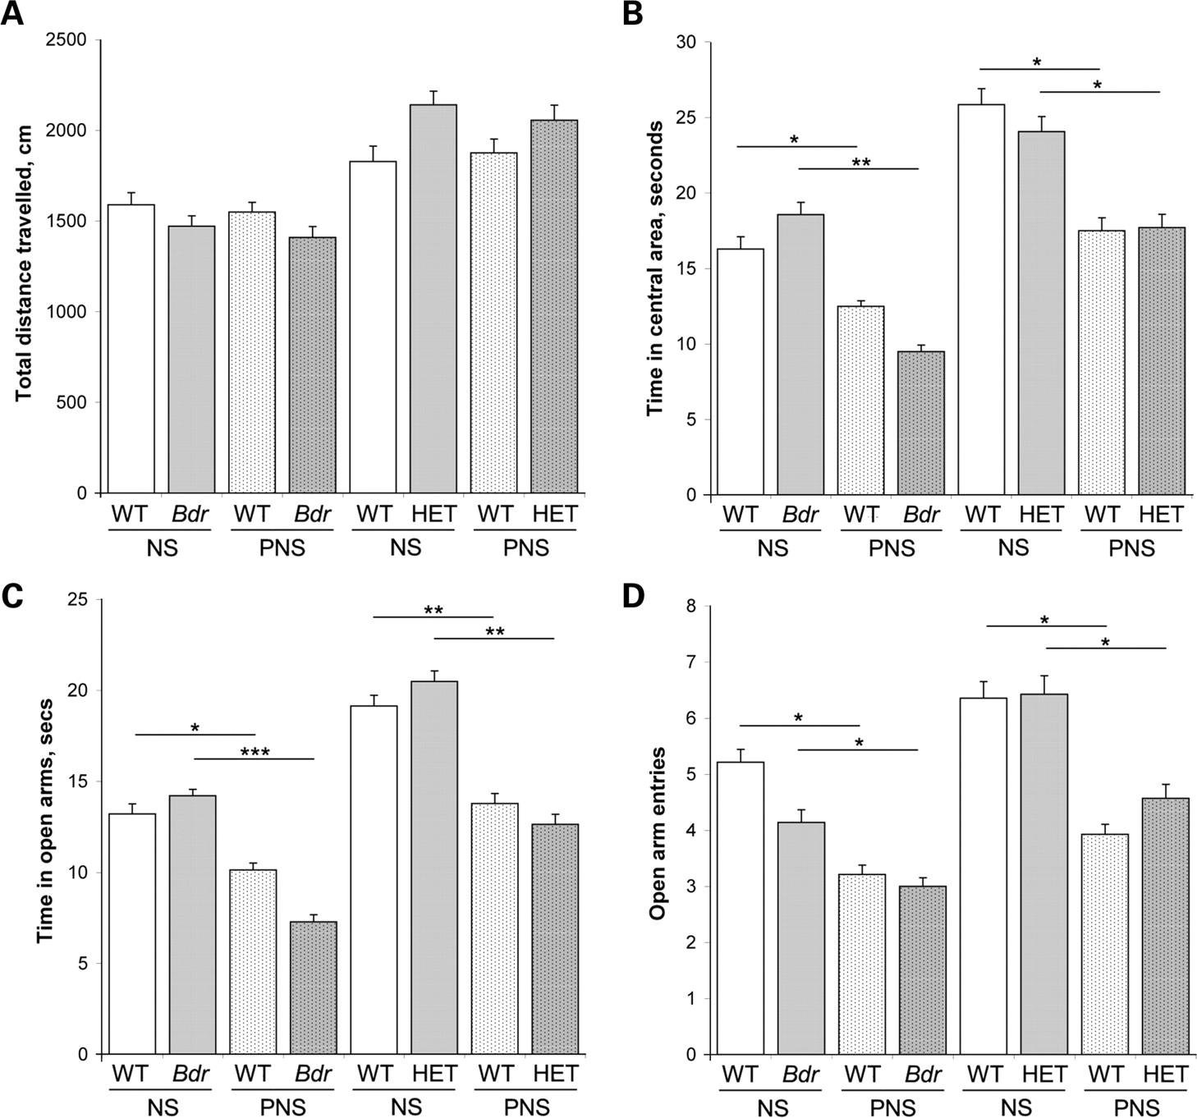
Figure 2. PNS influences anxiety irrespective of genotype. (A and B) Open field. (A) Offspring from the HET cross were ...
Notes:
Figure 2. PNS influences anxiety irrespective of genotype. (A and B) Open field. (A) Offspring from the HET cross were generally more active than those from Bdr cross, however this difference was not significant or influenced by PNS. (B) PNS caused a significant reduction in time spent in the central area of the open field in mice from both crosses, although there was no interaction between stress and genotype. (C and D) Elevated plus maze. PNS caused a significant reduction in the time spent in the open arms (C) and on the number of arm entries (D) in mice from both crosses, although there was no interaction between stress and genotype. Data are shown as mean ± SEM; NS versus PNS animals, *P < 0.05, **P < 0.01, ***P < 0.001.
Unless provided in the caption above, the following copyright applies to the content of this slide: © The Author 2009. Published by Oxford University PressThis is an Open Access article distributed under the terms of the Creative Commons Attribution Non-Commercial License (http://creativecommons.org/licenses/by-nc/2.5/uk/) which permits unrestricted non-commercial use, distribution, and reproduction in any medium, provided the original work is properly cited.

Slide 3
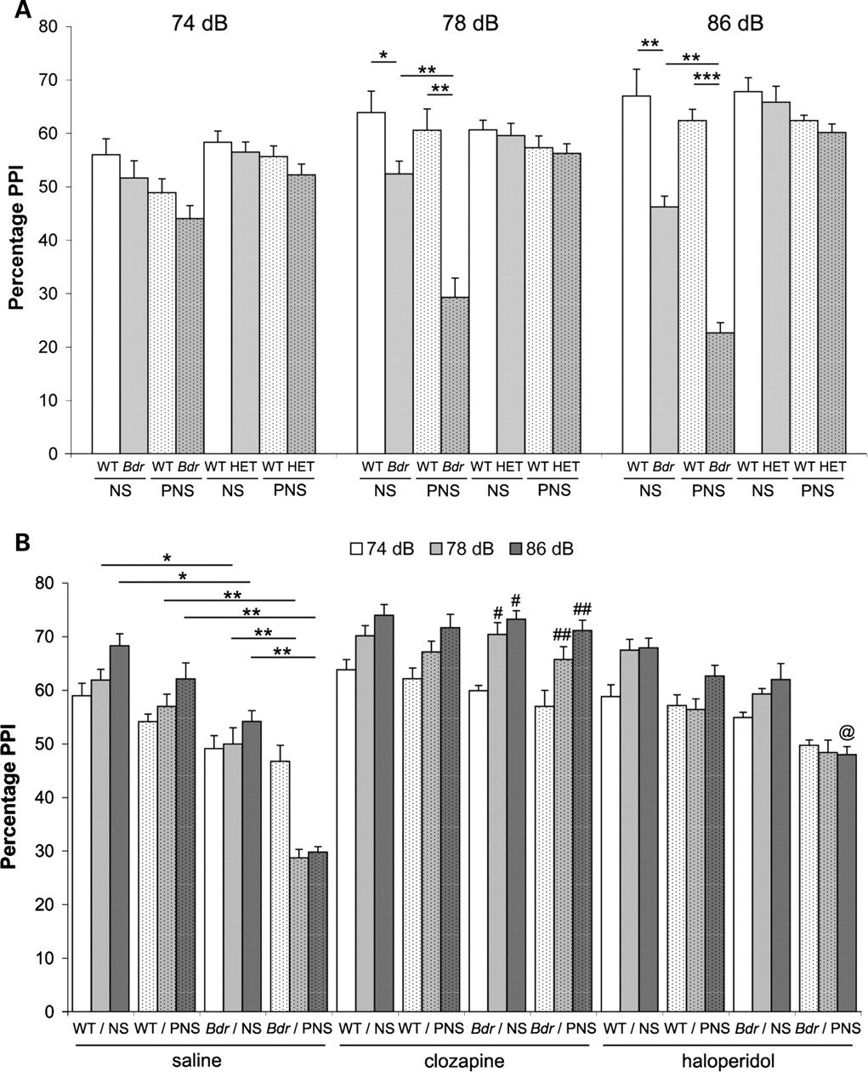
Figure 6. PPI deficits in Bdr mutants are enhanced by PNS. (A) PPI testing: Bdr mutants show a significant PPI deficit ...
Notes:
Figure 6. PPI deficits in Bdr mutants are enhanced by PNS. (A) PPI testing: Bdr mutants show a significant PPI deficit using a pre-pulse intensity at both 8 and 16 dB above background (70 dB) compared with WT controls (*P < 0.05, **P < 0.01). The application of PNS to Bdr mice further enhanced the PPI deficit compared with NS mutants (**P < 0.01) and PNS controls (**P < 0.01, ***P < 0.001). There was also significant genotype × stress interaction in Bdr mutants (see text). Mice from the HET cross did not show any PPI abnormalities. (B) Pharmacological responses: vehicle (saline) treated animals showed PPI responses equivalent to those in (A), with a reduction in Bdr mutants at 78 and 86 dB prepulse intensities (*P < 0.05) and further enhancement of the deficit in NS mutants or PNS WT animals (**P < 0.01). Clozapine administration reversed the PPI deficits in Bdr mutants from both NS (#P < 0.05) and PNS (##P < 0.01) dams versus vehicle-treated Bdr mice at 78 and 86 dB. Haloperidol administration caused a significant increase in PPI only at 86 dB in Bdr mutants compared with saline-treated mutants (@P < 0.05). Data are shown as mean ± SEM.
Unless provided in the caption above, the following copyright applies to the content of this slide: © The Author 2009. Published by Oxford University PressThis is an Open Access article distributed under the terms of the Creative Commons Attribution Non-Commercial License (http://creativecommons.org/licenses/by-nc/2.5/uk/) which permits unrestricted non-commercial use, distribution, and reproduction in any medium, provided the original work is properly cited.

Slide 4
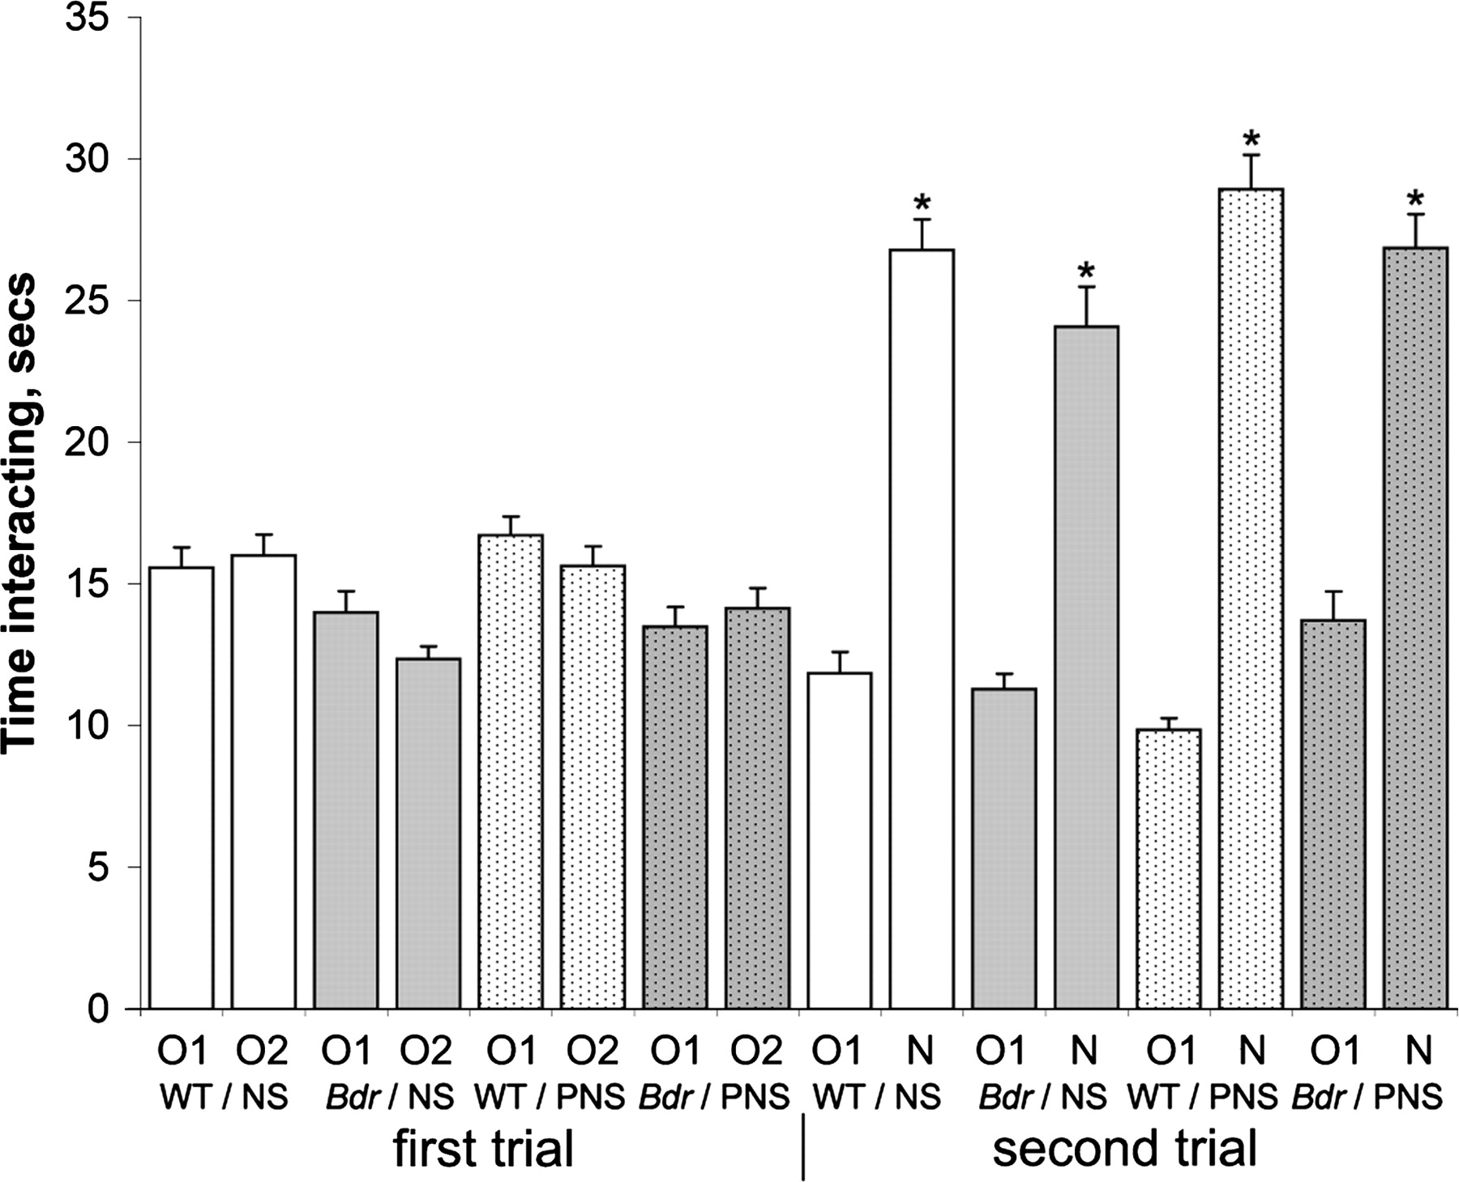
Figure 5. Bdr mutants show no deficit in novel object recognition. All animals spent equivalent amount of time ...
Notes:
Figure 5. Bdr mutants show no deficit in novel object recognition. All animals spent equivalent amount of time interacting with both identical objects 1 and 2 (O1 and O2) during the first trial and significantly more time with the novel object (N) compared with the familiar object (O1) in the second trial (*P < 0.05). Data are shown as mean ± SEM.
Unless provided in the caption above, the following copyright applies to the content of this slide: © The Author 2009. Published by Oxford University PressThis is an Open Access article distributed under the terms of the Creative Commons Attribution Non-Commercial License (http://creativecommons.org/licenses/by-nc/2.5/uk/) which permits unrestricted non-commercial use, distribution, and reproduction in any medium, provided the original work is properly cited.

Slide 5
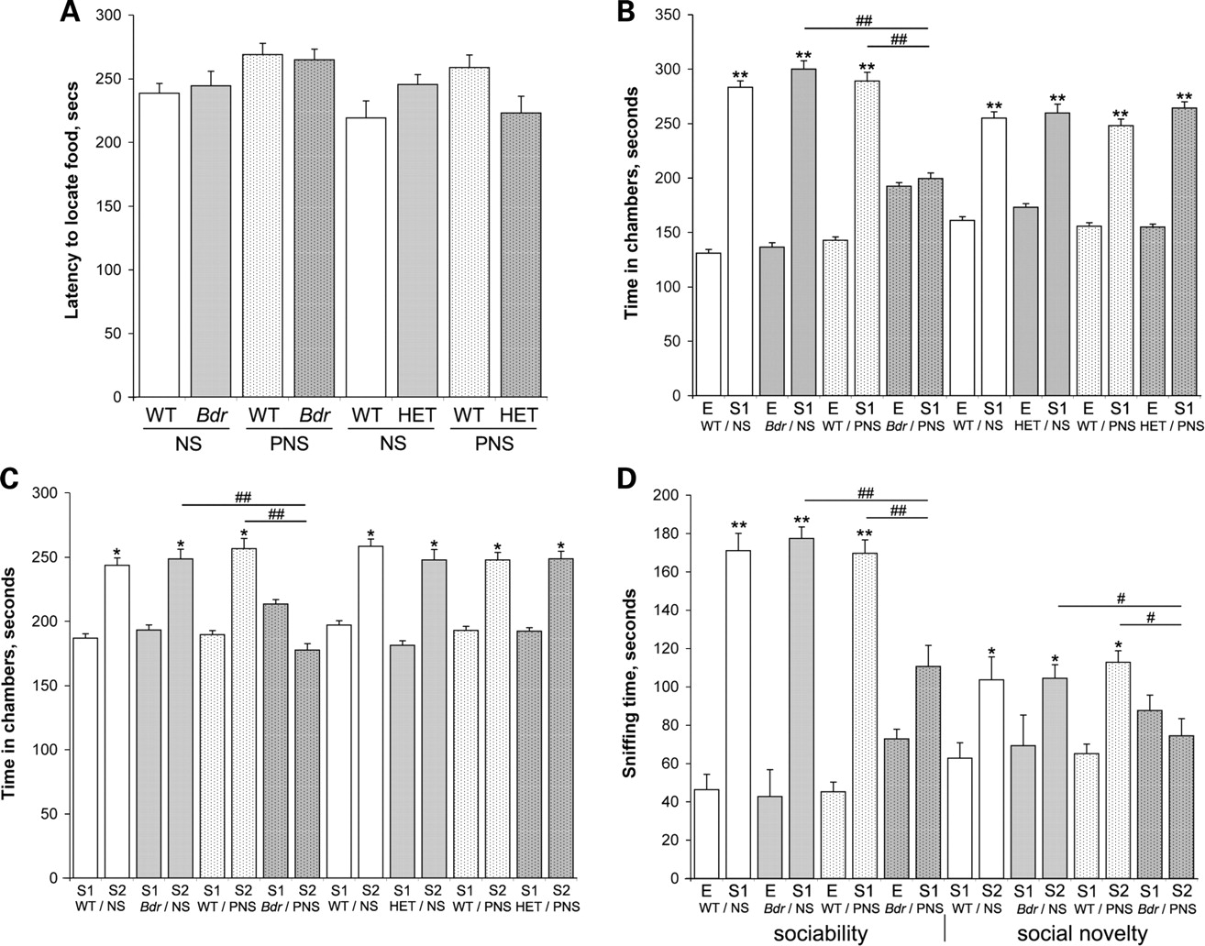
Figure 4. Bdr mutants subjected to PNS show social interaction abnormalities. (A) Test for anosmia. All mice tested ...
Notes:
Figure 4. Bdr mutants subjected to PNS show social interaction abnormalities. (A) Test for anosmia. All mice tested were able to locate a hidden food treat, suggesting no olfactory deficits. (B–D) Social testing. (B) Sociability: mice typically spent more time in the chamber containing the first stranger mouse (labelled S1) compared with the chamber containing the empty cage (labelled E) (**P < 0.01). In contrast, Bdr mutant mice subjected to PNS spent approximately equivalent time in both side chambers compared to Bdr mutants and PNS controls (##P < 0.01). (C) Social novelty: mice typically spent more time in chamber 2 containing a novel second stranger mouse (labelled S2) compared with the first stranger (S1) (*P < 0.05). As in (B), Bdr mutant mice subjected to PNS spent approximately equivalent time in both chambers compared to NS Bdr mutants and PNS controls (##P < 0.01). (D) The performance of the animals from the Bdr cross was re-scored from the same experiments (B and C) according to sniffing time. Mice spent significantly more time interacting with Stranger 1 compared with the empty cage (**P < 0.01) and more time with Stranger 2 than stranger 1 (*P < 0.05). In contrast, Bdr mutants subjected to PNS showed defects in social interaction behavior compared with NS Bdr mutants and PNS control littermates in both sections of the test (sociability, ##P < 0.01; social novelty, ##P < 0.01). In addition, there was a significant stress × genotype interaction on reduction in normal social interactions in Bdr mutants from stressed dams across all parameters tested (see text). Data are shown as mean ± SEM.
Unless provided in the caption above, the following copyright applies to the content of this slide: © The Author 2009. Published by Oxford University PressThis is an Open Access article distributed under the terms of the Creative Commons Attribution Non-Commercial License (http://creativecommons.org/licenses/by-nc/2.5/uk/) which permits unrestricted non-commercial use, distribution, and reproduction in any medium, provided the original work is properly cited.

Slide 6
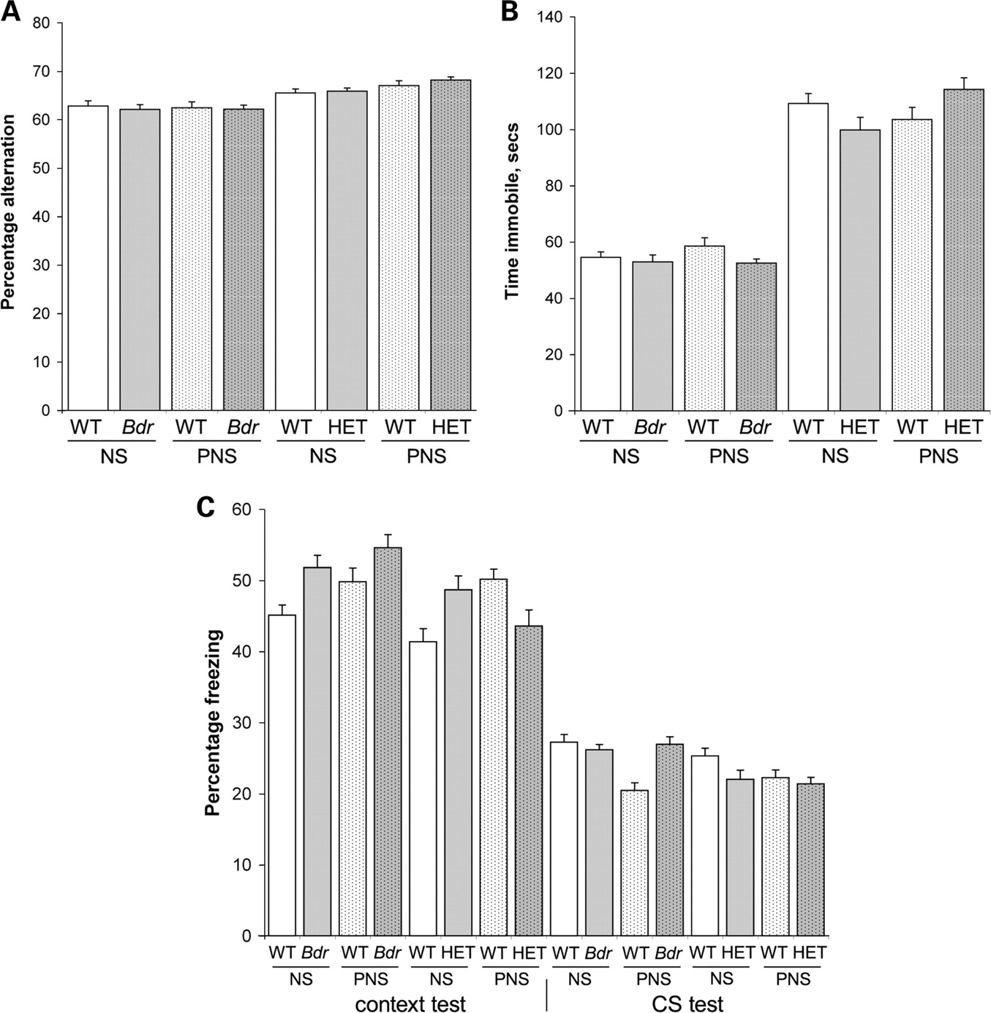
Figure 3. Behavioral tests unaffected by PNS. Alternation in the Y-maze (A), immobility in the forced swim test (B) and ...
Notes:
Figure 3. Behavioral tests unaffected by PNS. Alternation in the Y-maze (A), immobility in the forced swim test (B) and fear conditioning (C) testing showed that none of these behaviors were significantly influenced by PNS. Data are shown as mean ± SEM.
Unless provided in the caption above, the following copyright applies to the content of this slide: © The Author 2009. Published by Oxford University PressThis is an Open Access article distributed under the terms of the Creative Commons Attribution Non-Commercial License (http://creativecommons.org/licenses/by-nc/2.5/uk/) which permits unrestricted non-commercial use, distribution, and reproduction in any medium, provided the original work is properly cited.

