Slide 1
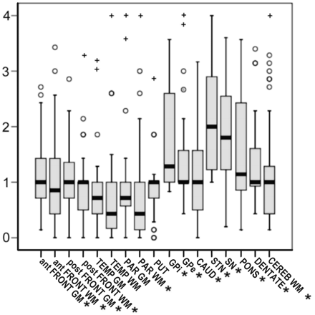
Fig. 1 Coiled body + thread pathology grades in different brain regions; median, interquartile ranges; ° outliers; ...
Notes:
Fig. 1 Coiled body + thread pathology grades in different brain regions; median, interquartile ranges; ° outliers; + extreme outliers; * regions used to test for correlation of overall tau.
Unless provided in the caption above, the following copyright applies to the content of this slide: © The Author (2007). Published by Oxford University Press on behalf of the Guarantors of Brain. All rights reserved. For Permissions, please email: journals.permissions@oxfordjournals.orgThis article is published and distributed under the terms of the Oxford University Press, Standard Journals Publication Model ( https://academic.oup.com/journals/pages/open_access/funder_policies/chorus/standard_publication_model)

Slide 2
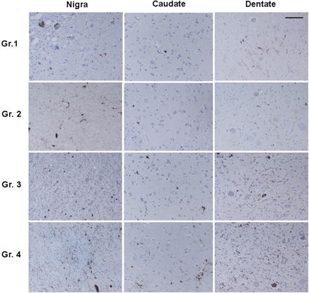
Fig. 2 Visual guide for scoring pathology severity in three regions of interest. Grade 0 was reserved for there was ...
Notes:
Fig. 2 Visual guide for scoring pathology severity in three regions of interest. Grade 0 was reserved for there was no AT8 positivity; bar represents 77 μm on all panels (×20 magnification).
Unless provided in the caption above, the following copyright applies to the content of this slide: © The Author (2007). Published by Oxford University Press on behalf of the Guarantors of Brain. All rights reserved. For Permissions, please email: journals.permissions@oxfordjournals.orgThis article is published and distributed under the terms of the Oxford University Press, Standard Journals Publication Model ( https://academic.oup.com/journals/pages/open_access/funder_policies/chorus/standard_publication_model)

Slide 3
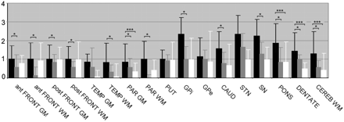
Fig. 3 Median regional tau severity in RS (black), PSP-P (grey) and PAGF (white). 1 standard deviation indicated by ...
Notes:
Fig. 3 Median regional tau severity in RS (black), PSP-P (grey) and PAGF (white). 1 standard deviation indicated by error bars. *RS versus PSP-P, Mann–Whitney U, P < 0.05; ***RS versus PAGF, Mann–Whitney U, P < 0.05. ant, anterior; post, posterior; GM, grey matter; WM, white matter; FRONT, frontal lobe; TEMP, temporal lobe; PAR, parietal lobe; PUT, putamen; GPi, internal globus pallidus; GPe, external globus pallidus; CAUD, caudate; STN, subthalamic nucleus; SN, substantia nigra; PONS, pontine nuclei; DENTATE, dentate nucleus; CEREB, cerebellar.
Unless provided in the caption above, the following copyright applies to the content of this slide: © The Author (2007). Published by Oxford University Press on behalf of the Guarantors of Brain. All rights reserved. For Permissions, please email: journals.permissions@oxfordjournals.orgThis article is published and distributed under the terms of the Oxford University Press, Standard Journals Publication Model ( https://academic.oup.com/journals/pages/open_access/funder_policies/chorus/standard_publication_model)

Slide 4
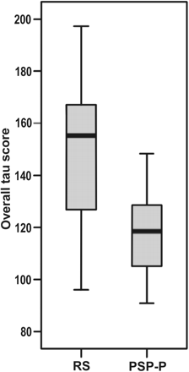
Fig. 4 Overall tau severity (sum of grades for all tau lesions in all regions) according to clinical group. Median ...
Notes:
Fig. 4 Overall tau severity (sum of grades for all tau lesions in all regions) according to clinical group. Median (Mann–Whitney U test, P = 0.002) and interquartile ranges.
Unless provided in the caption above, the following copyright applies to the content of this slide: © The Author (2007). Published by Oxford University Press on behalf of the Guarantors of Brain. All rights reserved. For Permissions, please email: journals.permissions@oxfordjournals.orgThis article is published and distributed under the terms of the Oxford University Press, Standard Journals Publication Model ( https://academic.oup.com/journals/pages/open_access/funder_policies/chorus/standard_publication_model)

Slide 5
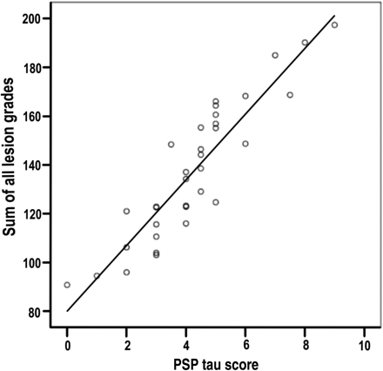
Fig. 5 Correlation between PSP-tau score and sum of all tau grades (Spearman's rho 0.93, P < 0.001).
Notes:
Fig. 5 Correlation between PSP-tau score and sum of all tau grades (Spearman's rho 0.93, P < 0.001).
Unless provided in the caption above, the following copyright applies to the content of this slide: © The Author (2007). Published by Oxford University Press on behalf of the Guarantors of Brain. All rights reserved. For Permissions, please email: journals.permissions@oxfordjournals.orgThis article is published and distributed under the terms of the Oxford University Press, Standard Journals Publication Model ( https://academic.oup.com/journals/pages/open_access/funder_policies/chorus/standard_publication_model)

Slide 6
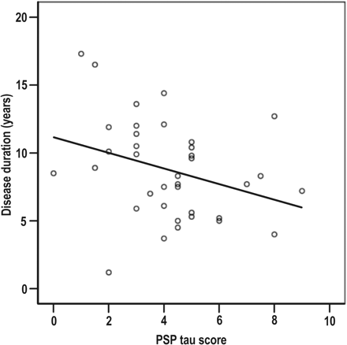
Fig. 6 PSP-tau score versus disease duration (Spearman's rho −0.36, P = 0.028).
Notes:
Fig. 6 PSP-tau score versus disease duration (Spearman's rho −0.36, P = 0.028).
Unless provided in the caption above, the following copyright applies to the content of this slide: © The Author (2007). Published by Oxford University Press on behalf of the Guarantors of Brain. All rights reserved. For Permissions, please email: journals.permissions@oxfordjournals.orgThis article is published and distributed under the terms of the Oxford University Press, Standard Journals Publication Model ( https://academic.oup.com/journals/pages/open_access/funder_policies/chorus/standard_publication_model)

Slide 7
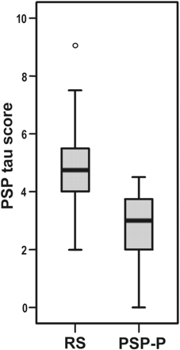
Fig. 7 PSP-tau score according to clinical group, median (Mann–Whitney U test, P < 0.001) and interquartile ranges.
Notes:
Fig. 7 PSP-tau score according to clinical group, median (Mann–Whitney U test, P < 0.001) and interquartile ranges.
Unless provided in the caption above, the following copyright applies to the content of this slide: © The Author (2007). Published by Oxford University Press on behalf of the Guarantors of Brain. All rights reserved. For Permissions, please email: journals.permissions@oxfordjournals.orgThis article is published and distributed under the terms of the Oxford University Press, Standard Journals Publication Model ( https://academic.oup.com/journals/pages/open_access/funder_policies/chorus/standard_publication_model)

Slide 8
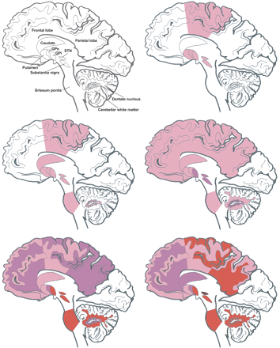
Fig. 8 Distribution of median coiled body + thread tau pathology, according to PSP-tau score. Colour/median grade ...
Notes:
Fig. 8 Distribution of median coiled body + thread tau pathology, according to PSP-tau score. Colour/median grade per PSP-tau score: pink/grade 1; purple/grade 2; red/grade 3; brown/grade 4. A = legend; B = PSP-tau scores 0–1; C = PSP-tau scores 2–3; D = PSP-tau scores 4–5; E = PSP-tau scores 6–7; F = PSP-tau scores >7.
Unless provided in the caption above, the following copyright applies to the content of this slide: © The Author (2007). Published by Oxford University Press on behalf of the Guarantors of Brain. All rights reserved. For Permissions, please email: journals.permissions@oxfordjournals.orgThis article is published and distributed under the terms of the Oxford University Press, Standard Journals Publication Model ( https://academic.oup.com/journals/pages/open_access/funder_policies/chorus/standard_publication_model)

