Slide 1
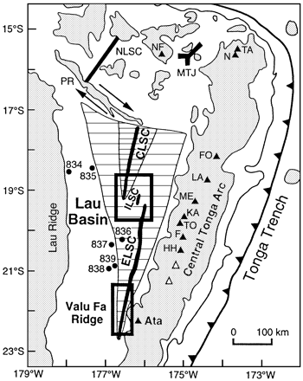
Fig. 1. Tectonic map of the Tonga–Lau arc–back-arc system, after Hergt & Hawkesworth (1994) and Hawkins (1995a). ...
Notes:
Fig. 1. Tectonic map of the Tonga–Lau arc–back-arc system, after Hergt & Hawkesworth (1994) and Hawkins (1995a). ELSC, Eastern Lau Spreading Centre; ILSC, Intermediate Lau Spreading Centre; CLSC, Central Lau Spreading Centre; NLSC, Northern Lau Spreading Centre; PR, Peggy Ridge; MTJ, Mangatolu triple junction; NF, Niuafo’ou; N, Niuatoputapu; TA, Tafahi; FO, Fonualei; LA, Late; ME, Metis Shoal; KA, Kao; TO, Tofua; F, Falcon; HH, Hunga Ha’apai. ▵, recent submarine arc-front volcanoes. Grey shading indicates areas with water depths <2 km. The Kermadec arc is the lateral continuation of the Tonga arc, south of 23°S. •, location of drill sites from the ODP Leg 135. Horizontally striped shaded regions represent new crust formed by true sea-floor spreading on the ELSC and CLSC. The two boxes indicate the locations of the studied samples.
Unless provided in the caption above, the following copyright applies to the content of this slide: Oxford University Press

Slide 2
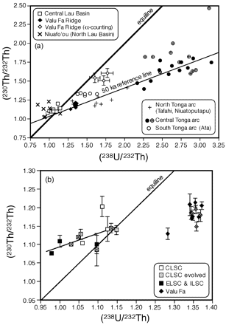
Fig. 2. (a) (²³⁰Th/²³²Th) vs (²³⁸U/²³²Th) equiline diagram for the ...
Notes:
Fig. 2. (a) (230Th/232Th) vs (238U/232Th) equiline diagram for the Tonga–Lau arc–back-arc system. •, samples from the central Tonga arc that have similar Nd isotopic compositions to the Valu Fa samples; together with the Valu Fa samples they define a linear trend with an apparent isochron age of 50 ka. Data sources: Tonga arc data and Niuafo’ou, Regelous et al. (1997) and Turner et al. (1997); Valu Fa, α-counting data, Vallier et al. (1991). (b) Close-up of part of the equiline diagram highlighting the new Lau Basin data. Of the nine samples analysed for 226Ra, eight have (226Ra/230Th) >1 (marked with × within the plotted symbols), and one has 226Ra/230Th in equilibrium (marked with a dot within the plotted symbol).
Unless provided in the caption above, the following copyright applies to the content of this slide: Oxford University Press

Slide 3
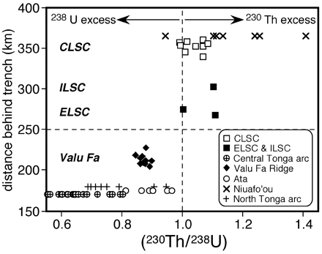
Fig. 3. (²³⁰Th/²³⁸U) vs distance behind the trench for samples from the Tonga arc and Lau Basin ...
Notes:
Fig. 3. (230Th/238U) vs distance behind the trench for samples from the Tonga arc and Lau Basin (data sources as for Fig. 2). The transition between lavas with 238U excesses and those with 230Th excesses occurs at ∼250 km from the trench.
Unless provided in the caption above, the following copyright applies to the content of this slide: Oxford University Press

Slide 4
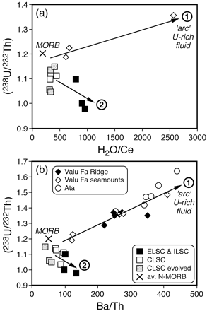
Fig. 5. (²³⁸U/²³²Th) vs (a) H₂O/Ce, and (b) Ba/Th. H₂O data by Fourier ...
Notes:
Fig. 5. (238U/232Th) vs (a) H2O/Ce, and (b) Ba/Th. H2O data by Fourier Transform Infrared spectroscopy (Jambon & Zimmermann, 1990; Kamenetsky et al., 1997; S. Newman, unpublished data, 1999). Average N-MORB data from GERM Web page, except average H2O/Ce (183 ± 33: Michael, 1995). Ata data from Turner et al. (1997). ◊, Seamount samples adjacent to the Valu Fa Ridge (Kamenetsky et al., 1997; this study). Highly evolved samples from the Central Lau Basin (grey shaded squares) have low Ba/Th, which is probably a result of extensive plagioclase fractionation (see Fig. 10b: Pearce et al., 1995). Trend 1, increasing U/Th with increasing H2O/Ce and Ba/Th, as shown by the Valu Fa Ridge and Ata samples near the trench; Trend 2, decreasing U/Th with increasing H2O/Ce and Ba/Th, as shown by the Central Lau Basin samples far from the trench.
Unless provided in the caption above, the following copyright applies to the content of this slide: Oxford University Press

Slide 5
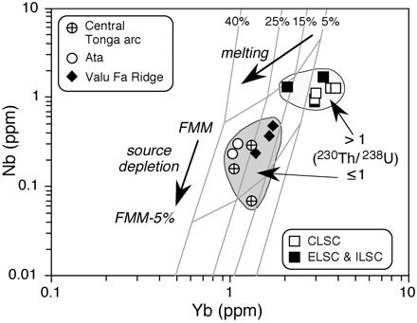
Fig. 8. Nb vs Yb diagram for primitive lavas from the Lau Basin–Tonga arc system, to resolve partial melting trends ...
Notes:
Fig. 8. Nb vs Yb diagram for primitive lavas from the Lau Basin–Tonga arc system, to resolve partial melting trends from source depletion trends (Pearce & Parkinson, 1993). All plotted samples have 7–8 wt % MgO, except the Central Tonga arc (6–7 wt % MgO). It should be noted that the grid is calibrated for samples with 9 wt % MgO (Pearce & Parkinson, 1993). FMM, fertile MORB mantle, equivalent to the N-MORB source.
Unless provided in the caption above, the following copyright applies to the content of this slide: Oxford University Press

Slide 6
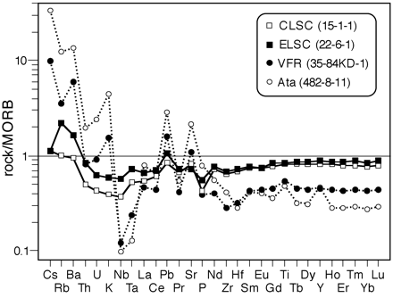
Fig. 7. N-MORB-normalized trace element patterns for representative samples from the Lau Basin region, all with ...
Notes:
Fig. 7. N-MORB-normalized trace element patterns for representative samples from the Lau Basin region, all with similar MgO contents. CLSC (15-1-1: MgO 7·3 wt %), ELSC (22-6-1: MgO 7·1 wt %), VFR (84KD1: MgO 7·3 wt %), and Ata (482-8-11: MgO 7·4 wt %, from Turner et al., 1997). Normalizing values from GERM Web page.
Unless provided in the caption above, the following copyright applies to the content of this slide: Oxford University Press

Slide 7
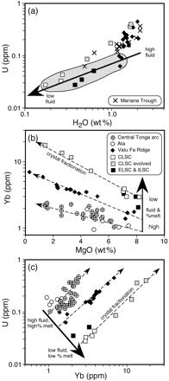
Fig. 6. (a) U vs H₂O, (b) Yb vs MgO, (c) U vs Yb. In (a), the outlined field highlights the more primitive ...
Notes:
Fig. 6. (a) U vs H2O, (b) Yb vs MgO, (c) U vs Yb. In (a), the outlined field highlights the more primitive (7–8 wt % MgO) samples. The solid arrows indicate a trend of inferred decreasing fluid content and decreasing degree of melting in primitive arc and back-arc lavas. The dashed arrows represent schematic within-suite crystal fractionation trends. Data sources as for Figs 4 and 5.
Unless provided in the caption above, the following copyright applies to the content of this slide: Oxford University Press

Slide 8
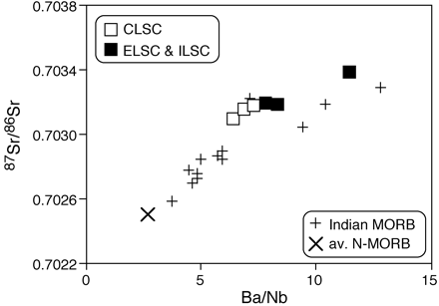
Fig. 9. Ba/Nb vs ⁸⁷Sr/⁸⁶Sr to illustrate the compositional similarity between Central Lau Basin ...
Notes:
Fig. 9. Ba/Nb vs 87Sr/86Sr to illustrate the compositional similarity between Central Lau Basin basalts (CLSC, ELSC, ILSC) and some Indian MORB. Only the primitive Central Lau Basin samples (7–8 wt % MgO) are plotted. MORB data from Rehkämper & Hofmann (1997), and references therein, plus the GERM Web page.
Unless provided in the caption above, the following copyright applies to the content of this slide: Oxford University Press

Slide 9
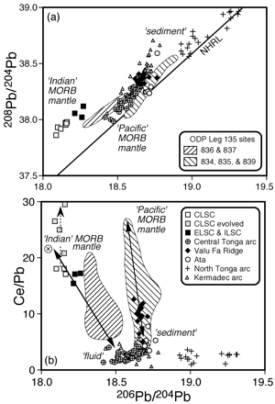
Fig. 4. ²⁰⁶Pb/²⁰⁴Pb vs (a) ²⁰⁸Pb/²⁰⁴Pb, and (b) Ce/Pb, to illustrate the ...
Notes:
Fig. 4. 206Pb/204Pb vs (a) 208Pb/204Pb, and (b) Ce/Pb, to illustrate the different mantle and slab components involved in magmatism in the Tonga–Kermadec arc and the Lau Basin. Data sources: Jenner et al. (1987), Vallier et al. (1991), Ewart et al. (1994, 1998), Hergt & Farley (1994), Regelous et al. (1997), Turner et al. (1997), Bach et al. (1998) and this paper. ‘Indian’ MORB mantle has lower Ce/Pb than ‘Pacific’ MORB mantle (Rehkämper & Hofmann, 1997; Sims & DePaolo, 1997). Circle with cross represents average ‘Indian’ MORB from Rehkämper & Hofmann (1997). Highly evolved samples from the Central Lau Basin (grey shaded squares: MgO ≪5 wt%) have elevated Ce/Pb (>20), which is probably a result of extensive plagioclase fractionation (marked by dashed arrow), e.g. Sims & DePaolo (1997).
Unless provided in the caption above, the following copyright applies to the content of this slide: Oxford University Press

Slide 10
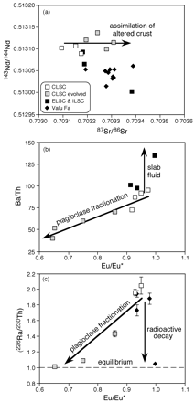
Fig. 10. (a) ⁸⁷Sr/⁸⁶Sr vs ¹⁴³Nd/¹⁴⁴Nd. The slightly elevated ...
Notes:
Fig. 10. (a) 87Sr/86Sr vs 143Nd/144Nd. The slightly elevated 87Sr/86Sr of evolved CLSC lavas compared with the basalts suggests minor assimilation of altered oceanic crust. (b) Eu/Eu* vs Ba/Th. Whereas Ba/Th is high in altered oceanic crust (∼323: Staudigel et al., 1996), the lower Ba/Th in the evolved CLSC lavas compared with the basalts indicates that the effects of extensive plagioclase fractionation dominate over any minor assimilation of altered oceanic crust. (c) Eu/Eu* vs (226Ra/230Th). Although plagioclase crystallization should fractionate 226Ra/230Th in a similar manner to Ba/Th, in the absence of independent eruption age estimates, the effects of radioactive decay cannot be assessed.
Unless provided in the caption above, the following copyright applies to the content of this slide: Oxford University Press

Slide 11
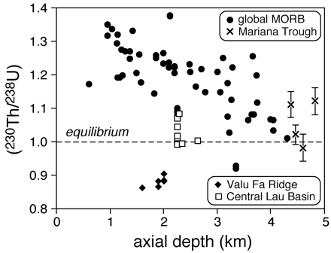
Fig. 11. (²³⁰Th/²³⁸U) vs axial ridge depth. Global MORB data by TIMS from Goldstein et al. ...
Notes:
Fig. 11. (230Th/238U) vs axial ridge depth. Global MORB data by TIMS from Goldstein et al. (1991), Volpe & Goldstein (1993), Lundstrom et al. (1995), Bourdon et al. (1996a, 1996b), Lundstrom et al. (1998a, 1998b), Peate et al. (2001). Mariana Trough data are α-counting analyses from Newman (1983).
Unless provided in the caption above, the following copyright applies to the content of this slide: Oxford University Press

Slide 12
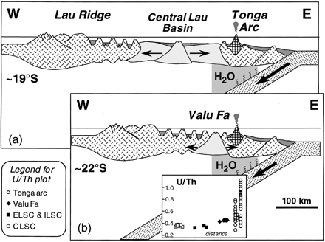
Fig. 12. Schematic cross-sections [modified from Hawkins (1995a)] through the Lau Basin–Tonga arc system, at; (a) ...
Notes:
Fig. 12. Schematic cross-sections [modified from Hawkins (1995a)] through the Lau Basin–Tonga arc system, at; (a) ∼19°S, (b) ∼22°S. The two sections are aligned on the arc front, and the inset shows how U/Th decreases laterally away from the trench.
Unless provided in the caption above, the following copyright applies to the content of this slide: Oxford University Press

