Slide 1
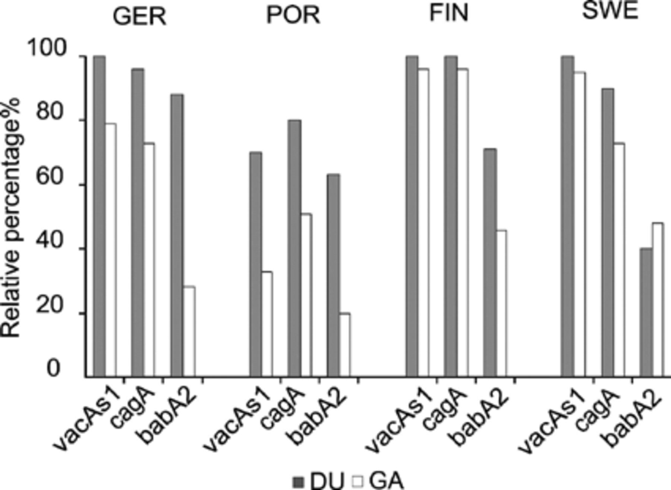
Figure 1 Prevalence of vacAs1, cagA and babA2 genotypes in patients with UD and GA in four European countries.
Notes:
Figure 1 Prevalence of vacAs1, cagA and babA2 genotypes in patients with UD and GA in four European countries.
Unless provided in the caption above, the following copyright applies to the content of this slide: © 2004 Federation of European Microbiological Societies.

Slide 2
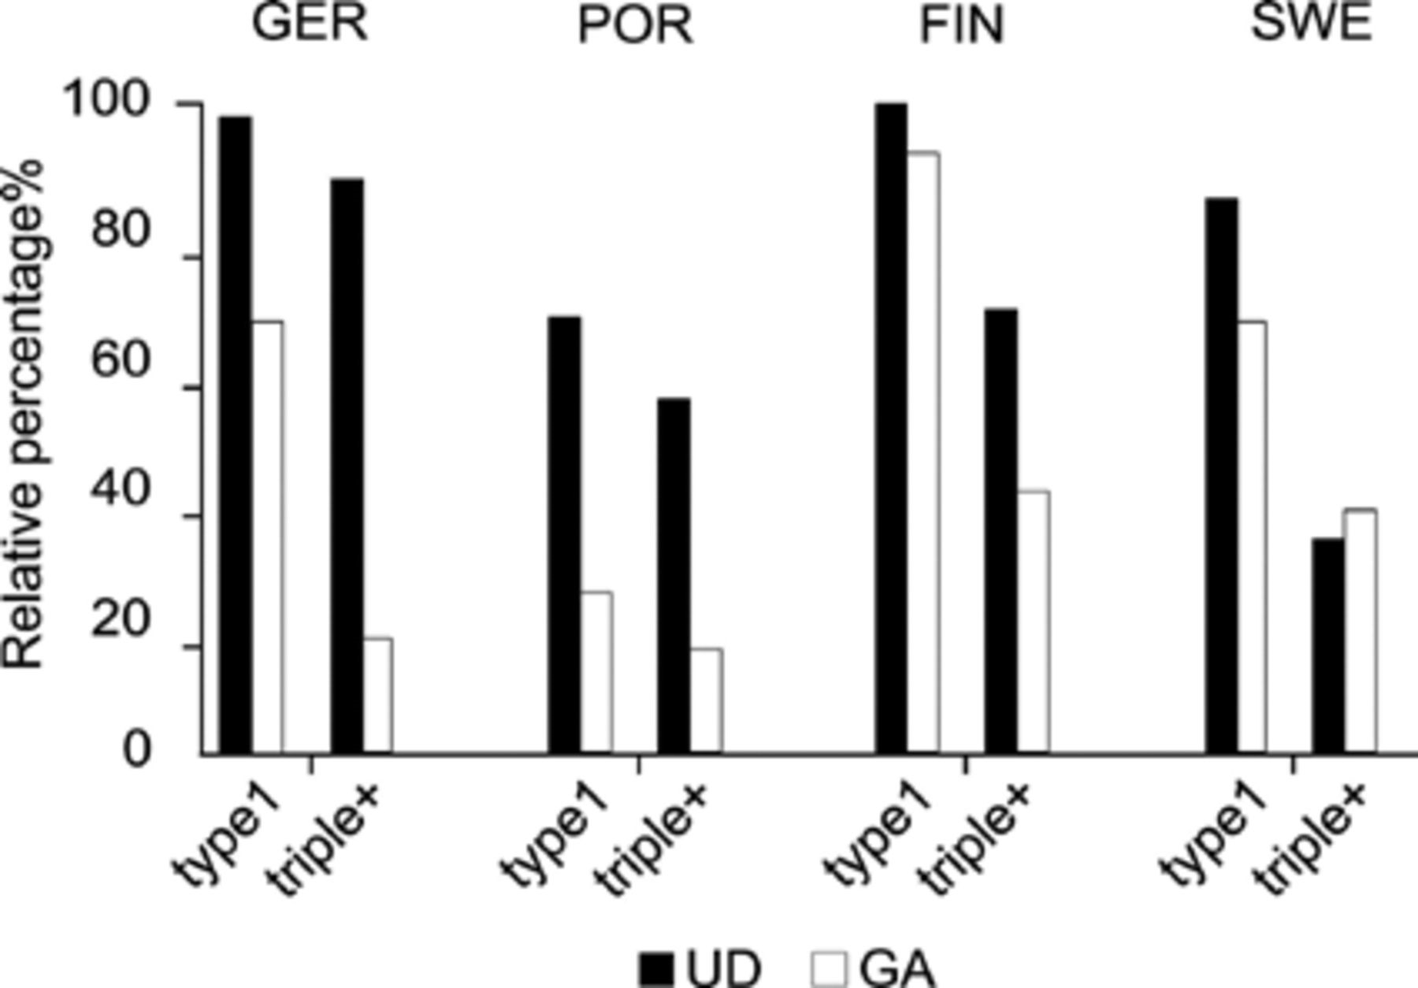
Figure 2 Comparison of type1 strains and triple-positive strains in patients with UD and GA in four European ...
Notes:
Figure 2 Comparison of type1 strains and triple-positive strains in patients with UD and GA in four European countries.
Unless provided in the caption above, the following copyright applies to the content of this slide: © 2004 Federation of European Microbiological Societies.

Slide 3
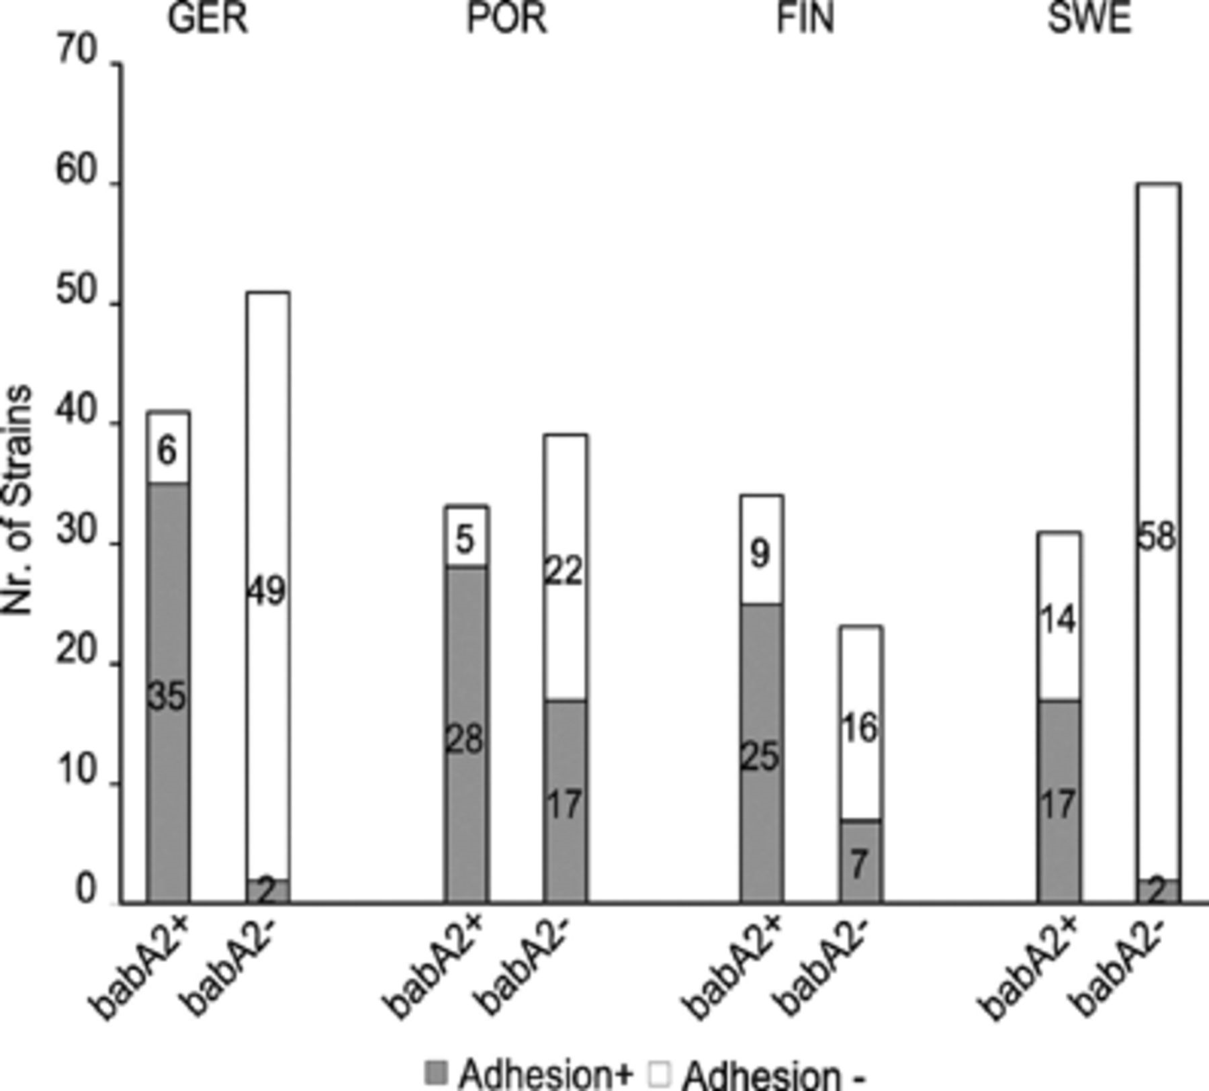
Figure 3 Comparison of babA genotype and adhesive properties to Lewis^{b} in four European countries.
Notes:
Figure 3 Comparison of babA genotype and adhesive properties to Lewisb in four European countries.
Unless provided in the caption above, the following copyright applies to the content of this slide: © 2004 Federation of European Microbiological Societies.

