Slide 1
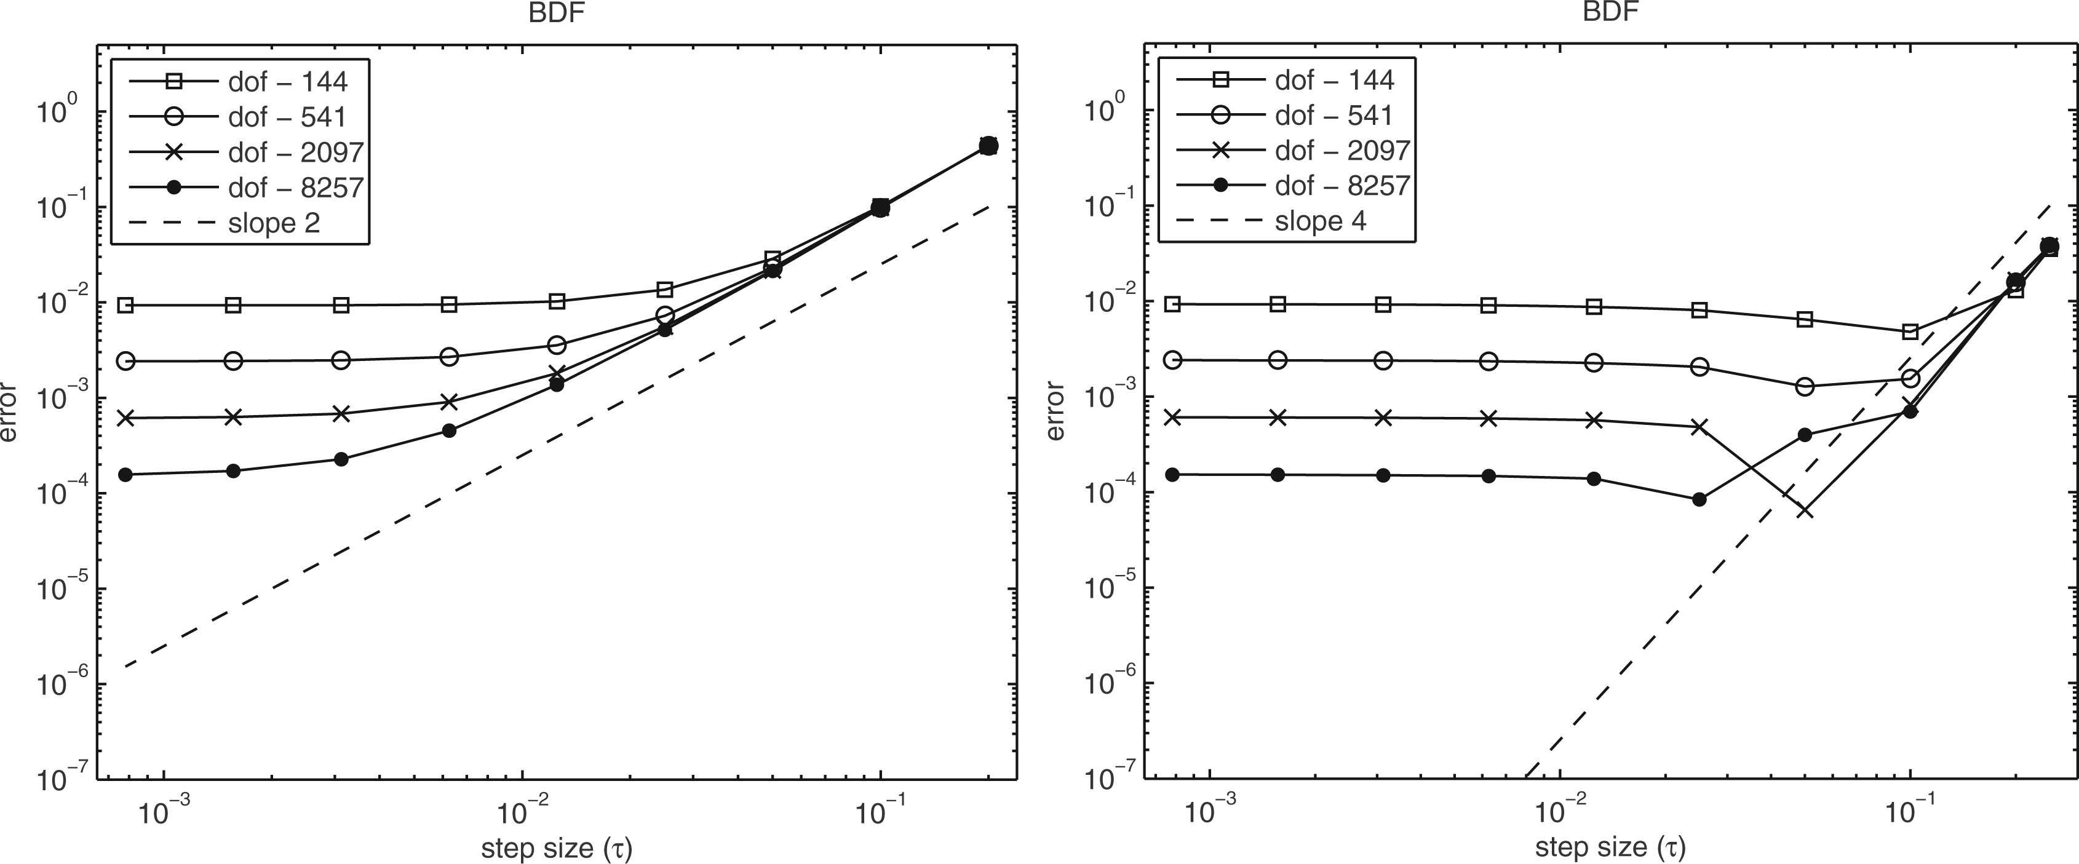
Fig. 1. Errors of the BDF2 and BDF4 methods for the Allen-Cahn equation at time $t = 1$.
Notes:
Fig. 1. Errors of the BDF2 and BDF4 methods for the Allen-Cahn equation at time $t = 1$.
Unless provided in the caption above, the following copyright applies to the content of this slide: © The authors 2016. Published by Oxford University Press on behalf of the Institute of Mathematics and its Applications. All rights reserved.

Slide 2
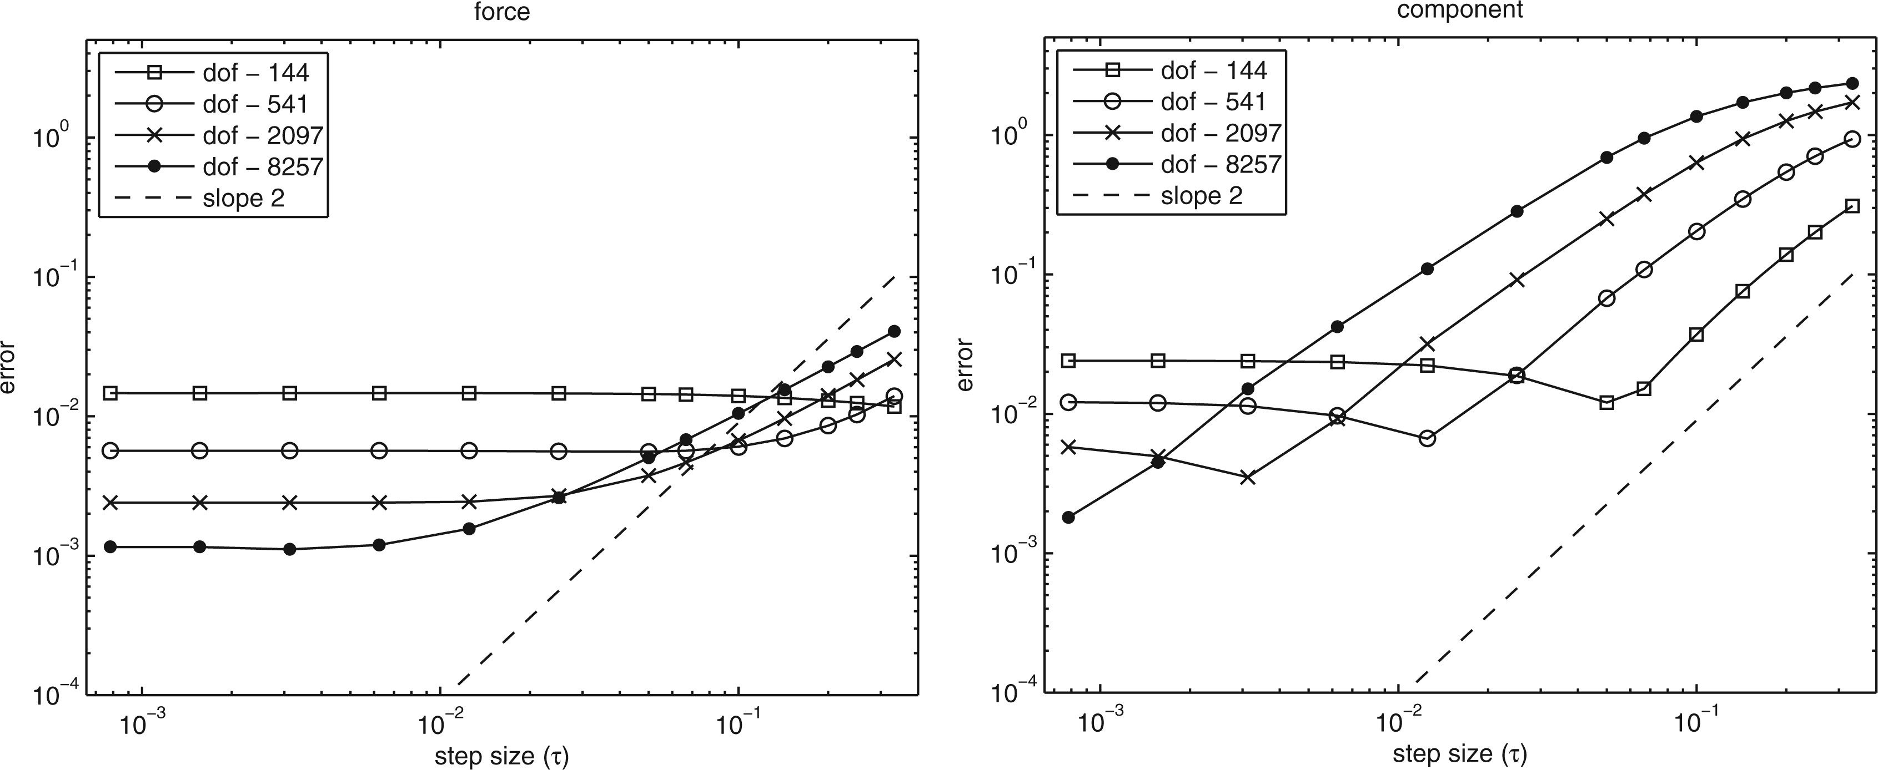
Fig. 2. Errors of the force and component splittings for the Allen-Cahn equation at time $t = 1$.
Notes:
Fig. 2. Errors of the force and component splittings for the Allen-Cahn equation at time $t = 1$.
Unless provided in the caption above, the following copyright applies to the content of this slide: © The authors 2016. Published by Oxford University Press on behalf of the Institute of Mathematics and its Applications. All rights reserved.

