Slide 1
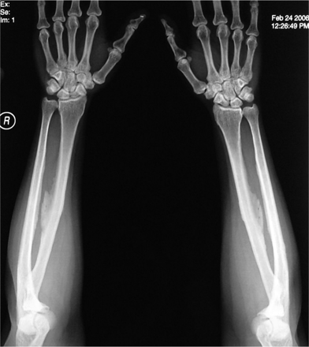
Fig. 1. Plain film of both forearms showing interosseous membrane calcification.
Notes:
Fig. 1. Plain film of both forearms showing interosseous membrane calcification.
Unless provided in the caption above, the following copyright applies to the content of this slide: © The Author [2006]. Published by Oxford University Press on behalf of ERA-EDTA. All rights reserved. For Permissions, please email: journals.permissions@oxfordjournals.org

Slide 2
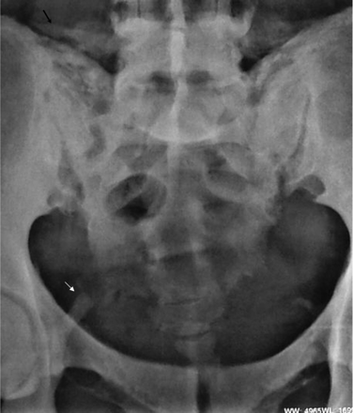
Fig. 2. Plain film of pelvis showing calcification of bilateral iliolumbar (black arrow) and sacrospinous ligaments ...
Notes:
Fig. 2. Plain film of pelvis showing calcification of bilateral iliolumbar (black arrow) and sacrospinous ligaments (white arrow).
Unless provided in the caption above, the following copyright applies to the content of this slide: © The Author [2006]. Published by Oxford University Press on behalf of ERA-EDTA. All rights reserved. For Permissions, please email: journals.permissions@oxfordjournals.org

Slide 3
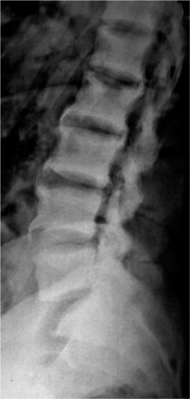
Fig. 3. Plain film lateral view of lumbar spine showing increase in bone density with osteophytes.
Notes:
Fig. 3. Plain film lateral view of lumbar spine showing increase in bone density with osteophytes.
Unless provided in the caption above, the following copyright applies to the content of this slide: © The Author [2006]. Published by Oxford University Press on behalf of ERA-EDTA. All rights reserved. For Permissions, please email: journals.permissions@oxfordjournals.org

