Slide 1
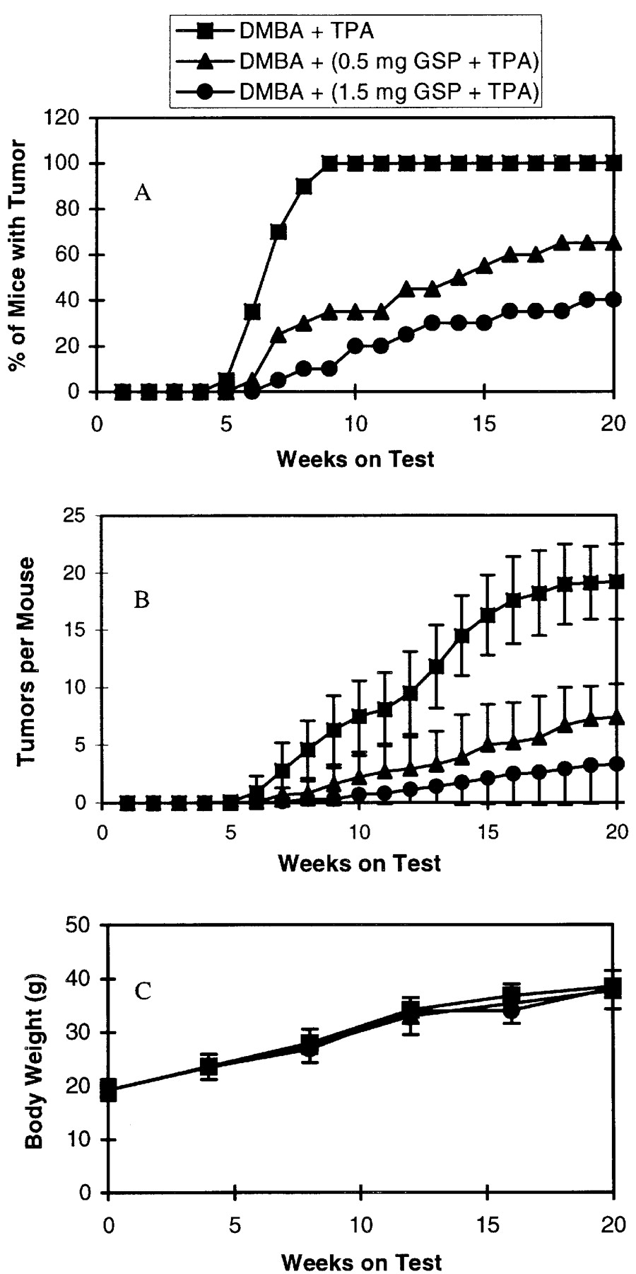
Fig. 1. Image obtained by in vivo GJIC assay using the IL/DT method, applying LY (A), which transfers through the gap ...
Notes:
Fig. 1. Image obtained by in vivo GJIC assay using the IL/DT method, applying LY (A), which transfers through the gap junction, and RhD (B), which is retained at the incision sites. The GJIC function was evaluated by analyzing net transfer of LY, excluding RhD stained regions (C).
Unless provided in the caption above, the following copyright applies to the content of this slide: © Oxford University Press

Slide 2
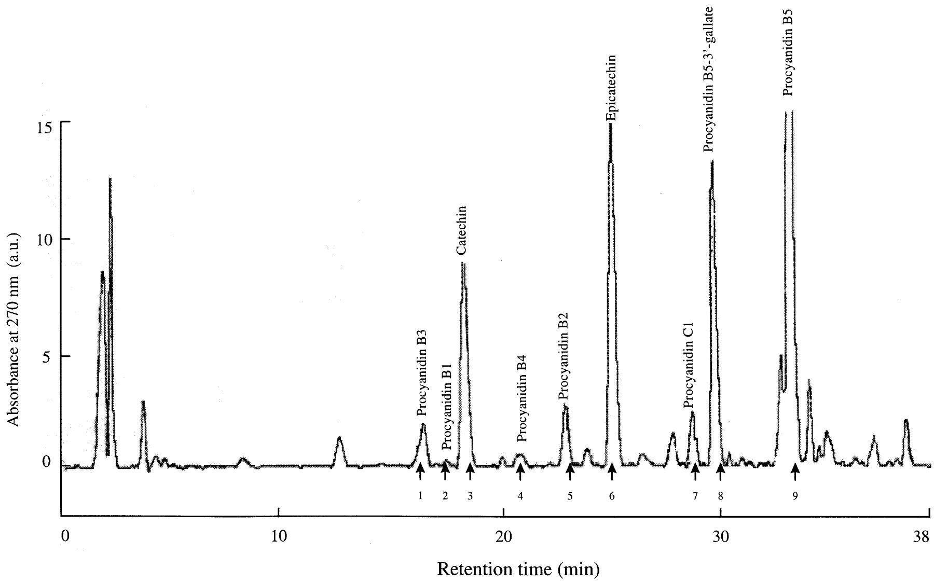
Fig. 2. In vivo assay of GJIC in the liver of mice treated with PCP alone or co-treated with green tea by the IL/DT ...
Notes:
Fig. 2. In vivo assay of GJIC in the liver of mice treated with PCP alone or co-treated with green tea by the IL/DT method as described in Materials and methods. PCP was fed to B6C3F1 mice in their diet for 2 weeks and green tea infusion was administered to mice 1 week before PCP treatment and throughout the experiment. GJIC in the livers of mice fed 600 p.p.m. PCP alone (C) was reduced compared with the control (A) or green tea treatment alone (B) and up-regulated by co-treatment with green tea (D). Bar 50 μm.
Unless provided in the caption above, the following copyright applies to the content of this slide: © Oxford University Press

Slide 3
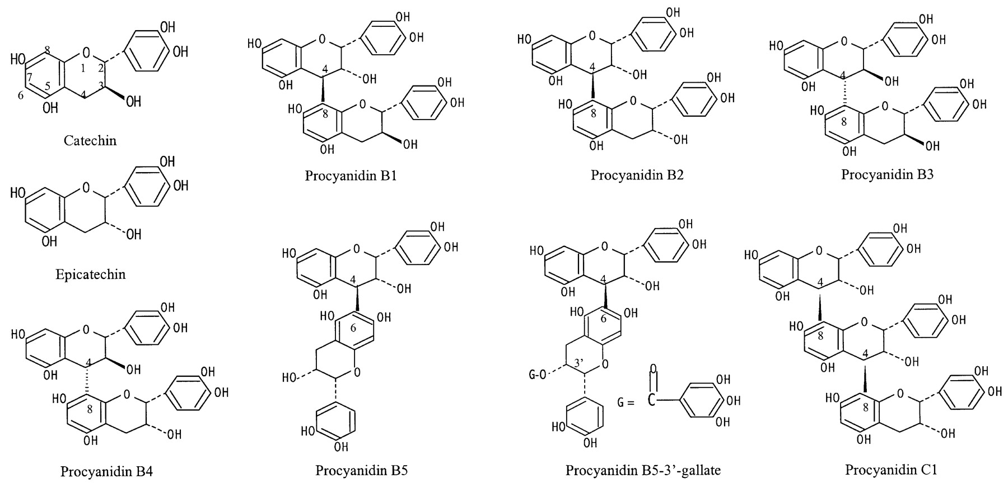
Fig. 3. Quantification of GJIC in the liver of mice treated with PCP alone and co-treated with green tea assayed by ...
Notes:
Fig. 3. Quantification of GJIC in the liver of mice treated with PCP alone and co-treated with green tea assayed by IL/DT. PCP was fed to mice at doses of 300 (L) or 600 p.p.m. (H) in their diet for 2 weeks and green tea infusion (Tea) was administered to mice 1 week before PCP treatment and throughout the experiment. The values represent the means ± SD of data from five mice. *P < 0.05 versus control; **P < 0.001 versus control; §P < 0.001 versus PCP (300 p.p.m.) treatment alone; †P < 0.001 versus PCP (600 p.p.m.) treatment alone.
Unless provided in the caption above, the following copyright applies to the content of this slide: © Oxford University Press

Slide 4
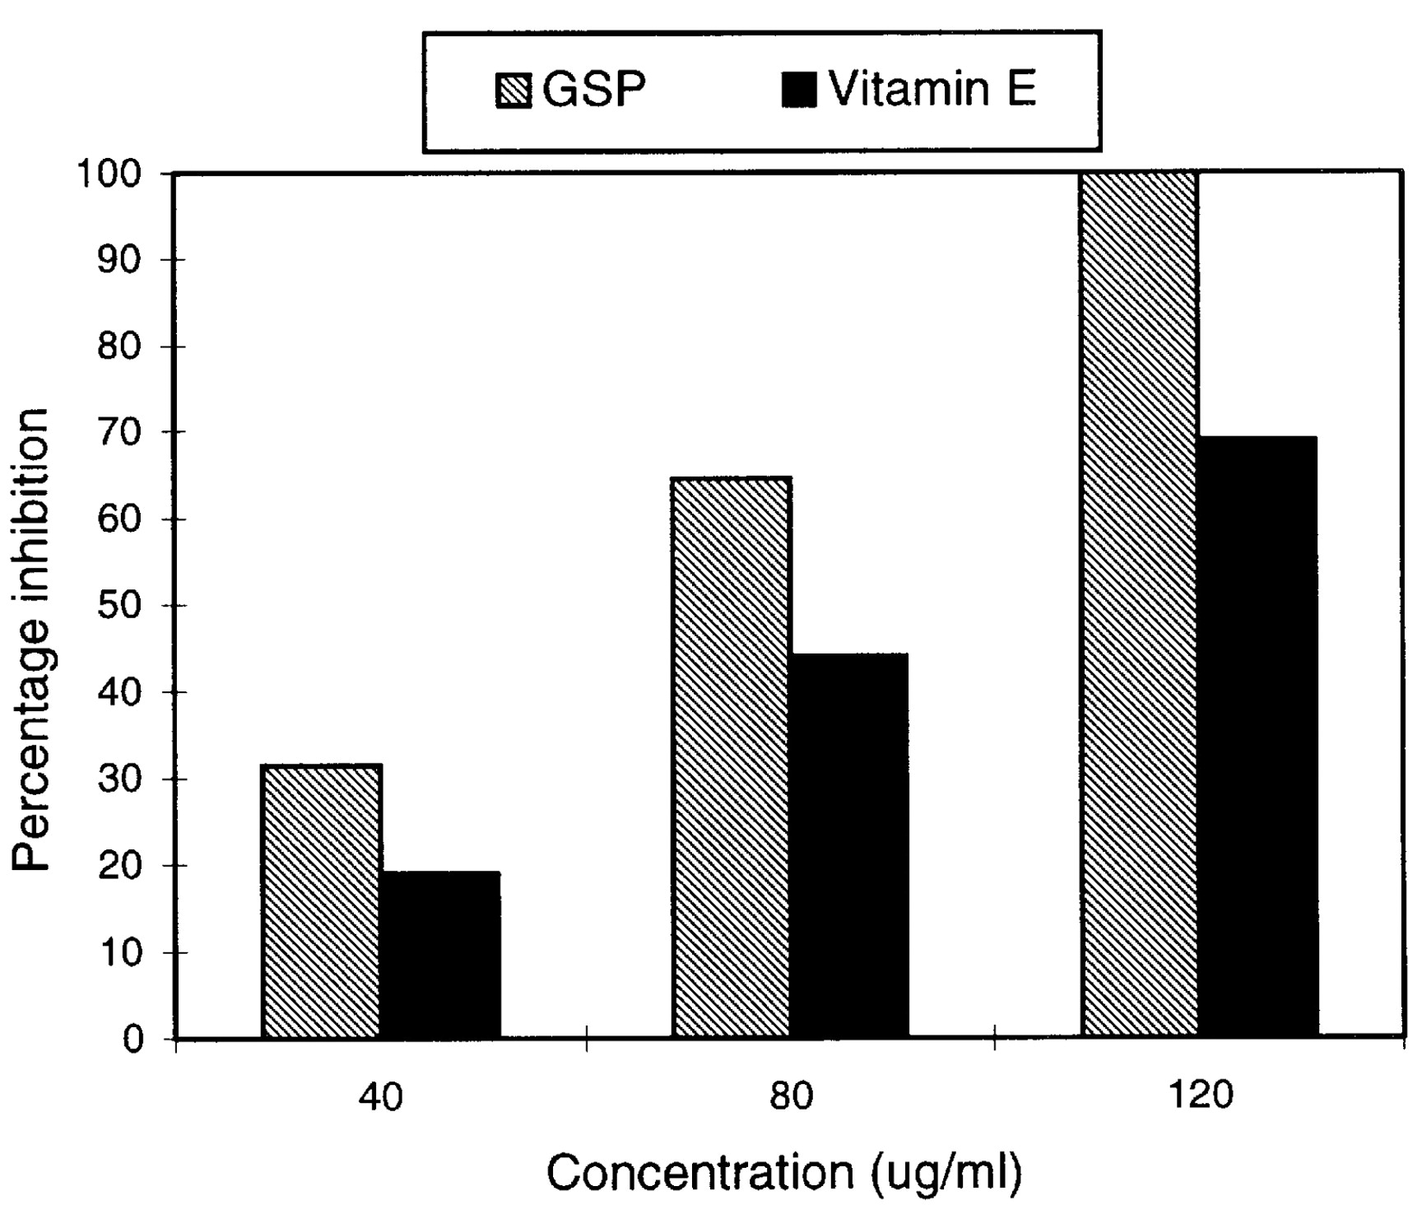
Fig. 4. Effect of green tea on the expression of Cx32 in the plasma membrane in the liver of mice treated with PCP. ...
Notes:
Fig. 4. Effect of green tea on the expression of Cx32 in the plasma membrane in the liver of mice treated with PCP. PCP and green tea infusion were given to mice as described in the legend to Figure 2. A reduction in Cx32 spots was observed in the liver of mice fed 600 p.p.m. PCP (D and E), compared with the control (B) or green tea alone (C), and prevention of this reduction in Cx32 was observed on co-treatment with green tea (F). CV, central vein; PP, periportal region. Bar 50 μm.
Unless provided in the caption above, the following copyright applies to the content of this slide: © Oxford University Press

Slide 5
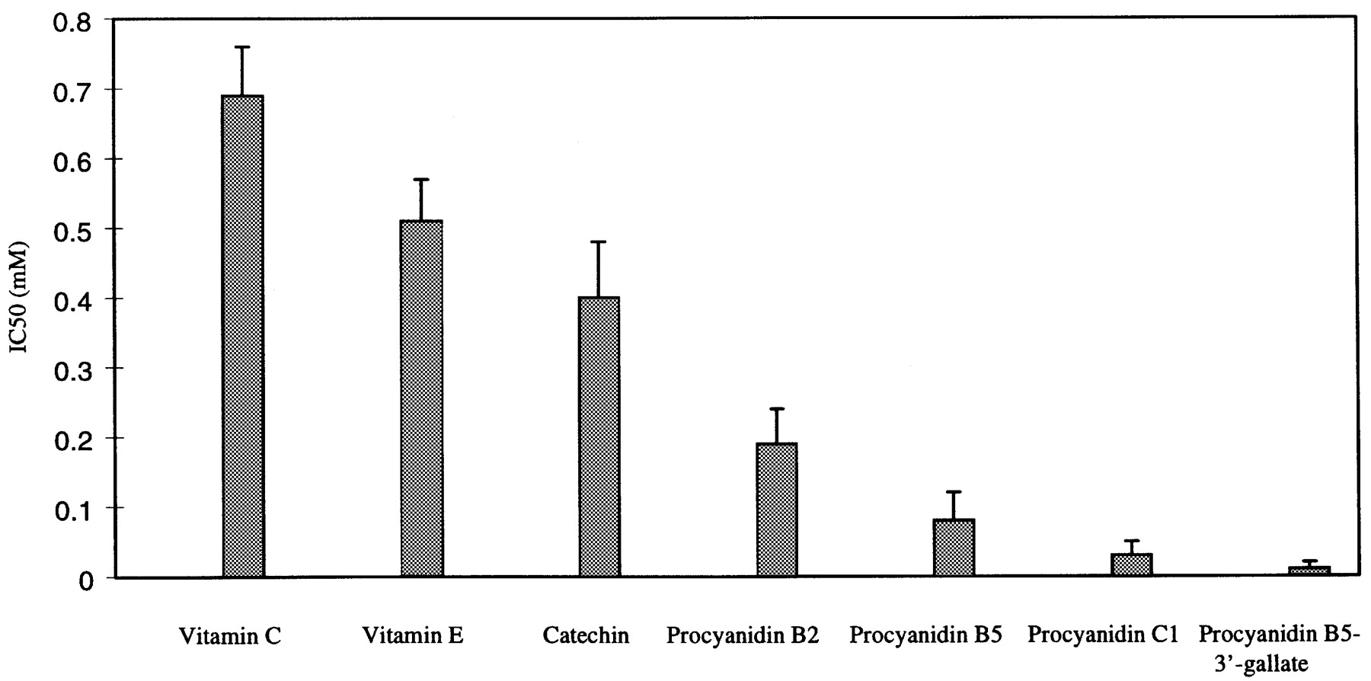
Fig. 5. Effect of green tea on cell proliferation in the liver of mice treated with PCP. PCP and green tea infusion ...
Notes:
Fig. 5. Effect of green tea on cell proliferation in the liver of mice treated with PCP. PCP and green tea infusion were given to mice as described in the legend to Figure 3. The values represent the means ± SD of data from five mice. *P < 0.05 versus control; **P < 0.001 versus control; §P < 0.001 versus PCP (300 p.p.m.) treatment alone; †P < 0.001 versus PCP (600 p.p.m.) treatment alone.
Unless provided in the caption above, the following copyright applies to the content of this slide: © Oxford University Press

