Slide 1
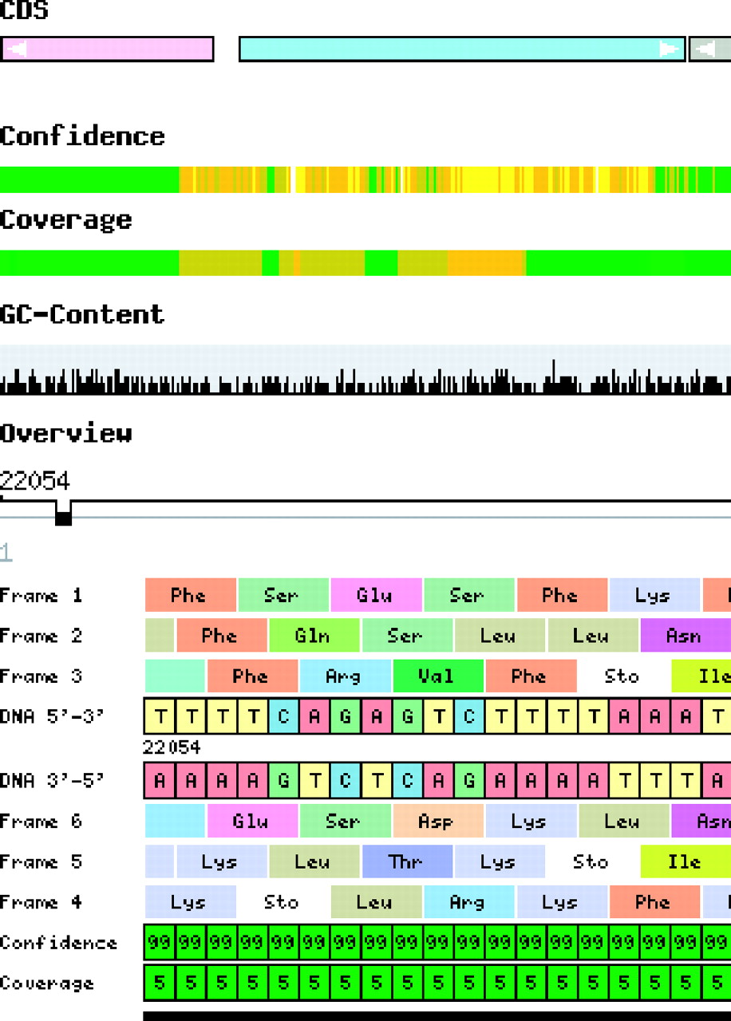
Fig. 1 Section of the Gene environment graph (top) and the Basepair view (bottom). Genes are colored according to ...
Notes:
Fig. 1 Section of the Gene environment graph (top) and the Basepair view (bottom). Genes are colored according to the COG functional classification. Color-coded bars indicate the technical quality of the sequence.
Unless provided in the caption above, the following copyright applies to the content of this slide: © The Author 2005. Published by Oxford University Press. All rights reserved. For Permissions, please email: journals.permissions@oupjournals.org The online version of this article has been published under an open access model. Users are entitled to use, reproduce, disseminate, or display the open access version of this article for non-commercial purposes provided that: the original authorship is properly and fully attributed; the Journal and Oxford University Press are attributed as the original place of publication with the correct citation details given; if an article is subsequently reproduced or disseminated not in its entirety but only in part or as a derivative work this must be clearly indicated. For commercial re-use, please contact journals.permissions@oupjournals.org

