Slide 1
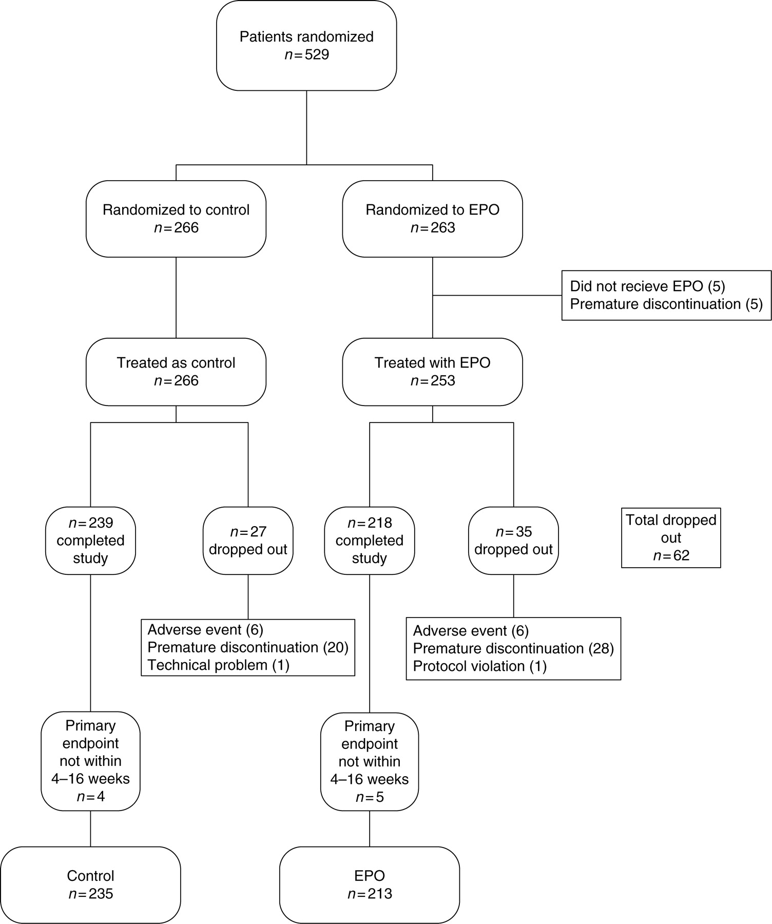
Figure 1 Flowchart representing number of patients randomized to erythropoietin or control, and patients who dropped ...
Notes:
Figure 1 Flowchart representing number of patients randomized to erythropoietin or control, and patients who dropped out for provided reasons.
Unless provided in the caption above, the following copyright applies to the content of this slide: Published on behalf of the European Society of Cardiology. All rights reserved. © The Author 2010. For permissions please email: journals.permissions@oxfordjournals.org.

Slide 2
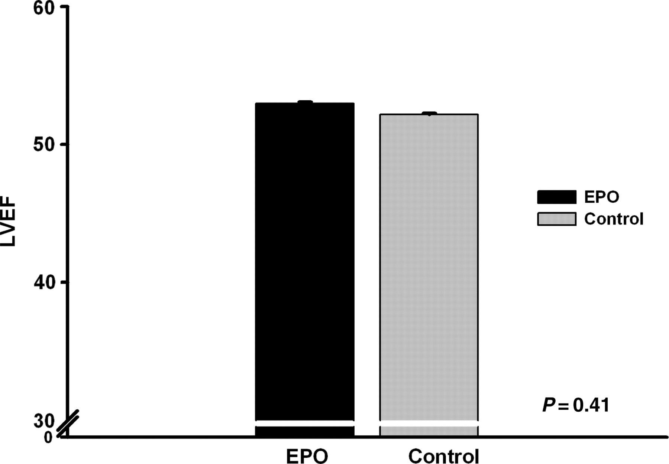
Figure 2 Primary endpoint; mean left ventricular ejection fraction (± standard deviation) of patients treated with ...
Notes:
Figure 2 Primary endpoint; mean left ventricular ejection fraction (± standard deviation) of patients treated with erythropoietin and of patients in the control group, 6 weeks after a successful primary coronary intervention.
Unless provided in the caption above, the following copyright applies to the content of this slide: Published on behalf of the European Society of Cardiology. All rights reserved. © The Author 2010. For permissions please email: journals.permissions@oxfordjournals.org.

Slide 3
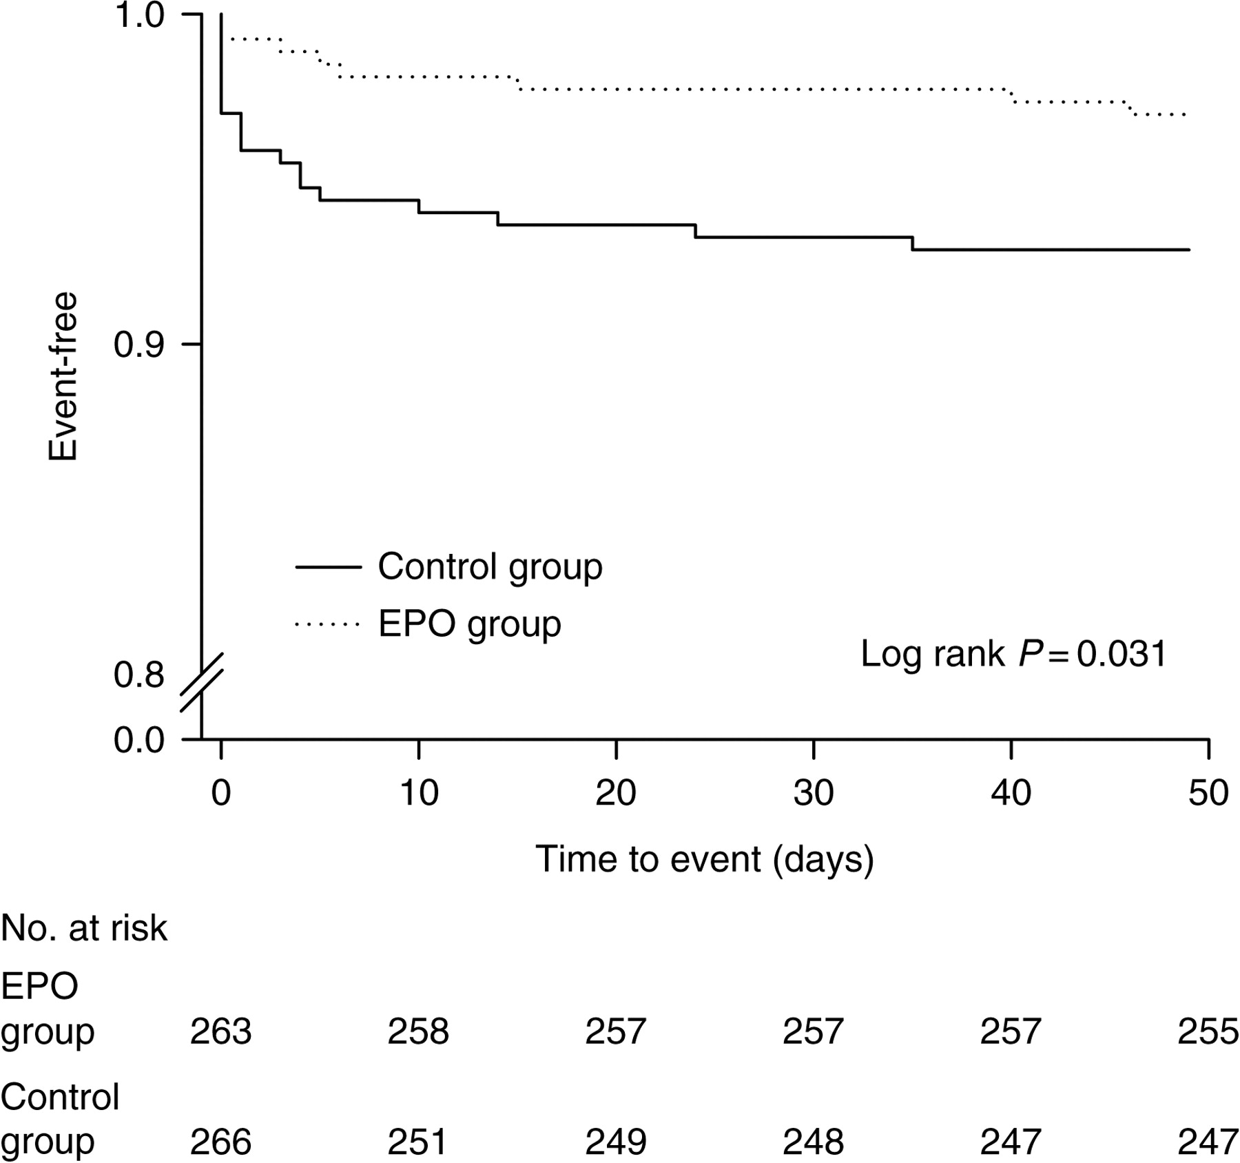
Figure 3 Secondary outcome: Kaplan–Meier curves indicating pre-defined cardiovascular events within 6 weeks after a ...
Notes:
Figure 3 Secondary outcome: Kaplan–Meier curves indicating pre-defined cardiovascular events within 6 weeks after a successful primary coronary intervention for a first ST-elevation myocardial infarction in patients treated with a single high dose of erythropoietin or control patients.
Unless provided in the caption above, the following copyright applies to the content of this slide: Published on behalf of the European Society of Cardiology. All rights reserved. © The Author 2010. For permissions please email: journals.permissions@oxfordjournals.org.

