Slide 1
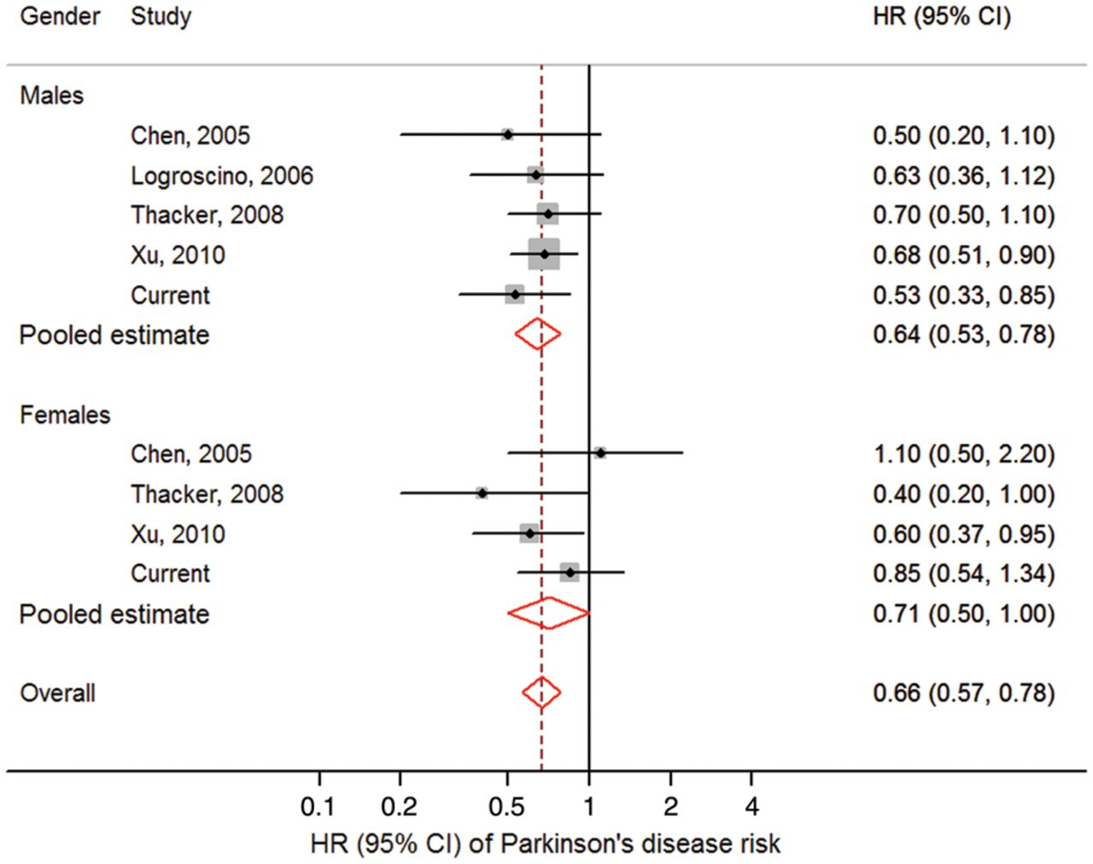
Figure 1 Forest plot. Forest plot showing meta-analysis of the risk of Parkinson’s disease associated with physical ...
Notes:
Figure 1 Forest plot. Forest plot showing meta-analysis of the risk of Parkinson’s disease associated with physical activity, comparing the highest level of physical activity to the lowest, by gender, and males and females pooled together. HR = hazard ratio; CI = confidence interval. Squares indicate the individual HR in each study. The size of each square is proportional to the per cent weight of that individual study in the meta-analysis, and the horizontal line represents the 95% CI. Pooled HRs and 95% CIs are indicated by hollow diamonds.
Unless provided in the caption above, the following copyright applies to the content of this slide: © The Author (2014). Published by Oxford University Press on behalf of the Guarantors of Brain. All rights reserved. For Permissions, please email: journals.permissions@oup.com

