Slide 1
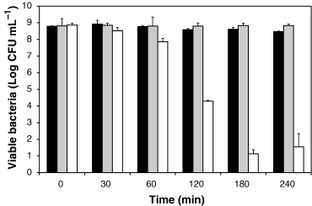
1 Evaluation of the bactericidal activity of Lactobacillus rhamnosus GG spent culture supernatant (LGG-SCS) on ...
Notes:
1 Evaluation of the bactericidal activity of Lactobacillus rhamnosus GG spent culture supernatant (LGG-SCS) on Salmonella typhimurium SL1344 as a function of contact time. Salmonella typhimurium SL1344 was incubated in sterile De Man–Rogosa–Sharpe medium (MRS) (pH 4.5) (black bars), sterile phosphate-buffered saline (pH 4.5) (grey bars) and LGG-SCS prepared from MRS culture (pH 4.5) (white bars). At the start and at specific intervals, aliquots were removed, serially diluted and plated on LB agar to determine bacterial colony counts. Each value is the mean ± standard deviation (error bar) of three experiments.
Unless provided in the caption above, the following copyright applies to the content of this slide: © 2006 Federation of European Microbiological Societies

Slide 2
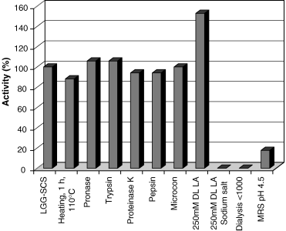
2 Effects of physical or chemical treatments on the antimicrobial activity of Lactobacillus rhamnosus GG spent ...
Notes:
2 Effects of physical or chemical treatments on the antimicrobial activity of Lactobacillus rhamnosus GG spent culture supernatant (LGG-SCS) against SL1344. LGG-SCS of 24 h old MRS cultures was prepared and treated with different proteases. The SCS was also heated, passed over a Microcon-SCX filter (cut-off 3000 Da) or dialyzed (dialysis <1000, dialysis with a molecular cut-off of 1000 Da against a HEPES-citrate-Tris buffer at pH 4.5). For comparison, 250 mM lactic acid (LA), 250 mM sodium lactate (LA sodium salt) and sterile De Man–Rogosa–Sharpe medium (MRS) at pH 4.5 (HCl) were included. Antimicrobial activity was determined in a radial diffusion test. The activities are shown in comparison with that of untreated LGG-SCS (100%). Each value shown is the mean of three experiments. The variation in reproducibility was less than 5%.
Unless provided in the caption above, the following copyright applies to the content of this slide: © 2006 Federation of European Microbiological Societies

Slide 3
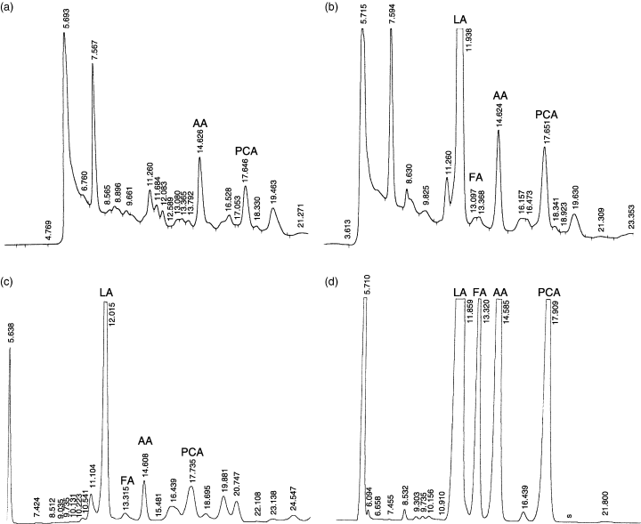
3 Organic acid composition of the sterile De Man–Rogosa–Sharpe (MRS) medium (a), Lactobacillus rhamnosus GG ...
Notes:
3 Organic acid composition of the sterile De Man–Rogosa–Sharpe (MRS) medium (a), Lactobacillus rhamnosus GG spent culture supernatant (LGG-SCS) (b), methanol acetone extract of the freeze-dried LGG-SCS (c), and the fraction exhibiting antimicrobial effect from the last purification step (RP-HPLC, C8) (d). The x-axis refers to the retention time of the acids (in minutes): lactic acid (LA), formic acid (FA), acetic acid (AA) and pyroglutamic acid (PCA). Chromatograms were recorded at 210 nm using a Waters 486 tunable UV detector connected to a Hewlett Packard HP3396 series II integrator (attenuation 8, 0.250 A full scale). Note that ammonium acetate was used in the buffers of all the purification steps.
Unless provided in the caption above, the following copyright applies to the content of this slide: © 2006 Federation of European Microbiological Societies

Slide 4
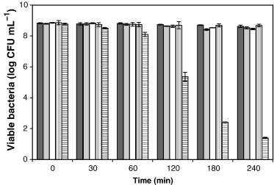
4 Evaluation of the bactericidal activity of organic acids in different media on the viability of Salmonella ...
Notes:
4 Evaluation of the bactericidal activity of organic acids in different media on the viability of Salmonella typhimurium SL1344 as a function of time. Salmonella typhimurium SL1344 was incubated in sterile De Man–Rogosa–Sharpe medium (MRS) (black bars), MRS supplemented with acetic acid (0.72 g L−1) (grey bars), MRS supplemented with formic acid (0.55 g L−1) (white bars), PBS supplemented with lactic acid (20 g L−1) (vertically striped bars) and MRS supplemented with lactic acid (20 g L−1) (horizontally striped bars), all at final pH 4.5. Initially and at specific intervals, aliquots were removed, serially diluted and plated on LB agar to determine bacterial colony counts. Each value is the mean±standard deviation (error bar) of three experiments.
Unless provided in the caption above, the following copyright applies to the content of this slide: © 2006 Federation of European Microbiological Societies

Slide 5
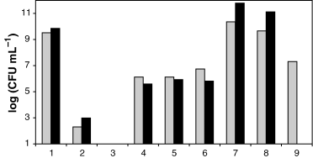
5 Growth of Salmonella in coculture with L. rhamnosus GG. (1) Control condition containing only Salmonella ...
Notes:
5 Growth of Salmonella in coculture with L. rhamnosus GG. (1) Control condition containing only Salmonella bacteria in coculture medium with glucose, at initial pH 7. (2) Salmonella in coculture with L. rhamnosus GG added at initial concentration of 105 CFU mL−1; coculture medium with glucose, at initial pH 7. (3) Salmonella in coculture with L. rhamnosus GG added at initial concentration of 109 CFU mL−1; coculture medium with glucose, at initial pH 7. (4) Control condition containing only Salmonella bacteria; coculture medium without glucose, at initial pH 5. (5) Salmonella in coculture with L. rhamnosus GG added at initial concentration of 105 CFU mL−1; coculture medium without glucose, at initial pH 5. (6) Salmonella in coculture with L. rhamnosus GG added at initial concentration of 109 CFU mL−1; coculture medium without glucose, at initial pH 5. (7) Salmonella in coculture with L. rhamnosus GG added at initial concentration of 105 CFU mL−1; coculture medium without glucose, at initial pH 7. (8) Salmonella in coculture with L. rhamnosus GG added at initial concentration of 109 CFU mL−1; coculture medium without glucose, at initial pH 7. (9) Salmonella in coculture with L. rhamnosus GG added at initial concentration of 105 CFU mL−1; coculture medium with sugar, at initial pH 7, in dialysis tube (cut-off 1000 Da, dialysis against coculture medium (with glucose added)). SL1344 was added at a starting concentration of 105 CFU mL−1. The CFU per mL of SL1344 and L. rhamnosus GG were calculated by plating out serial dilutions on, respectively, LB supplemented with streptomycin and MRS-agar, at 24 h (grey bars) and 48 h (black bars). For the dialysis experiment, the bacterial counts at 48 h were not determined. Data are reported for Salmonella only as the log of the obtained CFU mL−1. Values obtained for L. rhamnosus GG counts were 10 and 9 (log of CFU mL−1) for growth in coculture medium with and without glucose added, respectively. The results shown are from a single experiment representative of three independent experiments.
Unless provided in the caption above, the following copyright applies to the content of this slide: © 2006 Federation of European Microbiological Societies

