Slide 1
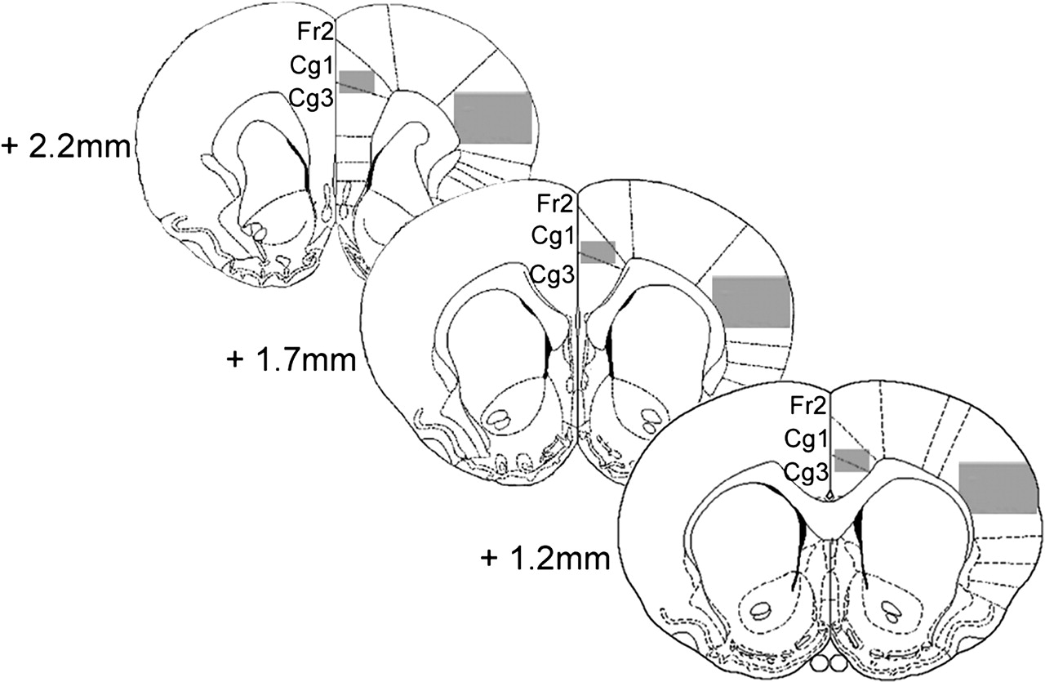
Figure 1. Schematic drawing of coronal brain sections containing the cingulate cortex (Cg1–Cg3) and the somatosensory ...
Notes:
Figure 1. Schematic drawing of coronal brain sections containing the cingulate cortex (Cg1–Cg3) and the somatosensory cortex (S1) at three corresponding rostral–caudal levels: 2.2 mm, 1.7 mm and 1.2 mm rostral to the bregma. Shaded boxes were placed over cortical layers II–VI in the Cg1/Cg3 (2.0 mm × 1.5 mm), and in the SI (5.0 mm × 3.75 mm) for quantitative data analyses. Cg1, cingulate cortex area 1; Cg 3, cingulate cortex area 3; Fr2, frontal cortex area 2; SI, primary somatosensory cortex. (Adapted from Paxinos and Watson, 1998.)
Unless provided in the caption above, the following copyright applies to the content of this slide: Cerebral Cortex V 15 N 3 © Oxford University Press 2004; all rights reserved

Slide 2
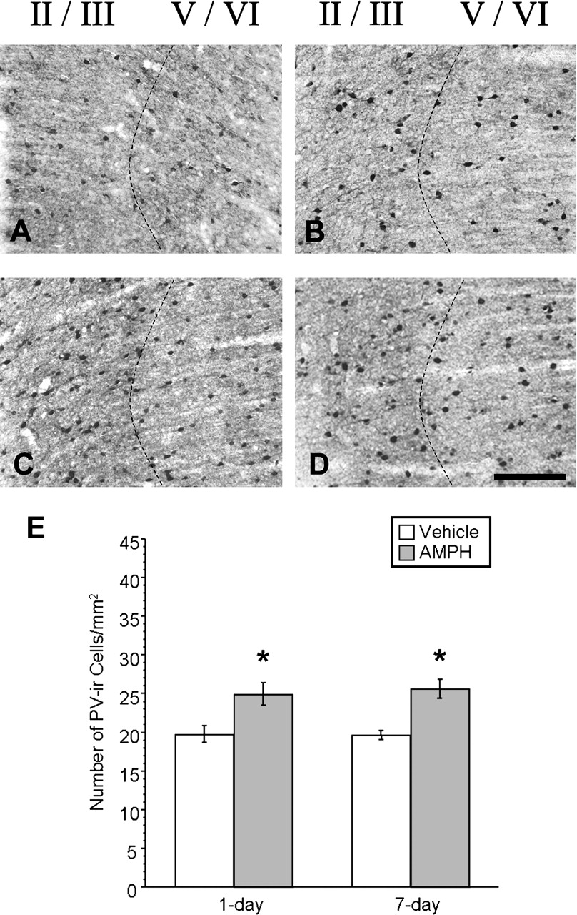
Figure 2. Photomicrographs of coronal sections showing PV-ir neurons in the ACC of vehicle-treated rats (A: 1 day ...
Notes:
Figure 2. Photomicrographs of coronal sections showing PV-ir neurons in the ACC of vehicle-treated rats (A: 1 day withdrawal; B: 7 day withdrawal) and of AMPH-treated rats (C: 1 day withdrawal; D: 7 day withdrawal). Layer II is located to the far left and layer VI to the far right edge of each picture. Higher densities of PV-ir neurons were observed in the ACC of rats treated with AMPH (C: at 1 day withdrawal; D: at 7 day withdrawal), relative to their respective vehicle-treated controls. These qualitative observations were confirmed by quantitative analysis (E) on three anatomical levels as depicted in Figure 1. Asterisks indicate statistical significance as determined by unpaired Student's t-test. (E) AMPH: at 1 day withdrawal (P = 0.0061) and at 7 day withdrawal (P < 0.0001). A-D refer to scale bar in D, 0.5 mm.
Unless provided in the caption above, the following copyright applies to the content of this slide: Cerebral Cortex V 15 N 3 © Oxford University Press 2004; all rights reserved

Slide 3
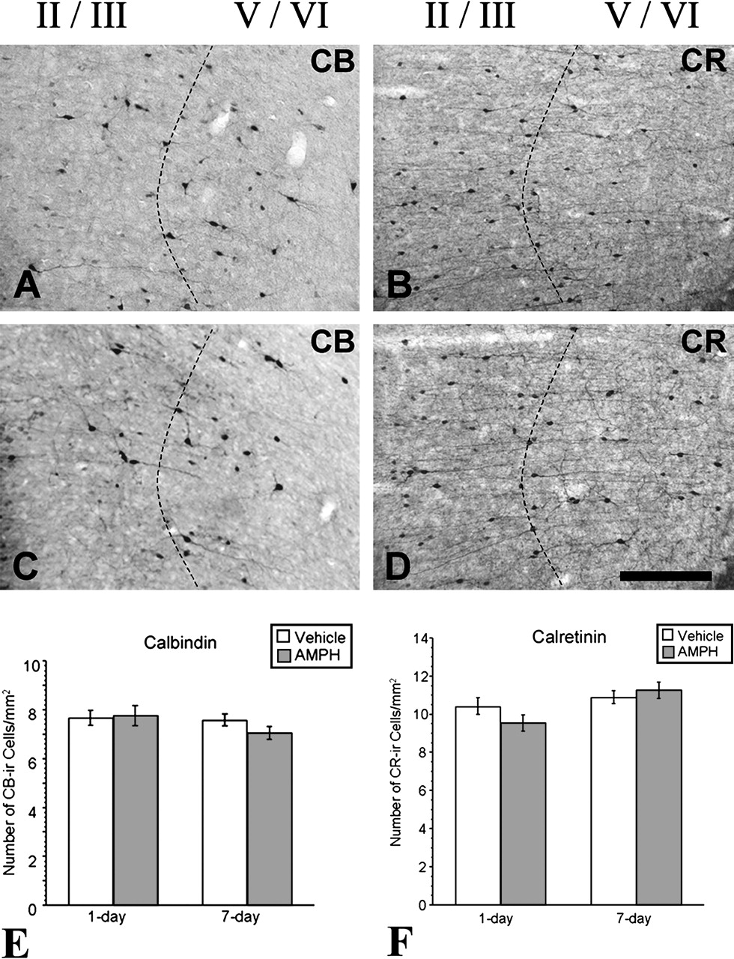
Figure 3. Photomicrographs of coronal sections showing CB-ir (A and C) and CR-ir (B and D) neurons in layers II–VI of ...
Notes:
Figure 3. Photomicrographs of coronal sections showing CB-ir (A and C) and CR-ir (B and D) neurons in layers II–VI of the ACC in vehicle-treated (A and B) and in AMPH-treated rats (C and D) at 1 day withdrawal. Layer II is located at far left and layer VI to the far right edge of each picture. Similar densities of CB-ir and CR-ir neurons were observed in the ACC of rats treated with AMPH at 1 day withdrawal (C and D respectively) compared with rats treated with vehicle (A and B respectively). Quantitative analysis of CB-ir (E) and CR-ir neurons (F) in the ACC on three coronal sections revealed no significant difference between the numbers of CB-ir neurons in the ACC of AMPH- and vehicle-treated rats (P = 0.828, NS), nor was any difference in the density of CR-ir neurons observed between AMPH- and vehicle-treated rats (P = 0.161, NS) at 1 day withdrawal. Similarly, at 7 day withdrawal no apparent changes were noted for both CB-ir (P = 0.143; NS) and CR-ir neurons (P = 0.466; NS) at 7 day withdrawal. A–D refer to scale bar in D, 0.5 mm.
Unless provided in the caption above, the following copyright applies to the content of this slide: Cerebral Cortex V 15 N 3 © Oxford University Press 2004; all rights reserved

Slide 4
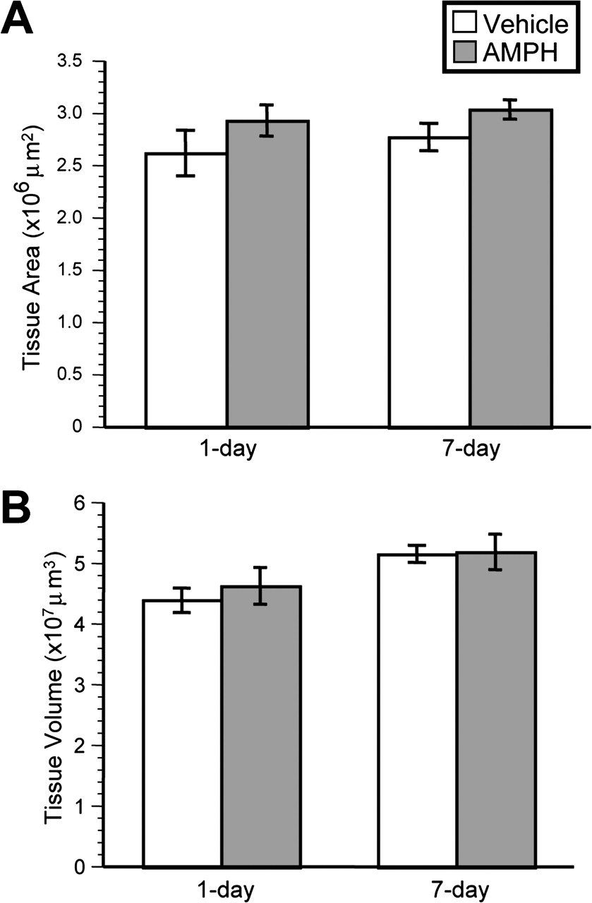
Figure 4. Bar graphs comparing ACC tissue area and volume in vehicle- and AMPH-treated rats at 1 day and 7 day ...
Notes:
Figure 4. Bar graphs comparing ACC tissue area and volume in vehicle- and AMPH-treated rats at 1 day and 7 day withdrawal. Quantitative analyses revealed no significant differences between the mean ACC tissue area (A) of AMPH- and vehicle-treated rats at either 1 day withdrawal (P = 0.27, NS) or 7 day withdrawal (P = 0.13, NS). No differences were observed when the mean ACC tissue volume was compared (B), at either 1 day (P = 0.53, NS) or 7 day withdrawal (P = 0.92, NS).
Unless provided in the caption above, the following copyright applies to the content of this slide: Cerebral Cortex V 15 N 3 © Oxford University Press 2004; all rights reserved

Slide 5
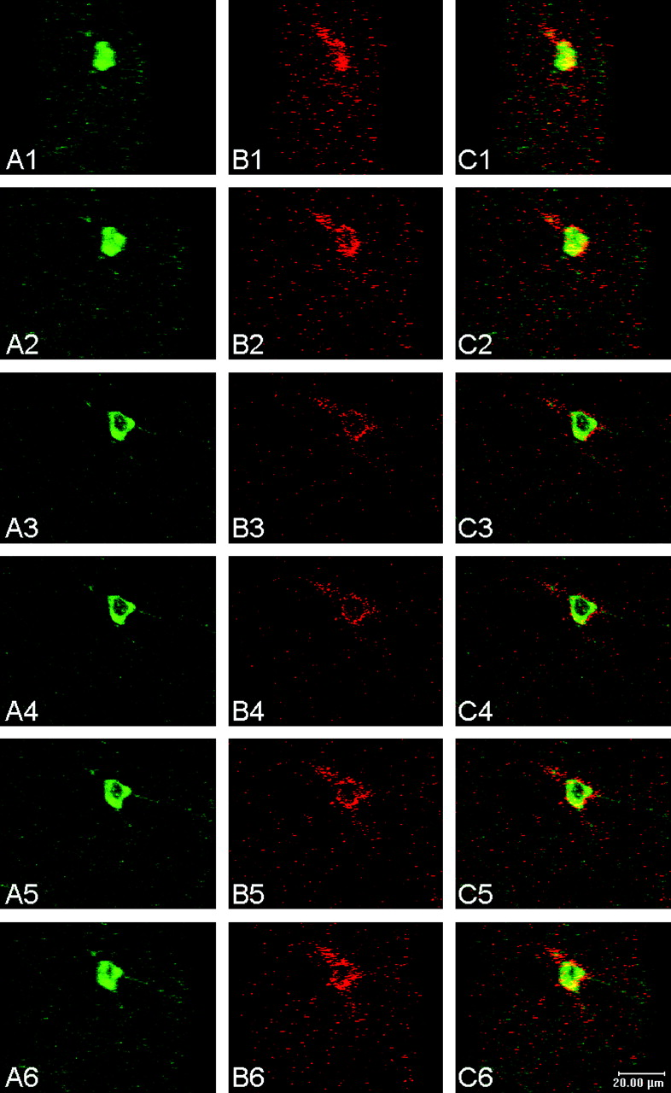
Figure 7. Confocal microscopy images of a neuron double-labeled with both CRF and PV in the ACC of a vehicle-treated ...
Notes:
Figure 7. Confocal microscopy images of a neuron double-labeled with both CRF and PV in the ACC of a vehicle-treated control rat. The images shown (1–6) are the stacked image of several optical sections (scanned at 2 μm intervals apart) of the neuron shown in Figure 6A (marked by an arrowhead with an asterisk) or in Figure 6B1–3. A rotation of 200 was applied between images 1–6. The three-dimensional views of CRF-ir varicosities and PV-ir soma by rotating these structures reliably revealed their interrelationship. The presence of a close relation (but the lack of coexistence) was established between CRF-ir puncta and PV-ir somata and proximal dendrites, but the presence of co-localization of CRF and PV was present in the cytoplasm. (A1–6) FITC-labeled PV-ir cell body and processes. (B1–6) Texas Red-labeled CRF-ir puncta. (C1–6) Dual-fluorescence labeling for both PV and CRF immunoreactivity. The yellow color indicates the merging of both green (PV-ir) and red (CRF-ir) fluorescence in the cytoplasm. Scale bar, 20 μm.
Unless provided in the caption above, the following copyright applies to the content of this slide: Cerebral Cortex V 15 N 3 © Oxford University Press 2004; all rights reserved

Slide 6
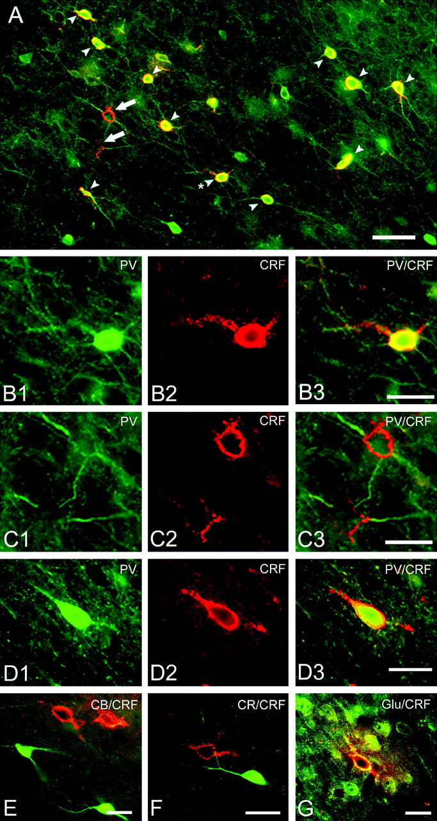
Figure 6. Photomicrographs showing a close relation between CRF-ir puncta and PV-immunopositive (B) or −negative (C) ...
Notes:
Figure 6. Photomicrographs showing a close relation between CRF-ir puncta and PV-immunopositive (B) or −negative (C) somata in the ACC of a vehicle-treated rat (A–C) and an AMPH-treated rat (D–G) at 7 day withdrawal. PV-ir neurons and processes were marked by FITC fluorescence (green) whereas CRF-ir puncta were labeled with Texas Red fluorescence (red) in the neuropil of the ACC. Arrowheads in (A) indicate dual-labeled CRF-ir puncta and PV-positive cell bodies, whereas arrows mark CRF-ir puncta in apposition to PV-negative somata. (B1, B2, B3) High-power views of the neuron marked with asterisk in (A) showing punctate CRF-ir varicosities in apposition to a PV-ir cell body and its proximal dendrites. In addition, CRF-ir was also detected in the PV-ir cell body, i.e. CRF co-localized with PV in the cytoplasm (yellow in B3). This is an example of CRF-ir puncta (non-PV containing) making possible pericellular contacts on a GABA interneuron containing both CRF and PV (Lewis and Lund, 1990; DeFelipe, 1997). (C1, C2, C3) High-power views of neurons marked with arrows in (A) showing CRF-ir puncta apposed cell bodies that were negatively-labeled with PV immunoreactivity. (D–G) Photomicrographs showing dual labeling for CRF-ir puncta and PV-ir cell bodies (D1–D3), CB-ir cell bodies (E), CR-ir cell bodies (F) or Glu-ir cell bodies (G) in the ACC of AMPH-treated rats at 7 day withdrawal. (B1, C1, D1) FITC-labeled PV-ir cell bodies (green). (B2, C2, D2) Texas Red-labeled CRF-ir puncta (orange red). (B3, C3, D3) Dual FITC and Texas Red fluorescence, indirectly marking PV-ir (green) and CRF-ir (red), respectively. The yellow color indicates the merging of FITC and Texas Red fluorescence. Texas Red, although mostly red color, has a significant orange hue (Vector Laboratories, Inc), and therefore may appear orange-red (Gonchar et al., 2002) as a result of intense fluorescence labeling. Scale bars: A, 50 μm; B1–B3 refer to scale bar in B3, 25 μm. C1–C3 refer to scale bar in C3, 25 μm. D1–D3 refer to scale bar in D3, 25 μm. E–G, 25 μm.
Unless provided in the caption above, the following copyright applies to the content of this slide: Cerebral Cortex V 15 N 3 © Oxford University Press 2004; all rights reserved

Slide 7
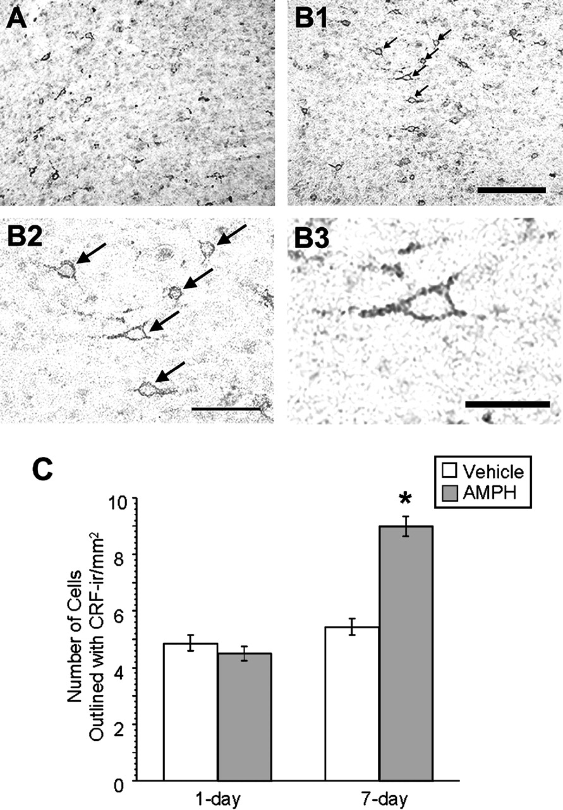
Figure 5. Photomicrographs of coronal sections showing CRF-ir puncta scattered throughout layers II–VI of the ACC in ...
Notes:
Figure 5. Photomicrographs of coronal sections showing CRF-ir puncta scattered throughout layers II–VI of the ACC in vehicle- (A) and AMPH-treated (B) rats at 7 day withdrawal. CRF-ir puncta appeared higher in density in AMPH-treated rats at 7 day withdrawal (B1: low power; B2 and B3: high power) than in vehicle-treated controls (A). Higher-power images (B2 and B3: 25×) of a region in B1 illustrate the morphology of CRF-ir puncta in close apposition with CRF-containing PV-ir cell bodies (arrows). (C) Bar graph compares the average number of cell bodies encircled by CRF-ir puncta in the ACC of vehicle- versus AMPH-treated rats. A significant increase in CRF-ir puncta was observed in AMPH-rats compared to vehicle-treated controls at 7 day withdrawal (P < 0.0001), but not at 1 day withdrawal (P = 0.317, NS). Asterisks indicate statistical significance as determined by unpaired Student's t-test. A–B1 refer to scale bar in B1, 0.5 mm; scale bar in B2, 0.2 mm; B3, 0.1 mm.
Unless provided in the caption above, the following copyright applies to the content of this slide: Cerebral Cortex V 15 N 3 © Oxford University Press 2004; all rights reserved

