Slide 1
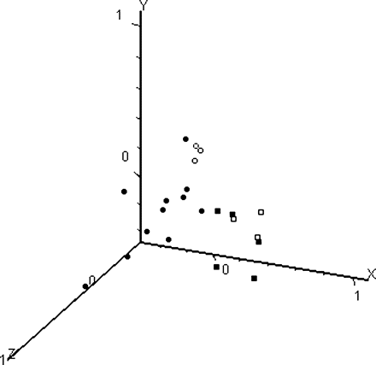
Figure 1: Principal components analysis of the 22 human stage-specific oocyte microarrays based on all genes: GV stage ...
Notes:
Figure 1: Principal components analysis of the 22 human stage-specific oocyte microarrays based on all genes: GV stage oocytes (closed squares), GV breakdown or metaphase I oocytes (open squares), in vitro matured metaphase II oocytes (open circles) and in vivo matured metaphase II oocytes (closed circles).
Unless provided in the caption above, the following copyright applies to the content of this slide: © The Author 2008. Published by Oxford University Press on behalf of the European Society of Human Reproduction and Embryology. All rights reserved. For Permissions, please email: journals.permissions@oxfordjournals.org

