Slide 1
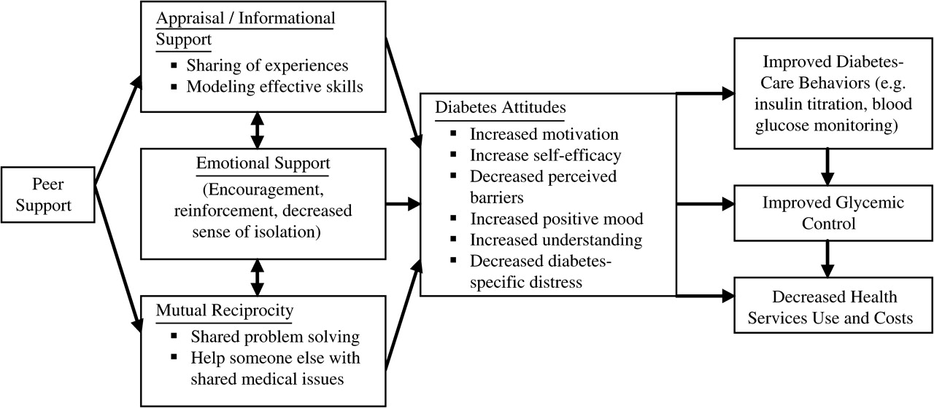
FIGURE 1 Hypothesized effects of peer support on self-care attitudes, behaviours and outcomes. (Adapted from Heisler, ...
Notes:
FIGURE 1 Hypothesized effects of peer support on self-care attitudes, behaviours and outcomes. (Adapted from Heisler, Congestive Heart Failure 2007.)
Unless provided in the caption above, the following copyright applies to the content of this slide: Published by Oxford University Press 2009.

