Slide 1
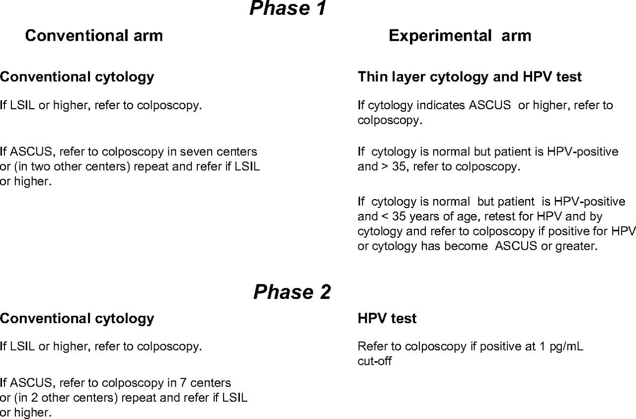
Figure 1 Testing and intended management by arm and phase in the New Technologies for Cervical Cancer study. HPV = ...
Notes:
Figure 1 Testing and intended management by arm and phase in the New Technologies for Cervical Cancer study. HPV = human papillomavirus; ASCUS = atypical squamous cells of undetermined significance; LSIL = low-grade squamous intraepithelial lesion.
Unless provided in the caption above, the following copyright applies to the content of this slide: © The Author 2008. Published by Oxford University Press.

Slide 2
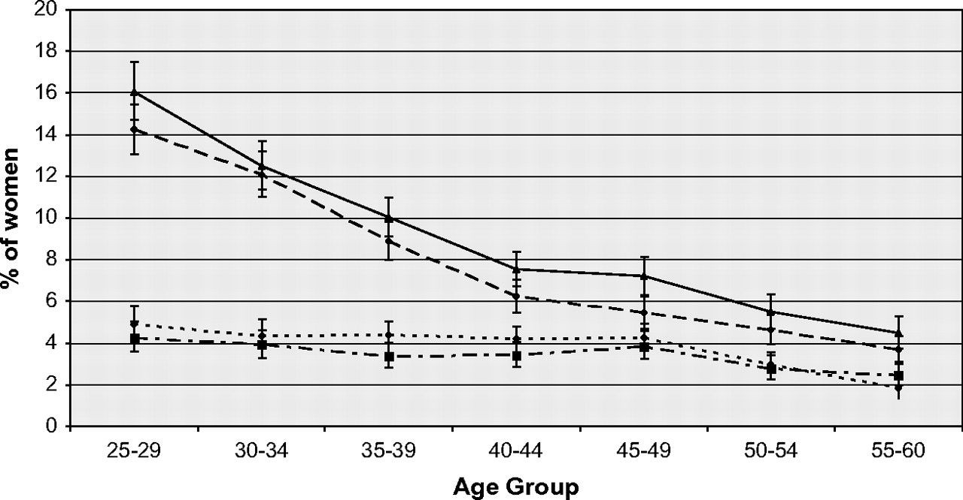
Figure 3 Proportion of women positive for human papillomavirus (HPV+) with abnormal cytology by age. Filled diamonds ...
Notes:
Figure 3 Proportion of women positive for human papillomavirus (HPV+) with abnormal cytology by age. Filled diamonds : HPV+ experimental arm phase 2; filled squares = atypical squamous cells of undetermined significance or more (ASCUS+) conventional arm phase 2; open triangles = HPV+ experimental arm phase 1; open diamonds = ASCUS+ conventional arm phase 1.
Unless provided in the caption above, the following copyright applies to the content of this slide: © The Author 2008. Published by Oxford University Press.

Slide 3
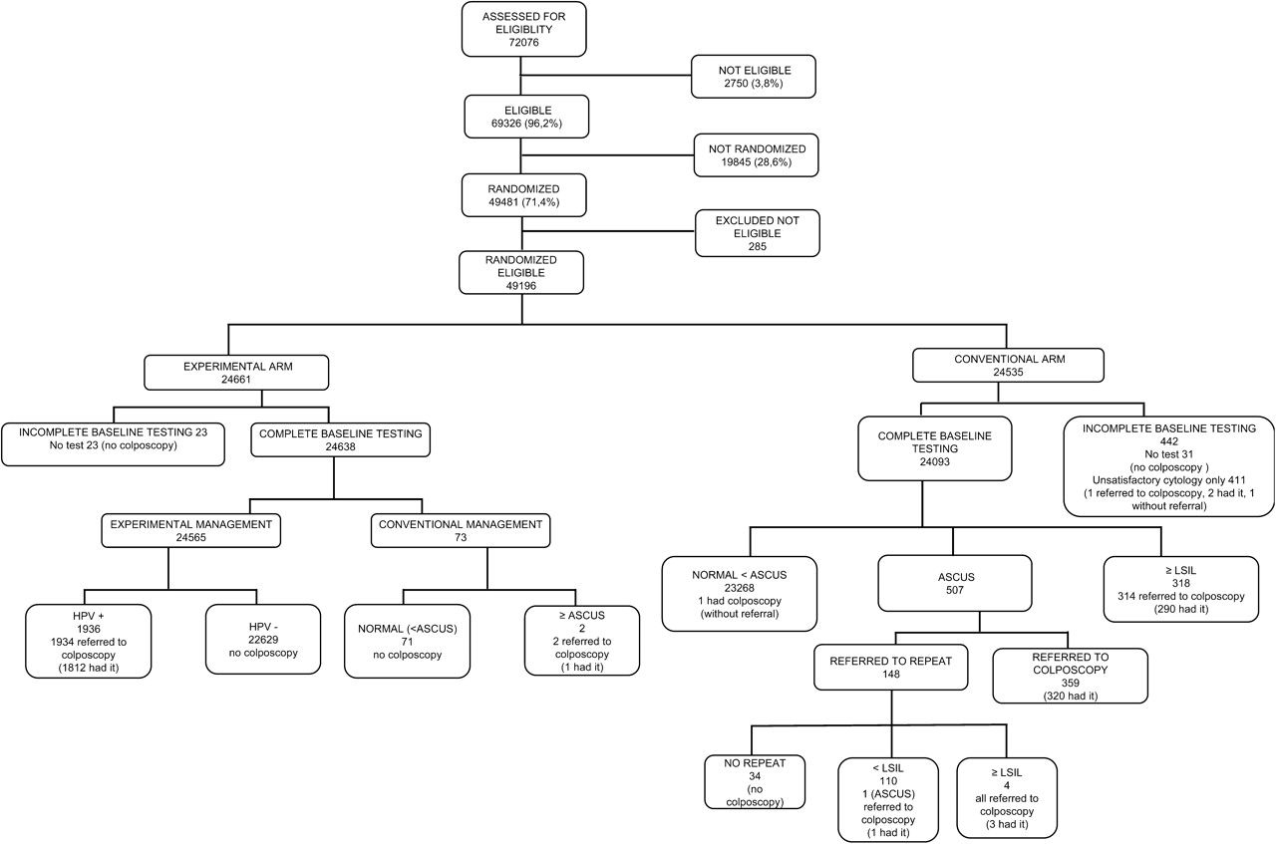
Figure 2 Trial profile. HPV = human papillomavirus; ASCUS = atypical squamous cells of undetermined significance; LSIL ...
Notes:
Figure 2 Trial profile. HPV = human papillomavirus; ASCUS = atypical squamous cells of undetermined significance; LSIL = low-grade squamous intraepithelial lesion.
Unless provided in the caption above, the following copyright applies to the content of this slide: © The Author 2008. Published by Oxford University Press.

