Slide 1
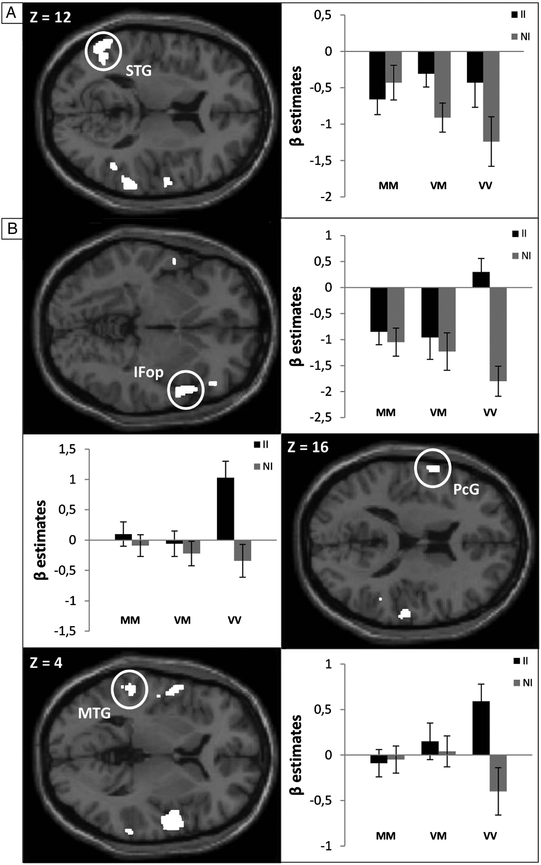
Figure 1. Brain areas involved in interference resolution and differently affected by the COMT genotype during the MC ...
Notes:
Figure 1. Brain areas involved in interference resolution and differently affected by the COMT genotype during the MC context. (A) Brain area showing a larger difference in activity between IIs and NIs for the Val allele carriers compared with homozygous Met carriers during the MC contexts; (B) Brain area showing a smaller difference in activity between IIs and NIs for the Met allele carriers compared with homozygous Val carriers during MC contexts. The regions are displayed on the T1 canonical image implemented in SPM8. See Table 2 for coordinates. IFop, inferior frontal operculum; PcG, precentral gyrus; MTG, middle temporal gyrus; STG, superior temporal gyrus; MM, Met/Met participants; VM, Val/Met participants; VV, Val/Val participants.
Unless provided in the caption above, the following copyright applies to the content of this slide: © The Author 2014. Published by Oxford University Press. All rights reserved. For Permissions, please e-mail: journals.permissions@oup.com

Slide 2
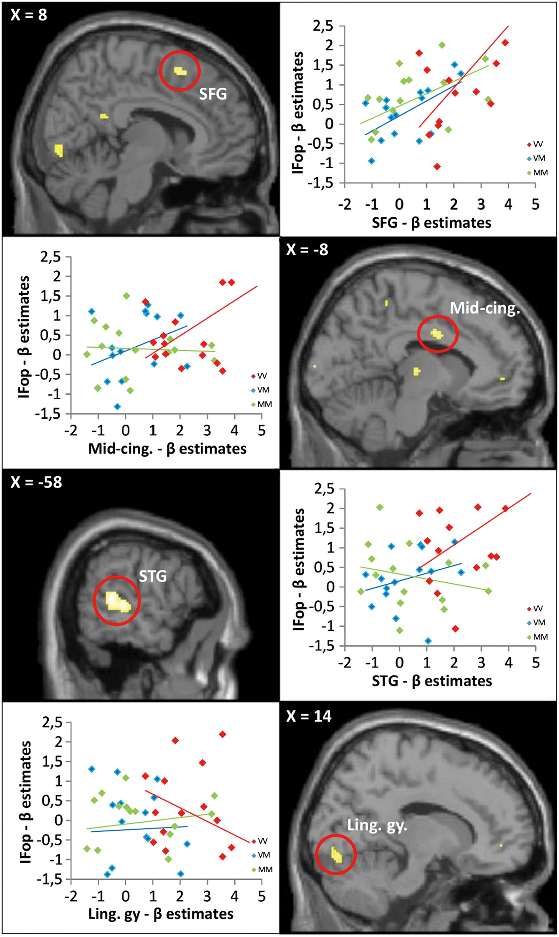
Figure 2. PPIs between the interference effect (II–NI) and the right IFop. Brain areas showing a significantly greater ...
Notes:
Figure 2. PPIs between the interference effect (II–NI) and the right IFop. Brain areas showing a significantly greater PPI with the right IFop in the homozygous Val individuals. The regions are displayed on the T1 canonical image implemented in SPM8. See Table 3 for coordinates. SFG, superior frontal gyrus; mid-cing., mid-cingulum; STG, superior temporal gyrus; ling. gy., lingual gyrus; MM, Met/Met participants; VM, Val/Met participants; VV, Val/Val participants.
Unless provided in the caption above, the following copyright applies to the content of this slide: © The Author 2014. Published by Oxford University Press. All rights reserved. For Permissions, please e-mail: journals.permissions@oup.com

