Slide 1
Figure 1 Comparison of Coenobita clypeatus behaviors (measured over 30-min observation periods) in laboratory studies ...
Notes:
Figure 1 Comparison of Coenobita clypeatus behaviors (measured over 30-min observation periods) in laboratory studies of solitary (1 crab, 5 shells) versus group (5 crabs, 1 shell) social contexts: (A) number of shell investigations per crab, (B) duration of each shell investigation, (C) latency from initial contact with vacant shell to shell switch, (D) number of shell switches, and (E) number of shell reversals (see MATERIALS AND METHODS for behavior descriptions), which describe the number of reversed shell switch decisions. For (A), (D), and (E), experimental values were divided by 5 to yield frequencies of behavior per crab in order to enable a direct, per crab comparison with solitary social context experiments. (B) and (C) were directly comparable on a per investigation basis.
Unless provided in the caption above, the following copyright applies to the content of this slide: © The Author 2010. Published by Oxford University Press on behalf of the International Society for Behavioral Ecology. All rights reserved. For permissions, please e-mail: journals.permissions@oxfordjournals.org

Slide 2
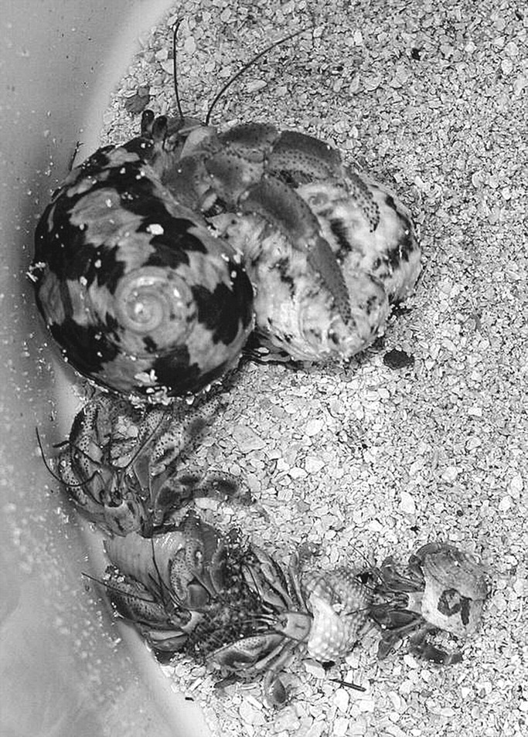
Figure 2 Social behavior in Coenobita clypeatus hermit crabs: size-sorted queue with largest hermit crab (top) ...
Notes:
Figure 2 Social behavior in Coenobita clypeatus hermit crabs: size-sorted queue with largest hermit crab (top) grasping a vacant shell. Such queuing behavior precedes synchronous vacancy chains.
Unless provided in the caption above, the following copyright applies to the content of this slide: © The Author 2010. Published by Oxford University Press on behalf of the International Society for Behavioral Ecology. All rights reserved. For permissions, please e-mail: journals.permissions@oxfordjournals.org

Slide 3
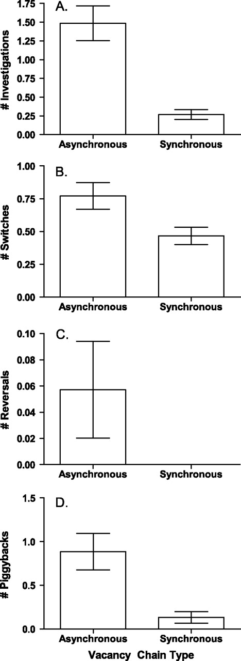
Figure 3 Comparison of Coenobita clypeatus behaviors during asynchronous and synchronous vacancy chains in group ...
Notes:
Figure 3 Comparison of Coenobita clypeatus behaviors during asynchronous and synchronous vacancy chains in group trials (30-min observation periods). For each chain type, we recorded (A) number of shell investigations per crab, (B) number of shell switches, (C) number of shell switch reversals, and (D) the number of piggyback events (see MATERIALS AND METHODS for behavior descriptions).
Unless provided in the caption above, the following copyright applies to the content of this slide: © The Author 2010. Published by Oxford University Press on behalf of the International Society for Behavioral Ecology. All rights reserved. For permissions, please e-mail: journals.permissions@oxfordjournals.org

Slide 4
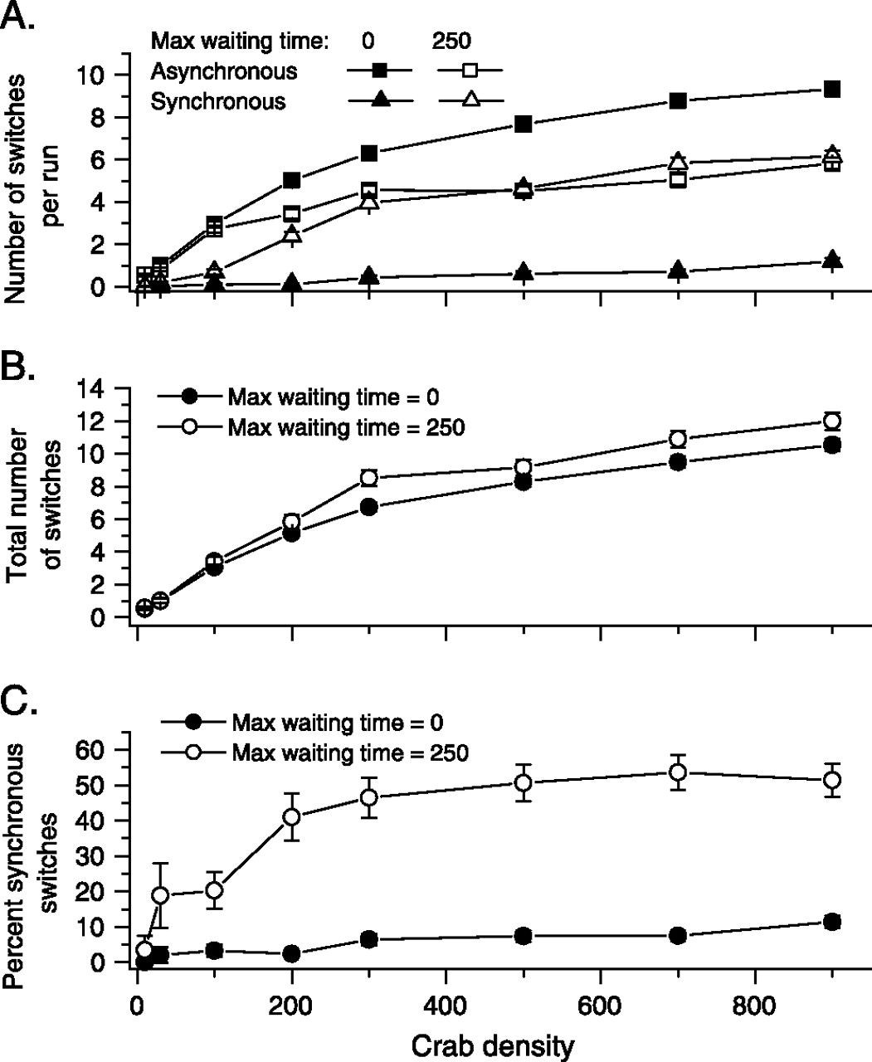
Figure 4 Hermit crab vacancy chain dynamics modeled with NetLogo (means ± standard error for n = 100 simulation runs ...
Notes:
Figure 4 Hermit crab vacancy chain dynamics modeled with NetLogo (means ± standard error for n = 100 simulation runs at each parameter combination). (A) Number of asynchronous (squares) and synchronous (triangles) shell switches by model crabs as a function of crab population density and maximum waiting times (0 or 250 time steps; see text for description). (B,C) Total number of switches (B) and percentage of all shell switches that took place in vacancy chains (C) as a function of crab population density and maximum wait time.
Unless provided in the caption above, the following copyright applies to the content of this slide: © The Author 2010. Published by Oxford University Press on behalf of the International Society for Behavioral Ecology. All rights reserved. For permissions, please e-mail: journals.permissions@oxfordjournals.org

